Slide 1

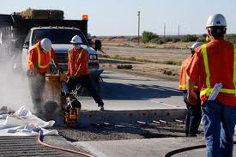
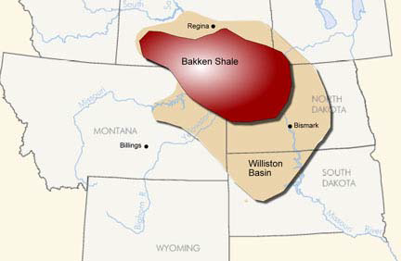
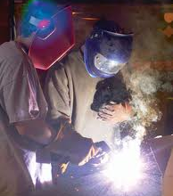
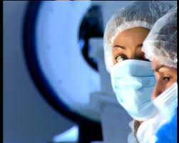
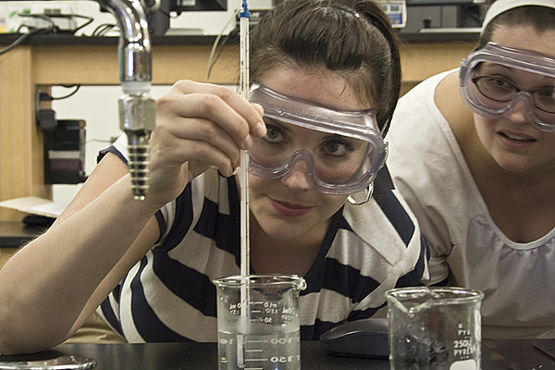
Workforce Development
(Goal #2 BOR Strategic Plan)
Increase responsiveness to workforce development needs
Notes:
Goal # 2 of the BOR Strategic Plan focuses on Workforce Development and the need for our System to be responsive to business and industry needs

Slide 2

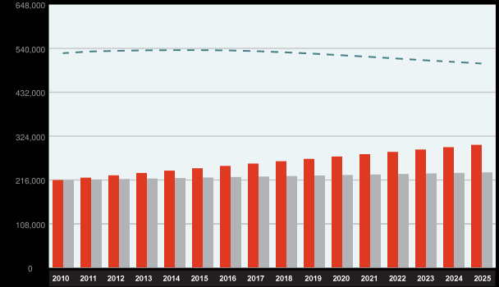
Montana Projected Degree Gap: 13.5%
Percent of 25 to 64 Year Olds with Associate Degrees or Higher
Demand Workforce ----- Population
Notes:
Montana is facing a Perfect Workforce Shortage Storm – 1) Aging population; 2) Large scale retirements; and 3) Significant growth in natural resource extraction. Forecast we will have a 13.5% gap between demand for skilled workers who have an Assoc Degree or higher and available supply by 2025

Slide 3
The Aging of Montana’s Population

Slide 4
Why does Montana need to improve opportunities for two-year higher education?
Source: IIPEDS
Montana under-utilizes low cost 2-year education
Notes:
Montana’s two-year Colleges have witnessed dramatic growth in the past ten years – however the percentage of undergraduate enrollment at 2-year colleges is still about half of the national average.

Slide 5
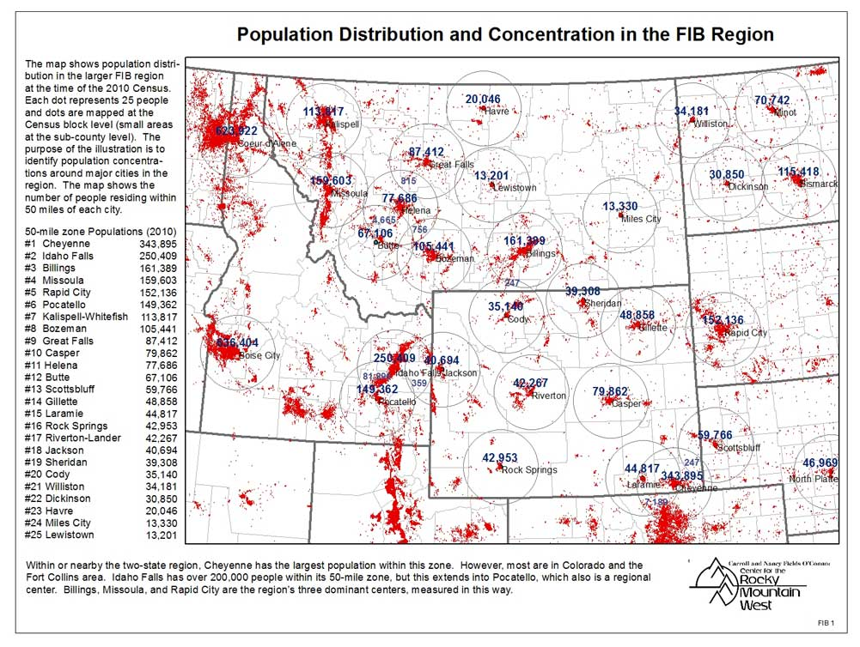
Montana’s Population Concentrated in Western 2/3rds
Source: Larry Swanson, UM O’Conner Center for the Rocky Mountain West
Notes:
While a significant amount of Montana’s natural resource development is already occurring in Eastern Montana, the majority of our population lies in the Western 2/3rds of the State.

Slide 6
Montana Population by County, West-to-East and Urban-to-Rural

Slide 7
A Look at Montana: West/East
Western 2/3rds:
Population Majority
Shifting economy
Higher Unemployment
Eastern 1/3:
Smaller infrastructures
Job growth
Lower Unemployment

Slide 8
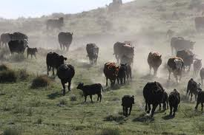
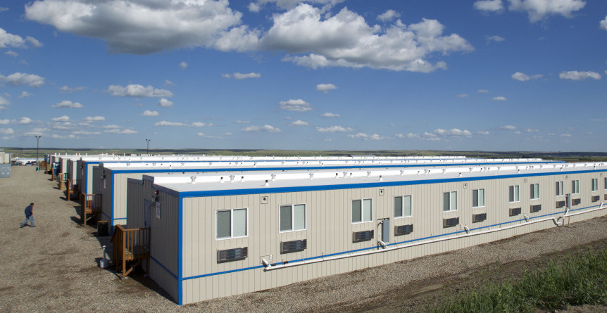
A Look at Eastern Montana’s Changing Economy
Gregory Bull/AP
Notes:
This goal in our BOR Strategic Plan is focused on “Assisting with the expansion and improvement of the state’s economy through the development of high value jobs and the diversification of the economic base.”

Slide 9
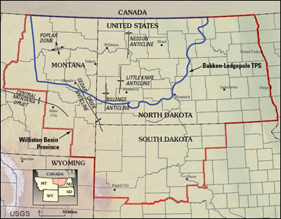
Bakken Reserve: Northeast MT and Western North Dakota
Notes:
The Bakken Region covers 24,000 miles about the size of the State of West Virginia. The USGS state in 2008 the Bakken shale was the largest contiguous reservore of oil it has ever assessed in the US. The development of this region is already having a huge impact on eastern Montana and North Dakota.

Slide 10
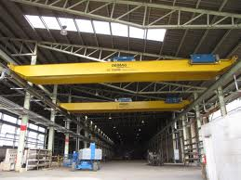
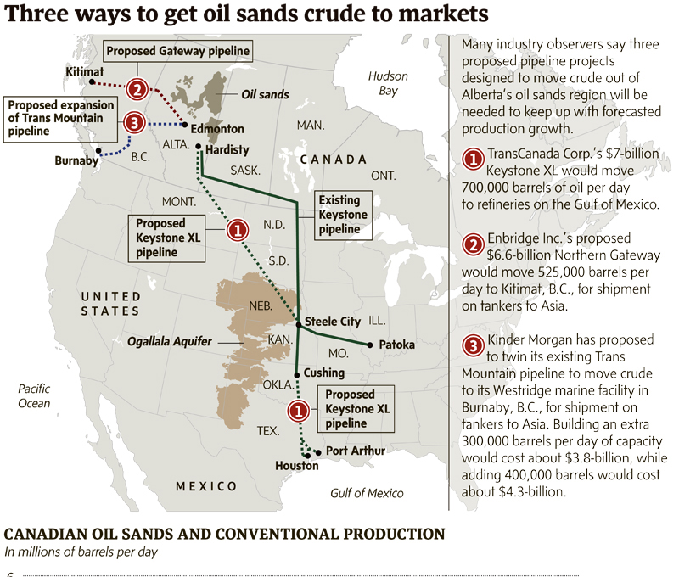
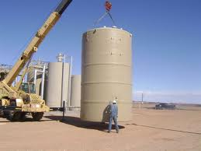
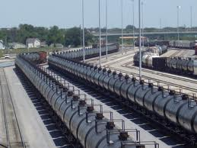
Current and Future Workforce Needs
Natural Resource Development
Notes:
The Canadian Energy Research Institute (CERI) estimates capital investment at $218 billion over the next 25 years in this region to our North. Montana communities such as Billings are already benefitting from this development with new companies such as Barry Y & V which focuses on fabrication.

Slide 11
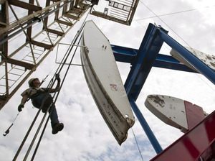
Great Start But Long Journey Ahead
“By 2017, investment bank Goldman Sachs predicts the US could be poised to pass Saudi Arabia and overtake Russia as the world's largest oil producer.” – NPR, 9/25/11
Gregory Bull/AP

Slide 12
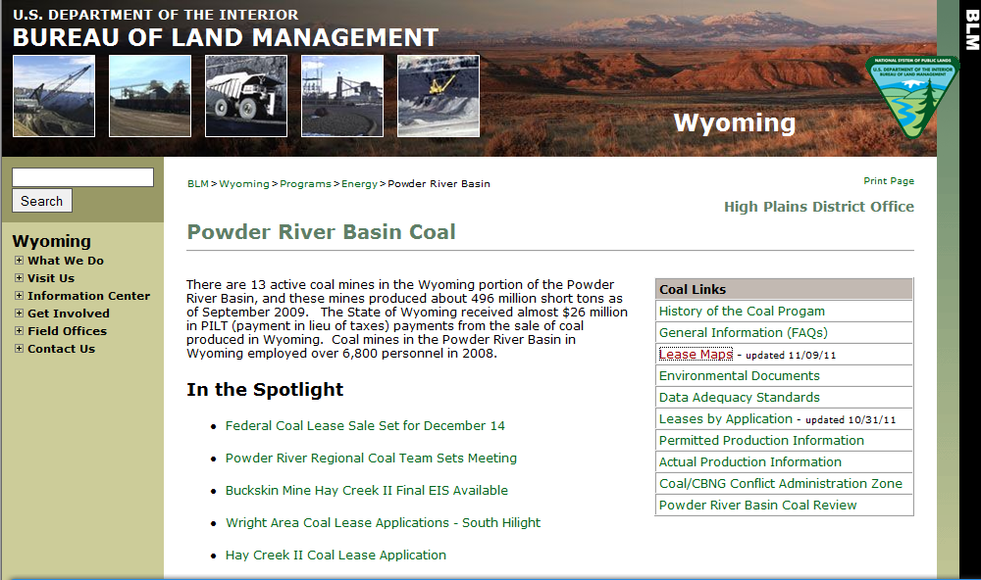
Coal Development

Slide 13
Workforce Development Challenges and Opportunities
Workforce Development and Education should be centerpieces of any strategy for Community Improvement
Regionally-based and Customized: Be grounded in the regions and communities served & tailored to the needs of area employers.
Inter-coordinated: With business and other aspects of community economic development.
Well-designed and Adaptive: Be “forward-looking” and “opportunistic”.
Life-long: – developed for workers of all levels.
Workplace-oriented: Flexible and placed in or nearby the workplace.
Well-funded: To be successful…must be well-funded.
- Adopted from Larry Swanson, O’Connor Center for the Rocky Mountain West, U. of MT
Notes:
13

Slide 14
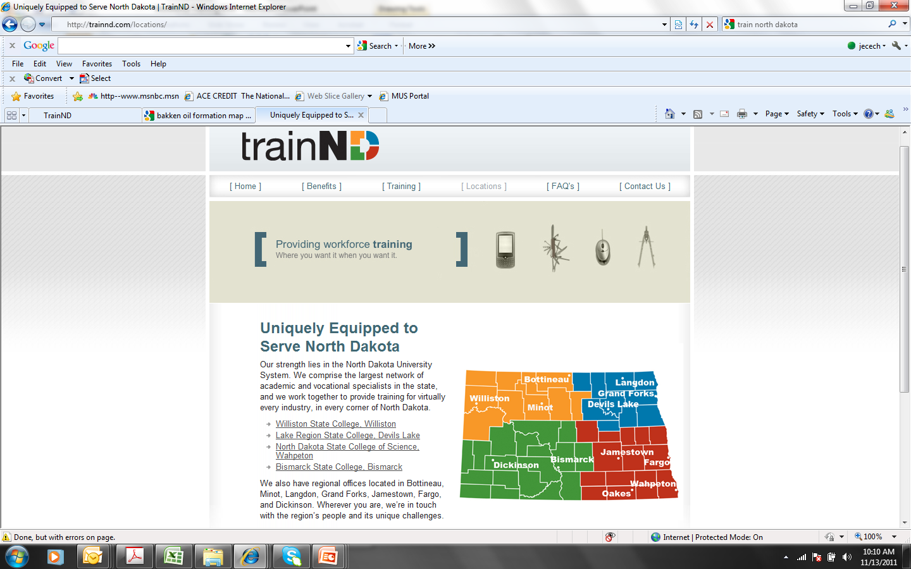
Existing Training Models to Consider
Notes:
Train North Dakota is an excellent model we should consider replicating – four ND two-year colleges have formed a network to work together to respond to the increased training needs resulting from the rapidly expanding economy in that state.

Slide 15
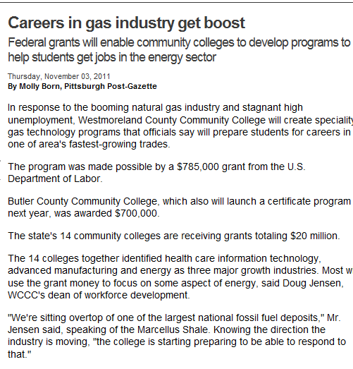
Sample Coalition Funded Grant
Notes:
This slide provides an example of North Dakota’s two-year college efforts to work together to seek coalition grants focused on workforce training. Montana’s two-year colleges got a good start working on joint grant applications with our TAA – it was not funded but we are working to plan for round #2 of the DOL initiatives.

Slide 16
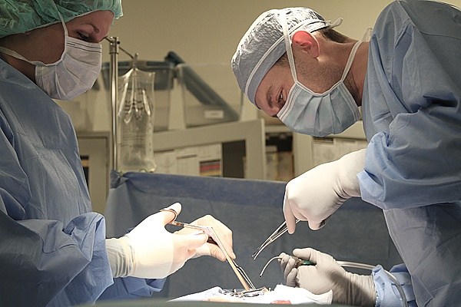
Needs
Skilled Workers:
Just-in-Time Training
Long Term Training Programs
Resources
Montana’s Two-Year and Community Colleges
Montana’s Universities
Flagship and Regional
Notes:
The Workforce Training goal of BOR’s Strategic Plan provides a solid foundation for today’s discussion – aligning the workforce and training needs of Montana’s changing economy with the resources we have within our two-year colleges and universities to respond to those needs.

Slide 17
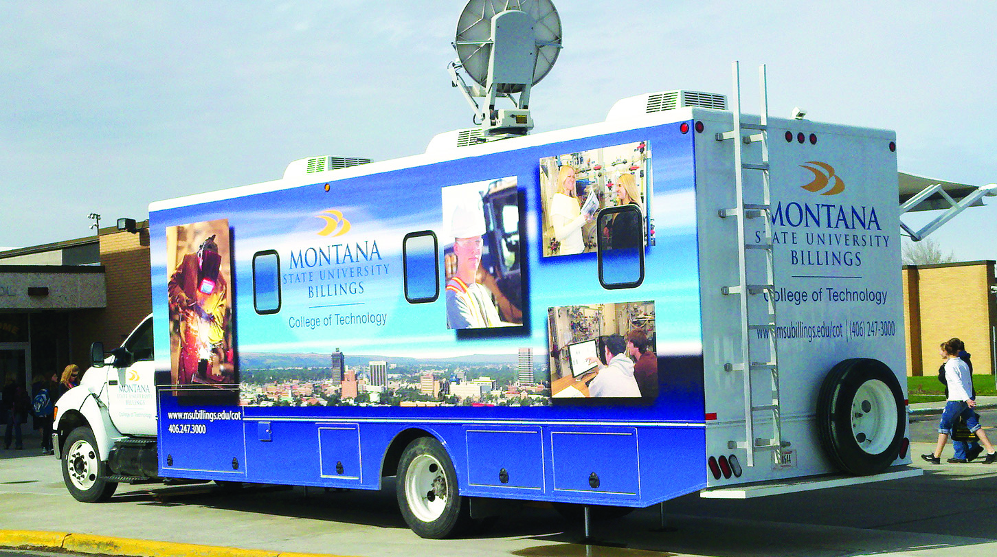
Needs
Flexible Scheduling:
On-Line
Hybrid
Field Training
Stackable Credentials
Resources
Proven Track-record:
Ability to Leverage Collective Education and Training Resources
Established Educational Pathways
Notes:
The Workforce Training goal of BOR’s Strategic Plan provides a solid foundation for today’s discussion – aligning the workforce and training needs of Montana’s changing economy with the resources we have within our two-year colleges and universities to respond to those needs.

Slide 18
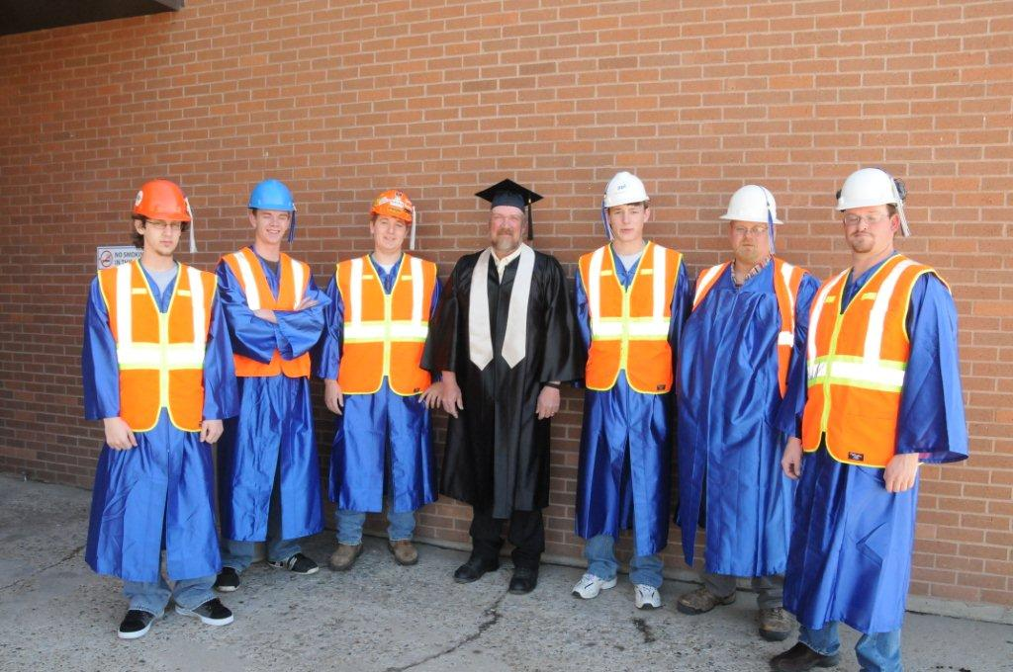
Needs
Infrastructure Growth:
Support for Infrastructure Growth
Prospect of Long Term Growth & Development
Resources
Collective Resources:
Ability to Leverage Collective Education and Training Resources
K-12 Pathways/Dual Enrollment
Notes:
The Workforce Training goal of BOR’s Strategic Plan provides a solid foundation for today’s discussion – aligning the workforce and training needs of Montana’s changing economy with the resources we have within our two-year colleges and universities to respond to those needs.

Slide 19
Leveraging MUS Partnerships to Focus on workforce Development (BOR SP Goal 2)
Collective Strength of the Montana University System (2-year, community colleges, universities & partner Tribal Colleges)
Respond with the Collective Diversity of Academic, Career and Technical Programs
Responding to Changing workforce Training Needs of Montana
Better Respond to Regional Grant Initiatives
Notes:
Leverage partnerships but also be realistic about our limitations.

Slide 20
Suggested Next Steps
Workforce Development
Convene College/University/Tribal Partners
  Inventory Potential Training Resources
  Discuss Possible Coalition Frameworks
Flathead Valley Comm. College
MSU Northern
Daniels
Sheridan
Lincoln
Glacier
Toole
Liberty
Hill
Blackfeet Comm. College
Valley
Libby Center
Flathead
Pondera
Blaine
Phillips
Roosevelt
Stone Child College
Fort Belknap College
Chouteau
Fort Peck Comm. College
Teton
Richland
Sanders
Lake
MSU Great Falls COT
McCone
Salish Kootenai College
Lewis and Clark
Cascade
Garfield
Dawson Comm. College
Fergus
Petroleum
Dawson
Mineral
UM Helena COT
Lewistown Center
Missoula
Judith Basin
Prairie
UM Missoula COT
Meagher
Miles Comm. College
Granite
Powell
Wheatland
Musselshell
Deer Lodge
Broadwater
Golden Valley
Treasure
Custer
Fallon
Ravalli
Jefferson
Little Big Horn College
Bitterroot Center (proposed)
MT Tech COT
MSU Bozeman/GF
Sweet Grass
Yellowstone
Rosebud
Silver Bow
Gallatin
Stillwater
MSU Billings COT
Chief Dull Knife College
Carter
Madison
Park
Big Horn
Powder River
Beaverhead
Carbon
UM Western

Slide 21
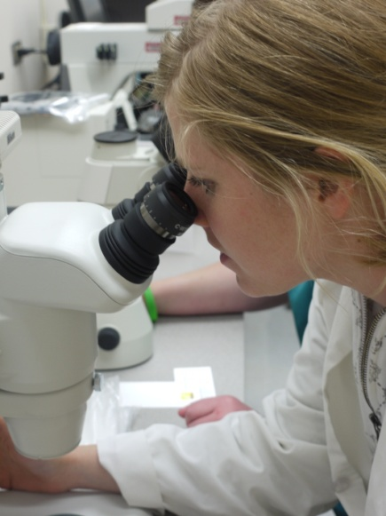
Suggested Next Steps
Workforce Development
  Engage Industry - Identify short and long term needs and Partnerships (leverage work already done)
  Explore partnerships with School Districts, Industry Associations, State Agencies, and Apprenticeships

Slide 22
Suggested Next Steps
Workforce Development
  Engage both areas of economic growth and areas of economic slump (find synergies to help both expand)
  Return to BOR with Recommendations by March 2012
  Send recommendations for participants with this effort to Deputy Commissioner John Cech, jcech@montana.edu

