Slide 1
Affordability Task Force Final Report and Recommendations
Report to the Board of Regents
November 21, 2013

Slide 2
History
Task force formed in 2011
Group made up of financial aid and data experts
Defined cost of education as more than just tuition
Analysis of data related to cost and financial aid
Developed three recommendations to the board that were implemented in Spring 2012

Slide 3
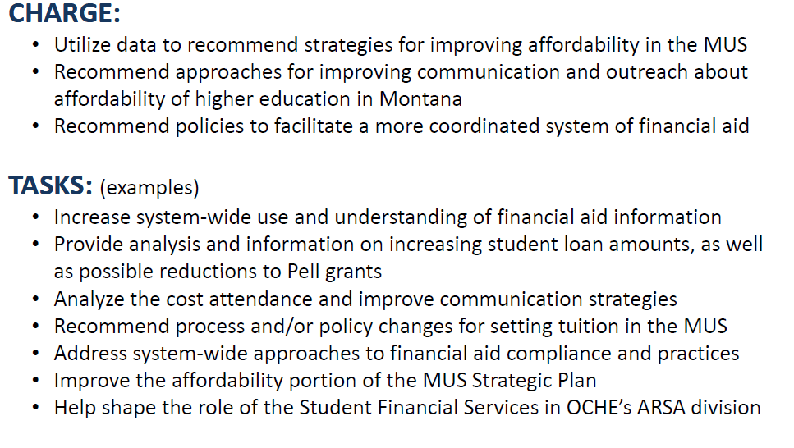
Charge and Tasks

Slide 4
Data Points
State funded need-based aid in Montana is low
Student loan debt and the percentage of students borrowing continues to escalate
Loan amounts and the percentage borrowing are higher than the national average
Low and moderate income students incur higher levels of debt, as well as non-traditional students at two-year campuses
Retention and graduation rates are lower for low income students
Recent increases in default rates are reflective of students’ struggles to manage debt
Borrowers receiving default prevention services from the MUS are less likely to default

Slide 5
Recommendations
Increase tuition assistance for low and moderate income students.
Provide a system-wide, coordinated financial literacy effort aimed at students most likely to generate high levels of debt.
Increase centralized default prevention efforts

Slide 6
Accomplishments
Tuition assistance was increased using College Access Challenge Grant funding and was precision targeted to incentivize students
Financial literacy program developed and best practices shared throughout the system
Centralized default prevention for direct loans implemented
Changed the lens with which we view affordability

Slide 7
Tools for Affordability
Continue to address affordability from a holistic approach
State based financial aid needs to be effective and efficient
Outreach and Information
Financial Success counseling

Slide 8
Tools for Affordability
Tool #1 - Continue to address affordability from a holistic approach
Keep affordability as a high priority
Continue the discussion of defining cost and affordability
Financial literacy education is essential
Build best practices model for financial literacy
Need more financial literacy for Pell students
Determine what the two most important metrics are for affordability
Continue to partner with tribal colleges

Slide 9
Tools for Affordability
Tool #2 - State based financial aid needs to be effective and efficient
Continue to study and assess current state aid programs
Review waivers
Potentially combine all state need-based aid into one targeted, incentivized program
Develop rewards for students who progress
Progression and completion – students receive more funding as they successfully complete more courses

Slide 10
Tools for Affordability
Tool #3 - Outreach and information
Financial aid availability information and financial literacy education available to high school students with improved outreach programs
Outreach to high school students and parents
College Access Challenge Grant funding for partnerships

Slide 11
Tools for Affordability
Tool #4 – Financial Success Counseling
Campus Student Success Offices incorporate affordability and financial literacy education into their offices
Student Success – tied with affordability task force messaging to include, flat spot and other incentives
Counseling of students with a financial aid, debt management, academic program, loan debt connection for “financial success”
Aligning ideas of – credits attempted, academic planning and financial planning
Make sure at all points where student is touched that there is a consistency in message
Partners from student success, academic counseling, financial aid and student services

Slide 12
Next Steps
Affordability Task force responsibilities are complete
Three I’s of the Affordability Task force
“Identified the need”. (need-based aid, student debt and loan default rates based on the data)
“Implementing the Program” – Tools of Affordability
“Make an impact” – implement measures and assessments

Slide 13
Next Steps continued
Two pronged approach
Policy side – Student Affairs Officers
Continue to address at a system level the policy issues related to affordability, cost and financial aid
Technical and Implementation side –
Financial aid, student success offices and data experts provide expertise and subject matter experts to implement tools of affordability and to develop future recommendations, measures and assessments

Slide 14
Next Steps continued
$425,000 allocated to campuses this year for financial literacy education programs from federal funds – Students Success Offices at UM and MSU on board with implementation
Student Affairs Officers and OCHE Student Affairs to include affordability as issue on which to focus
Directors of Financial Aid continue to focus and assess needs of students and how to best use state based financial aid with OCHE convening

Slide 15
Questions?

