Slide 1
Montana Common Core

Slide 2
Board of Public Education process for review and adoption of the Montana English Language Arts & Mathematics Standards
12 public meetings and 2 public hearings were held during a two-year period prior to adoption.
OPI & BPE solicited input on the standards from educators, school districts, business leaders, and the public.
Montana was the 46th state to adopt these standards.

Slide 3
A Few Key Factors Considered by the Board of Public Ed. Prior to Adoption
Standards are academically rigorous and provide clear pathways for student achievement.
Standards focus on development of knowledge and skills necessary for success in post-secondary education and the globally competitive workforce.
Standards build critical thinking and communication skills.
Standards include Indian Education for All.

Slide 4
Montana Common Core Standards for English Language Arts, Literacy, and Mathematics
1st time that college and career readiness for EVERY Montana high school graduate is an explicit goal

Slide 5
How Will MCCS Alter How Things Work in Higher Education?
Dual enrollment programs
Placement tests
Remediation rates
Who in higher education is most immediately affected by MCCS?
Pre-service Programs: Teaching tomorrow’s teachers right now!

Slide 6
What Are The Benefits of Collaboration?
Higher Education
PK-12 Education
Cut remediation rates
Increase in college retention rates
Shorten the path to a college degree
Highly qualified teachers and administrators
Seamless connection for high school graduates to college and career prep

Slide 7
Where we are now
Notes:
CCSSO/Helmsley Grant – strategic planning for implementation of the Montana ELA/Literacy and Mathematics Standards
Montana Professional Learning Network: collaborative network of all education professional development providers
Three Big Ideas Newsletter reaches more than 2000 educators each week with timely and targeted resources.
Revisions to the Montana Content Standards pages puts information for parents and communities up front
ELA/Literacy Companion Guides for IEFA integration
MCCS Mathematics Professional Learning Guide
MSP: STREAM and MPRES
MBI
All Standards, All Students
STEM: Imagine the Future

Slide 8
Strategies that Higher Education is Using to Ensure that New Teacher Candidates are Prepared to Implement the K-12 Common Core

Slide 9
Best Practices for Ensuring that New Teachers are Implementing Common Core
Partnerships between universities, school districts, OPI, and OCHE to develop, implement & evaluate Common Core
Grant Projects
Professional Development
Lab Schools or collaborative classrooms
Dual Enrollment
2. Curricular Changes:
more classroom experience earlier in teaching degree
Interdisciplinary content
Technology Emphasis
Assessment Focus
Educate administrators as to how to best utilize/implement the common core
REPORT: YR 3 of Implementing the Common Core State Standards: State Educational Agencies’ Views on Post Secondary Involvement (Sept 2013)
By the Center on Educational Policy at George Washington University

Slide 10
STREAM Partnership Project
15 School Districts AA, A, B, C
5 RESAs
2 Universities
2 Non-Profit Organizations
1 Science Project
2 Leadership Staff
2 Evaluation Staff
1 Project Manager
Goal 1: Create a statewide systemic, research-based and sustainable approach to improve student achievement and teacher content knowledge of the MCCSM
Goal 2: Design and deliver interactive, on-demand, high-quality learning modules… Number Systems and Operations, Fraction-Ratio-Proportion, PLCs, Modeling Instruction, STEM, Geometry, Data into Statistics

Slide 11
CEEDAR Center Technical Assistance Project
MT CC State Project Leads:
OPI
UM
MSU
Reform teacher and leadership preparation and induction to incorporate evidence-based strategies.
Year One: Support MT Higher Education Consortium in conducting a needs assessment and developing intensive TA blueprints for reviewing and reforming their teacher and leader preparation system for mathematics and classroom management.

Slide 12
CCSSO Rural States Project
Build statewide coalitions and improve communication strategies with state policy leaders and other state organizations to implement the MT Common Core Standards
Initial Strategies:
MCCS Commission
MT Professional Learning Network

Slide 13
Implementation: That Train Left the Station Three Years Ago
OPI’s Implementation Team: Dr. Jael Prezeau and Colet Bartow, along with content specialists and Assessment Director Judy Snow have trained profs.
Our Role in CC Testing Interface for SmarterBalanced Assessment
Curriculum is taught in PK-8 Reading Methods, Ed Tech, Library Media Endorsement, English Language Arts & Literacy and Mathematics Methods; Next Generation Science Standards (NGSS)
PD in Schools

Slide 14
Implementation Across Other Disciplines
Communicative Sciences and Disorders - in both undergraduate and graduate courses related to speech/language development and disorders; ASHA support of SLP collaboration on curriculum and functional goal development
Educational Leadership – PD, assessment, instructional leadership, MT Core State Standards
Counselor Education – MT Core for assessment (interpolation of scores) and faculty support

Slide 15
Success at the Core
Currently there are 202 schools in Montana (485 educators) using materials for PD
All students studying to become teachers and administrators are familiar with this program
UM & MSU have held face-to-face trainings and UM hosted a webinar series

Slide 16
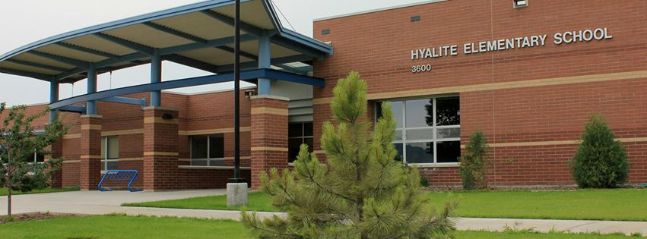
Partnerships
Lab School/Collaborative Classroom
Hyalite Elementary School
Dr. Nick Lux (MSU Faculty), Mike Van Buren (Principal), Veteran Hyalite Teachers, MSU Tech Ed Students, Instructional Coaches (Robin Miller & Anne Keith)
Observations, Group Teaching, Videotaping, Debrief, Receive Coaching, Repeat

Slide 17
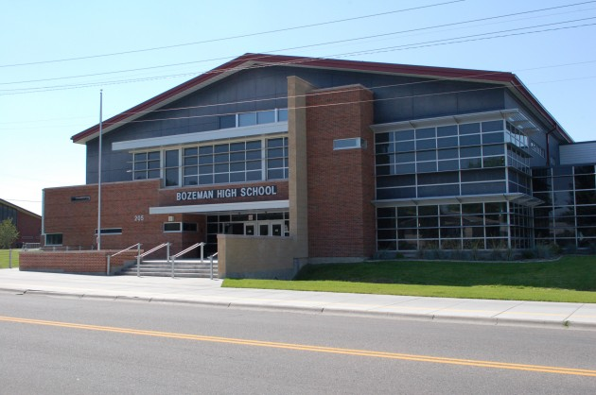
Partnerships
Dual Enrollment (helps with college completion & implementing common core concepts)
Bozeman HS
EDU 101 (Teaching & Learning: A
Critical Intro to Public Education)
Computer Science

Slide 18
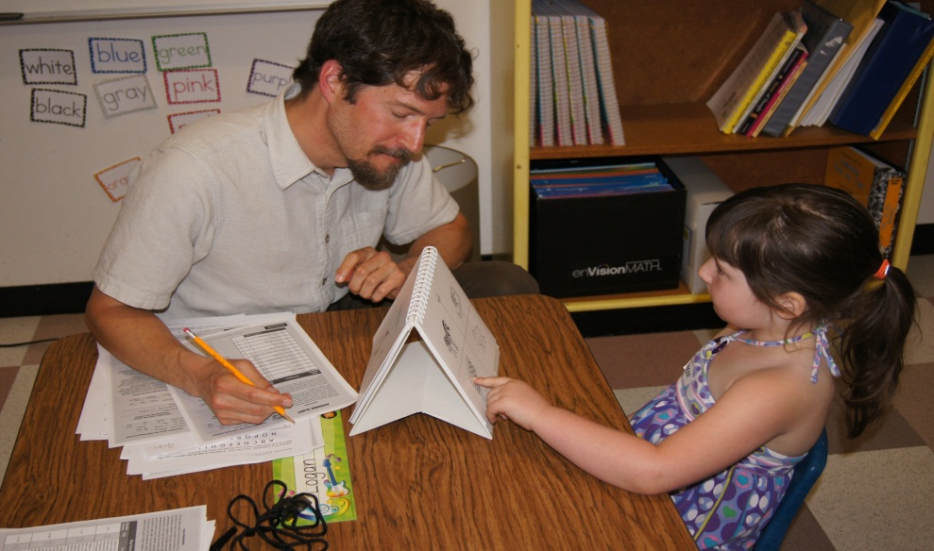
Partnerships
Schools and Higher Education Advancing Public Education Across the P-20 Spectrum (SHAPE P-20): A Community Impact Project
PJWCoEHS and MCPS
District-wide (impacts 6,430 PK-12 students)
Holistically aligns
P-20 education

Slide 19
Partnerships
DeSmet Elementary (PK-8)
Professional Development School
Lucila Rudge (UM Faculty), Shelley Andres (Principal), Nancy Marra (UM Field Experience Director)
- On-site UM faculty mentor
- Clinical cohort
- Ongoing Montana Core

Slide 20
Curricular Adjustments: OVERALL
Teach for mastery of subject vs. age-graded curricula
Understand by design: start with standard, then develop activity and assessment (vs. staring with activity)
Integrate technology & interdisciplinary concepts throughout
Sequenced clinical experiences that provide over 800 classroom hours for elementary education and 600 classroom hours for secondary education

Slide 21
Curricular Adjustments: ELA
GOALS: Read non-fiction; support arguments with evidence; improve vocabulary
Treasure Hunt
Create a graphic organizer that helps you remember how standards, strands and grade level standards are organized
Design an activity where you combine technology, STEM, and ELA (e.g., Prezi slide presentation on what happens to the human body while exercising in altitude)
Watch “Teaching Channel” vignette and tell which parts of the lesson are tied to the common core
Find an example of Indian Education for All embedded in the standards
Examine the standards for speaking & listening for grades 2 & 4; How are they similar (reinforce) & different (scaffold)?

Slide 22
Curricular Adjustments: MATH
GOALS: deeper understanding of fewer concepts; develop problem solving skills (vs. memorize); apply math to the real world
Add, subtract, divide, multiply first
Fractions for recipes
Room dimensions for calculating paint needed
Statistics from sporting events

Slide 23
Administrator Training
ILEAD to prepare Native Students as Leaders in Native Communities
MSU Assessment workshop is Collaborating with 4 Rivers Superintendents to conduct assessments

Slide 24
Ensuring the Success of Common Core: Moving Forward
Quality Professional Development , Curricular Materials, and Assessments
Continue Partnerships between Higher Education, OPI & School Districts
Ensure a quality assessment system
Prepare new teacher candidates & administrators to use Smarter Balanced (e.g., collaboration with 4 Rivers Superintendents)
Refine & prioritize strategies for implementing programs for ALL STUDENTS/ALL STANDARDS (e.g., Special Education, ELL, or Low Performing students)

Slide 25
Moving Forward (Cont’d.)
Ensure that Principals are educated to develop a vision, offer professional development, and measure progress
Engage the community about the benefits of MCCS
Anticipate joint work with OPI, other post-secondary units, MTDA’s new PD specialist, school in-service training, and ensuring through PEC active knowledge across campus.
Support alignment of curriculum P-16, calibrated assessment, and full transparency of expectations.

