Slide 1
Montana Two-Year Colleges
Mission Expansion Plan Update 2014
March 6, 2014
Notes:
Introduction

Slide 2
History
College!NOW - Lumina Grant
Mission Expansion Plans
Expansion Comprehensive 2-yr Mission
Board of Regents Update
Meetings with Deans/CEOs
Review and update 2013
Notes:
Provide context for this project. Discuss history since the Lumina Grant
Don’t need to talk about the planning cycle here

Slide 3
The Comprehensive Mission Drives the Planning Process
Comprehensive Mission
College Goals
College Initiatives
Planning Hierarchy
Notes:
Discuss how the comprehensive mission is the driver for all planning
The colleges set their own goals but keep the overall mission in mind
The colleges establish initiatives (action steps) to achieve their goals
This ensures that the planning at each college, is unique, but moves the system toward the overall goals

Slide 4
Planning Cycle
Review of Past Year
Action Plan Update
Data Provided to the Colleges
College-wide Collaboration
Report to Regents
Review with Deputy Commissioner
Notes:
Institutional effectiveness is dependent upon solid planning
- The planning must be data-driven, broad-based, collaborative and cyclical.
- The cycle must include evaluation of the previous year and updated plans.
- The report to the Regents ensures that the comprehensive mission remains central.
- The Deputy Commissioner will hold one-on-one meetings with each Dean/CEO.
- This will help identify obstacles, and perhaps find solutions to some.
- This also ensures that Deans are held accountable for making progress.

Slide 5
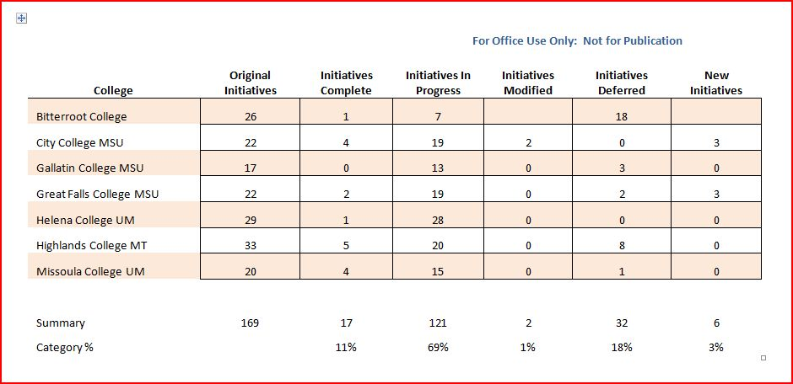
Overview of Mission Expansion Plans
Notes:
This chart shows a summary of the initiatives in the Mission Expansion Plans.
Original plans contained 169 initiatives
A year later, 13 of them (7%) were reported as completed.
121 were in progress, 2 were modified, 32 initiatives were deferred.
6 new initiatives were generated in the updated plans

Slide 6
Initiatives
Transfer Education
Workforce Development
Developmental Education
Lifelong Learning
Community Development
Branding & Marketing
General – Other
Notes:
These are the categories into which the initiatives are organized.
These categories correspond with the goals enumerated in the comprehensive mission.
They are the primary areas of focus for two-year education.

Slide 7
Next Steps
Institutionalize the planning cycle
Continue to develop culture of continuous improvement
Support the two-year college system
Identify roadblocks to success
Develop standardized data portfolio
Notes:
These are the next steps in the planning cycle for the colleges.
Over the next couple years we, at OCHE will continue to strengthen the planning process
We will continue to develop a standardized data portfolio – consistent with the Voluntary Framework for Accountability

Slide 8
Thank you
Mission Expansion Plan is posted on the Regents’ website.
Notes:
Questions/comments

