Slide 1
Indian Education for All & The Montana University System
Board of Regents
May 23, 2014

Slide 2
Montana State Constitution
1972— Article X
“ The state recognizes the distinct and unique cultural heritage of the American Indians and is committed in its educational goals to the preservation of their cultural integrity”.

Slide 3
Indian Education for All
Every Montanan, whether Indian or non-Indian, be encouraged to learn about the distinct and unique heritage of American Indians in a culturally responsive manner.

Slide 4
Indian Education for All
Every educational agency and all educational personnel will work cooperatively with tribes…to include information specific to the cultural heritage and contemporary contributions of American Indians.

Slide 5
Indian Education for All
All school personnel should have an understanding and awareness of Indian tribes to help them relate effectively with Indian students and parents….and will gain an understanding of and appreciation for the American Indian people.

Slide 6
Office of American Indian and Minority Achievement
To support and facilitate the advancement of American Indian and minority people through the academic, student service, research, human resource, and community outreach efforts of the Montana University System.

Slide 7
Montana University System
Policy 1902—Minority Achievement
To enroll and graduate American Indians and other minorities in proportion to their representation in the state’s population. It is expected that the minority students would have comparable levels of achievement with non-minority students.

Slide 8
Montana University System
To increase the employment of American Indians and other underrepresented minorities in administrative, faculty and staff positions to achieve representation equal to that of the relevant labor force.
To enhance the overall curriculum by infusion of content which enhances multicultural awareness and understanding.

Slide 9
Montana University System
Policy 303.5—American Indian Study
Each campus of the Montana university system is required to offer a formal course of American Indian study developed with the advice and assistance of Indian people.
Policy 301.10—General Education Transfer Policy
MUS Operational Rules state that “students must successfully complete at least one course that includes significant content related to the cultural heritage of American Indians” to satisfy the MUS transfer Core.

Slide 10
Curriculum
Native American Studies
  MSU Bozeman MA and undergraduate minor, Native American Studies Graduate Certificate
  UM Missoula BA and Minor
  MSU Billings Specialized area of study/Minor
  MSU Northern Specialized area of study/Minor
Law
Health and Human Services
Social Sciences
Environmental Sciences
Teacher Education
Humanities

Slide 11
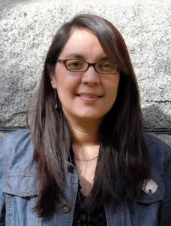
Dr. Annie Belcourt

Slide 12
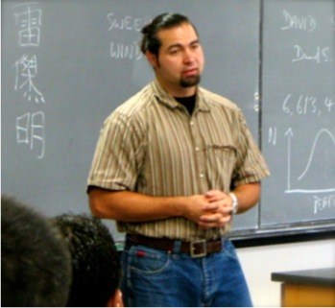
Dr. Sweeney Windchief

Slide 13
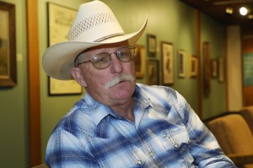
Dr. Stan Wilmoth

Slide 14
Research
Indigenous Research and STEM Education (IRSE)
American Indian Research Opportunities (AIRO)
Multitude of collaborations with Tribal Communities and Tribal Colleges, as well as research whose topic focuses on these communities

Slide 15

Dr. Jessi Smith

Slide 16

Dr. Aaron Thomas

Slide 17
Student Support Services
American Indian/Multicultural Student Services
  MSU Bozeman
  MSU Billings
  MSU Northern
  UM
  FVCC
TRIO
  MSU Bozeman
  MSU Billings
  MSU Northern
  UM Missoula
  Montana Tech
  UM Western
  Helena College
  FVCC
  DCC
  OCHE

Slide 18
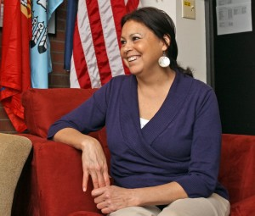
Reno Charette

Slide 19

Amy Verlanic

Slide 20
Community Outreach
Teacher training/student teaching
Clinical rotations
Upward Bound/Gear Up/Talent Search
Bridges to Baccalaureate
American Indian Heritage Day
Powwows
State wide Committees
Volunteer/Service Learning

Slide 21
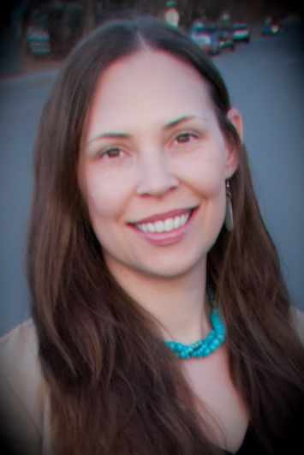
Dr. Heather Cahoon

Slide 22
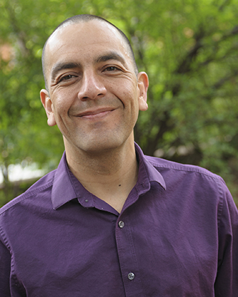
Dr. Shane Doyle

Slide 23
Professional Development
Workshops
Guest Speakers
Conferences

Slide 24
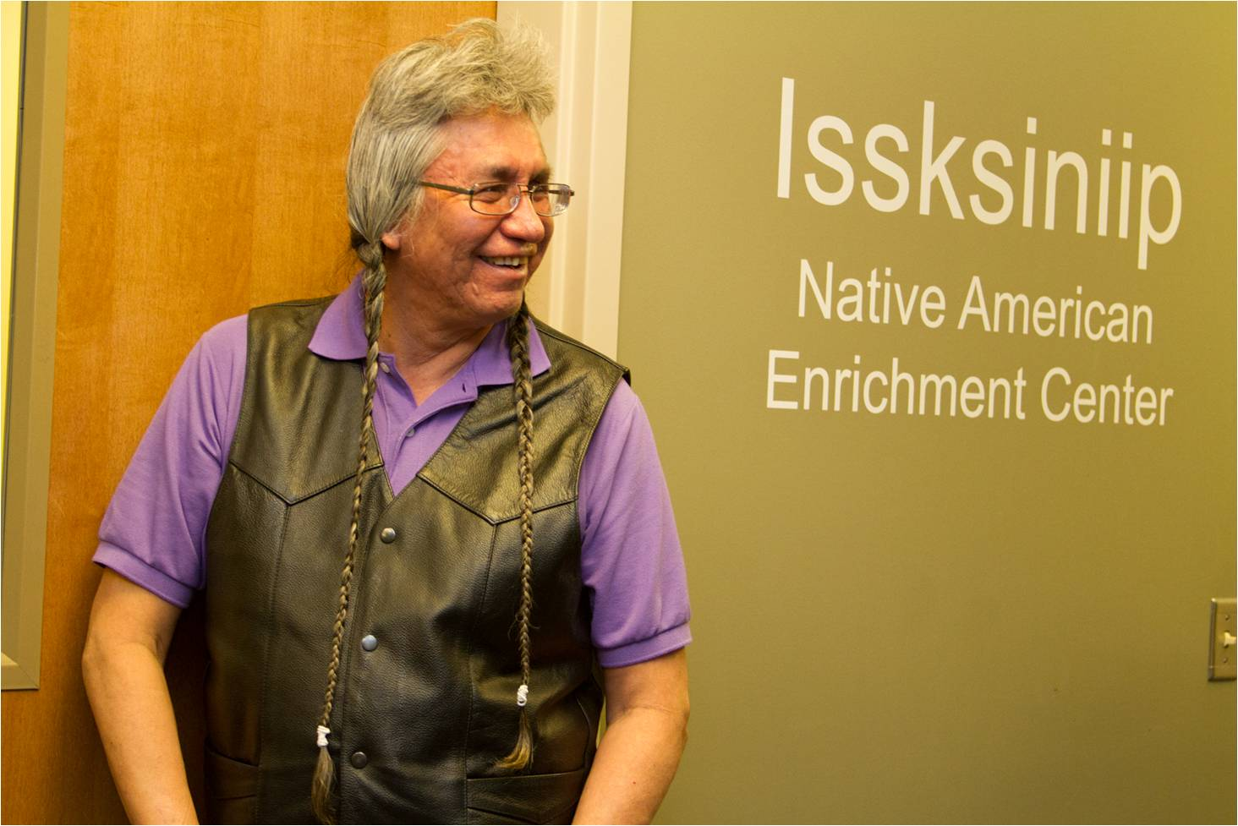
Donald Fish

Slide 25
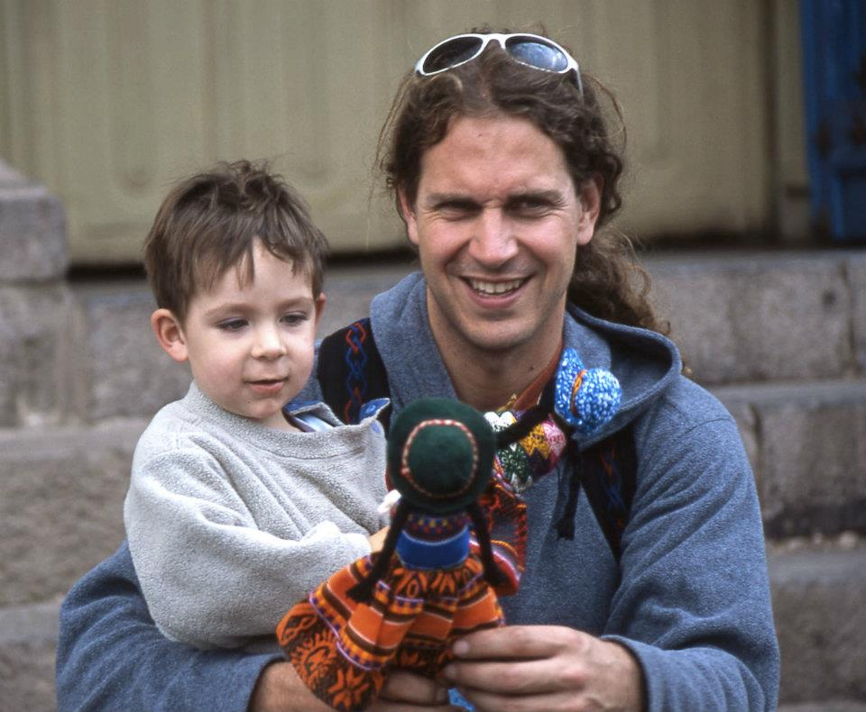
Mick Stemborski

Slide 26
Diversity and Inclusion
Create global citizens, we have to start at home.
Montana has unique opportunities which gives us unique responsibilities.
Diversity is a constant and consistent pursuit.

