Slide 1


2013—2014

Slide 2
MTCC advances the public purposes of colleges and universities by deepening their ability to improve community life and to educate students for civic and social responsibility.

Slide 3


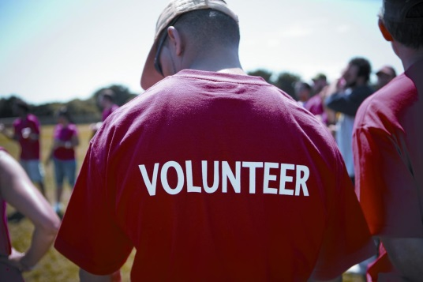
Compact Service Corps
6 State Region Montana
Students 2,174 671 (31%)
Campuses 36 13 (36%)
Ed Awards $3,186,502 $1,025,985 (32%)
Support $172,262 $55,463 (32%)
Hours 1,512,286 417,112 (28%)

Slide 4
MTCC VISTA
29 Full Time Placements
$32,000 w/training, benefits, allowance
= $928,000 + of value
60,320 hours
Campus-Community Partnerships
Reintegrate Veterans
College Access & Success

Slide 5
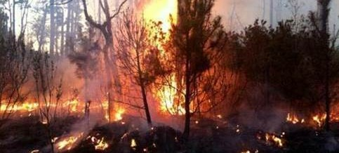
Ready Campus
Disaster Preparedness Trainings:
    Rocky Mnt. College Carroll College
    Little Big Horn College Univ. of Great Falls
Active Shooter Simulations:
    Bitterroot College Little Big Horn College
    Univ. of Great Falls
Disaster Institute-- October 16-18, 2014

Slide 6
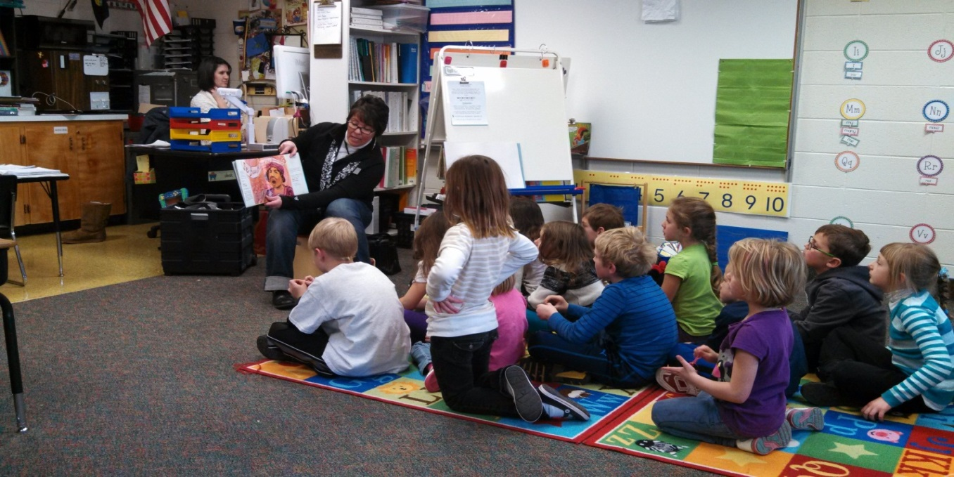
MLK Day: Read for Peace
14 Montana Communities
200 volunteers
4,600 school children participated

Slide 7
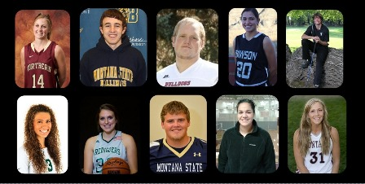
Montana Athletes in Service
Bozeman, November 23, 2013

Slide 8
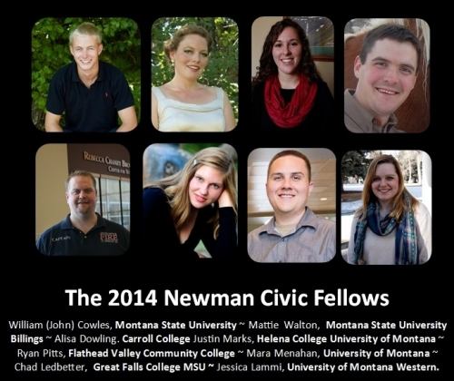

Slide 9
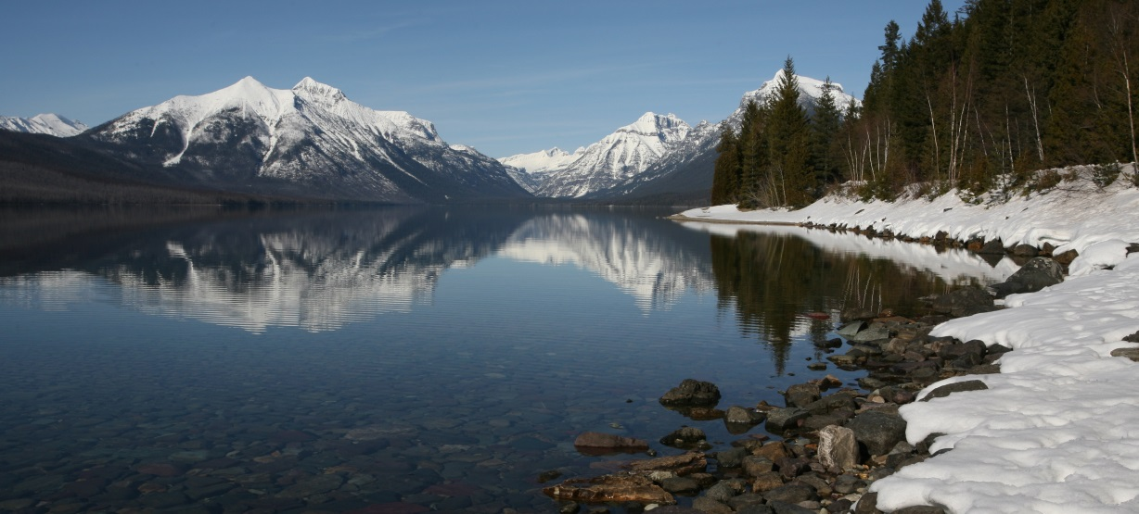
Carnegie Community Engagement Classification
President’s Higher Education Community Service Honor Roll
Campus Election Engagement Project
Youth Serve Montana Scholarships

