Slide 1


MONTANA STATE UNIVERSITY BILLINGS
Budget Principles
Minimize the impact on our students and invest in their long-term success
Work diligently within our shared governance process and current contracts
Involve and engage the entire campus community in balancing our budget
Ensure strategic reductions and reallocations are not unilateral or opportunistic

Slide 2

MONTANA STATE UNIVERSITY BILLINGS
Internal Planning Assumptions
Estimated tuition revenue reduction due to enrollment decline $1.15M
Estimated State support reduction due to enrollment decline $1.00M
Estimated State support reduction based on performance based funding $1.58M
Base budget expenditure increase due to increase in enrollment reserve $0.30M
Base budget expenditure for State fixed cost increases & other obligations $0.37M
Total Revenue Gap $4.40M

Slide 3
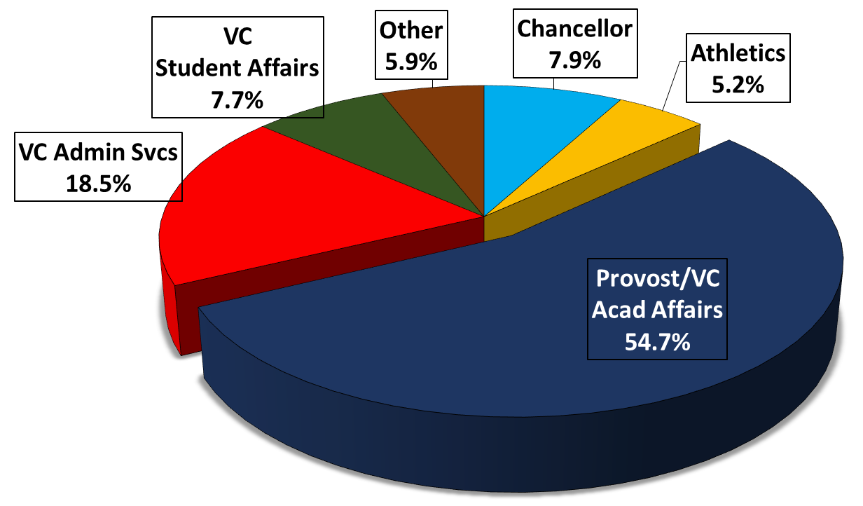
MONTANA STATE UNIVERSITY BILLINGS REDUCTION BY EXECUTIVE - 2/10/2015

Slide 4
MONTANA STATE UNIVERSITY BILLINGS
  BUDGET BRIEFING - 2/10/2015

Slide 5
MONTANA STATE UNIVERSITY BILLINGS
http://www.msubillings.edu/budgetoffice/2015-2017estimates/index.htm

Slide 6
MONTANA STATE UNIVERSITY BILLINGS
Full Time Equivalent Personnel BUDGET BRIEFING - 12.10.2014

Slide 7
MONTANA STATE UNIVERSITY BILLINGS Enrollment by Residency, FY09 - FY15 BUDGET BRIEFING - 12.10.2014

Slide 8
MONTANA STATE UNIVERSITY BILLINGS
  BUDGET BRIEFING - 12.10.2014

Slide 9
MONTANA STATE UNIVERSITY BILLINGS
Student FTE to Personnel FTE Ratios BUDGET BRIEFING - 12.10.2014

Slide 10

MONTANA STATE UNIVERSITY BILLINGS
THANK YOU!
Budget Briefing 12.10.2014
2:15 p.m. University campus – LI 148
3:45 p.m. City College campus – HSC 119

Slide 11
MONTANA STATE UNIVERSITY BILLINGS
  BUDGET BRIEFING - 12.10.2014

Slide 12
MONTANA STATE UNIVERSITY BILLINGS
  BUDGET BRIEFING - 12.10.2014

Slide 13
MONTANA STATE UNIVERSITY BILLINGS REDUCTION BY EXECUTIVE - 2/10/2015

Slide 14
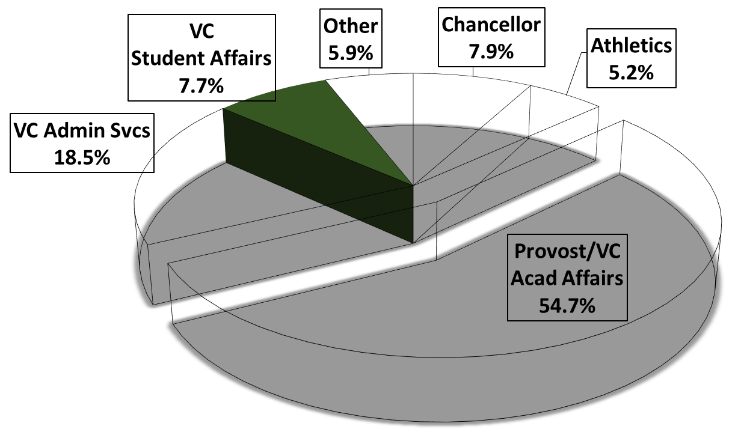
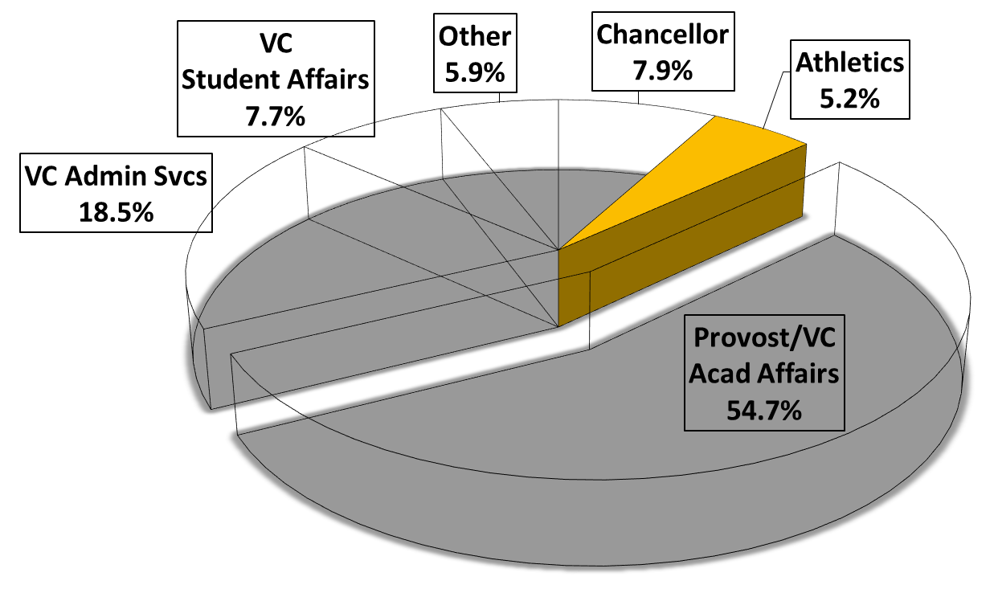
MONTANA STATE UNIVERSITY BILLINGS
  ATHLETICS - strategic reductions
Yellowjacket Sports:
Discontinue men’s and women’s tennis indefinitely
Rational for Reduction:
All sports will now be played in the Great Northwest
Athletic Conference (GNAC)
  Men’s and women’s tennis was the only sport MSUB
  participated in as a member of the Rocky Mountain
  Athletic Conference
  GNAC alignment will allow for strategic growth within
  the conference’s core sports
Elimination of tennis will mitigate across the board
cuts which would greatly impact competiveness and
academic excellence of other MSUB sports
Position Reductions: 1 FTE
Reduction Total: $231,001

Slide 15
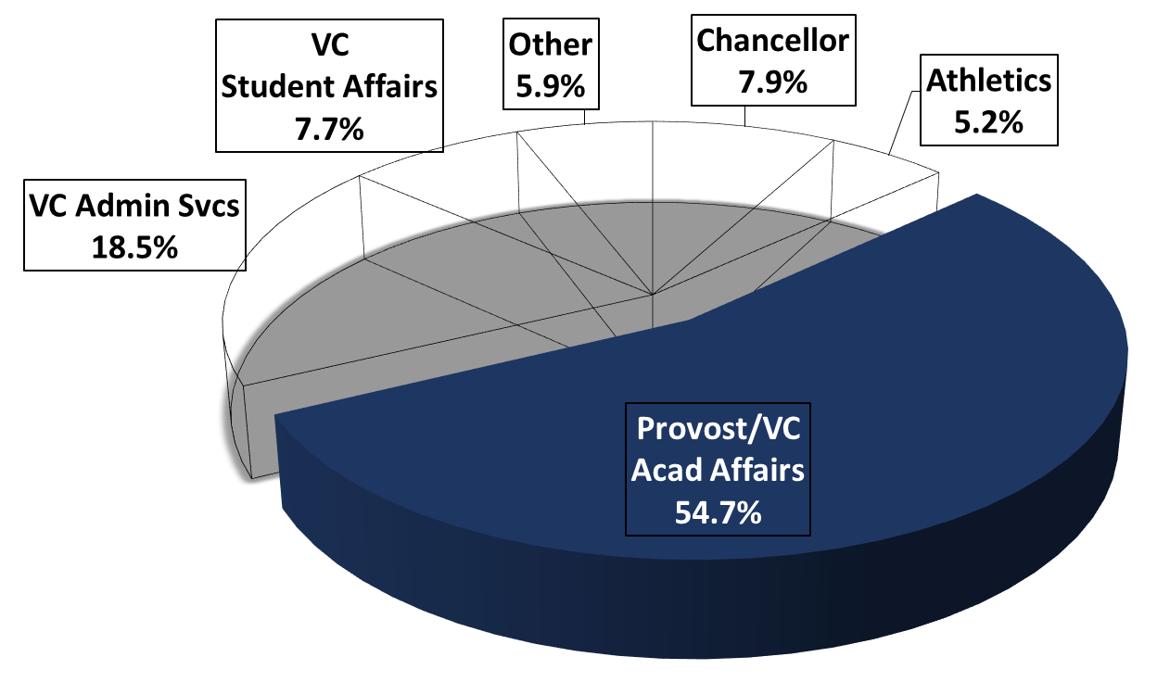
MONTANA STATE UNIVERSITY BILLINGS
  PROVOST/VC ACADEMIC AFFAIRS - strategic reductions
Non-instructional operations:
Eliminate Garfield Center operation
Eliminate Center for Applied Economic Research
Reduce Extended Campus staff
Reduce Office of International Studies Staff
Reduce Library Staff
Honors Program
Instructional operations:
Provost Office reductions
College of Allied Health Professions
College of Arts & Sciences
College of Business
College of Education
City College
Graduate Studies

Slide 16
MONTANA STATE UNIVERSITY BILLINGS
  PROVOST/VC ACADEMIC AFFAIRS - net effect
FY 2015 – 16 Proposed Budget: $24,076,640
Reduction Total: $2,407,664 (10%)
Reduction from Colleges: $1,477,500 (8.4% of total)
Reduction from other areas: $930,164 (11.6% of total)
Position Reductions: 30.25 FTE (16.25 instructional, 6 clerical
4 Professional, 4 FTE equivalent in part-time, summer, overload, etc.)
Note: 43.8% of total AA budget is instruction. Instruction reduction is 41.0% of total.

Slide 17
MONTANA STATE UNIVERSITY BILLINGS
  VC STUDENT AFFAIRS - strategic reductions
Goal: Holistic student advising from orientation to graduation
Enrollment Services:
Merge Career Counseling and Academic Advising; and, broaden mission of Orientation and Peer Mentoring
Student Life:
Merge roles in Career Services Job Locator/Community Service Work Study Program & Office of Community Involvement
Diversity Center programming/training, multicultural student support and respective student organizations
will be supported by staff in the Student Union and
Events Office
Position Reductions: 7 FTE
Reduction Total: $338,800

Slide 18
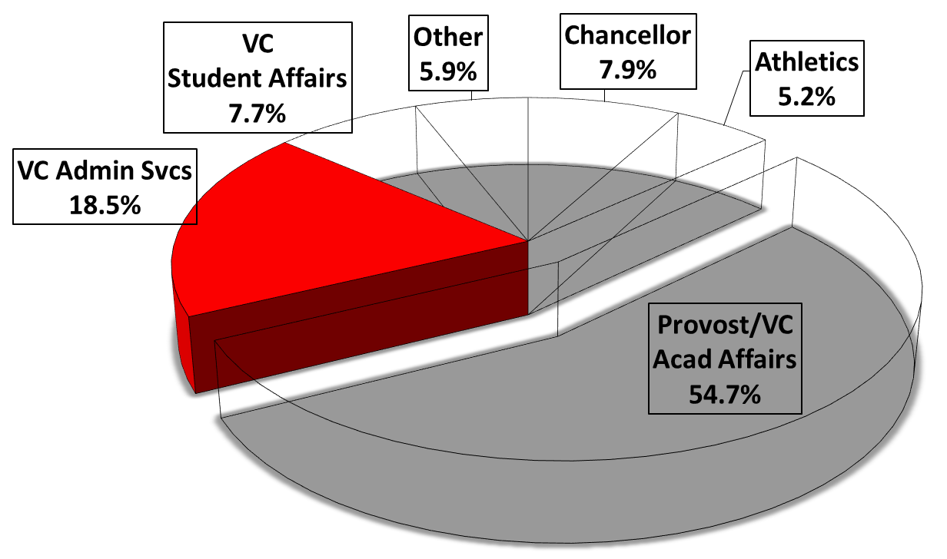
MONTANA STATE UNIVERSITY BILLINGS
  VC ADMINISTRATIVE SERVICES - strategic reductions
Admin Services:
Personnel
  Vice Chancellor’s Office
  University Police
  Human Resources
  Financial Services
  Facilities Services
  Business services
Reduce lease obligations and other direct costs
  Operations
  Utilities/Energy Savings
  Maintenance
Position Reductions: 7 FTE
Reduction Total: $815,945

Slide 19
MONTANA STATE UNIVERSITY BILLINGS
  BUDGET BRIEFING - 12.10.2014

