Slide 1
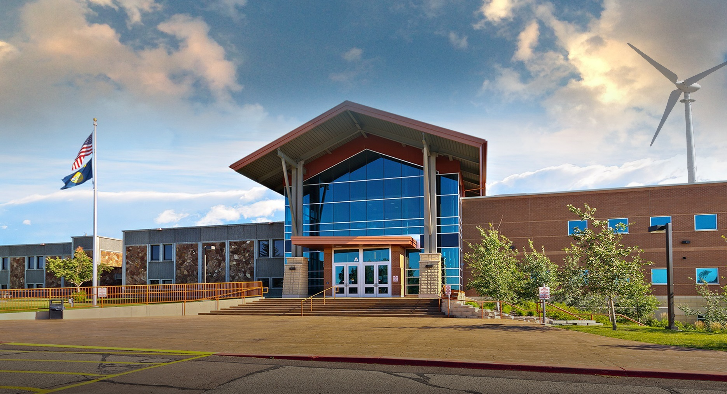
Mission Review
Board of Regents March 2015

Slide 2
Two-Year Education in Montana
Tribal Colleges
Aaniih Nakoda College
Blackfeet Community College
Chief Dull Knife College
Fort Peck Community College
Salish Kootenai College
Stone Child College
Community Colleges
Dawson Community College
Flathead Valley Community College
Miles Community College
MUS
Gallatin College MSU
Great Falls College MSU
Highlands Tech of Montana Tech
Helena College UM
Bitterroot College
City College at MSU Billings
Missoula College UM

Slide 3
Montana University System
Missoula College
Gallatin College
Montana State University
University of Montana
Bitterroot College
MSU Billings
MSU Northern
Great Falls College MSU
Montana Tech
UM Western
Helena College UM
City College
Highlands College

Slide 4

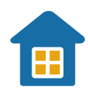

Our Students
72%
35%
female
have children living at home
72%
average age of
29
of students work at least part-time
Notes:
**Gender and age stats are updated from 2013-2014 school year
**children and working are from 2012-2013 Report to Community

Slide 5


Our Students
16:1
17.2
average class size
student to faculty ration
54%
6%
Wholly online students
39%
students attend face-to-face
students attend in a hybrid format
Notes:
**Gender and age stats are updated from 2013-2014 school year
**children and working are from 2012-2013 Report to Community

Slide 6

Our Staff
45
full-time faculty
3
part-time faculty
full-time administrative and support staff
85
95
adjunct faculty
FY13 Payroll
$9.8 million

Slide 7
Online Courses and Degrees
3
Transfer Degree Options
Associate of
Applied Science Degrees
Spring 2015
126
online only courses
4
Certificate of
Applied Science Degrees
3
3
Professional Certificate Options

Slide 8
Early College
Total Dual Credit Students
Spring 2015 - 136
Fall - 226
AY 2014 - 296
Dual Credit
Welding Students
Spring 2015 - 9
Fall 2014 - 10
AY 2014 - 12
The first dual credit, concurrent class of M121 College Algebra at Great Falls High School had 29 students enrolled in the course, and 27 passed with a C- or better.
Dual Credit
Carpentry Students
Spring 2015 - 3
Fall 2014 - 4

Slide 9
Student Scholarships
600
in AY13 from
institutional, local, state and out-of-state resources
totaling over
$584,000

Slide 10
Community & Business Connections
College and Community Choir
Customized training
Trans-border welding testing facility
Outreach
Program Advisory Committees
Executive Team serves on 40 community
boards, councils, and committees

Slide 11
Economic Impact
 | Added income in region
Effect of college operations
Effect of student spending
Effect of worker productivity
Total effect
$466.4 thousand

Slide 12
Mission
Our Mission is to foster the success of our students and their communities through innovative, flexible learning opportunities for people of all ages, backgrounds, and aspirations resulting in self-fulfillment and competitiveness in an increasingly global society.

Slide 13
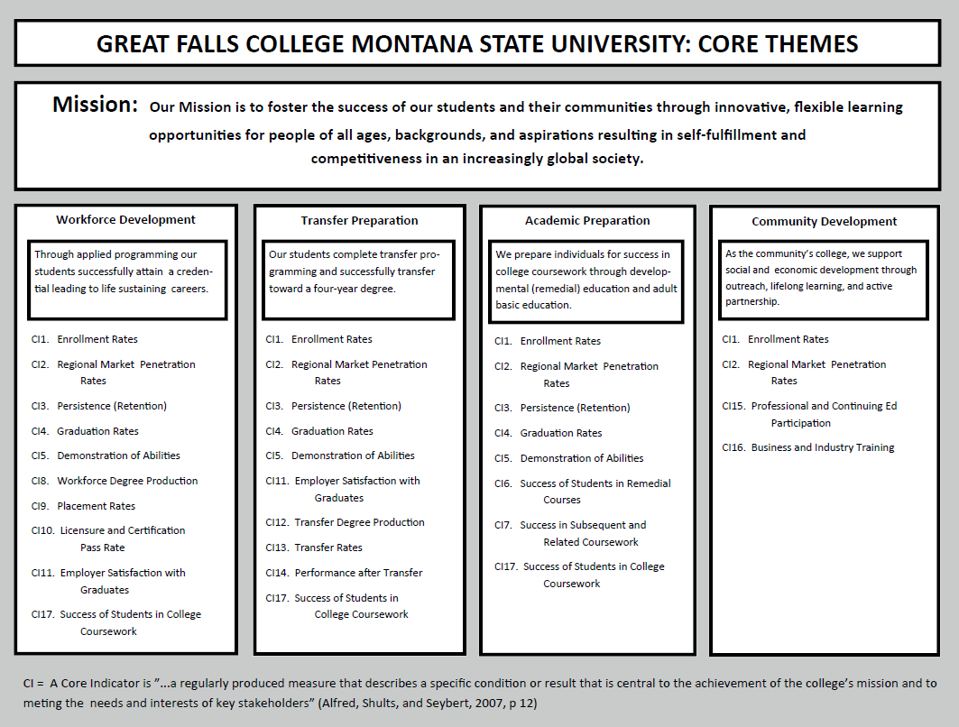

Slide 14
Mission Expansion
3 Transfer degrees: Associate of Science; Associate of Arts; Certificate of General Studies
6 Certificates of Technical Studies
(formerly called Professional Certificates)
11 options for the Certificate of Applied Science
22 Associates of Applied Science Degrees
designed specifically for entry into and advancement in a variety of career fields

Slide 15


The SEM Planning Framework
Building a Solid Base
Clear Mission and Goals
Data Collection and Analysis
Enrollment Infrastructure
Strategies
Tactics
Meeting Goals
SUCCESS
STEP 6
STEP 5
STEP 4
STEP 3
STEP 2
STEP 1
Notes:
Explain the SEM framework/pyramid and how we need to focus our efforts on those things that start at our base (Mission, vision & values).
Explain how most of the tasks that we do are often reactive in nature and only occur in Step 4 and 5 without taking into consideration the base.
Communication needs to occur between each tier of the pyramid.

Slide 16

Putting It All Together - Interactions
Planning / Budget /Analysis
Proper allocation of resources
Needs Analysis
KPI (Core indicators)
Data Analysis
Common Ground
SEM
Operational Plan
Strategic Task Groups
Working Groups
Recruitment
Enrollment
Retention
Persistence
Graduation
Planning
Common
Ground
SEM
CPBAC
and ET
Technology Planning
Academic Technology
Infrastructure
Needs Analysis
Capacity Planning
Support Technology
Business Support
Academic Master
Plan
Facilities Master Plan
Academic Master Plan
Capacity Management
Room Utilization
Space Needs
Construction Planning
Remodeling
Expansion
College Goals
Initiatives
Planning/ Assessment
External Inputs
Need-Finding
Set Priorities
Notes:
This graphic brings all of the intersections together.
Point out the bulls eye in the middle of the graphic and explain that is our targeted goals.

Slide 17
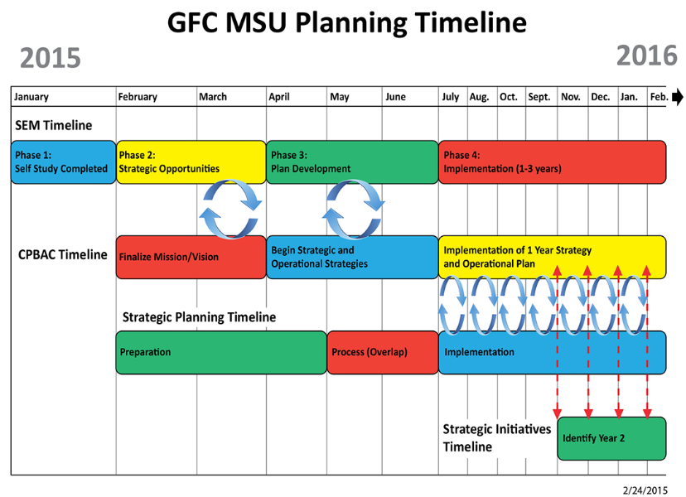
Next Steps
Notes:
SEM Team meeting weekly to review data this spring
Expecting to have goals for review by end of March, so plan can be developed for July implementation
SEM co-chairs meeting monthly with Dr. Wolff with updates
SEM Team will be presenting regularly to joint ET/JD, CPBAC, and other groups

