Slide 1
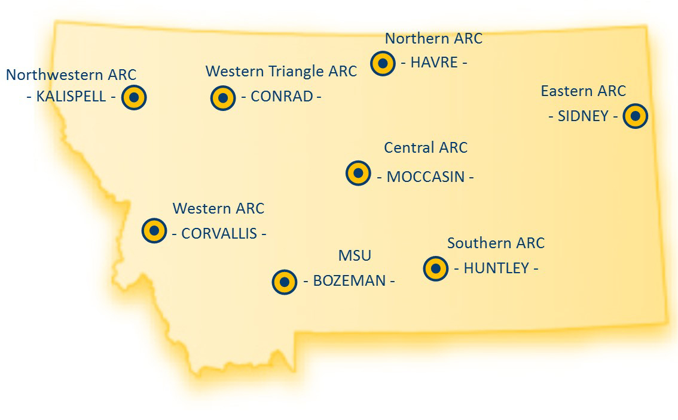
MSU’s
Montana Agricultural Experiment Station
(MAES)
and its 7 Agricultural Research Centers (ARC)

Slide 2
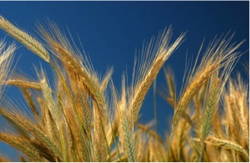
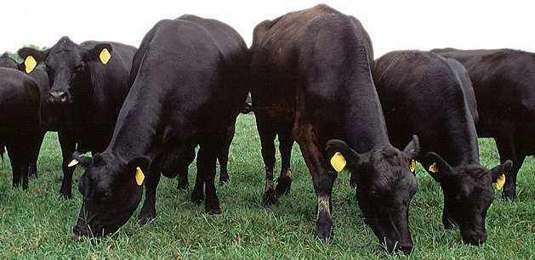
MSU’s Agricultural Experiment Station (MAES) working for Montana
On average, 60-70% of all wheat varieties grown in MT are from MSU MAES.
Annual production of peas, lentils and other pulses reached nearly 800,000 acres in 2015.
MAES conducts its own research & research in cooperation with the USDA to benefit Montana’s 2.5 million head of cattle.

Slide 3
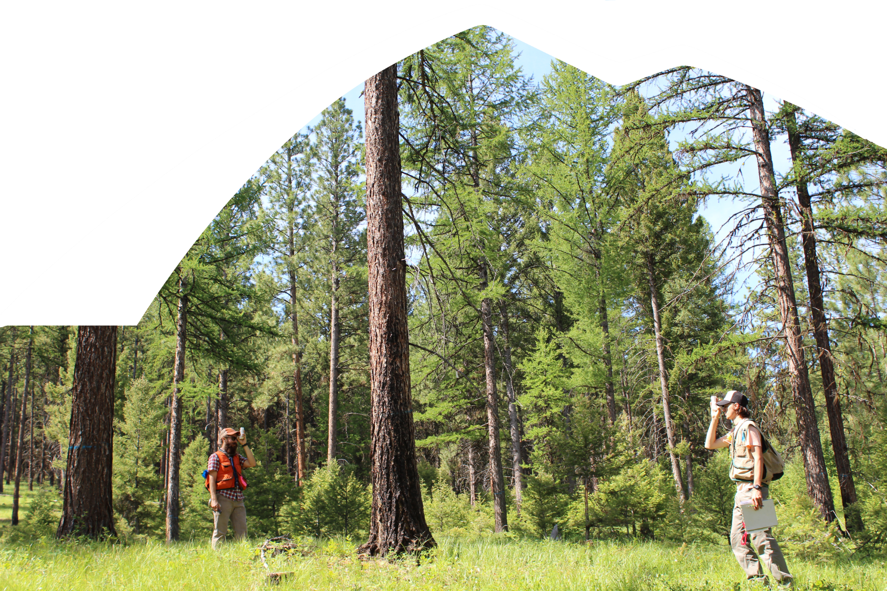
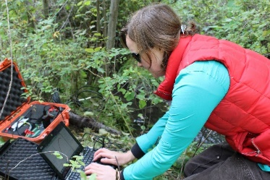
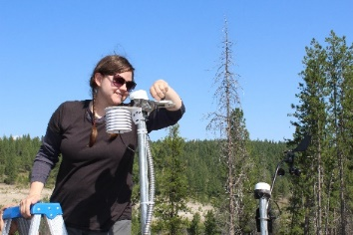
Montana Forest & Conservation Experiment Station
cfc.umt.edu/research/mfces

Slide 4
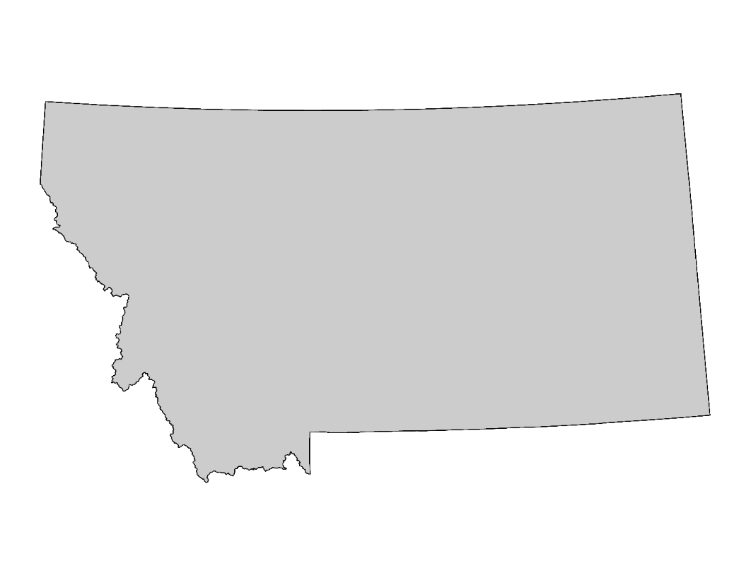
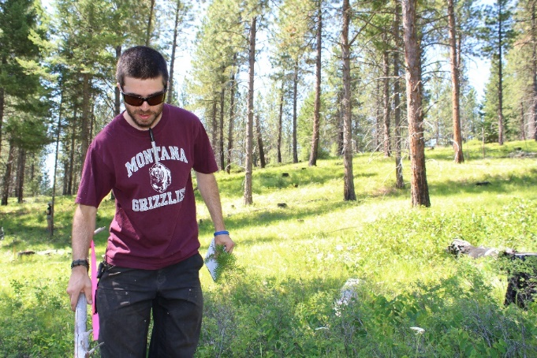
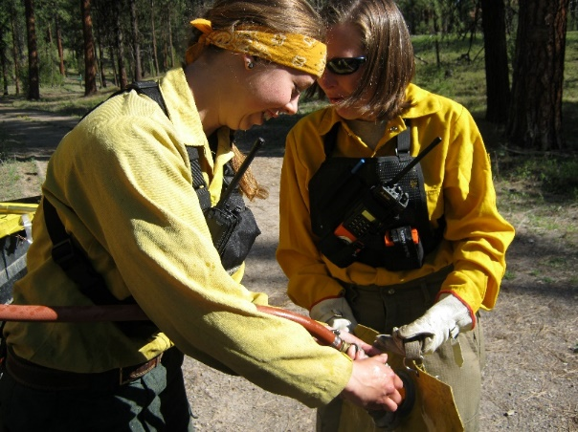
Montana Forest and Conservation Experiment Station RESEARCH THAT MAKES A DIFFERENCE
> Water availability
> Understanding wildfire
> Forest management
> Wildlife
LUBRECHT FOREST
Montana’s only university-managed experimental forest
With the state’s investment of approximately $1 million per year, the MFCES leverages an additional $13 million in external funds from federal, state and private sources.
125 scientists, research assistants and graduate students are employed by the MFCES.
The MFCES has more than $30 million in active external grants from federal agencies; more than $5 million from other sources (universities, foundations, etc.) and $600,000+ from McIntire-Stennis, a USDA grant program.

Slide 5
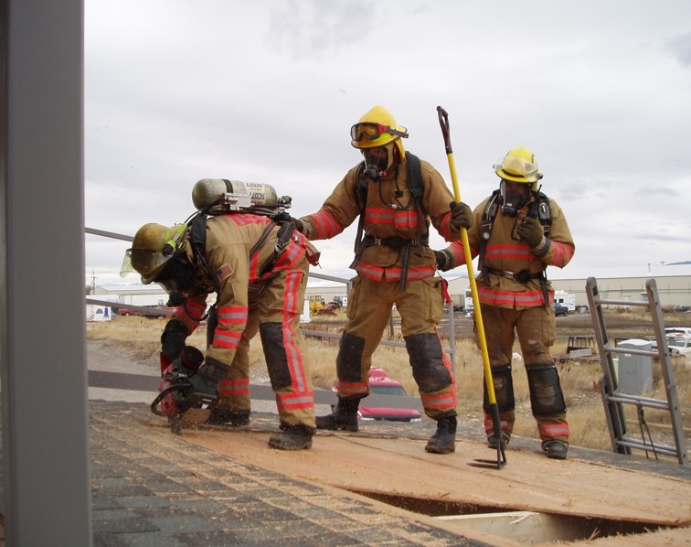
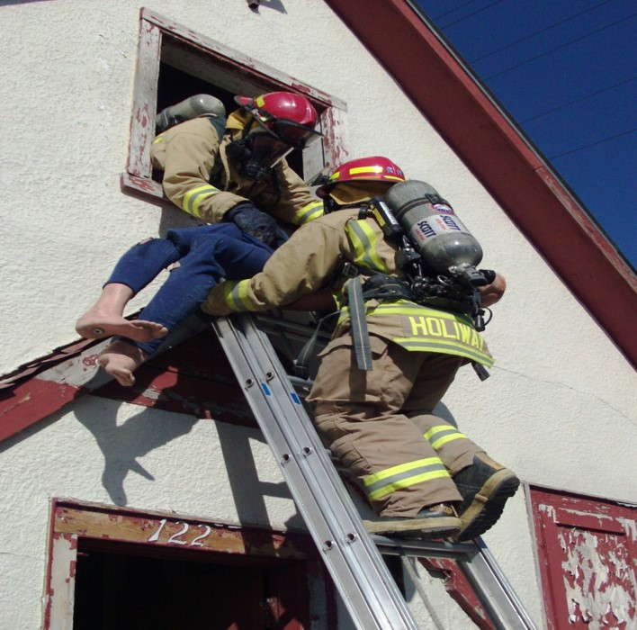
Fire Services Training School
Building capacity in local governments to protect lives and property

Slide 6
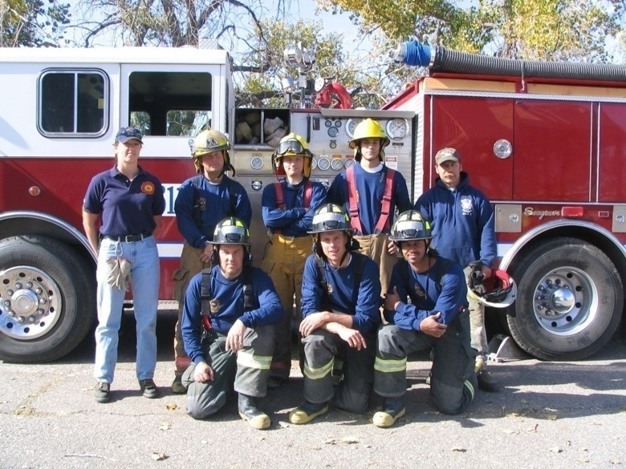
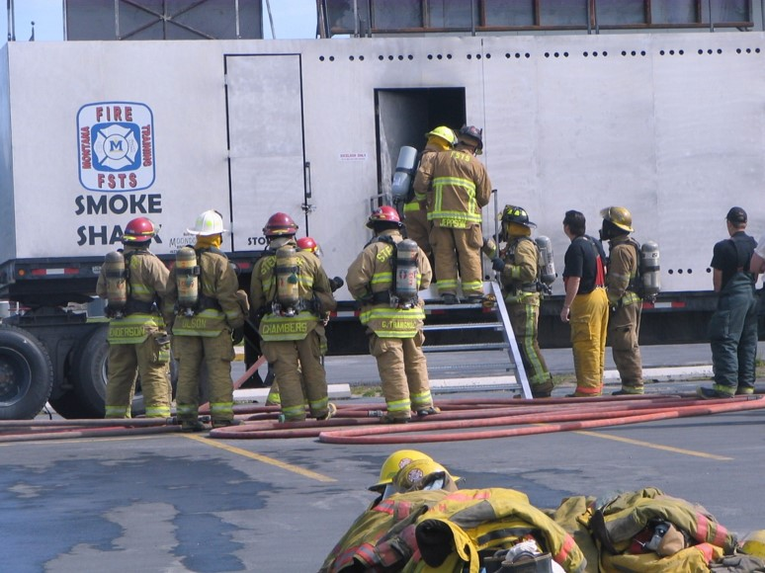
Fire Services Training School
Protects every community in Montana
381 Fire Departments
10,000 fire fighters (96% are volunteers)
Provides professional certification to fire fighters
Certifications are internationally accredited by two bodies
More than 500 training sessions
Trained more than 6,700 fire fighters

Slide 8
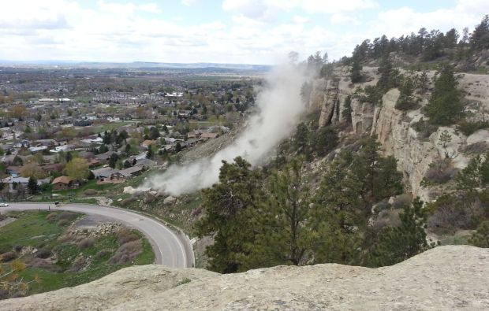
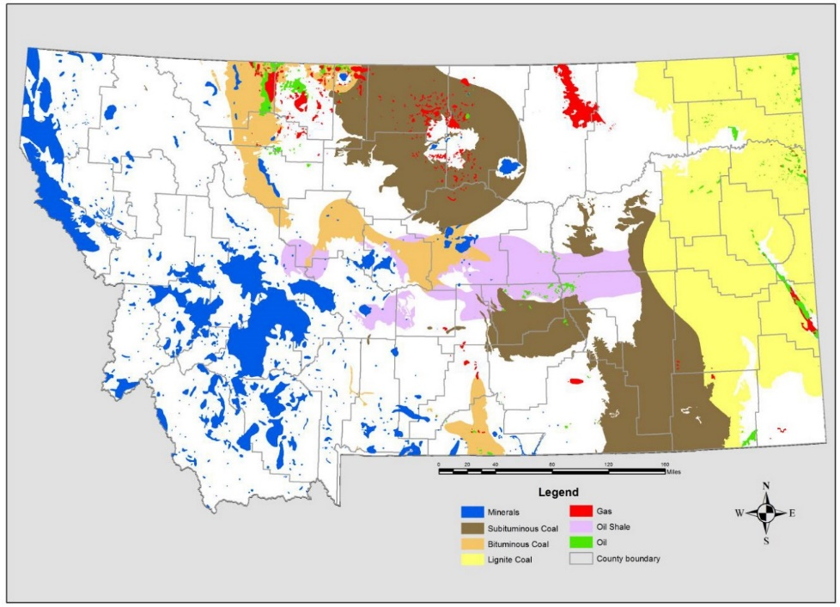
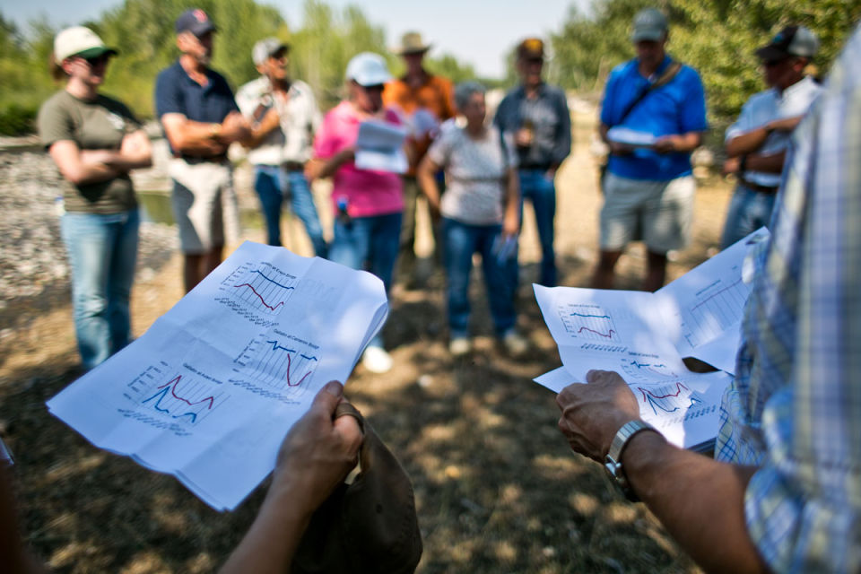
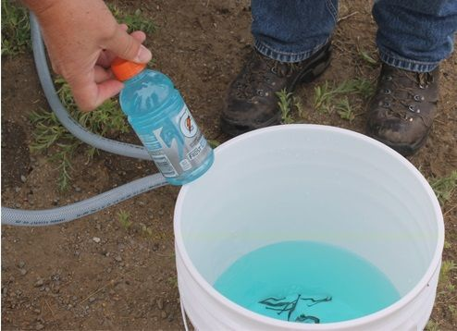
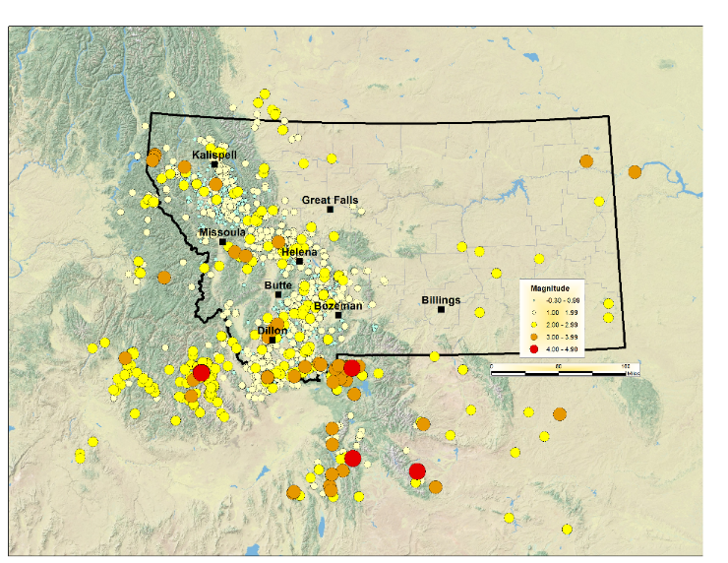
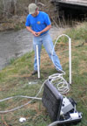
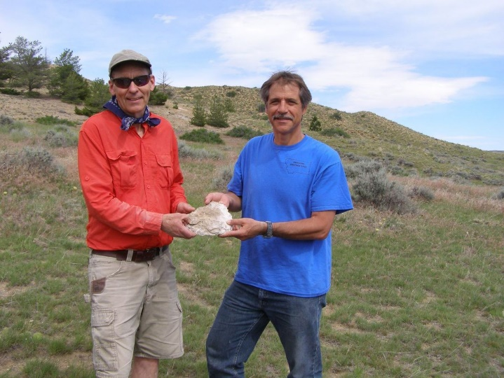
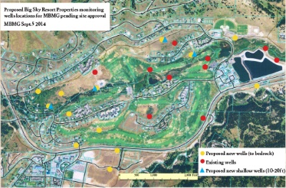
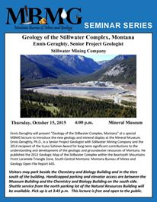
Deep in the heart of Butte: A special report on the Parrot Plume: What you should know —Montana Standard
State legislators, others tour Gallatin Valley water resources
—Bozeman Daily Chronicle
Ennis Geraghty to discuss the “Geology of the Stillwater Complex” at a special MBMG lecture at the Mineral Museum
—Montana Standard
Hydrogeologists to conduct water study in Hamilton area
—NBC Montana
STATE DRILLING TO TEST BIG SKY’S WATER SUPPLY
—Explore Big Sky
Experts: CSKT water-rights compact based on 'reasonable' science’
—Missoulian
Jurassic starfish discovery in south-central Montana wows researchers
—Billings Gazette
"It’s kind of like predicting an earthquake': The geology behind the Rims' rock slides
—Billings Gazette
Geologist: Recent Shakes Reminder that Montana is ‘Earthquake Country’
—Flathead Beacon
Montana, the Treasure State: A look at how Montana's diverse geology has provided an abundance of resources
—GeoNews, Montana Department of Commerce
What do we do?
If it’s related to natural resources in Montana, we do it.

Slide 10
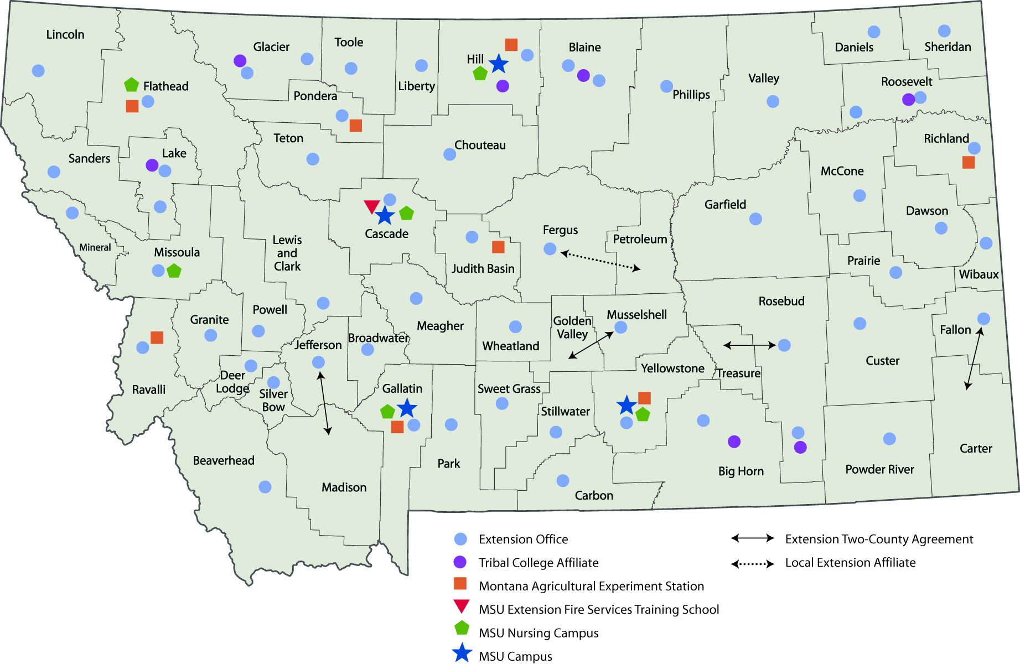
The Entire State is our Campus

