Slide 1


Updates in Dual Enrollment for the Montana University System
Report to the Montana Board of Regents
March, 2016

Slide 2
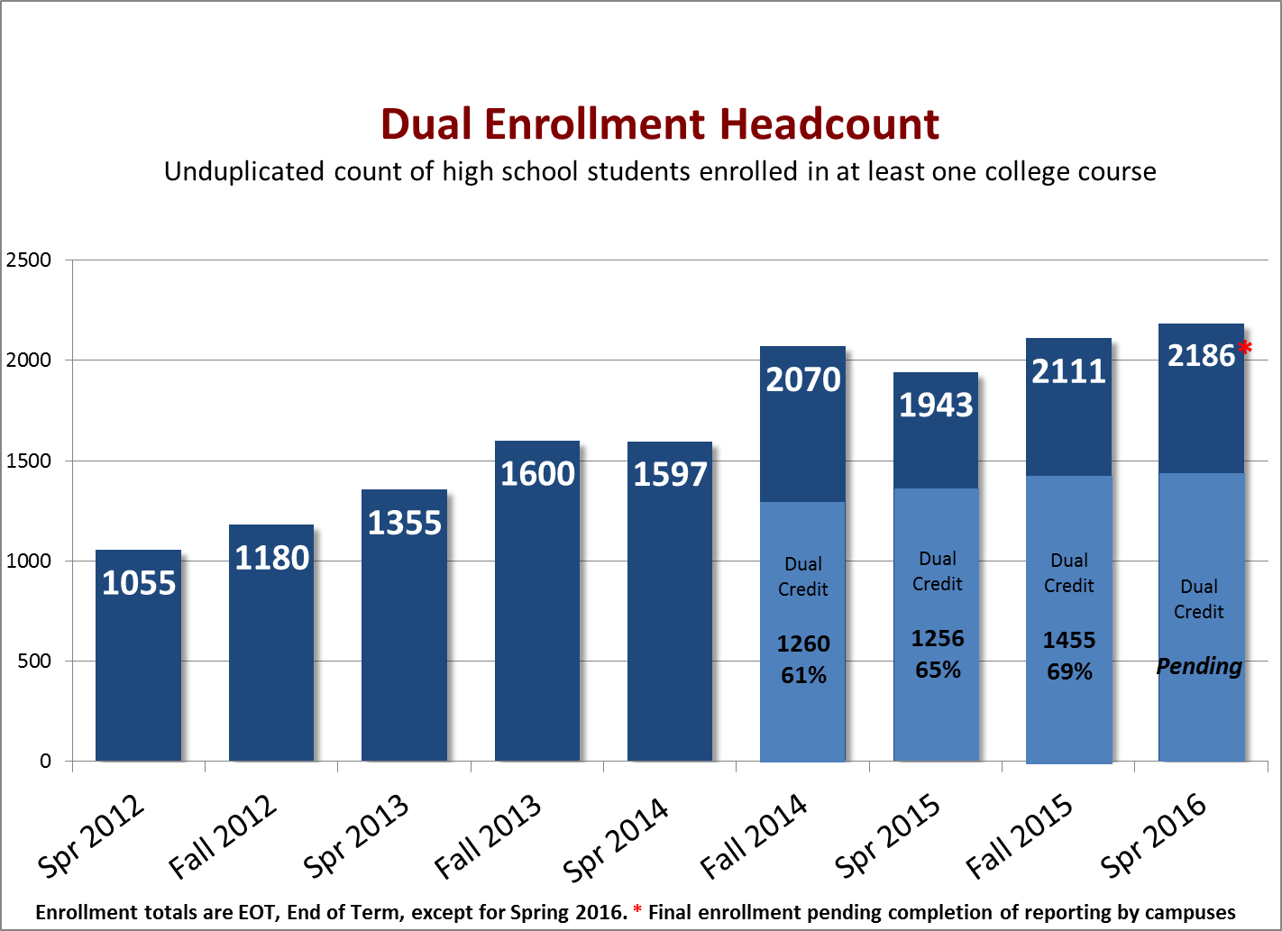
Enrollment
Start of C4C

Slide 3
Credit-4-Credit
Credit-4-Credit had increased the number of teachers, courses, and high schools offering on-site dual enrollment options for Montana students.
The Credit-4-Credit program sunsets this semester.
Totals as of fall 2015:
310 teachers rewarded with 458 C4C’s totaling 1449 credits
Tremendously popular with teachers

Slide 4
Students Choose the MUS
Montana dual enrollment participants enter the MUS at high rates.
63% of high school students earning dual enrollment credit enter the MUS as college students.
In comparison, approximately 40% of public high school graduates attend a MUS campus within 16 months of graduation.

Slide 5
Student Success
Montana dual enrollment participants are well prepared.
Compared to students who do not participate in dual enrollment, dual enrollment students outperform their peers in key success areas.
16% higher rate of first year retention (84% DE, 68% non-DE)
Two tenths higher freshman GPA (3.06 DE, 2.8 non-DE)
Earn more credits in first year of college.
The benefits are independent of high school GPA, and often “B” and “C” students make larger gains than “A” students when compared to non-participating peers.
Student performance data averaged over 2012, 2013, and 2014 freshman cohorts entering the MUS with dual enrollment credit from the MUS. (Data from Dep. Commissioner T. Trevor)

Slide 6
What’s Next?
Strategic Use of Perkins Funds
Realign the Big Sky Pathways program to grow career-technical dual enrollment.
Strategic Program Targets
Increase enrollment in existing programs and pursue growth in new areas.
Strategic Partnerships
Enhance linkages between OCHE programs, build on existing collaborative efforts with OPI, and forge new relationships public and private partners.
Increase dual enrollment in the Montana University System by 1000 students annually over the next three years.
Governor Bullock, Commissioner Christian, and Superintendent Juneau are committed to increasing access to this program for Montana students by achieving the goal.

