Slide 1
WWAMI in Montana
WASHINGTON WYOMING ALASKA MONTANA IDAHO
W W A M I
Jay S. Erickson M.D.
Assistant Dean-WWAMI Clinical Phase/Montana

Slide 2
Physician Pipeline
K-12
College (4 years)
Medical School (4 years)
Residency/Fellowship (3-7 years)
Practicing Physician

Slide 3

WWAMI
Non-metro percent of population by state
12%
65%
34%
70%
33%
Notes:
27% of the total land mass of the U.S.
3% of the U.S. population
25% of the people live in rural areas

Slide 4
The WWAMI Program:
Founding Goals (1971)
Access to Publicly Supported Medical Education
Avoid excessive capital costs by using existing educational infrastructure
Create Community-Based Medical Education
Expand GME and CME across WWAMI
Increase the number of primary care providers (MD) /address maldistribution of physicians
Notes:
Established in 1946
Outstanding faculty recruited by Dean Turner
“To test new concepts at a school that was not yet mired in tradition”
University Hospital built in 1959
WAMI established (Washington, Alaska, Montana, Idaho) in 1970(first MT students 1973)
Wyoming joins WWAMI in 1996
The University of Washington School of Medicine has two distinct missions:
Meeting the health care needs of our region, especially by recognizing the importance of primary care and providing service to underserved populations
Advancing knowledge and assuming leadership in the biomedical sciences and in academic medicine.

Slide 5
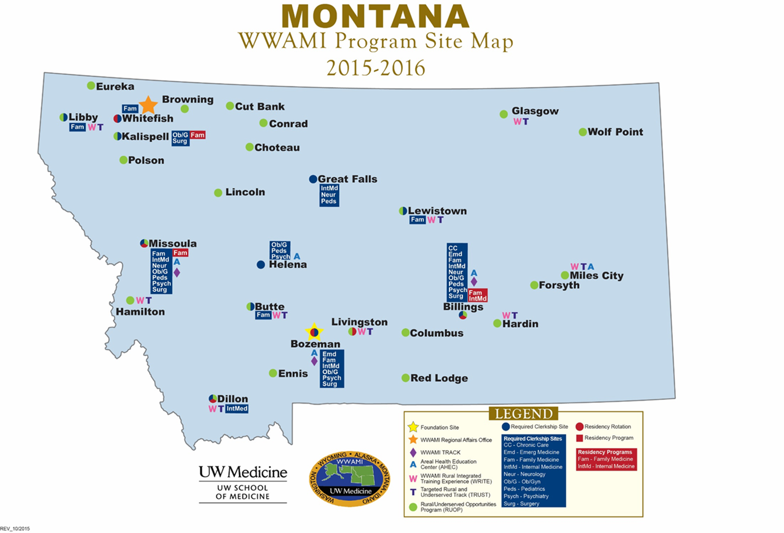
Notes:
40 clerkship sites in 16 communities
Over 150 WWAMI students from all 5 states participating in a clerkship in Montana
Over 350 clinical faculty

Slide 6
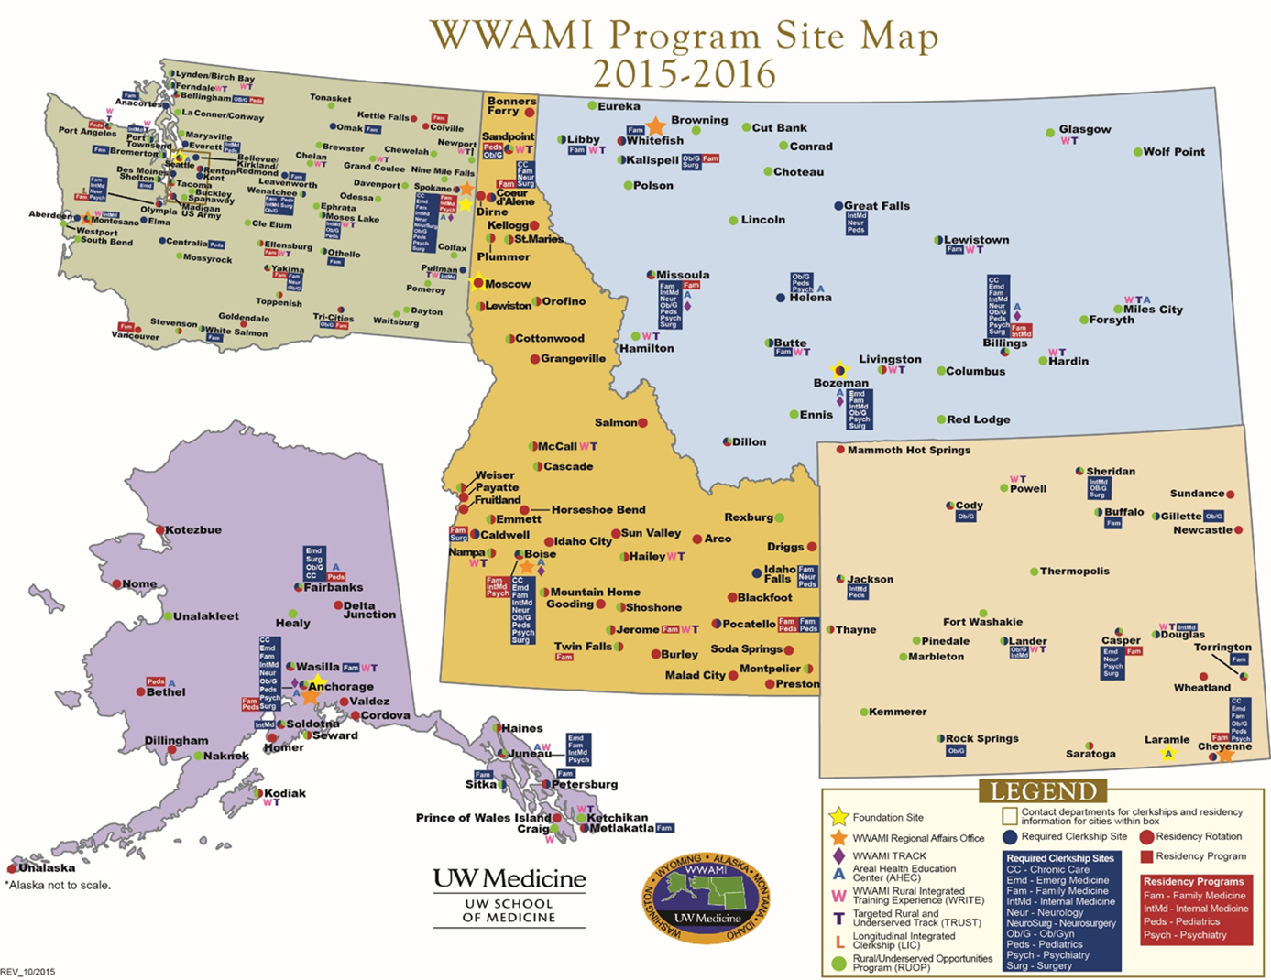
Notes:
Part of the bigger WWAMI picture

Slide 7

UWSOM TRUST/WRITE
2015-2016 ~ 34 sites
Lynden/Birch Bay
Ferndale
Port Angeles
Grand Coulee
Newport
Port Townsend
Chelan
Glasgow
Spokane
Sandpoint
Libby
Whitefish
Montesano
W
Montana
Ellensburg
Moses Lake
Orofino
Lewistown
Washington
Pullman
Butte
Miles City
Hamilton
Livingston
W
Hardin
Dillon
McCall
Powell
Idaho
Alaska
Hailey
Wyoming
Boise
Nampa
Jerome
Lander
Douglas
Wasilla
Anchorage
Cheyenne
Juneau
TRUST/WRITE Sites
Kodiak
Ketchikan
WWAMI Regional Offices
Notes:
TRUST 2008 in MT
The MT WWAMI TRUST program began in 2008 with the ultimate goal of creating a rural/underserved physician workforce in Montana. The MT WWAMI TRUST program involves a targeted admissions process and linkage with a rural/underserved preceptor and continuity community, culminating in a 5-6 month learning experience in the third year. 10 of the 30 MT WWAMI students each year are enrolled in TRUST.

Slide 8
E15 TRUST Scholars

Slide 9
Montana Physician Workforce Data
Per 100K population, Montana ranks:
  29th in nation for total active patient care physicians
  24th for active patient care primary care physicians
  11th for active patient care general surgeons
Montana’s physicians are aging:
  32.7% of Montana physicians are over age sixty
    (National average is 29.4%)
2015 AAMC State Physician Workforce Data Book

Slide 10
The Pipeline
How many Montana students attend medical or osteopathic schools, past 7 years?
54 MT residents per year attend medical school in the US
  MT WWAMI-30
  WICHE medical school-6
19 MT residents per year attend osteopathic school in the US
    WICHE osteopathic school-2

Slide 11
Workforce Progress-Montana WWAMI since inception in 1973
Rate of return: 40%
(MT WWAMI grads that practice in MT)
Return on Investment for MT: 56%
( all WWAMI grads that practice in MT)
National rate of return on instate medical education: 38.7%
Notes:
Montana WWAMI’s retention rate of 40% is higher than the national rate of 38.7% for all US medical schools

Slide 12
Specialty Choice of WWAMI Graduates 1973-2015 (top ten)
51% matched into a primary care specialty
Notes:
51% of grads have gone into a primary care residency match

Slide 13
WWAMI is cost-effective
  State support per student for medical education in Montana is $35,871 (Provides funding for 110 WWAMI, 24 WICHE medical students and 8 WICHE osteopathic students per year)
Montana FY 16 state appropriation for UW/WWAMI is $4,124,480
60% of Montana state appropriations for WWAMI are spent in Montana
A 2010 study showed that for every state dollar invested in WWAMI , Montana gets back 5.14 dollars into our economy
Notes:
WWAMI is cost-effective and the cost to educate a student in WWAMI is significantly less than other medical schools nationally.
Nationally, it is about $60K more per student per year (approx $130k/student/year)- from AAMC 2014 LCME Part I-A Annual Financial Questionnaire
Based on 2010 MT WWAMI Economic report

Slide 14
State supported medical students per 100,000
14.8

Slide 15
Medical Education-cost per capita
Notes:
MT $4.91
ND $37.11
SD $25.95

Slide 16
Medical Education-Cost per Student
$35,871
Notes:
MT $ 35,871
ND $ 87,958
SD $ 79,075

Slide 17
UWSOM Curriculum
Scientific Foundations Phase | Patient Care Phase | Career Explore & Focus Phase
Integrated blocks medical science in clinical context Clinical experience longitudinal clerkship Bozeman | Required clerkships Integrated basic science Specific rotations in Seattle Montana, Seattle or the region | Career exploration Specialty-specific preparation Research/ scholarship Montana, Seattle or the region

Slide 18
GME- Graduate Medical Education
“Residency”
K-12
Residency
(GME)
3-7 years
Practicing physician
College
4 years
Medical School (UME)
4 years
Notes:
The education that occurs after 4 years of medical school
MD or DO
Residency
Specialty specific e.g. Family Medicine or Internal Medicine
3-5 years
Required for board certification

Slide 19
Montana’s gme history
Montana Family Medicine Residency
  Billings
  First class matriculated 1995
  24 residents / 8 per class
Family Medicine Residency of Western Montana
  Missoula and Kalispell
  First class matriculated 2013
  30 residents / 10 per class
Billings Clinic Internal Medicine Residency
  Billings
  First class matriculated 2014
  18 residents / 6 per class (expanding to 8 with private funding)

Slide 20
333% increase in GME since 2011

Slide 21
Why don’t we have more residencies in MT?
Development costs
Hospital support
Physician leadership
  Program directors and faculty
Limited clinical teaching resources
  Practicing physician teachers in our communities
Accreditation obstacles and complexities

Slide 22
State comparisons in GME residents per 100,000-2016
High
  1st Massachusetts: 81.7
  2nd New York: 81.5
Mean 36.9 (Median 27.4)
Low
  44th North Dakota 18
  45th South Dakota 15.5
  47th Montana 8.2
  48th Wyoming: 7.2
  49th Idaho: 6.4
  50th Alaska 4.9

Slide 23
Why is this important?
Family Medicine February 2015
  “55% of FM graduates in U.S practice within 100 miles of their residency”
  “Reached 70% in a handful of states” (including MT!)
  “Thus, addressing the primary care shortage, particularly in underserved areas, will require an increase in the number of residency positions in those locations.”
Notes:
MFMR Billings TOTAL = 70/105
69% Retention Rate
FMR of WM
At least 5 and perhaps 7 of the 2016 graduating class will remain in Montana
4 in rural communities
1 in the CHC in Helena

Slide 24
What increases the likelihood of a resident practicing in the rural and underserved parts of Montana?
More exposure to rural medical communities
Clear understanding of the unique cultures of rural communities
Good quality and comprehensive training
Opportunities for loan repayment / forgiveness
Simply placing a larger number of physicians in MT will not solve the rural / underserved workforce issues.

Slide 25
How are MT residencies funded?
MT residency programs
Montana
state funding
Sponsoring hospitals cover budget deficits
Federal GME funding through sponsoring hospitals

Slide 26
Where does the state funding reside?
Within the MUS budget
Connected to DPHHS (state Medicaid contract)
  Allows 3:1 federal matching dollars to increase the total state funding from $519,336 to approximately $1.5M per year
Notes:
Teaching hospitals support funding shortfalls on average $250,000 per year for each program.
Billings Clinic and St Vincent Healthcare 1996-2015 $4,500,000
Providence St. Patrick
Community Medical Center 2013-2015 $ 720,000
Kalispell Regional Medical Center
State Funding of GME $319,000-$519,000 annually

Slide 27
The economic impact of investment in GME
Return on Investment for GME
  Annual economic impact of one new FM physician in a community.
  $1,958,600
MFMR- Billings has 70 graduates over 17 years that have remained in MT
  These 70 graduates have created over $ 1 Billion of economic impact for MT and its communities
Source: Family Medicine Residency – Return on Investment Study by Larry White

Slide 28
Key Questions
Do we have the appropriate physician workforce data?
What are our goals based on the best available data?
How can we best meet those goals, attending to the entire medical education pipeline?
  Improve STEM efforts in K-12 education-grow pipeline
  Scalable medical student increase
  Focused residency increase
How can we assist rural/underserved Montana in recruiting and retaining physicians beyond simply increasing the physician supply?
How can we improve the diversity in our physician workforce especially for our Native American populations?

Slide 29
Future Directions
Additional state funding for GME is needed
Consider support for new and additional partnership residencies within Montana (ex. Psychiatry, Surgery, Pediatrics, OB/GYN, additional Primary Care
Need to improve diversity within the WWAMI student population; create position of MT WWAMI Diversity Director
Need to plan/advocate for a scalable increase to WWAMI slots

