Slide 1


Slide 2
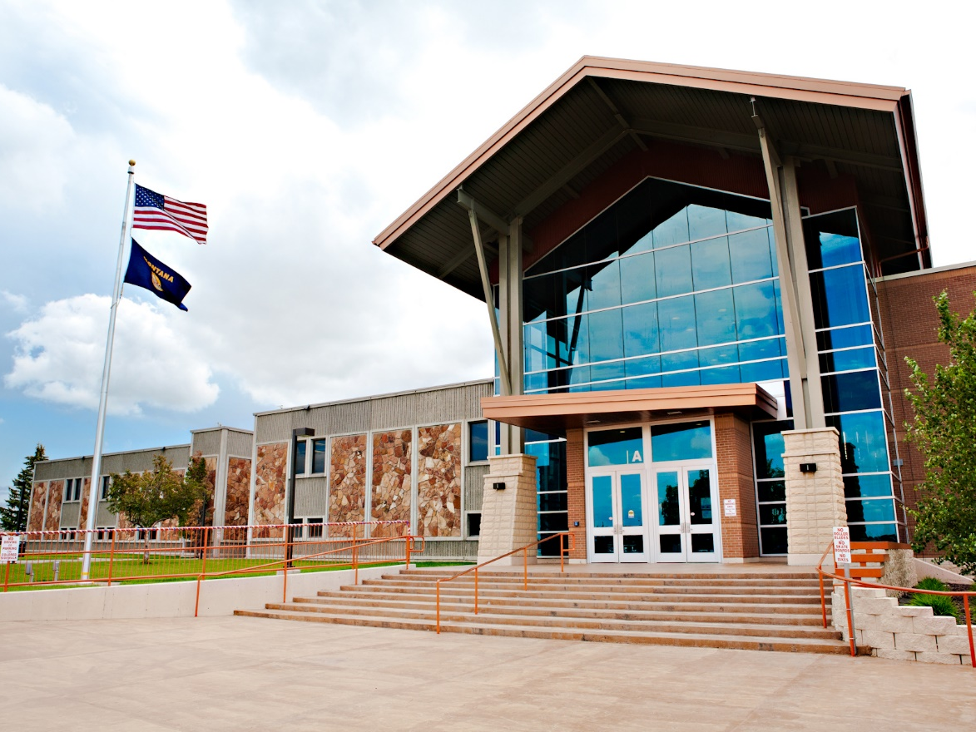
Who is GFC MSU and who do we serve?

Slide 3
Growth in Great Falls, MT
1980
56,725
2017
58,876
4%
4%
Growth since 1980

Slide 6
633 students enrolled from 40 high schools
4,272 total credit hours
FY19
FY19 Total Savings for dual enrollment students =
$803,900

Slide 7














Slide 8
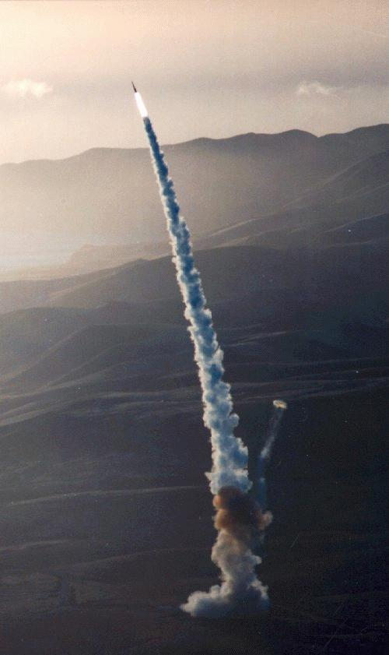
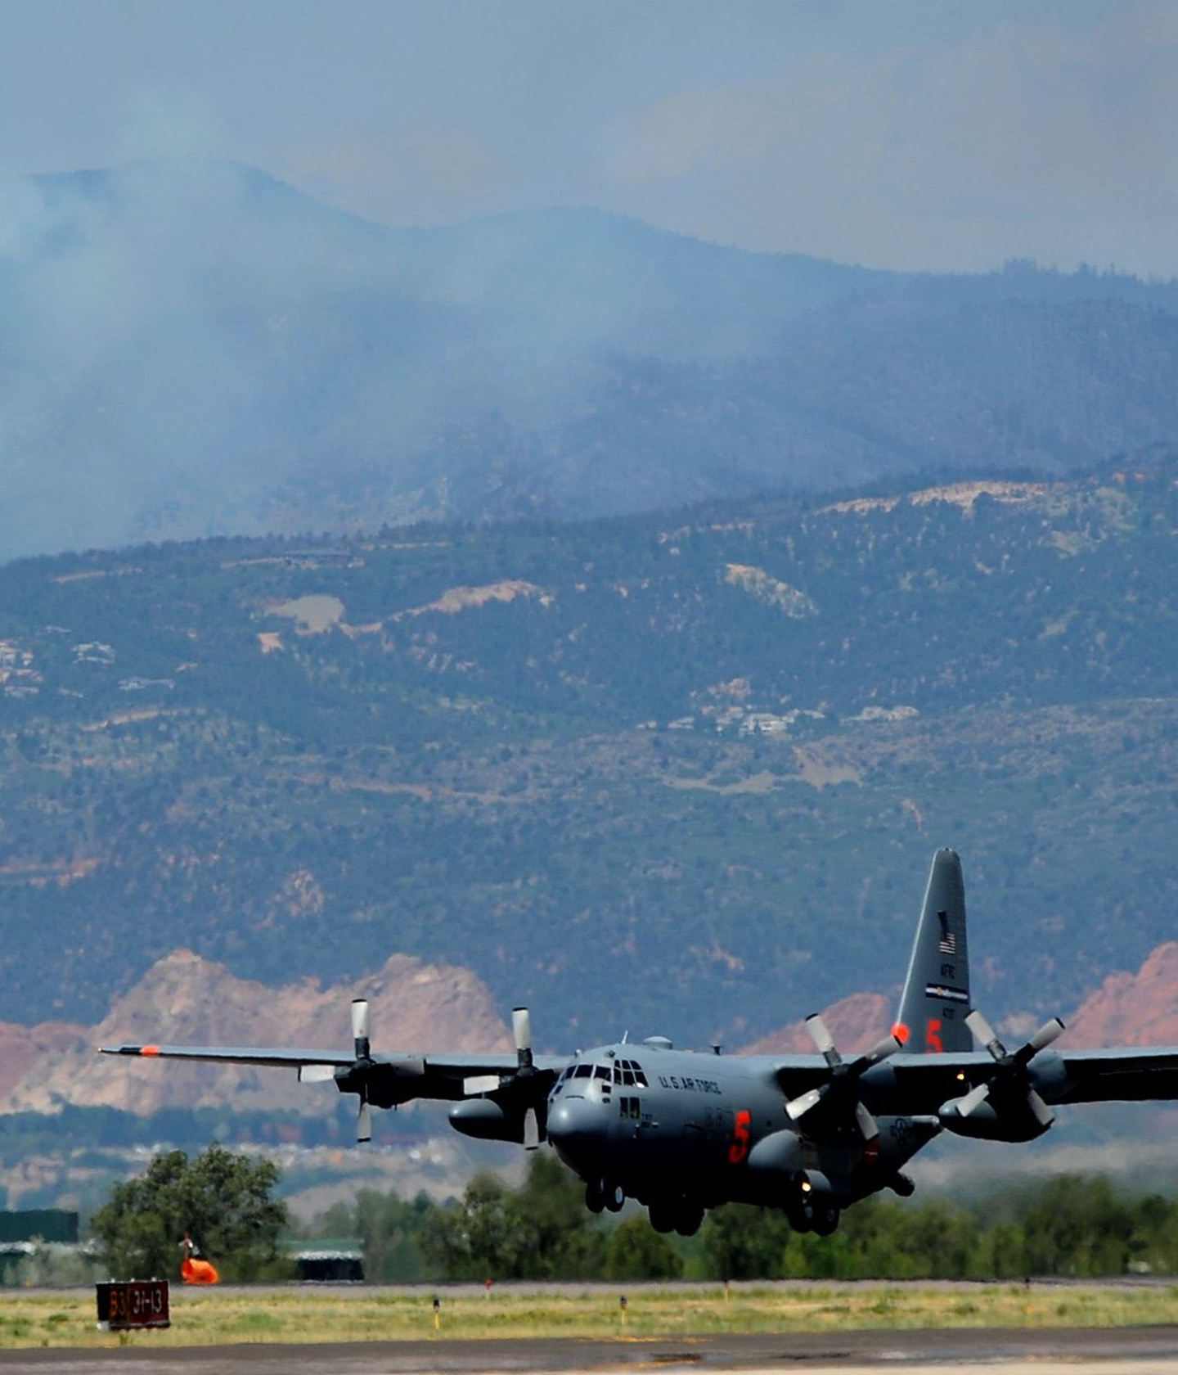
MILITARY TOWN

Slide 9



Slide 10
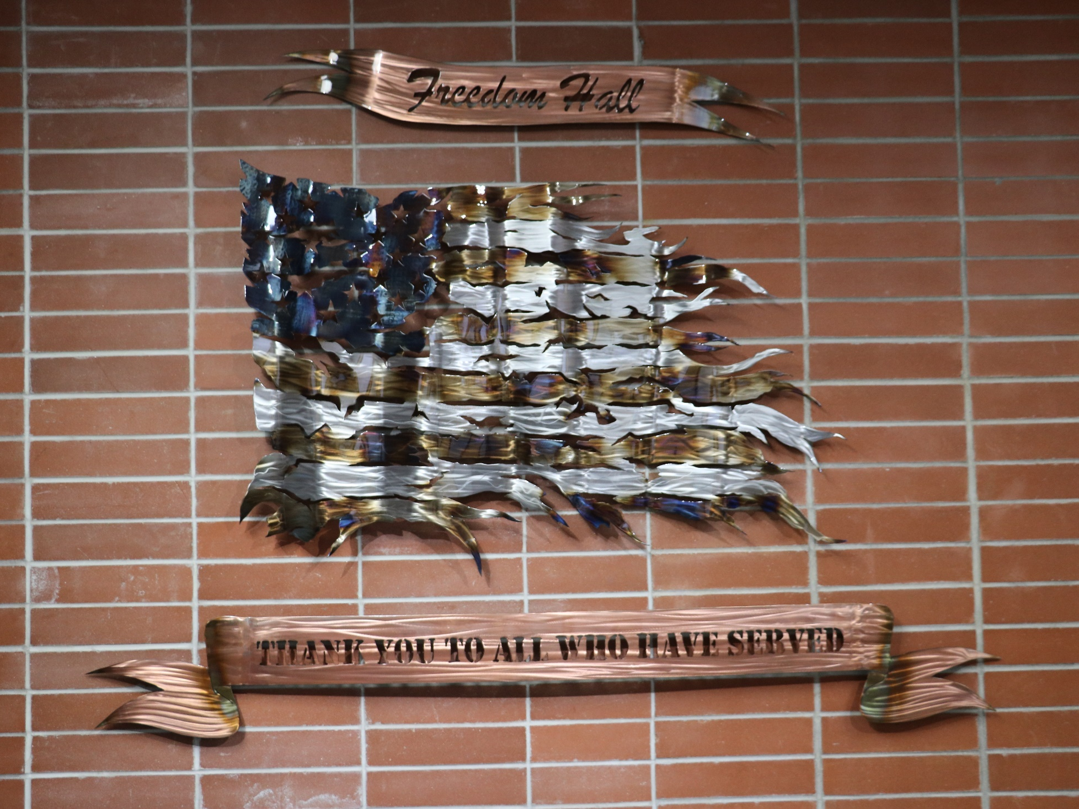

Slide 11
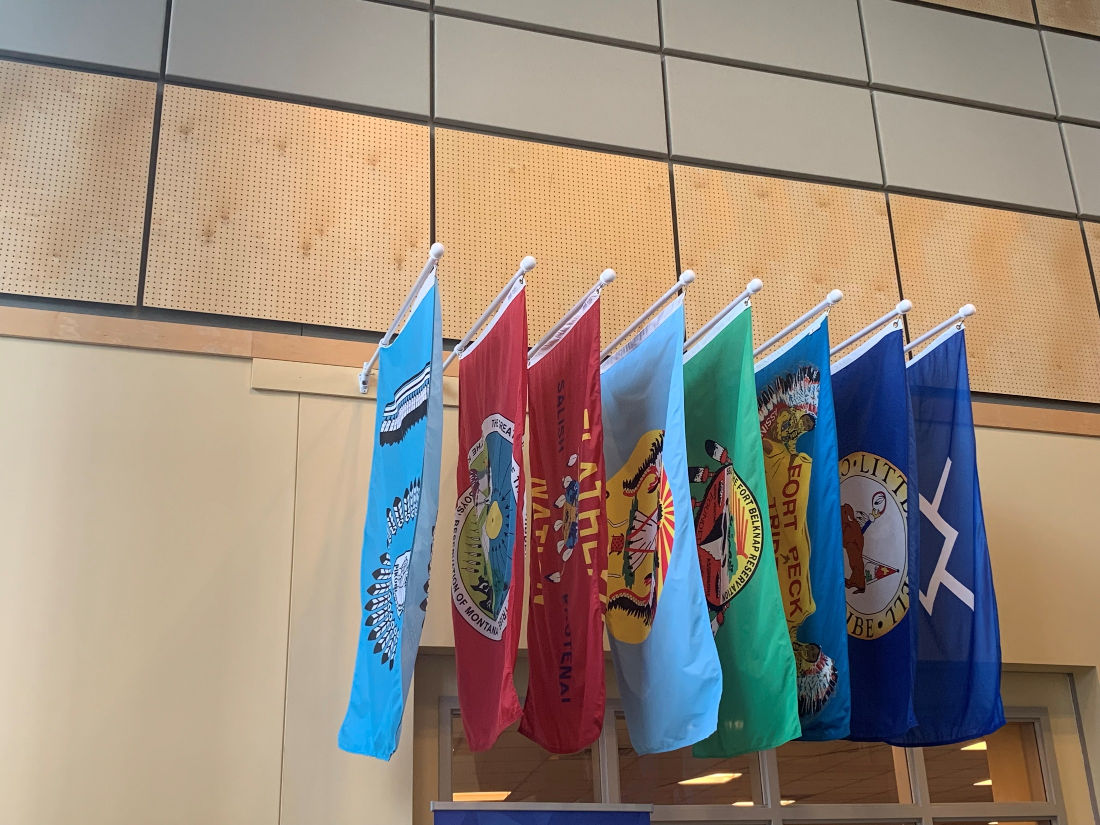
Celebrating Our Native American Students

Slide 12
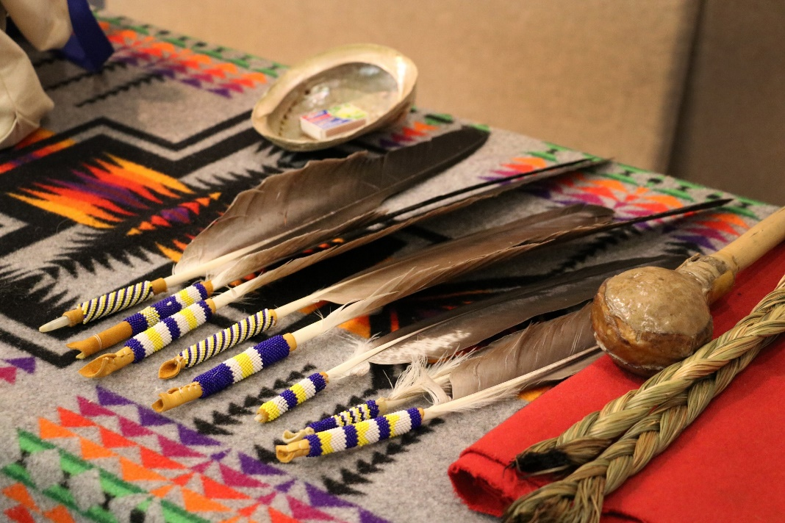
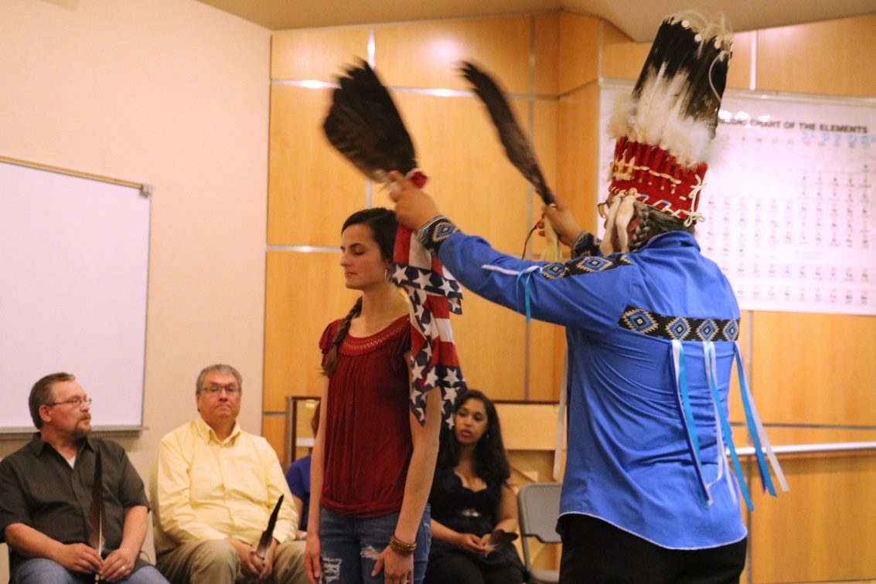
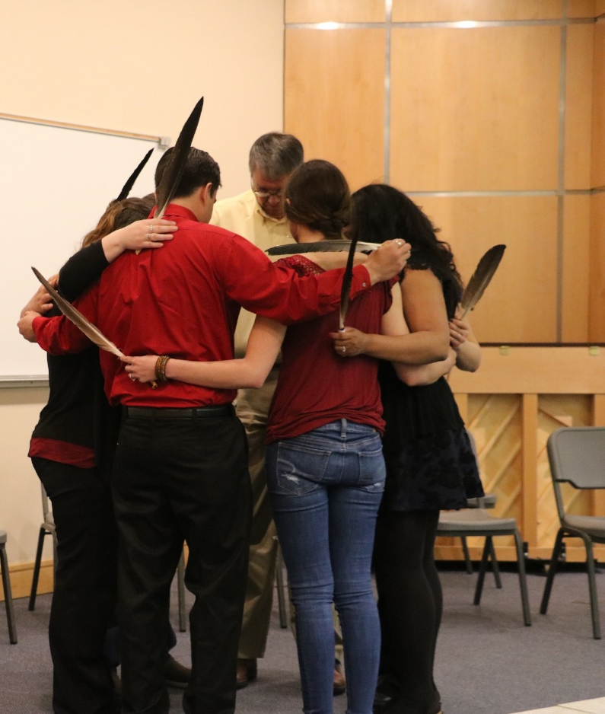
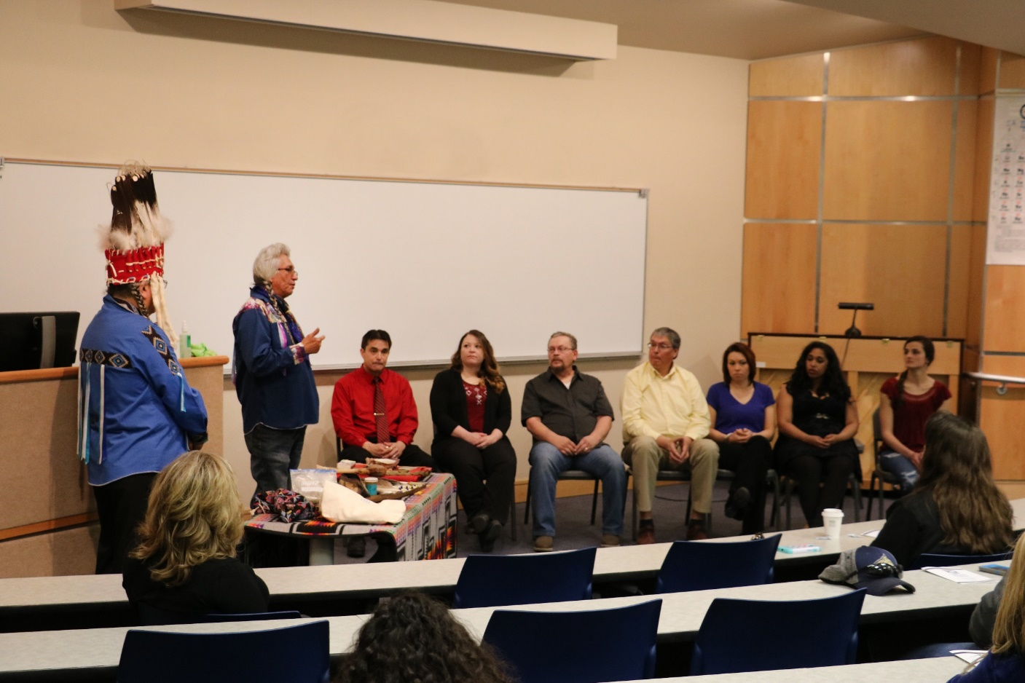

Slide 13
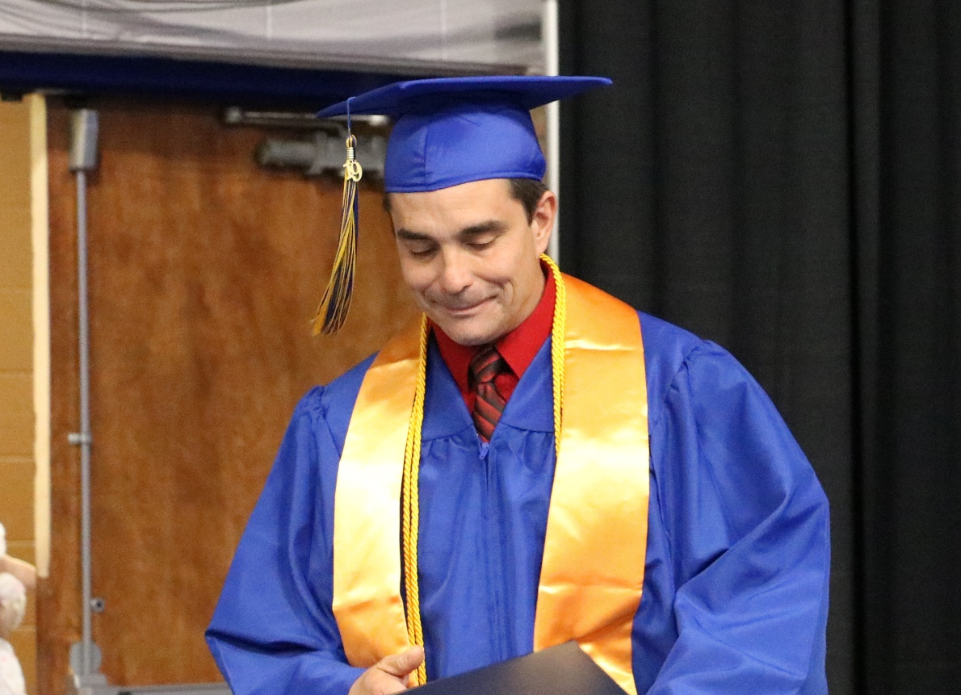
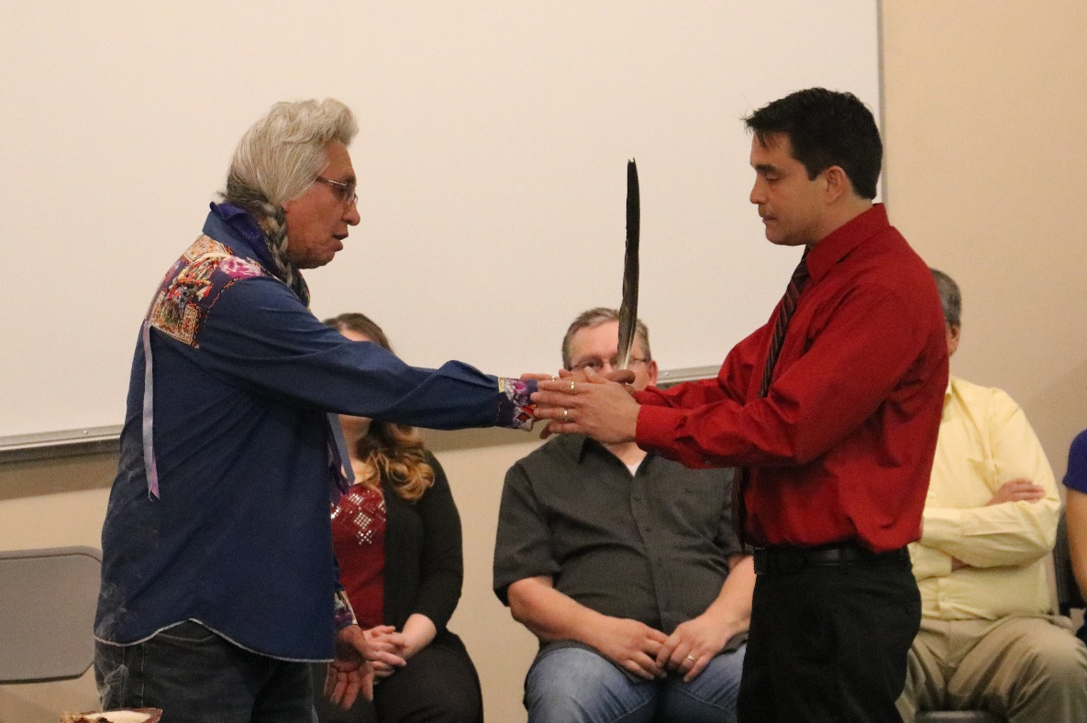
“Graduating from college is a great accomplishment.
I’ve worked very hard.”
“[Receiving an Eagle Feather]” is a connection to my culture and one of our highest honors”
-Shawn Arbuckle
Class of 2019

Slide 14
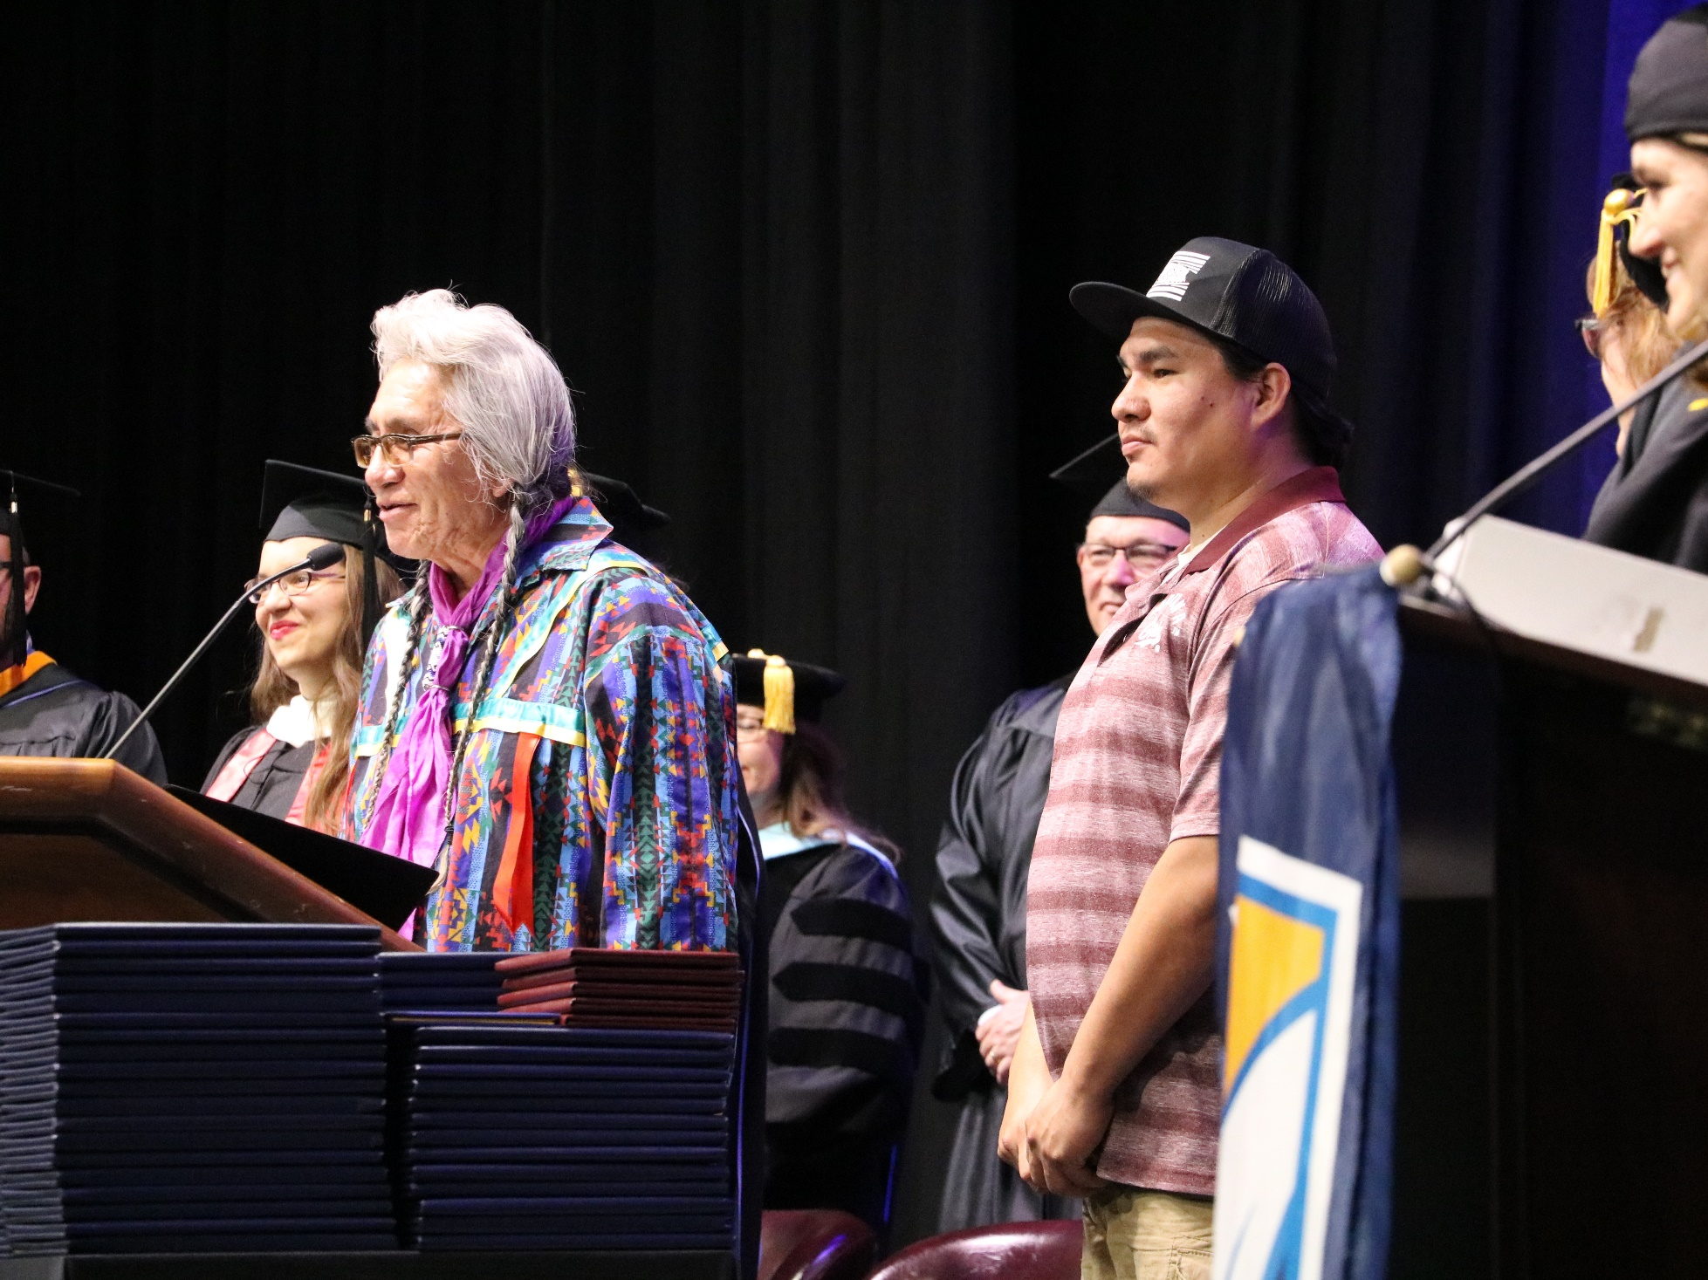

Slide 15
Academic Success Center
2018
2019
Comparison
Spring 2018 Total Visits | 1095 |  | Spring 2019 YTD Total Visits | 1607
Spring 2018 Unique Visitors | 104 |  | Spring 2019 YTD Unique Visitors | 227
Human Biology | 419
Math | 411
Testing Center
Testing Center 2019
Year | Professional Tests | Campus Tests | ALL
2019 | 554 | 3167 | 3928

Slide 16
42
42
Full-time faculty
4 Doctorate
27 Masters
6 Bachelors
5 Associates

Slide 17
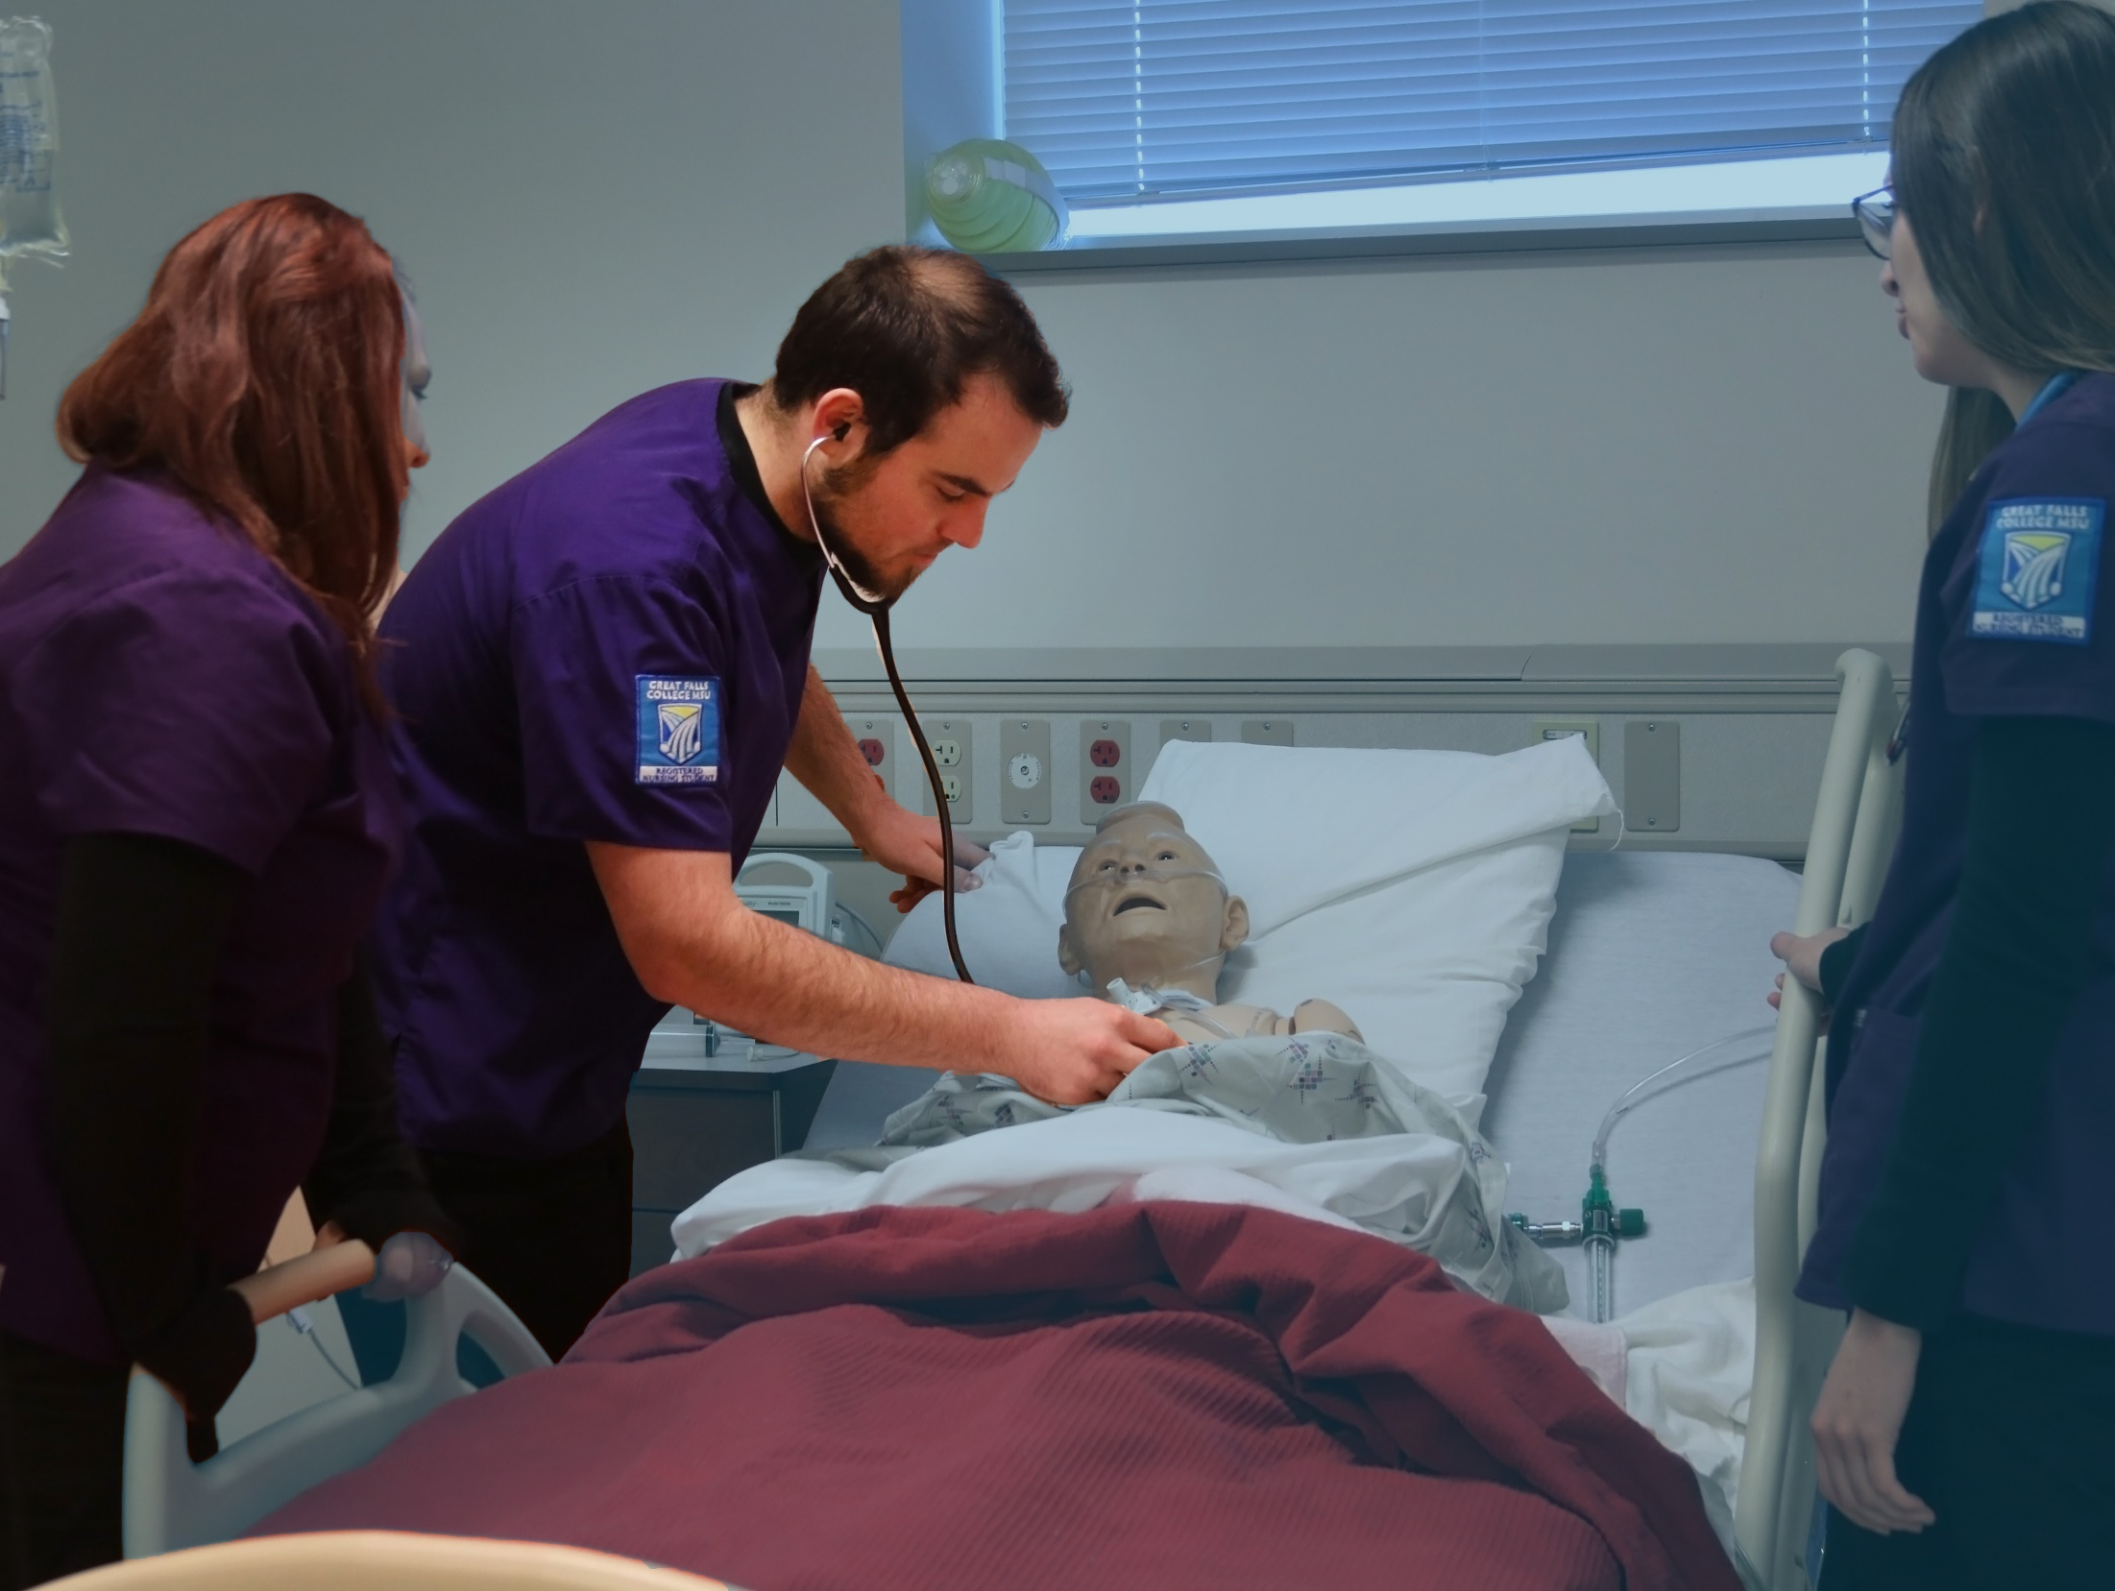
Health Care Center for the Region
Rectangle

Slide 18
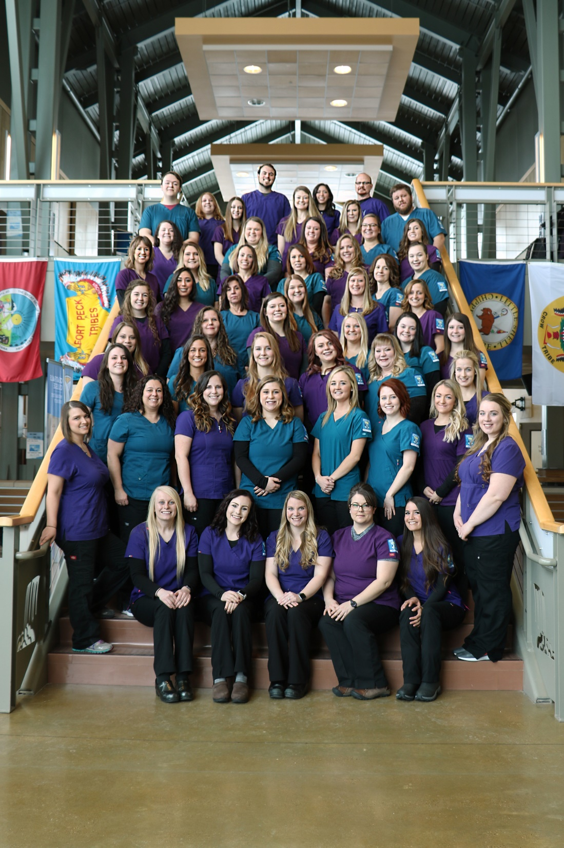
52 nursing students graduated in spring 2019

Slide 19
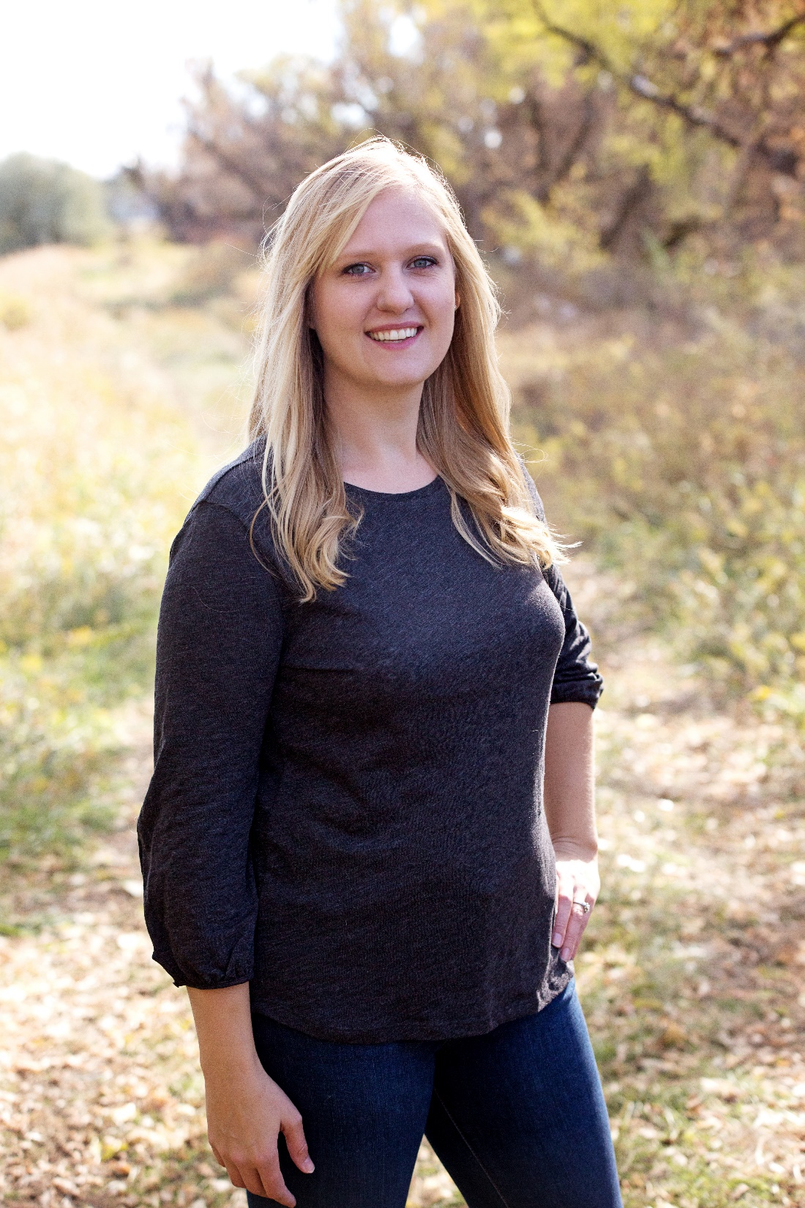
Dental Hygiene
Student of the Year
Stacy Orr
“She even recorded herself reading her textbook so she could listen to it while she was cooking or folding laundry”
-Julie Barnwell
Dental Hygiene Program Director

Slide 20


Slide 21
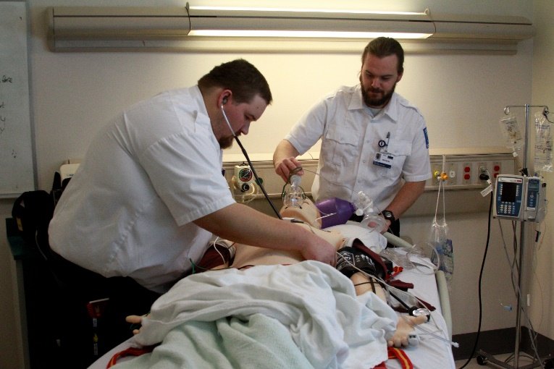
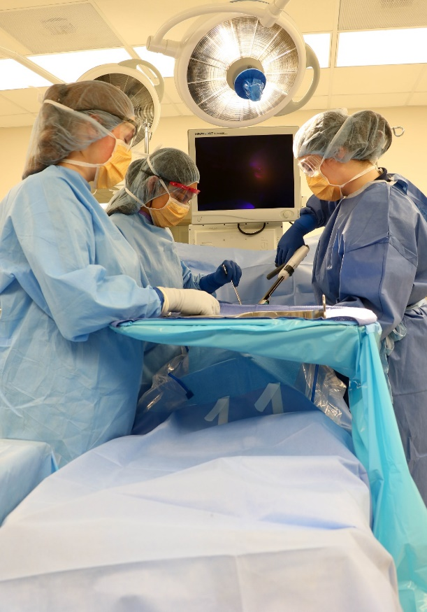
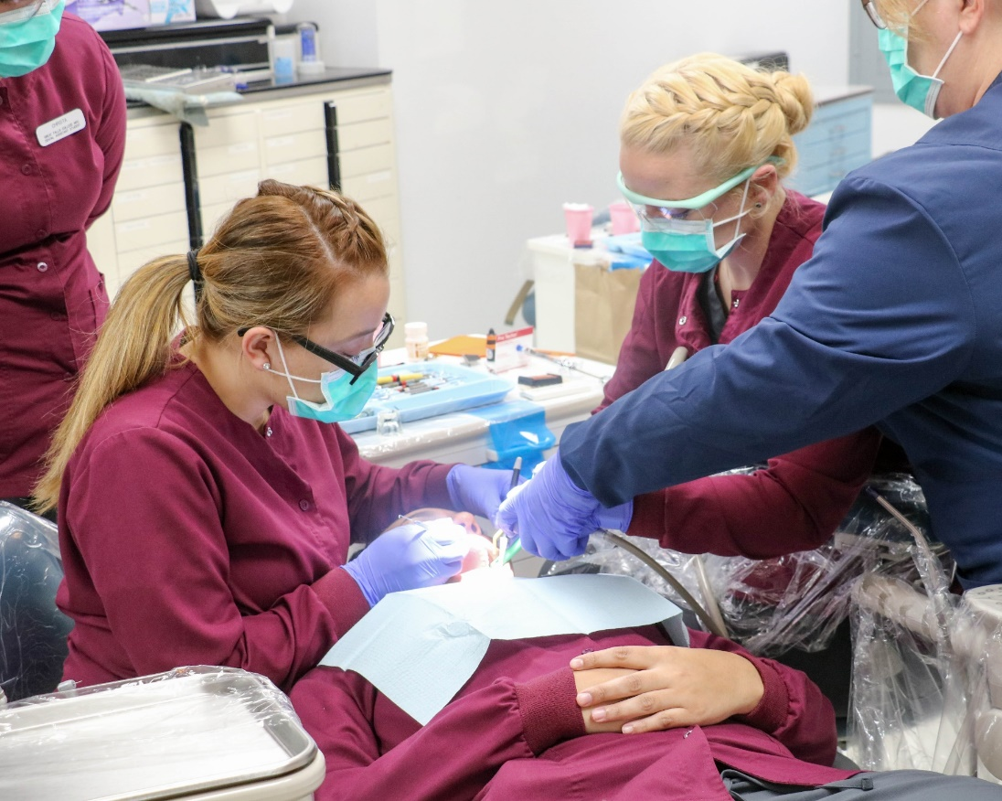
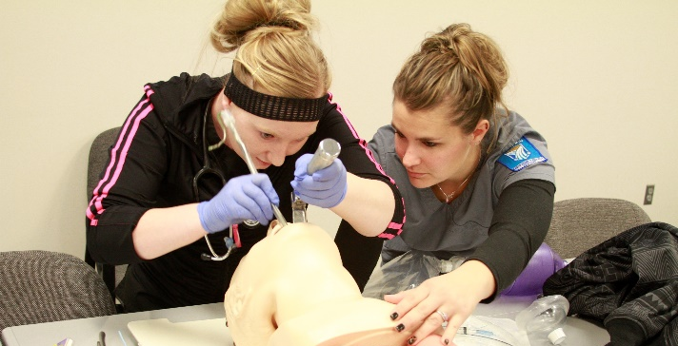
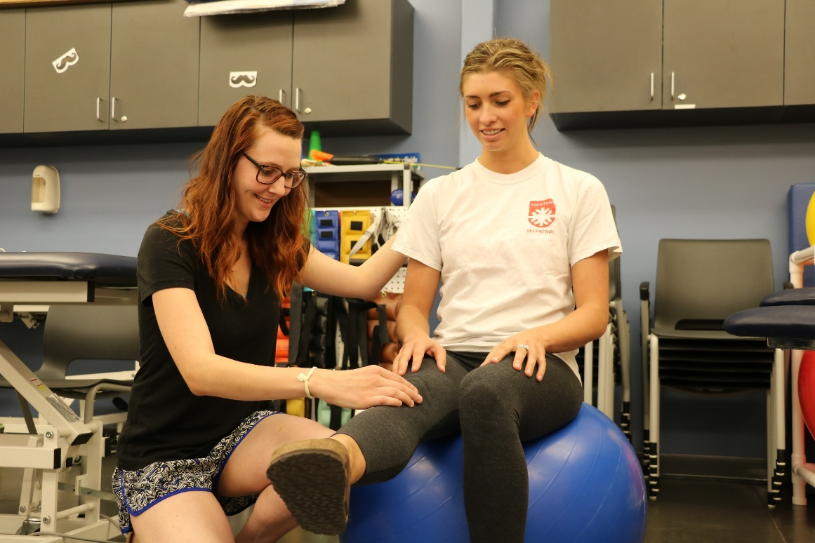
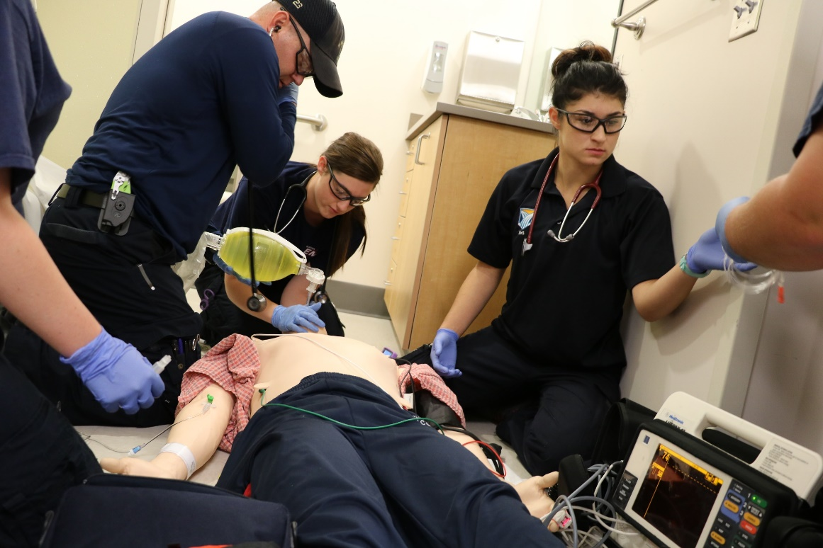

Slide 22
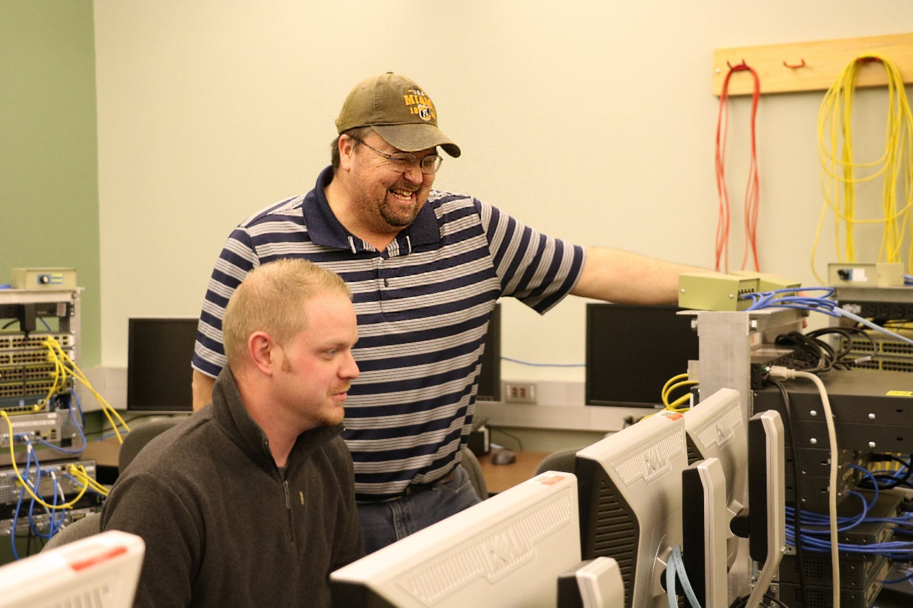
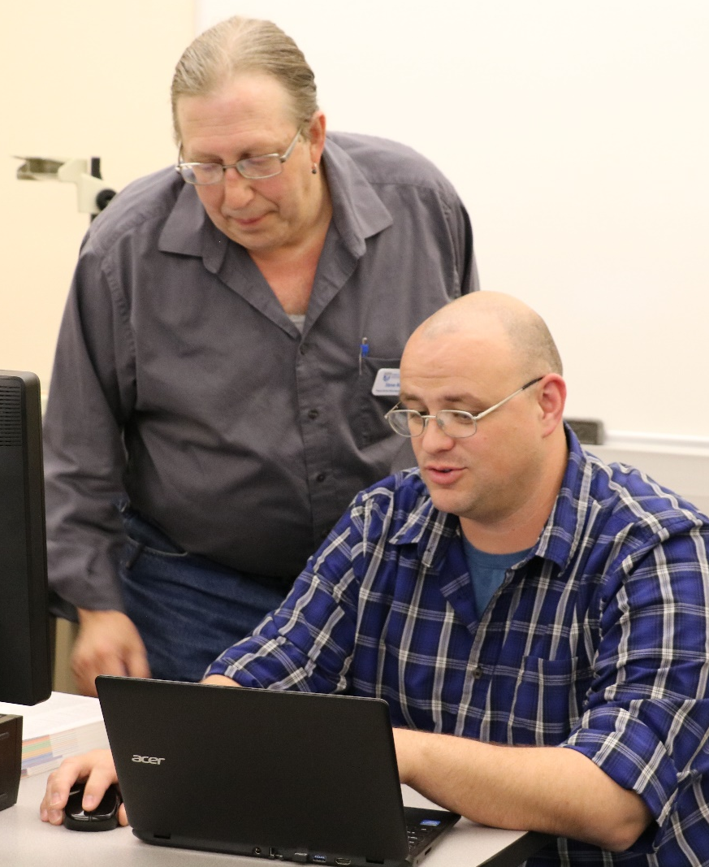
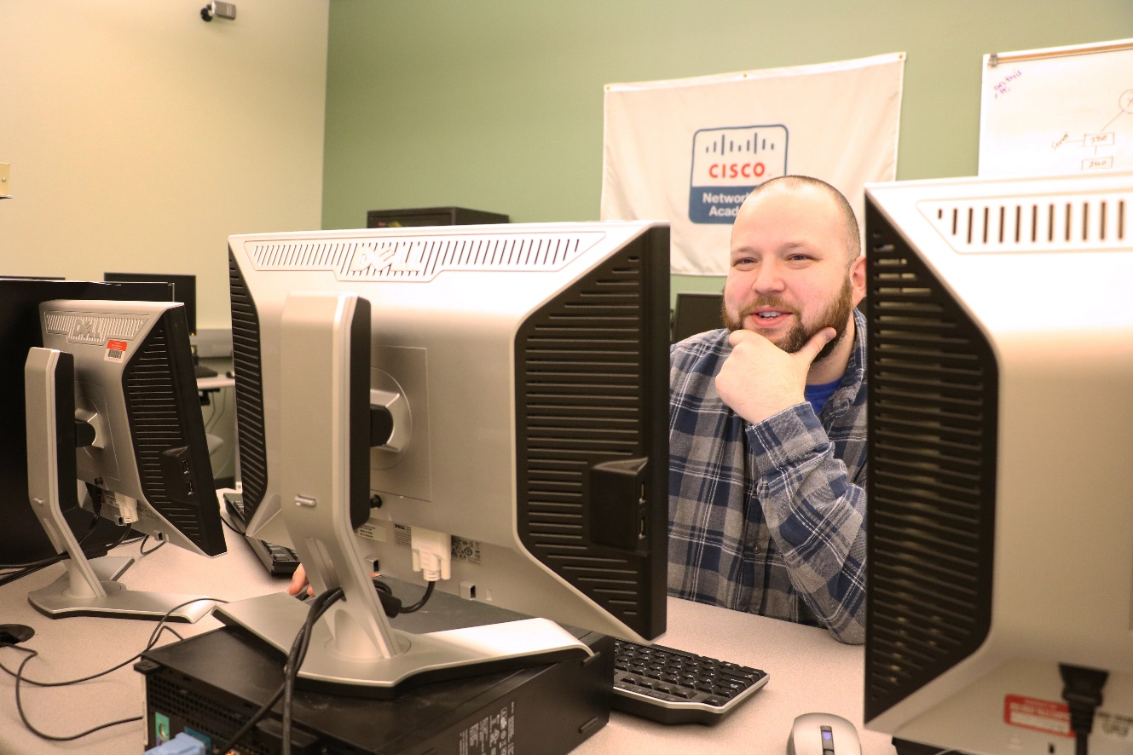
Computer Information Technology

Slide 23

Rectangle
New Cybersecurity Program
Fall 2019

Slide 24
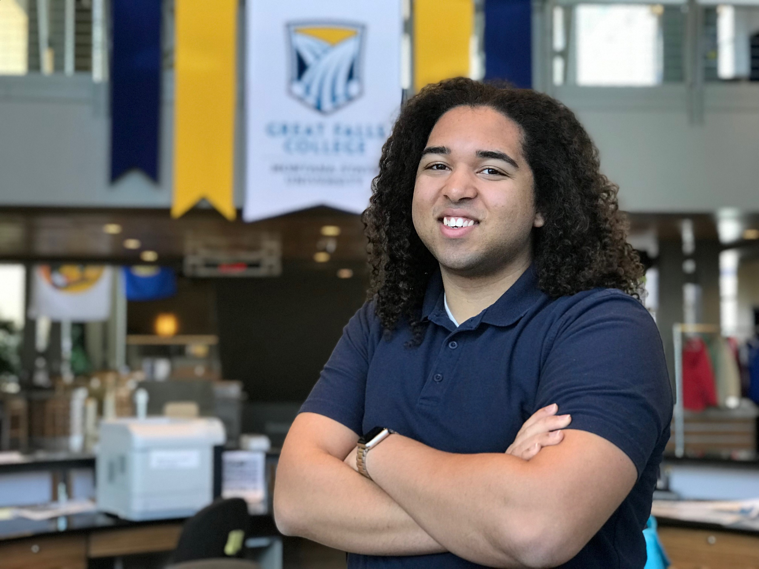
“By attending GFC MSU, I am able to turn what was once a hobby into an in-demand career.”
-Julius Scott
ASGFCMSU President
2019 Newman Civic Fellow

Slide 25
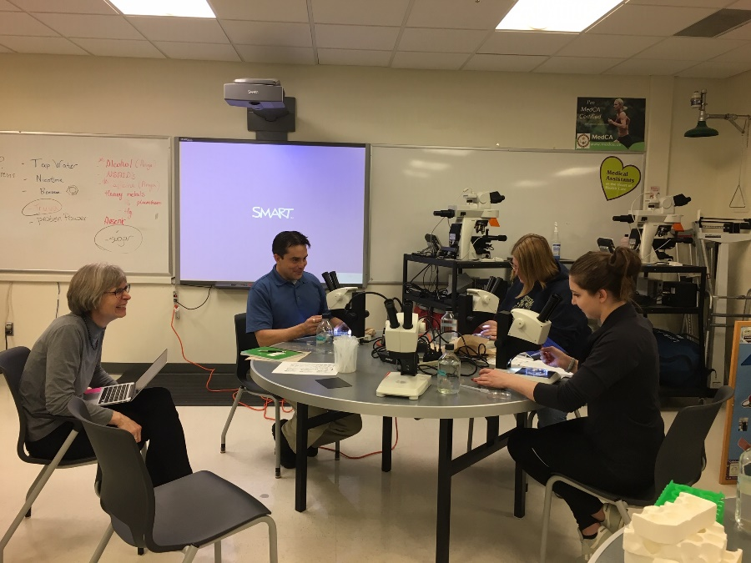
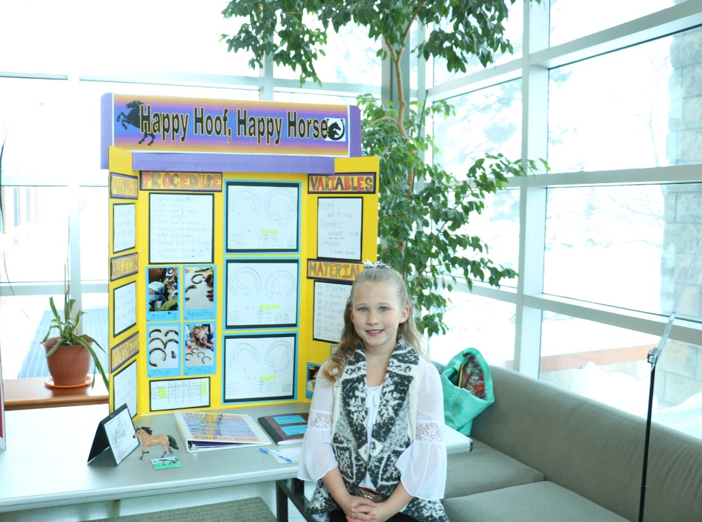
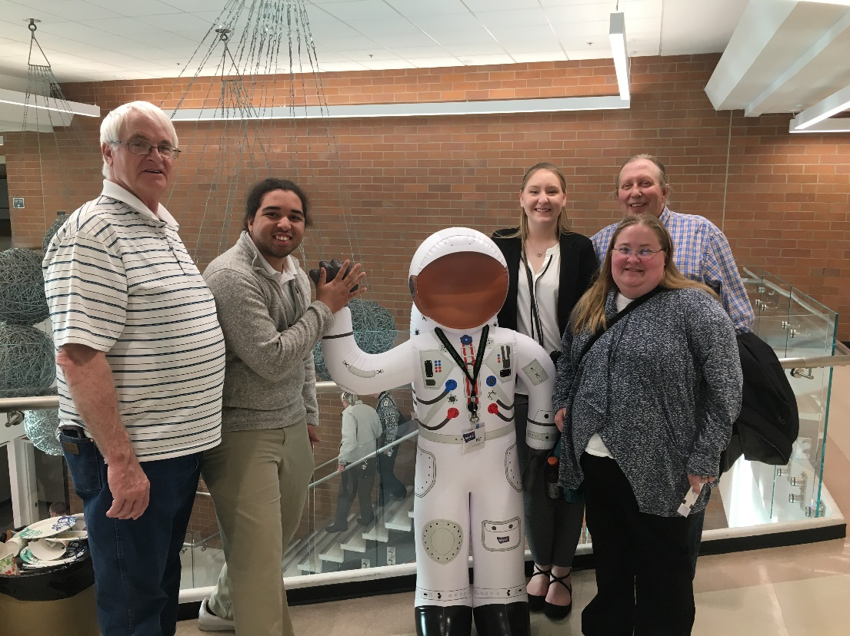
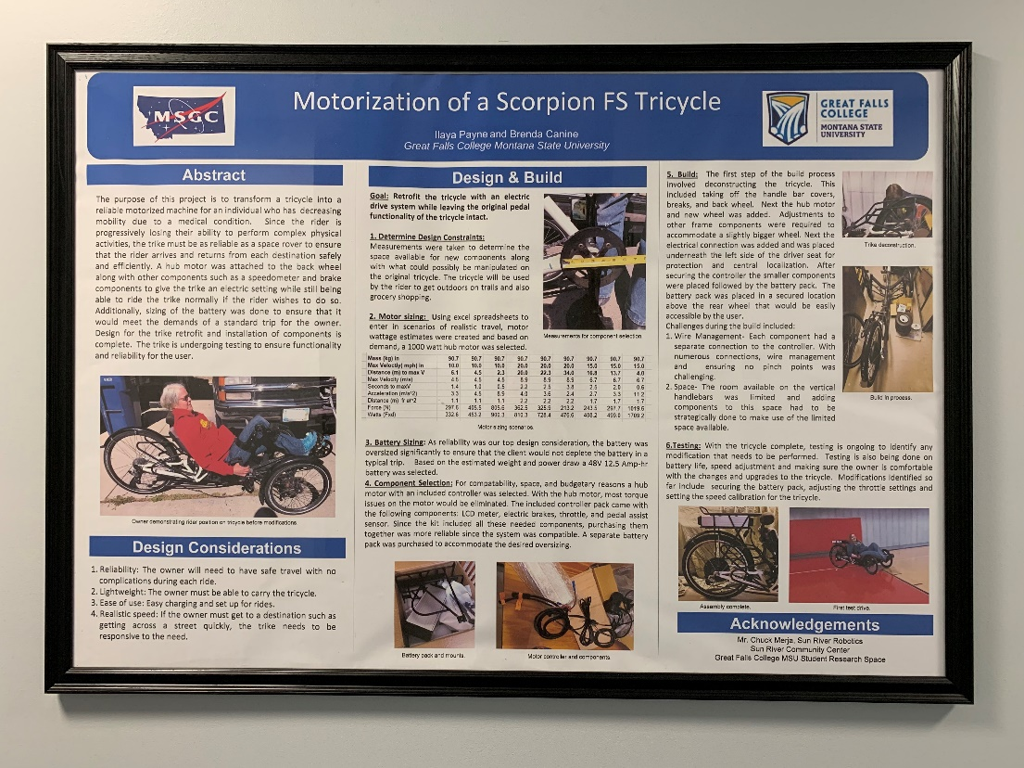

Slide 26
Students
What do you like about the 8-Week Advantage?
Top 5 Themes | Spring 2019
Shortened time to course completion | “It’s right to the point and is quick.”
Ability to take more courses | “I like that I can do a lot more classes in a semester now that we have 8-week blocks. I am able to attend full time now, whereas before I could only do part-time, due to being a mother and having a full time job.”
Focus on fewer courses at a time | “I like that I can focus on a few classes at a time, rather than a large amount all at once. This allows me to keep my full-time job, and be a full-time student. I have become a better student since introduced to the 8-week blocks.”
Learning | “I am able to focus on one or two classes at a time making it easier to remember everything I’ve learned.”
Motivation | “The shorter length of the classes keeps me from getting exhausted from repetition.”
Flexible with work | “I love how it is only 8 weeks. This allowed me to fully focus on each individual class and work full time. I’m thankful that 8 week blocks [are] available to me!”

Slide 27
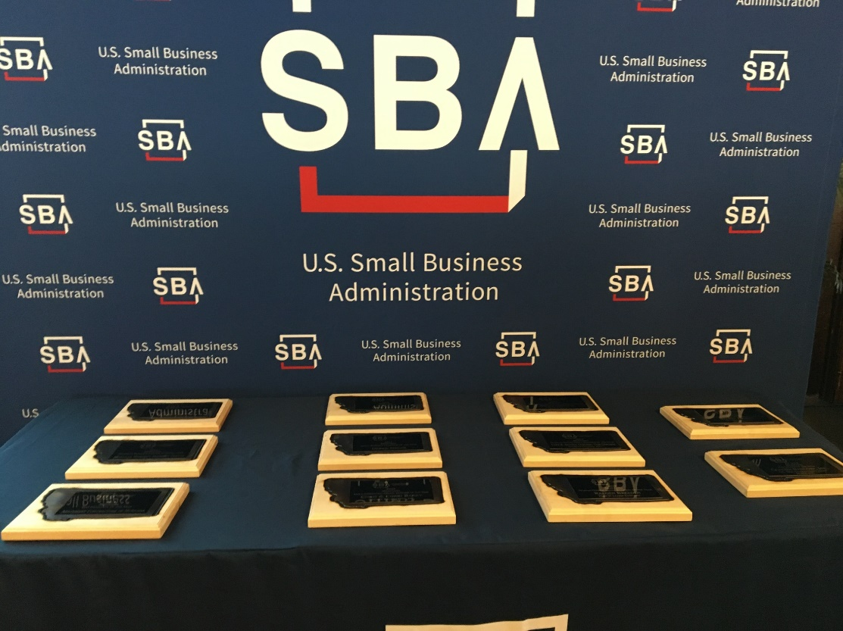
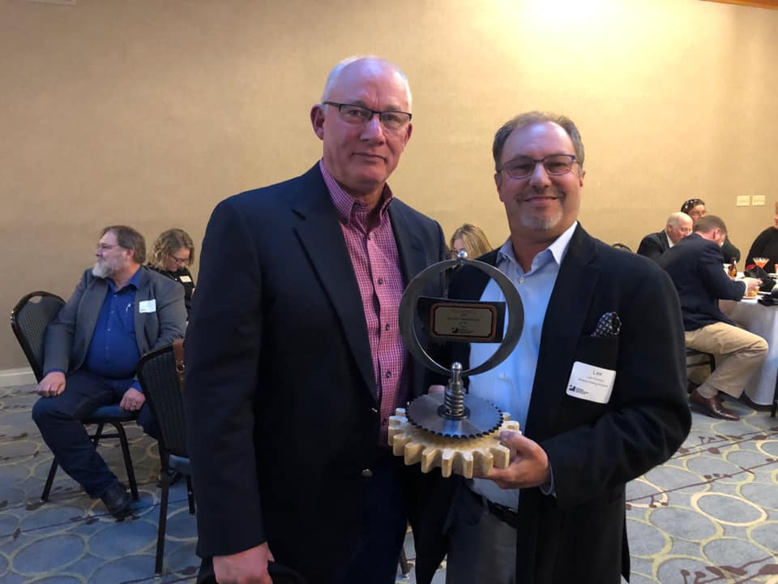
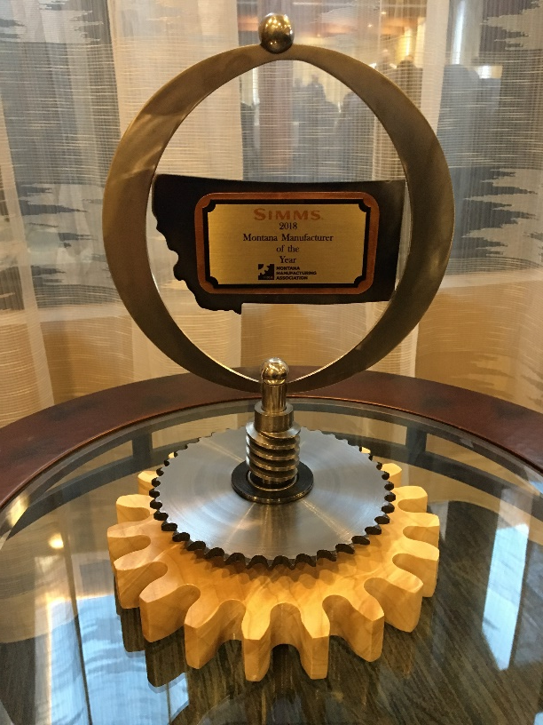

Slide 28
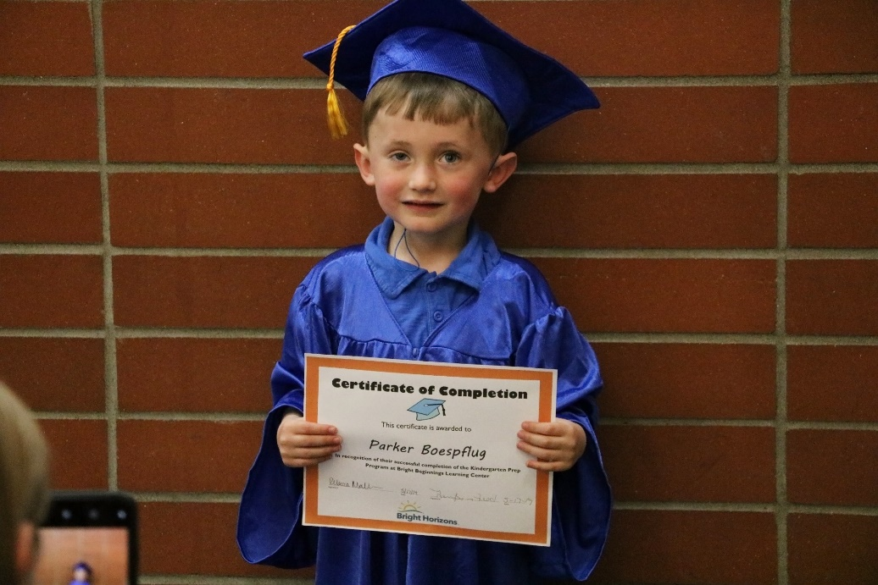

Bright Horizons at Bright Beginnings
April 2019
Enrollment Overview
Students, Faculty & Staff
82 FTE
Community
38.7%
62.1%

Slide 29


Slide 30
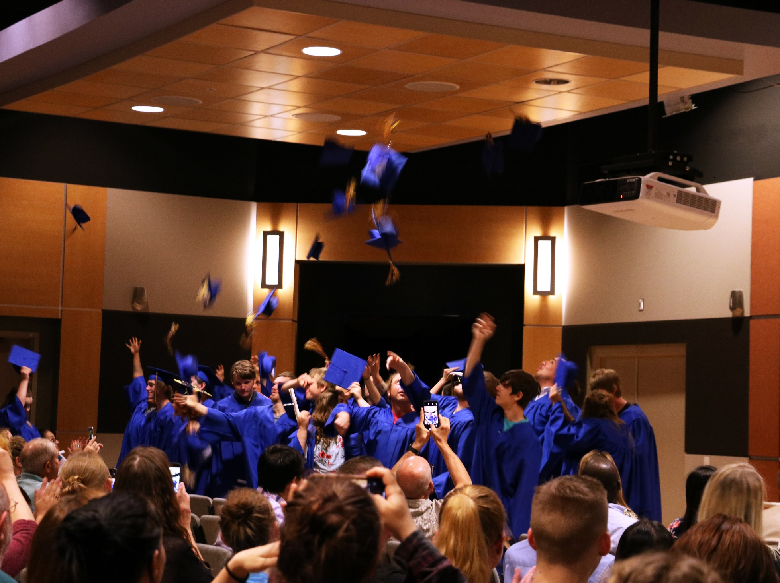


Slide 31
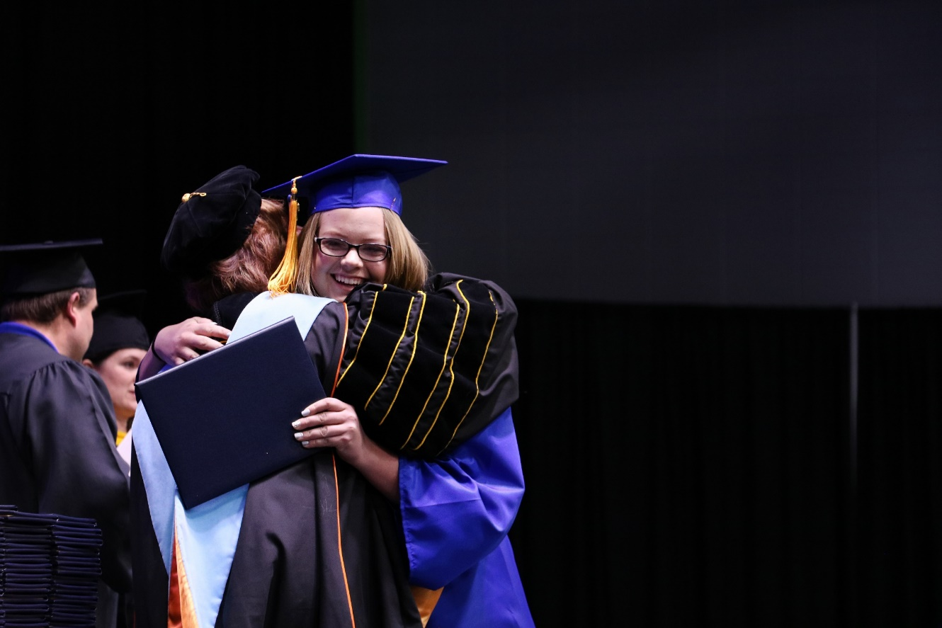
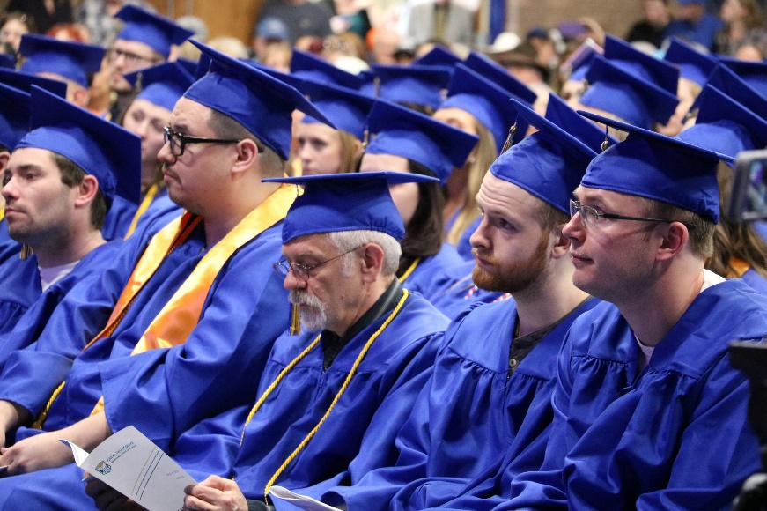
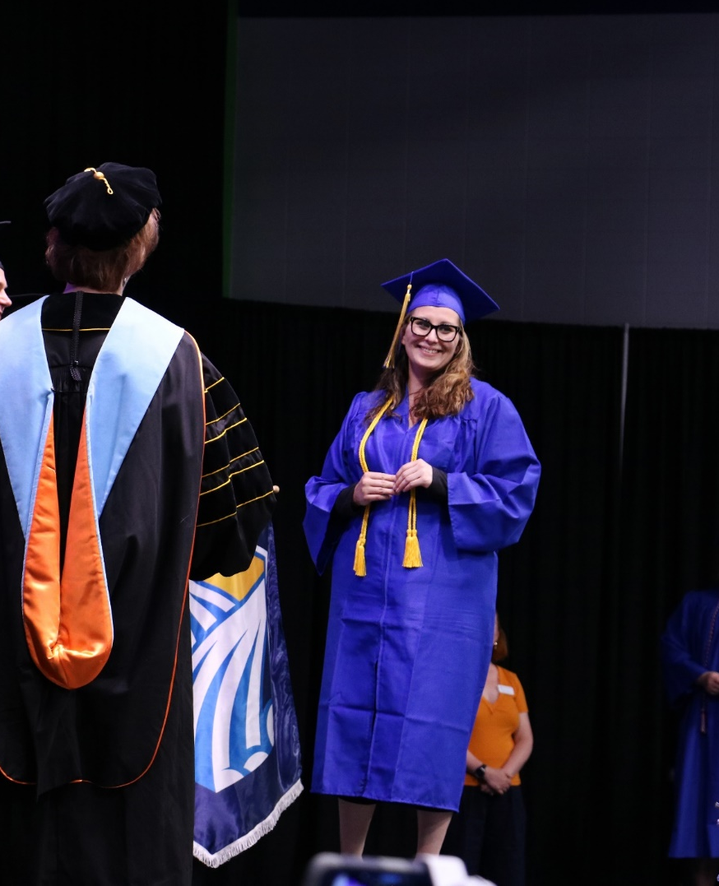
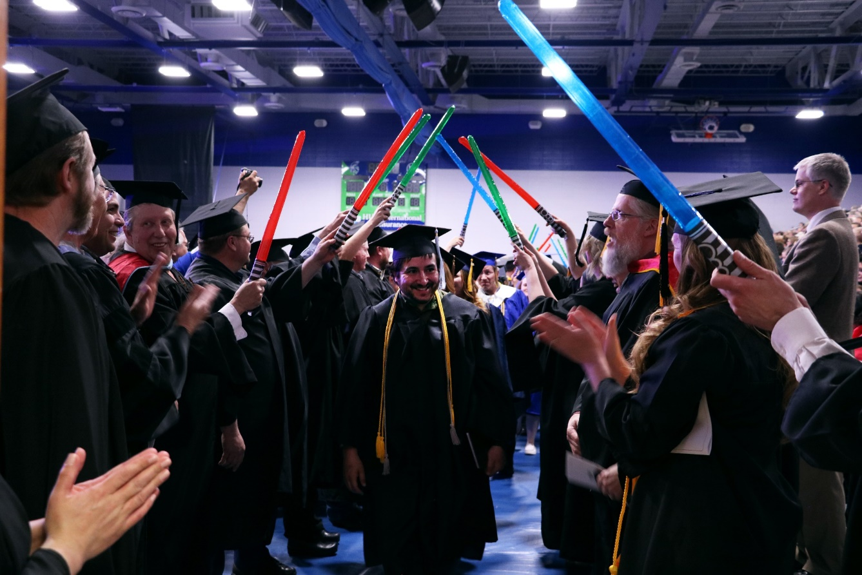

Slide 32
