Slide 1



MUS 2-year Education Review
Presented to the 2-year Education Restructuring Commission
v6
November 2019
Office of the Commissioner of Higher Education

Slide 2
MUS 2-year Review
MUS 2-year Review
TOPICS
CTE Profile: What is Career & Technical Education (CTE)?
Definition | Enrollment | Degrees/Certificates | Trends in Enrollment & Degree Production | Career Pathways
Cost of CTE: What does it cost to educate a student?
Educational Revenue per Student Comparisons | Peer Data | National Trends
MUS CTE Initiatives: 2-year education in the MUS
Recent History | Tuition & Fees | Program Specific Focus (Nursing)

Slide 3
What is Career & Technical Education (CTE)?
CTE Profile
What is Career & Technical Education (CTE)?
CTE represents all occupationally-oriented education and training provided by 2-year colleges and programs.
Programs and courses are designated as CTE through a taxonomy provided by the federal government (i.e. Classification of Instructional Programs, CIP codes).

Slide 4
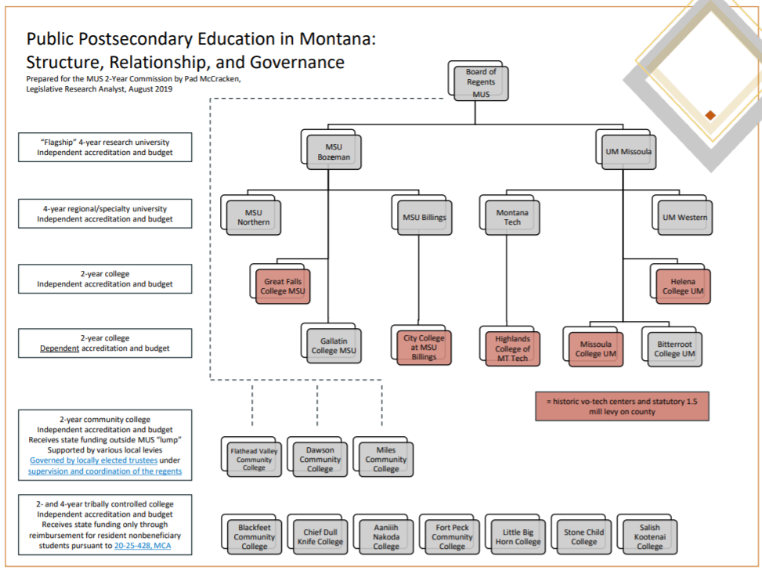
Public Postsecondary Education in Montana: Structure, Relationship, and Governance
CTE Profile

Slide 5
Two-Year Colleges Mission
CTE Profile
Mission
Two-year Colleges
The Two-year Colleges in the MUS will possess a comprehensive community college mission, committed to providing transfer education through the associates degree, workforce development including certificates and applied science degrees, developmental and adult basic education, lifelong learning opportunities, and community development. These institutions will provide affordable, open access admissions that will allow opportunities for all Montanan’s to access higher education. (source: MUS Comprehensive Two-year Education Mission/Vision)
Two-year Colleges will pursue efficiencies by integrating operations with Four-year and Flagship campuses whenever and wherever possible.
Great Falls College | Helena College | Gallatin College | City College Missoula College | Bitterroot College | Highlands College

Slide 6
MUS 2-year Education/CTE Providers
CTE Profile
MUS 2-year Education/CTE Providers
Montana University System
Stand Alone 2-year
Integrated 2-year
Independent accreditation, budget, operations, facilities, and services
Dependent accreditation, budget, operations, facilities, and services
Great Falls College MSU
Missoula College UM
Helena College UM
Bitterroot College UM
Highlands College of MT Tech
City College at MSUB
Gallatin College MSU
UM Western, 2-year Programs
MSU Northern, 2-year Programs

Slide 7
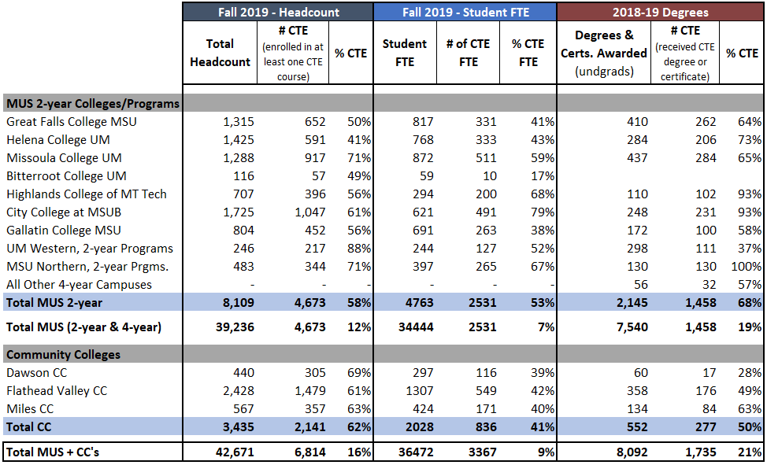
MUS 2-year Colleges & Programs – CTE Concentration
CTE Profile
MUS 2-year Colleges & Programs – CTE Concentration

Slide 8
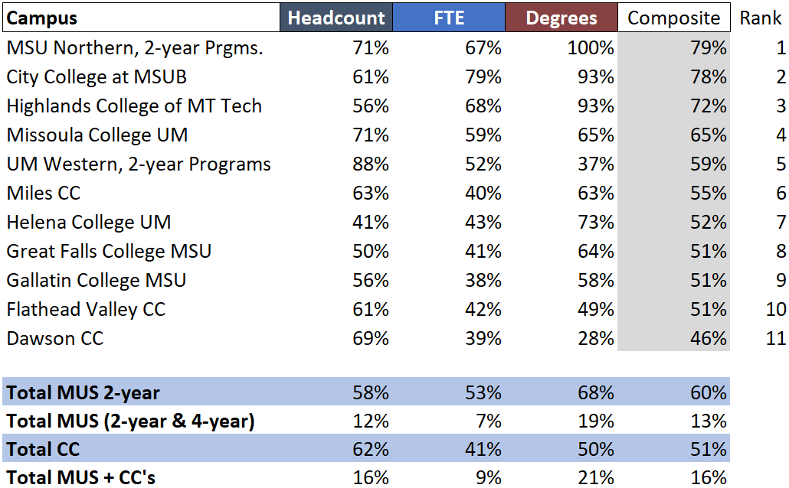
MUS 2-year Colleges & Programs – CTE Concentration Ranked
CTE Profile
MUS 2-year Colleges & Programs – CTE Concentration Ranked

Slide 9
MUS 2-year College & CC Enrollment
CTE Profile

Slide 10
MUS 2-year College & CC Enrollment, continued
CTE Profile

Slide 11
MUS 2-year Enrollment History - Headcount
CTE Profile
CC's not included

Slide 12
MUS 2-year Degrees & Certificates Awarded, 2018-2019
CTE Profile
Total = 2,149
#CTE = 1,454
%CTE = 68%

Slide 13
MUS 2-year Degrees & Certificates Awarded
CTE Profile

Slide 14
MUS 2-year Degrees & Certificates Awarded by Program Type
CTE Profile
CC's not included

Slide 15
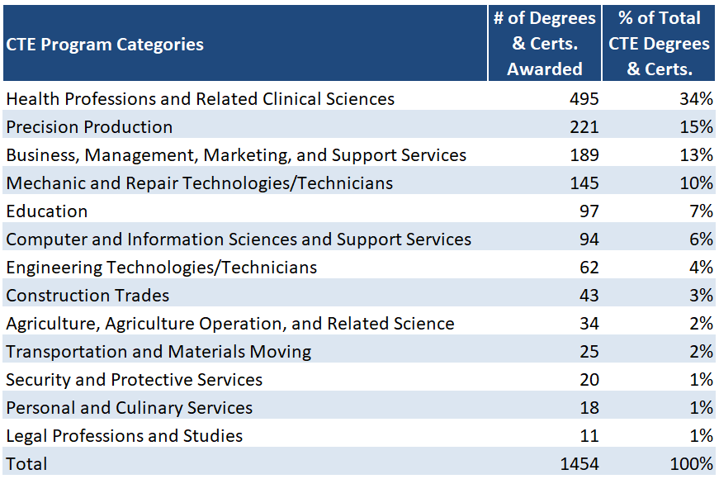
MUS 2-year CTE Degrees & Certificates Awarded, 2018-19
CTE Profile
MUS 2-year CTE Degrees & Certificates Awarded, 2018-19
CC's not included

Slide 16
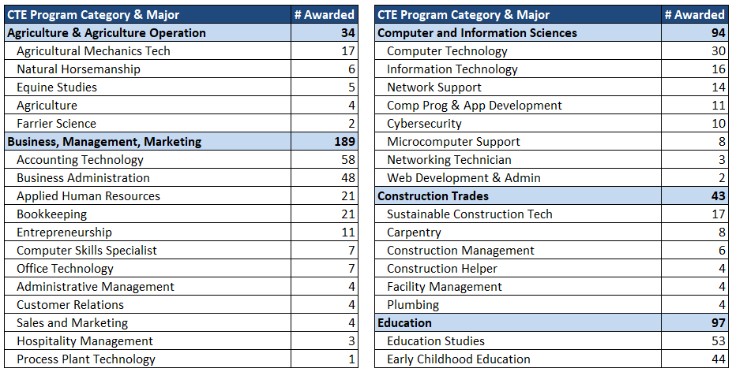
MUS 2-year CTE Degrees & Certificates Awarded by Major, 2018-19
CTE Profile
MUS 2-year CTE Degrees & Certificates Awarded by Major, 2018-19
CC's not included

Slide 17
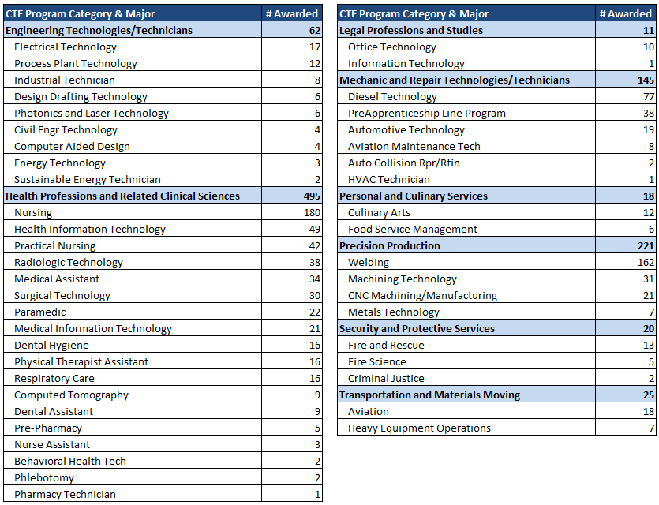
MUS CTE Degrees & Certificates Awarded by Major, 2018-19 (continued)
CTE Profile
MUS CTE Degrees & Certificates Awarded by Major, 2018-19 (continued)

Slide 18
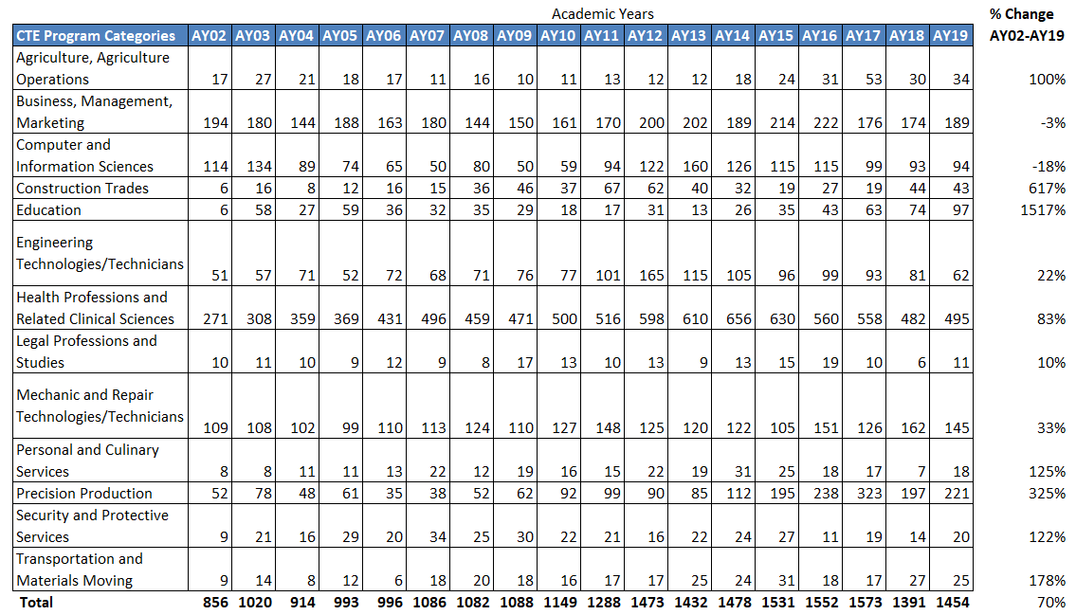
MUS CTE Degrees & Certificates Awarded by Academic Year and CTE Program Category
CTE Profile
MUS 2-year CTE Degrees & Certificates Awarded
CC's not included

Slide 19
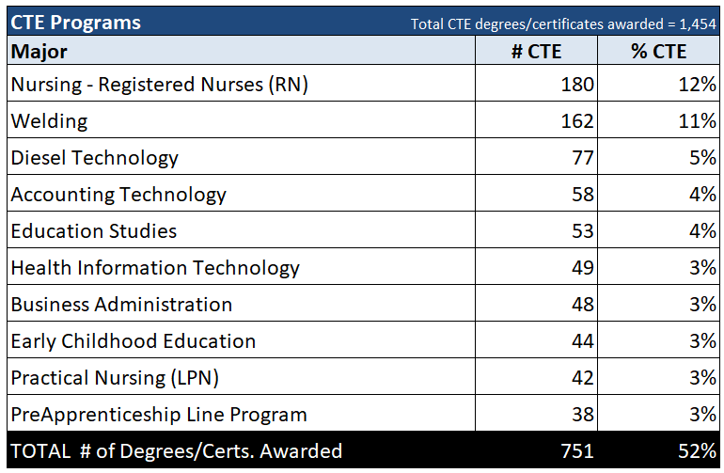
Top 10 MUS CTE Degrees & Certificates Awarded, 2018-19
CTE Profile
Top 10 MUS CTE Degrees & Certificates Awarded, 2018-19
CC's not included

Slide 20
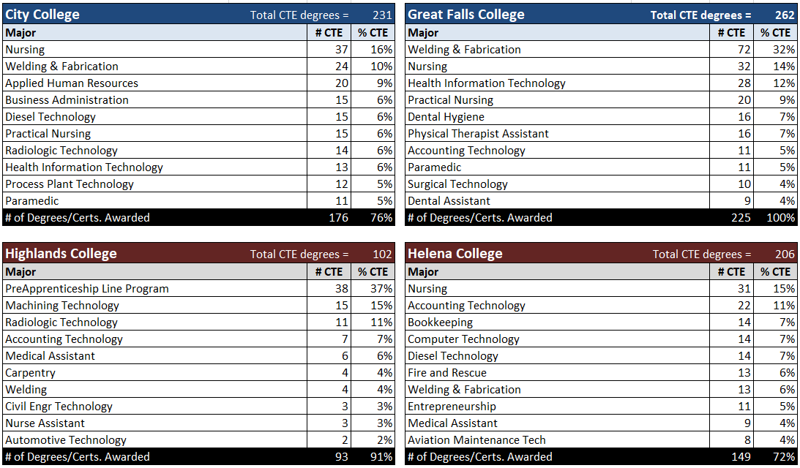
Top 10 MUS CTE Degrees & Certificates Awarded by Campus, 2018-19
CTE Profile
Top 10 MUS CTE Degrees & Certificates Awarded by Campus, 2018-19

Slide 21
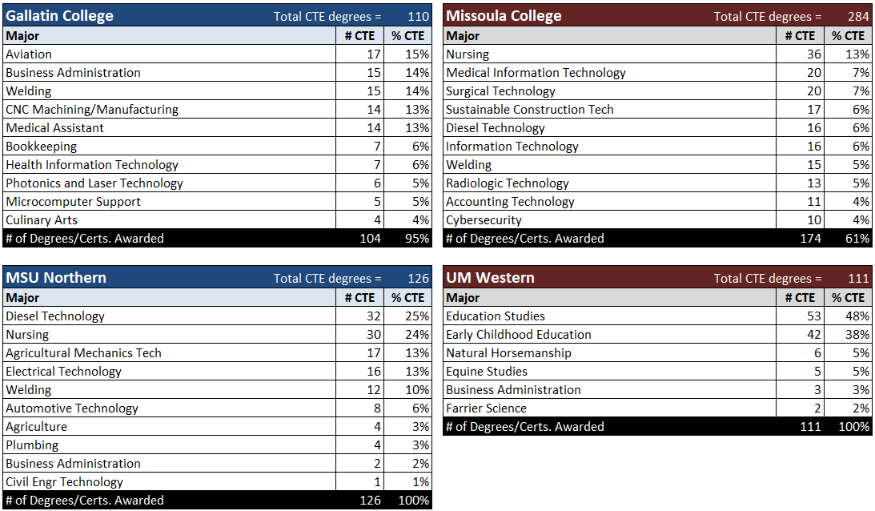
Top 10 MUS CTE Degrees & Certificates Awarded by Campus, 2018-19- continued
CTE Profile
Top 10 MUS CTE Degrees & Certificates Awarded by Campus, 2018-19
CC's not included

Slide 22

Montana Career Pathways website
CTE Profile

Slide 23
Current Unrestricted Revenue -- Operating Budget, FY19
COST

Slide 24
Current Unrestricted Revenue per Student FTE, 2018-19
COST
Peer 1 = public 2-year colleges without local funding, <2500 students, all states, 2016-17, (aggregate values represented above)
Peer 2 = public 2-year colleges with local funding, <2500 students, all states, 2016-17, (aggregate values represented above)

Slide 25
Current Unrestricted Revenue per Student FTE, 2018-19 - continued
COST
Peers: public 2-year colleges, <2500 students, all states, 2016-17
Carnegie Categories: (aggregate values represented above)
High Transfer: fewer than 30% of awards (degrees and certificates) in career & technical programs; N = 107; DCC
Mixed Transfer, Vocational: 30-50% of awards (degrees and certificates) in career & technical programs; N = 165; FVCC
High Vocational: more than 50% of awards (degrees and certificates) in career & technical programs; N = 127; HLN, GFC, MCC

Slide 26
Current Unrestricted Revenue per Student FTE, FY19
COST

Slide 27
2-year Education – System Initiatives – 15-Year History
MUS Initiatives
2-year Education – System Initiatives
15 Year History
2005 – BOR establishes Workforce & 2-year Education Committee
2007 – $5M OTO for equipment at 2-year colleges and programs
2007 – $1.5M OTO to improve transferability, Common Course Numbering
2007 – LRBP, $4.5M Helena College expansion; $3M Great Falls College expansion; $2.2M City College expansion
2007 - 2017 - 10 consecutive years of Tuition Freeze at MUS 2-year Colleges
2008 – OCHE hires Deputy Commissioner for 2-year Education
2009 – Lumina Grant (grew into College!NOW)
2009 – $2M OTO to implement Banner at MCC & DCC
2009 – Bitterroot College Programs established
2010 – Gallatin College established
2013 – $1M OTO for Workforce Development, CC’s
2013 – $1M OTO for Dual Enrollment
2013 – Renaming & Rebranding of the Colleges of Technology
2013 – LRBP, $35M for 2-year/CTE facilities (Missoula College, MSUN Auto/Diesel Tech, GFC roof)
2013 – $25M federal grant focused on career pathway development

Slide 28
2-year Education – System Initiatives – 15 Year History, continued
MUS Initiatives
2-year Education – System Initiatives
15 Year History
Continued
2014 – Full 2-year college mission implemented at all MUS 2-year colleges
2015 – $15M federal grant for Healthcare with a focus on revising nursing curriculum
2015 – Performance Funding adopted for all MUS campuses include integrated 2-year colleges
2017 – Developmental Education Reform (Co-requisites)
2018 – Dual credit, 1-2-Free
2019 – LRBP, $4.25M Dental Clinic Lab, Great Falls College MSU
2019 – College & Career Access Portal

Slide 29
MUS 2-year Tuition & Fees History
MUS Initiatives
Tuition Freeze

Slide 30
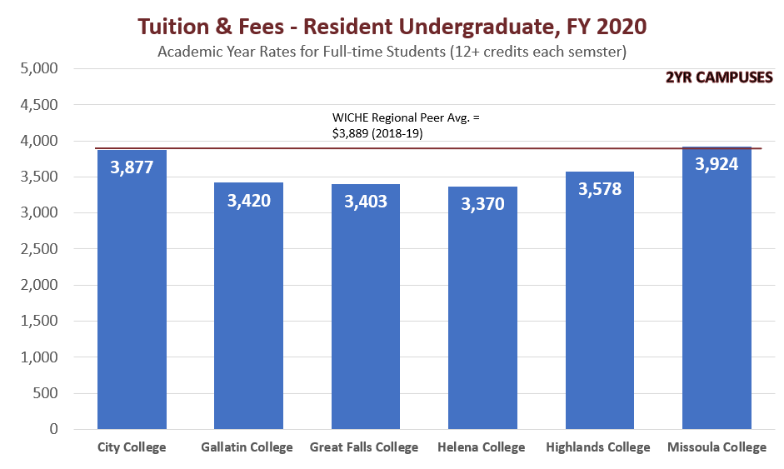
Tuition & Fees – Resident Undergraduate, FY2020
MUS Initiatives

Slide 31
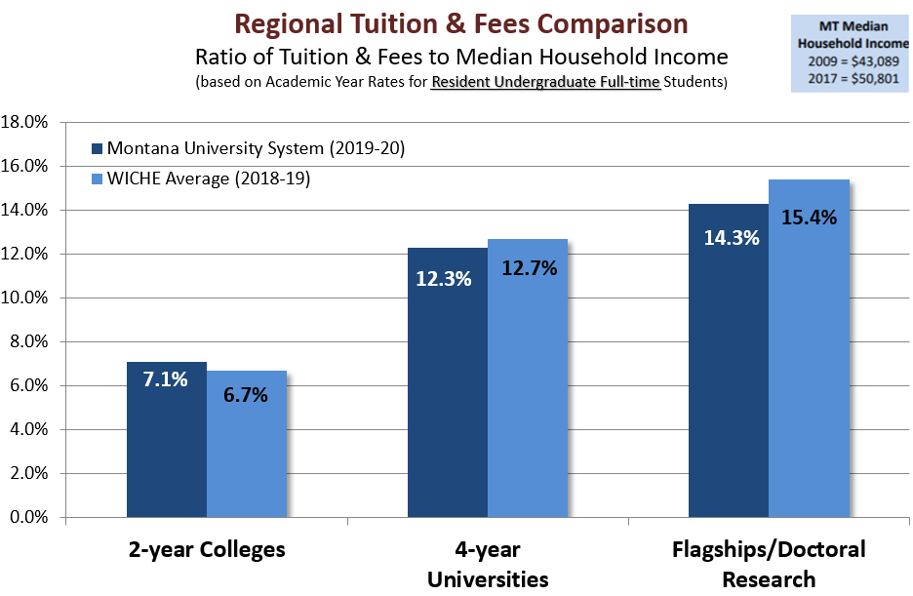
Region Tuition & Fees Comparison
MUS Initiatives

Slide 32

MUS Initiatives – New Portal for College & Career Planning
MUS Initiatives
College & Career Access Portal
COMING SOON!!!!
College Prep – ACT
Dual Enrollment
Academic Program Guide
Career Pathways
Financial Aid
Central Admissions Application
ReachHigherMontana.org

Slide 33
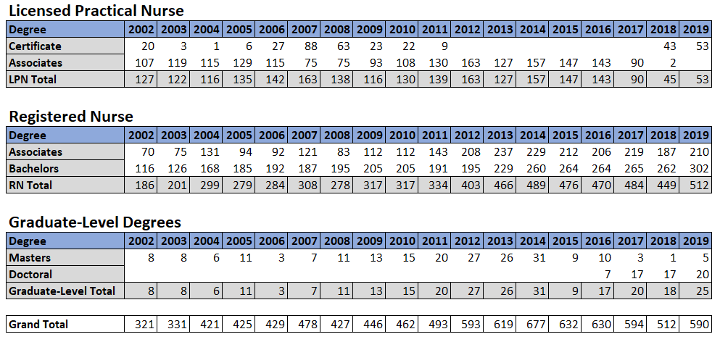
Nursing Degree & Certificate Production
MUS Initiatives
Nursing Degree & Certificate Production
Includes CC’s

Slide 34
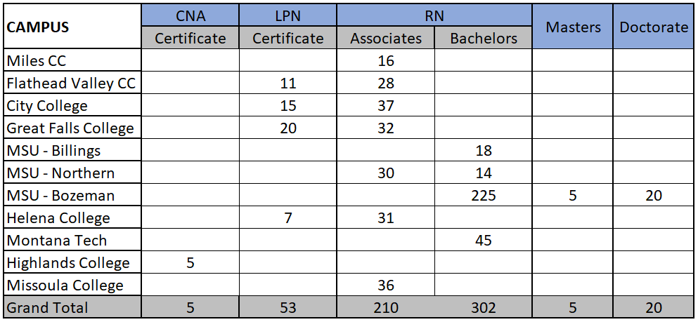
Nursing Degree & Certificate Production, 2018-19
MUS Initiatives
Nursing Degree & Certificate Production, 2018-19

Slide 35
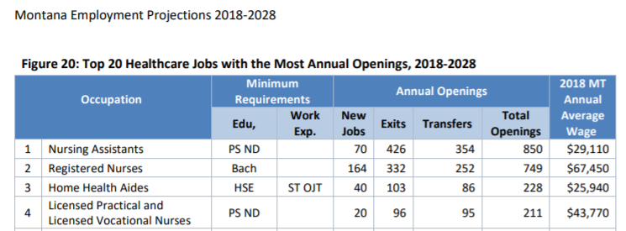
Nursing Labor Market Demand Data
MUS Initiatives
Nursing Labor Market Demand Data
Source: MT DOLI

