Slide 1
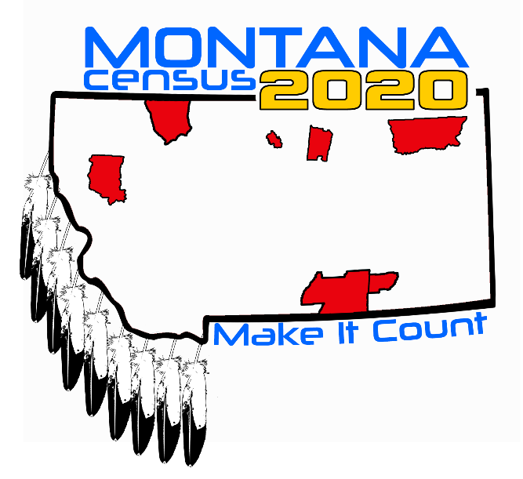
2020 Census
1

Slide 2
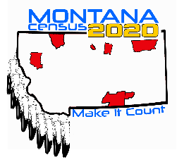
2020 Census: Team Montana
Jeri Bucy
Montana Partnership Specialist
Dallas Regional Census Office/Field Division/Denver Region
U.S. Census Bureau
M: (406) 302-2227
census.gov | @uscensusbureau
Research & Information Services Montana Dept. of Commerce
Bureau Chief: Mary Craigle | 406.841.2742
Mary.Craigle@mt.gov
Communications: Cassidy Blanton |406.841.2543 Cassidy.Blanton@mt.gov
CENSUS.MT.GOV | COMMERCE.MT.GOV
2

Slide 3
Decennial Census Overview
Article 1, Section 2 of the US Constitution
The actual Enumeration shall be made within three Years after the first Meeting of the Congress of the United States, and within every subsequent Term of ten Years, in such Manner as they shall by Law direct.
Notes:
Why we do a census
Every decade since 1790, the U.S. Census Bureau has conducted a constitutionally mandated census to determine the number of people living within the United States and our territories. These data are used by our nation’s leaders to help make vital decisions on behalf of all residents, including reapportionment and redistricting.

Slide 4
Why every person in Montana should be counted
Annually, more than $675 billion in Federal Funds goes to states based on Census data. Montana receives more than $2 billion every year.
Future planning needs up-to-date, accurate and detailed information on populations and communities. Census Data makes it possible to plan better services, improve the quality of life, and solve existing problems.
The U.S. Constitution requires a national census every 10 years. The census is a count of everyone residing in the United States and its territories. The Census is used for Apportionment, determining how many seats each state will have in the U.S. House of Representatives, and Redistricting, establishing legislative district and other boundaries.

Slide 5
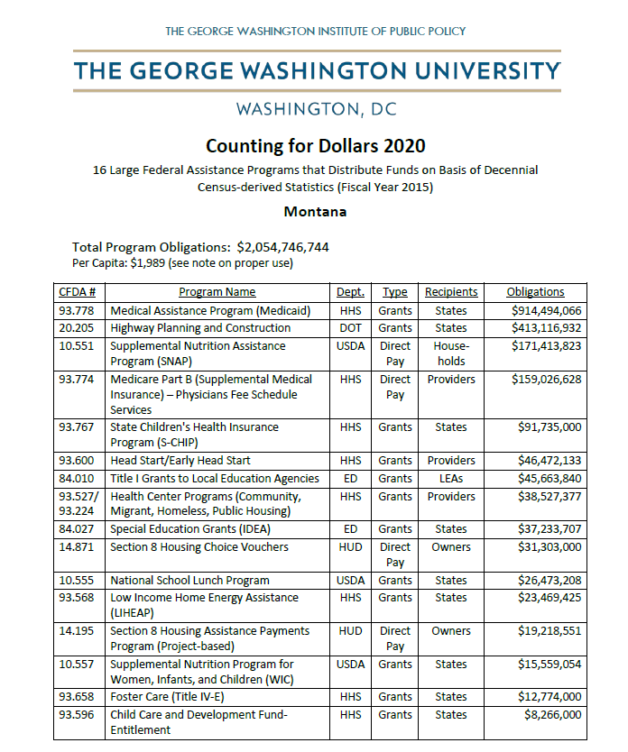
Funding
Funding
Students, Workforce, Community, Infrastructure. The census can shape many different aspects of your community and its economy. Each year, the results help determine how more than $675 billion in federal funding is distributed to states and communities.
For every Montana resident counted, the Census estimates the state will receive almost $2,000 each year for ten years. That is $20,000 per person over the decade.

Slide 6
How Does Census Information Impact Montana Higher Education Funding? Census data is used to allocate federal funding for programs critical to Montana. A few examples from FY 2016 include:
Programs for Campuses & Students | Agency | MT FY16 Allocation
Federal Direct Student Loans | ED | $213,883,457
Pell Grants | ED | $10,640,020
HOME programs | HUD | $7,320,575
Career & Technical Education | ED | $5,165,733
Cooperative Extension Services | USDA | $5,173,200
WOA Dislocated Worker Grants | DLI | $1,681,408
Programs for College Communities | Agency | MT FY16 Allocation
Highway Planning and Construction | DOT | $441,147,063
Health Care Centers | HHS | $38,793,385
Community Facilities Loans/Grants | USDA | $24,825,130

Slide 7
Census Data Matters to Montana Higher Education
Data from the census gives a profile of everyone that lives in our state (demographic, economic, veteran, disability status, etc.) and provides crucial information about students, workforce, and the state’s economy.
Census Data Matters to
Montana
Higher Education
Census data helps colleges understand where the next generation of workers is coming from and where workers are need, which will influence student recruitment, degree programs and curriculum development, and training offerings and decisions.
If the census is inaccurate, colleges don’t have information for future planning and communities can’t provide needed services and infrastructure critical to higher education.

Slide 8
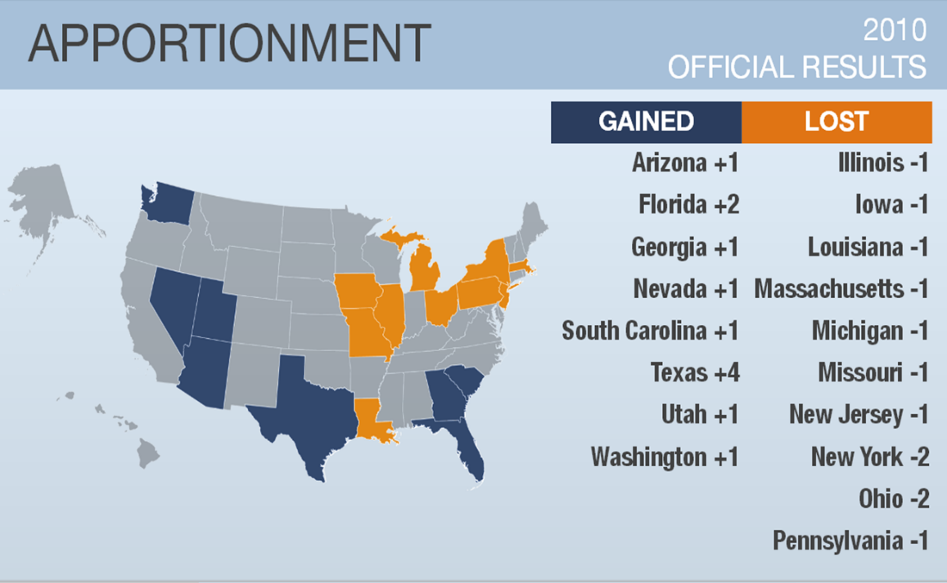
Apportionment
Where additional seats would
have gone in 2010?
The Census count apportions the 435 seats
in the U.S. House of Representatives
Seat 436. North Carolina - 14 seats
Seat 437. Missouri - 9 seats
Seat 438 New York - 28 seats
Seat 439 New Jersey - 13 seats
Seat 440 Montana – 2 seats
Notes:
Mary

Slide 9
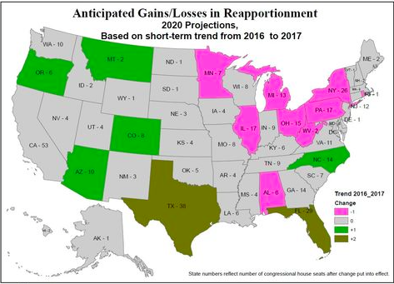
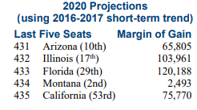
What is the chance of Montana gaining another seat
What is the chance of Montana gaining another seat in the
U.S. House of Representatives?
Source: Election Data Services https://www.electiondataservices.com/reapportionment-studies/

Slide 10
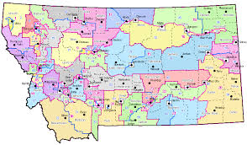
Redistricting
Redistricting
Redistricting is used to define state legislative boundaries as well as other political and economic regions, such as voting precincts and school districts.
Areas within a state gaining or losing significant population in comparison to others will have more changes than those that are stable. District boundaries may also change due to population migration within a state.
Notes:
Mary – Population Map Handout

Slide 11
Road to the 2020 Census
Notes:
Education Phase: Now – December 2019
During this period, key community and municipal leaders receive training, informational materials, and one-on-one meetings with Census Bureau partnership staff about the importance of the census and the necessity of local involvement to a successful count. Although, the Education Phase ends in December 2019, training continues until all CCCs are formed and trained.
This is also the period when CCC Chairpersons and Subcommittee Chairpersons work to ensure their respective members fully understand the mission of the CCC in relation to the overall awareness-building effort.
It is during this period that the CCCs are engaged in educating ALL individuals in their community.
This message to each community member is that the census is a civic activity that affects all people of all ages, races, cultures and ethnicities, regardless of citizenship status. This is the period to emphasize strongly the many uses of census data and what’s in it for them. We will talk more about census data as we progress with the training.
It is also during this phase when our Regional and Area Census offices open. For example, the Dallas Regional Census Center, which will house all of our 12 state region’s decennial census operations, is scheduled to open at the end of March. We are having a grand opening ceremony on May 1st – so you all are invited to that and I will make sure invites go out to all of you and your elected officials as well.
In addition:
Early Area Census Offices open in Jan. and Feb. 2019 – these offices will handle all of our address canvasing operations between August 2019 and October 2019. Unlike 2010, we will not go door to door to measure the growth and change in our country. Instead, we’re relying on aerial data, postal records and other 3rd party data to identify the areas with high growth and change – about 30% of the country. Only in those areas will be go door to door to identify housing structures.
ACTIVITY: Take one minute to write down one activity that your CCC could promote during the Education Phase and make sure to list the month for your proposed activity.

Slide 12
Ways to Respond
Ways to Respond
2020 Census Offers More Choices
Internet
Phone
Paper
In-Person
Self Response Available Until late July 2020

Slide 13
Confidentiality
Census Bureau reputation depends on keeping data confidential.
We take it very seriously!
Federal Law – Title 13 of the US Code protects the confidentiality of all information
Employee Oath – Protect confidentiality for life. Penalties if violated can be 5 years in prison and/or $250,000 fine.
Statistical Safeguards – Ensure that statistics released do not identify individuals.

Slide 14
Campus and Local Complete Count Committees:
How can you play a direct role
CCCs are one of the core strategic elements of the Partnership program for the 2020 Census
CCCs exist to plan and implement locally-based outreach campaigns that raise awareness of the census and ultimately drive participation
CCCs are all inclusive and representative of your local community
Notes:
Why we do a census

Slide 15
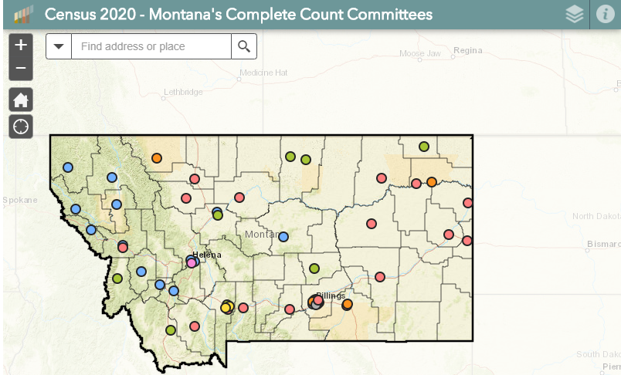
Census 2020 – Montana’s Complete Count Committees
https://ceic.mt.gov/Census2020/MapofCompleteCountCommittees

Slide 16
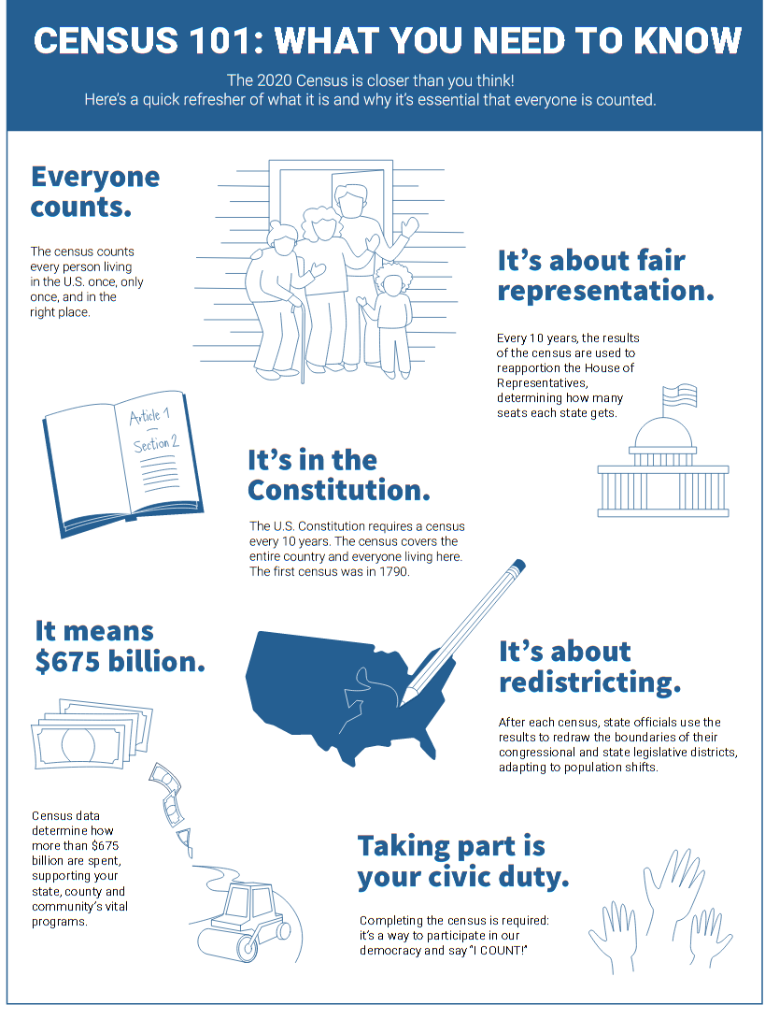
Materials From Census.gov
census.gov/programs-surveys
census.gov/partners/toolkit
Notes:
There are some limitations or cautions you should be aware of when using the LRS.
It only considered mail self-response from the 2010 Census – 2020 Census will offer internet, phone and mail options to self-respond.
There are instances when LRS is not calculated.
Reasons LRS is not calculated
A census tract contains zero housing units
A census tract did not receive a census questionnaire (e.g. American Indian reservations)
A census tract experienced a geographic boundary change between making the data non-comparable.

Slide 17
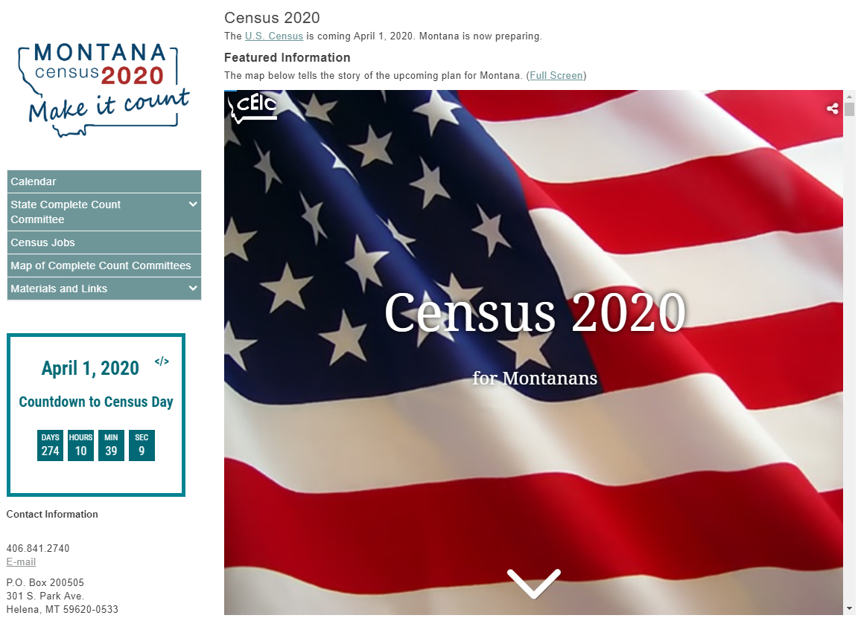
State CCC Website
State CCC Website CENSUS.MT.GOV
Downloadable Materials for CCC / Educators’ use – talking points, presentations, logos, flyers, brochures, videos – coming soon!
Calendar of Events
State CCC members, minutes, plans
Map of MT CCCs

Slide 18
What You Can Do to Promote the 2020 Census
Talk: Promote discussion about the 2020 Census and emphasize the benefits of participation.
Reassure: By law, the Census Bureau cannot share respondents’ answers with anyone, including other federal agencies and law enforcement entities. All Census Bureau employees take an oath of non-disclosure and are sworn for life to protect the confidentiality of the data. The penalty for unlawful disclosure is a fine of up to $250,000 or imprisonment of up to five years, or both.

Slide 19
What you can do to promote the 2020 census
What You Can Do to Promote the 2020 Census
Host: Be part of your local CCC. Invite us (Federal or State Partners) to events in your community. Request Census materials and our portable display for your community. Volunteer to record a radio PSA to be aired on YOUR local radio stations. Host a Census awareness event. Commit to do at least ONE THING to get us closer to a complete count!
Encourage: Participation in the census is easy, important and safe, and participation is vital.

Slide 20
CENSUS JOBS
https://2020census.gov/jobs

Slide 21
April 1, 2020 Census Day is 131 days away
Thank you
Montana Higher Education!
Thank you – for educating people about
Internet, phone, and paper self response
Safety of the process
Benefits of civic participation
Thank you – for motivating people to participate and self respond to the 2020 Census

