Slide 1


MSU Program Review
MSU Program Review
Board of Regents Meeting Nov. 21-22, 2019
As requested by the Montana Board of Regents and the Office of the Commissioner of Higher Education, the MSU Program Review was conducted as a comprehensive program prioritization of all doctoral programs at MSU.
  “Decision(s) concerning the future of the program(s), based on the program review criteria established at the campus.”
  “Rationale or justification for the decision based on the program review process established at the campus.”
- As described in the MUS Program Review Template as part of the Academic Affairs Handbook implementing Board Policy 303.3: Program Review
Notes:
At the direction of the Board of Regents and the Office of the Commissioner of Higher Education, MSU underwent a review of all its doctoral programs to evaluate their performance. This review resulted in the MSU Doctoral Prioritization Review Report, a document created by the 16-member MSU Doctoral Program Prioritization Committee and circulated widely across campus

Slide 2
Doctoral Program Prioritization
Doctoral Program Prioritization
Conducted to strengthen and improve the entire portfolio of doctoral programs offered by MSU.
Created a relative ranking among doctoral programs at MSU.
Informed by data and by input from the doctoral degree granting departments at MSU.
Launched in November 2017 by the Office of the Provost.

Slide 3
16-Member Committee
16-Member Committee
7 Faculty
3 Department Heads
3 Deans
1 Graduate Student
1 Administrator
1 Institutional Researcher

Slide 4
Metrics averaged over 2013-2017
Metrics averaged over 2013-2017
16 metrics grouped into 5 categories:
  Degree & Graduate SCH Production
  Selectivity & Program Demand
  Expenses & Revenue
  Efficiency
  Faculty Prestige

Slide 5
Building blocks of process
Building Blocks of Process
Data for 16 metrics provided by the institution and not self-reported.
Metrics were discussed with the campus community.
Programs/departments provided context to metric scores
(no change in numerical score).
Narratives were constructed by the DPPC but informed by the programs/department's responses.
Department Heads were given the opportunity to provide responses to specific questions, review and provide context to help the DPP committee better understand the data and provide strengths and weaknesses of their doctoral program(s).

Slide 6
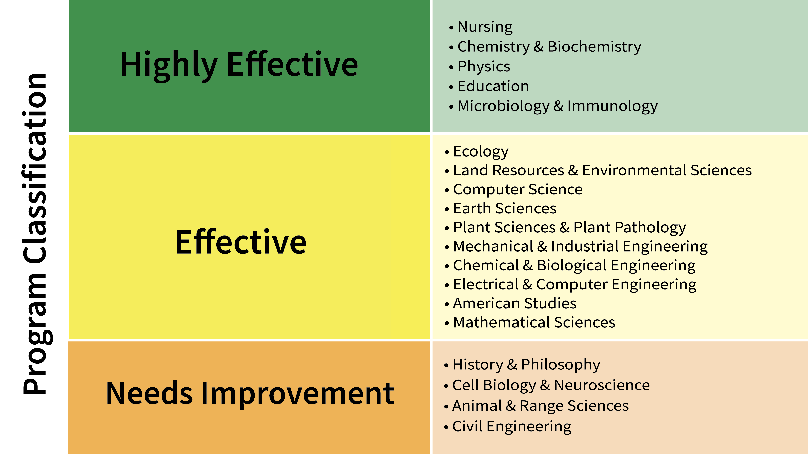
Program classification

Slide 7
Next Steps for Programs Ranked
Next Steps for Programs Ranked: “Highly Effective” & “Effective”
Departments all plan to make changes to either maintain or strengthen their programs.
Departments will seek continuous improvement of graduate student recruitment, graduate student support, updating of existing academic programs and development of new programs, as appropriate.
All 15 departments will undergo review again as part of their regular seven-year review cycle.

Slide 8
Needs Improvement
Next Steps for Programs Ranked: “Needs Improvement”
History and Philosophy, Animal and Range Sciences, Civil Engineering
Department heads acknowledged weaknesses and areas for improvement that were identified by the process.
Each department provided details about changes that are being made or will implemented to address weaknesses.
In each case, the DPP committee recommended that the departments develop a plan for improvement.
Each department is taking steps to improve.
Each program will be re-reviewed in 3 years.

Slide 9
Needs Improvement Continued
Next Steps for Programs Ranked: “Needs Improvement”
Continued…
Cell Biology and Neuroscience
The department was not meeting the performance expectations required of all academic departments at Montana State University.
As a department, the low ratio of graduate students per faculty member was unsustainable when compared to the low teaching loads and low scholarly productivity of some of the tenured faculty in the department.
Notes:
All departments and academic programs within the Montana University System are expected to strive for continuous improvement in the education they provide to students, in the outreach they provide to the public and in the research they conduct to further the bounds of knowledge. This is an expectation of the Montana Legislature, which appropriates funds to the university system, the Montana Board of Regents, which governs the university system, the Office of the Commissioner of Higher Education, which administers the university system, and of the local administrations of each campus.

Slide 10
Needs Improvement Slide 3
Next Steps for Programs Ranked: “Needs Improvement”
Continued…
Cell Biology and Neuroscience: documented areas of underperformance
Research expenditures per tenurable faculty
Scholarly productivity per tenurable faculty
Tenurable faculty teaching loads
Graduate program -- enrollment
Graduate program -- curriculum
Notes:
All departments and academic programs within the Montana University System are expected to strive for continuous improvement in the education they provide to students, in the outreach they provide to the public and in the research they conduct to further the bounds of knowledge. This is an expectation of the Montana Legislature, which appropriates funds to the university system, the Montana Board of Regents, which governs the university system, the Office of the Commissioner of Higher Education, which administers the university system, and of the local administrations of each campus.

Slide 11
Needs Improvement Slide 4
Next Steps for Programs Ranked: “Needs Improvement”
Continued…
Cell Biology and Neuroscience
To move the department forward and strengthen its offerings, it was merged with one of MSU’s most successful departments in terms of research and graduate education, the Department of Microbiology and Immunology.
Board of Regents Item 185-2010-R1119 has been submitted to document the merger request by MSU.

Slide 12
MSU Logo

