Slide 1
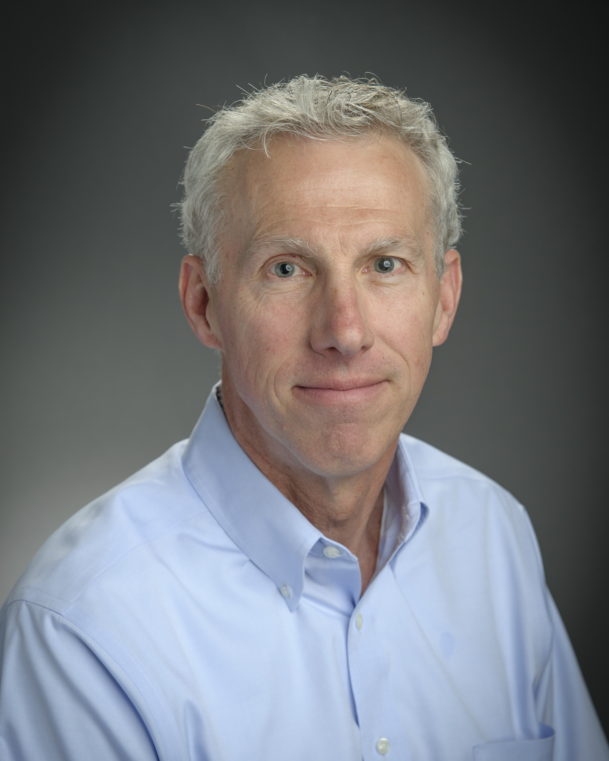


2019 Regents Professor, Phil Stewart
2019 Regents Professor
Phil Stewart
Department of
Chemical & Biological Engineering
Notes:
Today is a special day as we honor one of our very accomplished faculty members at Montana State. As you may know, the title of Regents Professor is reserved for faculty who have demonstrated outstanding scholarship of an international caliber, a genuine commitment to teaching and mentoring, and service both within and outside the university. Phil Stewart, a professor of chemical and biological engineering, meets all of these criteria.

Slide 2
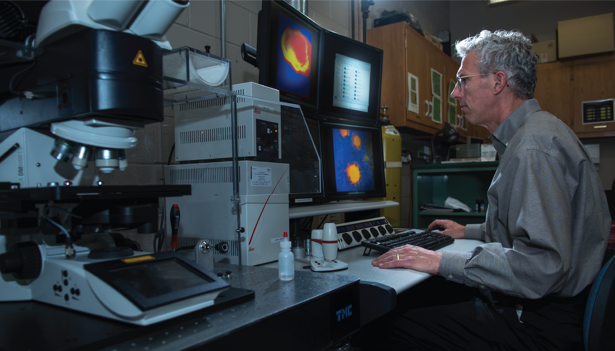
Photo, Phil Stewart
Notes:
As a world leader in the study of biofilms, Dr. Stewart has played a central role in advancing our knowledge of the complex microbial communities that form on the surfaces of such things as medical equipment. Since coming to Montana State in 1991, he has published groundbreaking studies about how microbes, including harmful bacteria, resist being killed by antibiotics. His publications have been cited more than 41,000 times. In fact, he has the distinction of being the most-cited researcher at Montana State. His research is making possible new products and medical treatments that alleviate suffering and save lives.

Slide 3
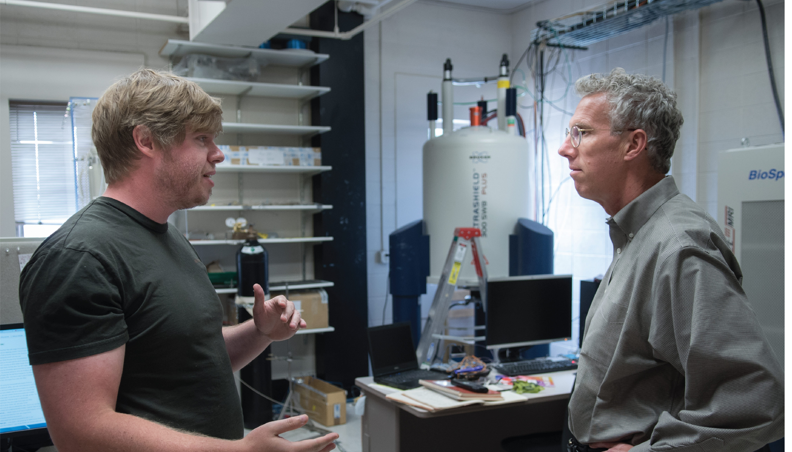
Photo, Phil Stewart
Notes:
Outside the laboratory, Dr. Stewart's leadership has been instrumental in transforming MSU's Center for Biofilm Engineering into one of the world's largest and best-known biofilm research centers, serving as its deputy director from 1996 to 2004 and then director until 2015. Dr. Stewart is also known for his seemingly effortless ability to teach difficult material in the classroom. In fact, some credit him as the reason they decided to pursue chemical engineering. For all these reasons and more, we say thank you for his 28 years of service to our Montana University System. Dr. Stewart, you are truly deserving of this highest honor.

