Slide 1
RIDE Program
Montana State University
Regional Initiatives in Dental Education
Presented to the MUS Board of Regents
November 21, 2019, Bozeman MT.
Dr. Robert L. Mokwa, Provost, MSU

Slide 2
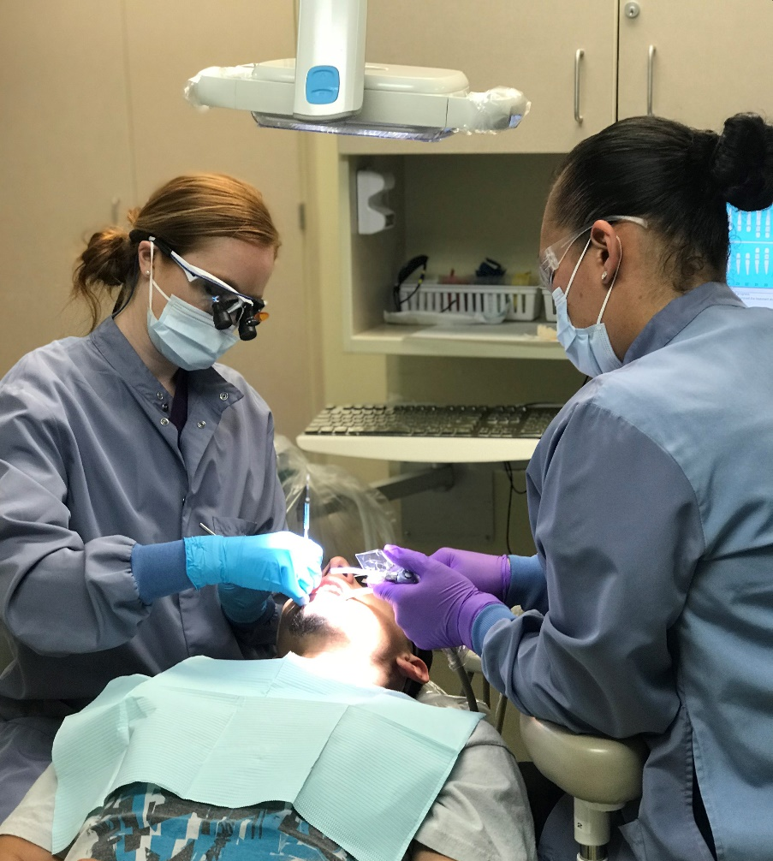
Mission
MISSION:
Develop dentists who will make a personal commitment to serving the needs of rural and underserved communities.

Slide 3
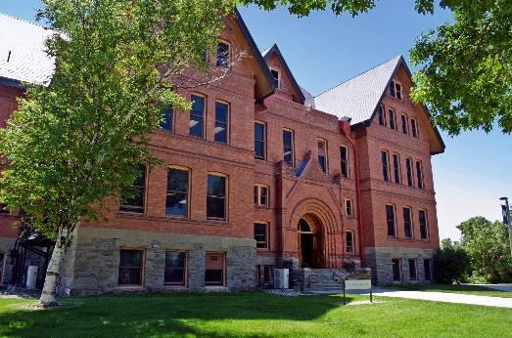
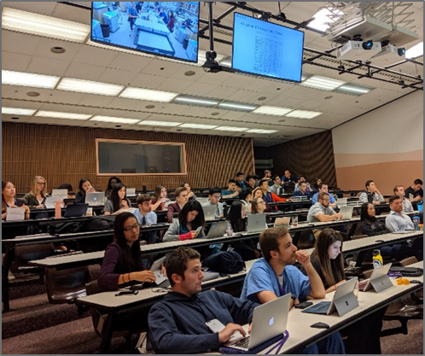
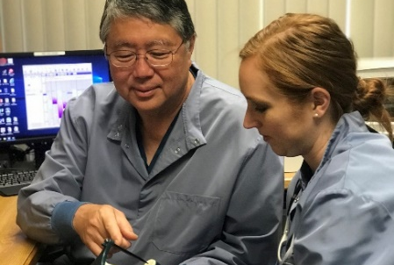
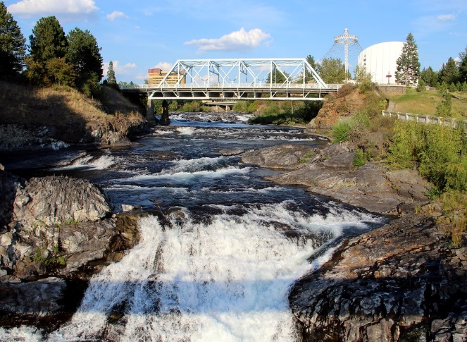
Montana RIDE
MONTANA RIDE
YEAR 1: MONTANA STATE UNIVERSITY
YEAR 3: UNIV OF WA– SEATTLE
MT RIDE dental students in existing MSU WWAMI infrastructure.
Clerkship and comprehensive care clinical training in Seattle.
YEAR 2: RUOP ROTATION – MONTANA
YEAR 4: EXTENDED ROTATION – MONTANA
Four-week clinical rotation in rural Montana communities.
Five-month clinical rotation in rural Montana communities.
Partner with UM and MSU to provide interprofessional education (IPE)
YEAR 2: EASTERN WA UNIV. – SPOKANE
Didactic and pre-clinic courses in Spokane.

Slide 4
Montana RIDE, Slide 2
MONTANA RIDE
80% of Montana dentists practice in 9 counties.

Slide 5
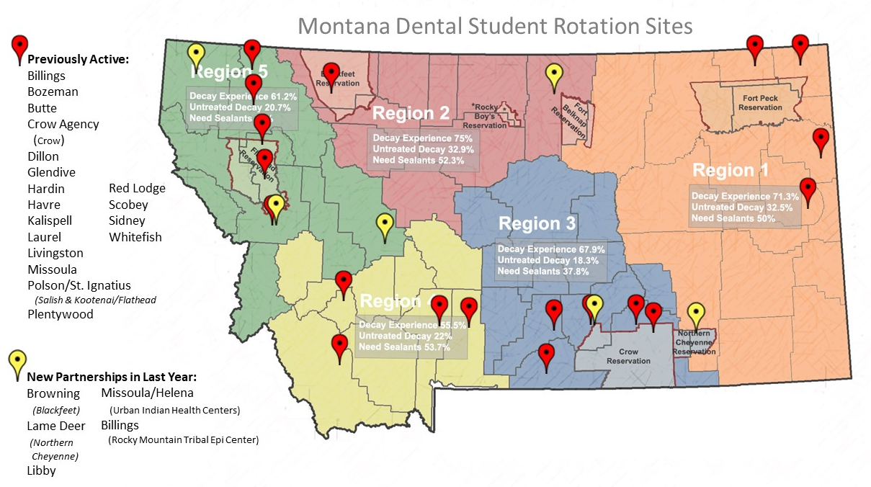
Montana RIDE Partners
MONTANA RIDE PARTNERS

Slide 6
2019 Montana RIDE Advances
2019 MONTANA RIDE ADVANCES
In 2018, Montana BoR approved the RIDE curriculum at MSU in conjunction with WWAMI.
These are our 2019 funding & rotation site updates.
New Funding:
US HRSA grant subcontract with Montana DPHHS:
Montana Oral Health Workforce Activities for Prevention
4 years, 2018-2022, $389,202
2019 Montana Healthcare Foundation Grant with MSU Office of Rural Health
$46,660
Grant Applications:
HRSA-20-026 Rural Health Network Planning submitting, November 2019
2020 Montana Healthcare Foundation Grant submitting, January 2020

Slide 7
2019 Montana RIDE Advances, Slide 2
2019 MONTANA RIDE ADVANCES
New Partnerships & In person Meetings:
Interprofessional Education Montana -August 2019: 2-day IPE training event with MSU and UM faculty and students on oral health case.
Rocky Mountain Tribal Epidemiology Center
Missoula Urban Indian Health Center -Executive Director
Montana American Indian Health Leaders Mtg -Invited Presenter (Oct 2019)
New Student Rotation Sites in Lame Deer, Blackfeet CH and Libby CHC-(in dev.)
USDA grant funded Teledentistry Units shipping December 2019 to dental clinics in Polson, Browning and Hardin
University of Montana, Certificate Program in Public Health (in discussion)
University of Montana, Dean, College of Health Professions & Biomedical Sciences
Headwaters Foundation Meeting (Nov 2019)

