Slide 1


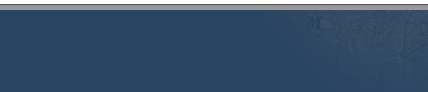
Online Education’s Key Role in Montana Higher Education
Montana University System
November 21, 2019
Office of the Commissioner of Higher Education

Slide 2
Selected demographics by attendance modality
Selected Demographics by Attendance Modality
(Fall 2018 EOT, MT Resident Students)
Source: MUS data warehouse; linked DLI UI wage data
 | Face-to-face | Some Distance | Online Only
# of students (% of total) | 21,215 (66.5%) | 7,085 (22.2%) | 3,585 (11.2%)
Non-traditional % | 26.6% | 32.8% | 70.0%
Working Students* | 43.7% | 55.1% | 71.3%
Part-time | 33.1% | 19.3% | 76.3%
Average Credit Load (undergraduates) | 11.9 | 13.6 | 7.4
* Fall 2017 figure reported. Student categorized as working if unemployment insurance wage data indicate >$500 in earnings for the fourth quarter of 2017.
22% of non-traditional age students enroll fully online
15% of working students enroll fully online
Notes:
~11k non-traditional students
~16k working students

Slide 3
Online has grown in Montana
Online Has Grown in Montana
MUS resident students, all levels, by attendance modality
Source: MUS data warehouse

Slide 4
MSU Billings and City College provide one example
MSU-Billings & City College provide one example
MSU-Billings and City College resident undergraduate students by attendance modality
Source: MUS data warehouse

Slide 5
Graduate students are another
Graduate students are another
MUS resident graduate students by attendance modality
Source: MUS data warehouse

Slide 6
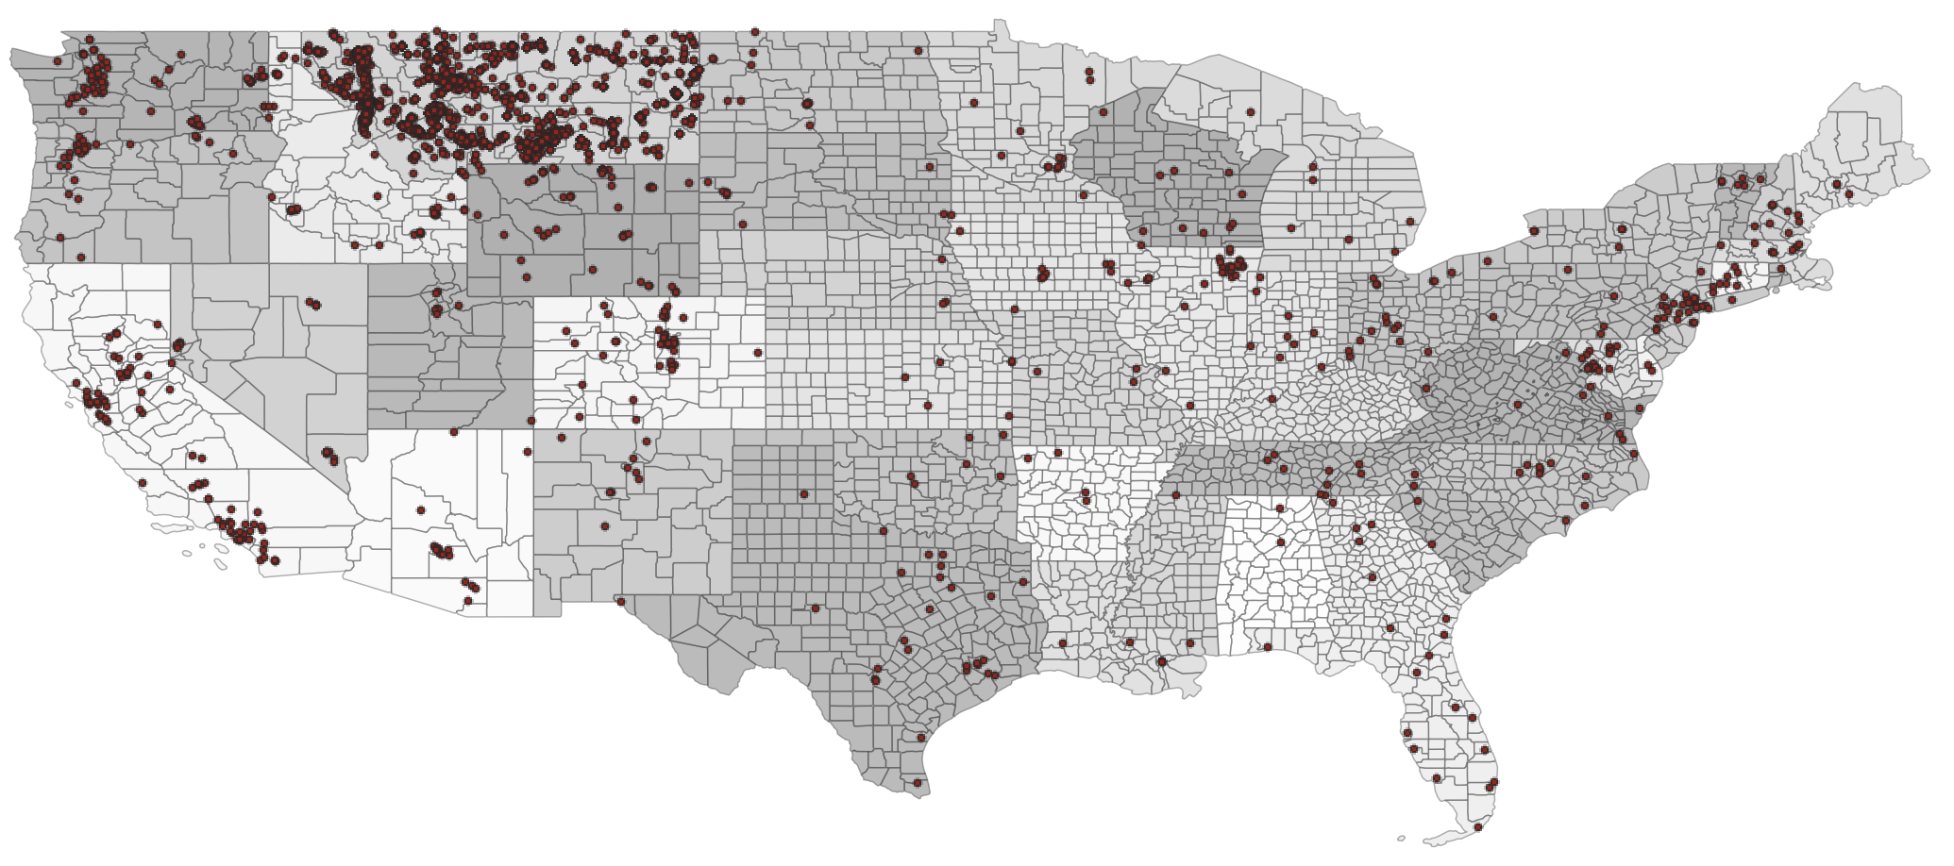
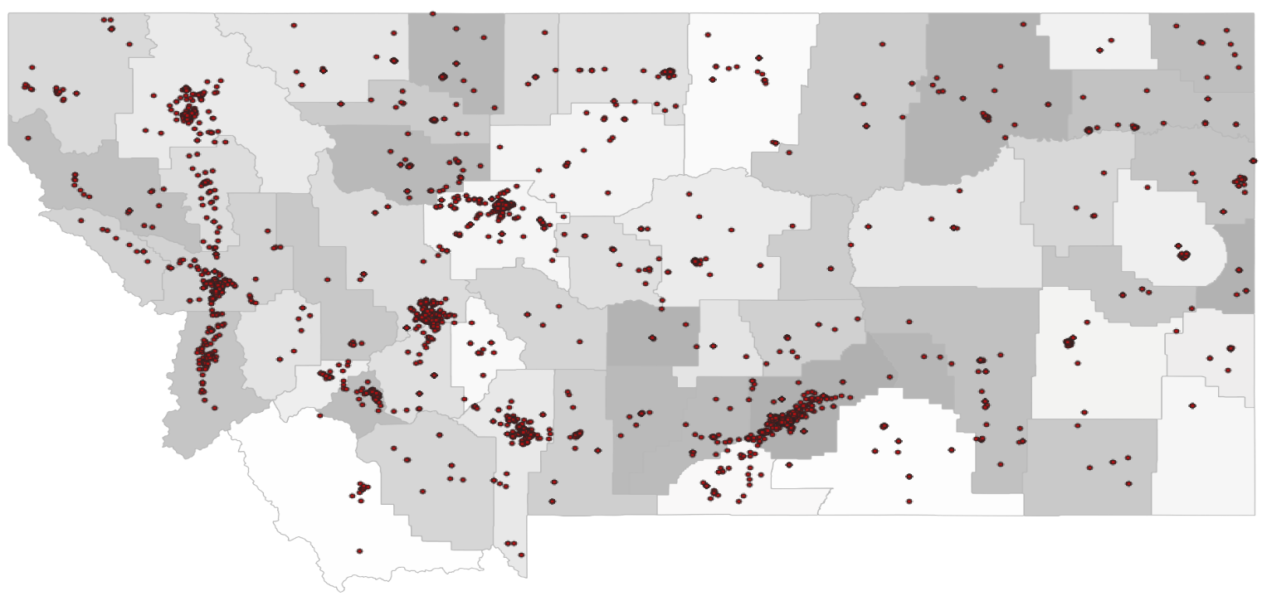
Where are online students?
Where are online students?
Fall 2018 Census, all levels. Source: MUS data warehouse

Slide 7

Online student success
Online Student Success
Brandi Williams of Havre, MT
Organizational Communication Student at MSU-Billings

Slide 8
Online student success, continued
Online Student Success
  “As a single working mother…the online program seemed to fit best for my hectic life. The Liberal Studies online program gave me the flexibility I needed to be able to finish my degree. Not only that, the program gave me a well-rounded education that focused on different cultures, different languages, politics, law, business, art and sociology. I believe I have gained a very valuable and well-rounded education.”
  Shanna Stanley of Conrad, MT
  Liberal Studies Bachelors Degree Completion Graduate at MSU-Bozeman

Slide 9
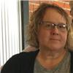
Online student success, example 2
Online Student Success
Kathy Willhite of Billings, MT
BSLS Healthcare and Communication student at MSU-Billings

Slide 10
Online student success, example 2 continued
Online Student Success
  Dora Hugs, a Crow Elder and science teacher in Pryor MT, received the Outstanding Non-Traditional Student award from the University Professional and Continuing Education Association and was honored at a ceremony in Seattle.
  Dora completed MSU’s Masters Degree in Science Education, which is offered largely online.
  Dora taught science and Crow language in Pryor while completing her degree and believes that this degree helped her to teach science in a way that is accurate in science content while remaining meaningful and consistent with the culture of her students.

Slide 11
What is next?
What is next?
Policy: Do BOR policies hamper (or can they advance) access to quality online opportunities for Montana students?
Partnerships: Can we develop tools that lower the activation energy for online collaborations between MUS campuses?
Priorities: Can we identify and prioritize areas of need (by industry or geography) and strategically act to address those needs?
Expect an update at the March 2020 BOR meeting

