Slide 1

Become an Alum

Slide 2
Overview/Recap
Situation Analysis
Supporting the Economy and Individual Growth
Process
Investment
Lessons Learned
Next Steps
Notes:
Working with UM and the National Student Clearinghouse, we found about 3,900 students who left UM since the fall of 2013 without obtaining a degree or certificate from UM or any other institution
As of 9/26
909 individuals have been contacted in some way (email, USPS, phone call)
49 have stated they will enroll
42 have actually enrolled
We have 16 confirmed for Spring semester at this time
47 ADDITIONAL people have enrolled as a result of the outreach that was done by Become An Alum, according to Joe Hickman, Registrar. We are in the process of getting those names so we can reach out to them and assist with retention.

Slide 3
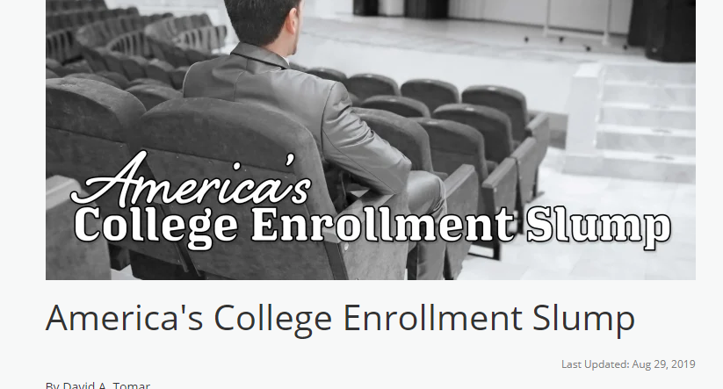
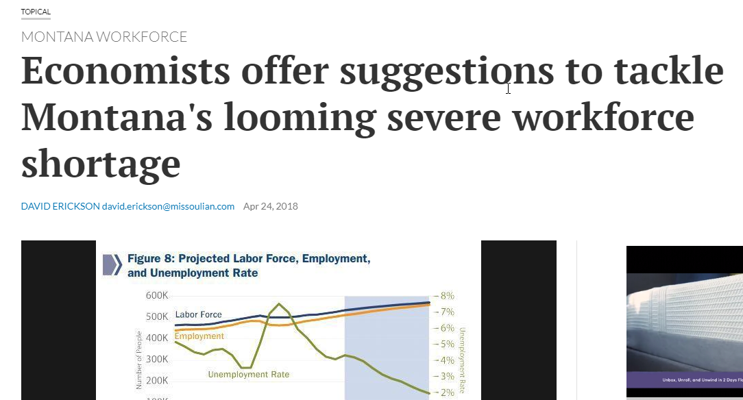
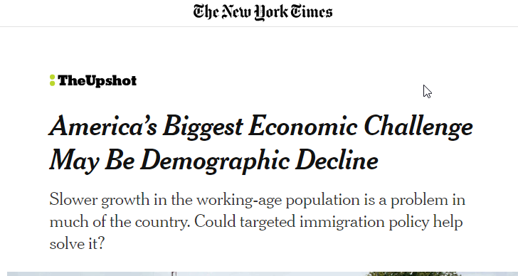
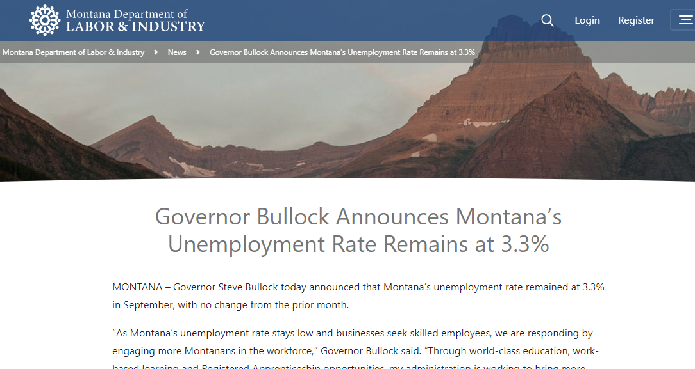
Situation Analysis
Situation Analysis

Slide 4
Future Ready 2025 Goals
BECOME AN ALUM GROUP SUMMARY
 | Credits Earned | Internal Concept | Lead on Outreach | Number in Group
Group 1 | 0-15 credits | “Relaunch” | DLI | Approx 2,000
Group 2 | 15-30 credits | “Swing Students” | UM + DLI | Approx 1,000
Group 3 | 30+ credits | “Finish Line” | UM | Approx 800
Group 4a | 60-120 credits | Degree in Hand – Associates* | UM
Group 4b | 120+ credits | Degree in Hand - Bachelors | UM

Slide 5
Process
Group | Activity | Contacts
Under 15 credits w/reliable contact information | Survey Email Mailings Phone calls | 537 individuals
Under 15 credits | In-person meetings | Ongoing
Under 15 credits without contact information | Running list against additional UM databases (Alumni for first round. Looking at options of using foundation and financial aid) | 700 individuals
15 – 30 credits | Mailings Email Phone calls | 348 Individuals
Employers | Survey Phone calls In-person sector meetings | 35 contacted 16 commitments Ongoing
General Public | Website/Video

Slide 6
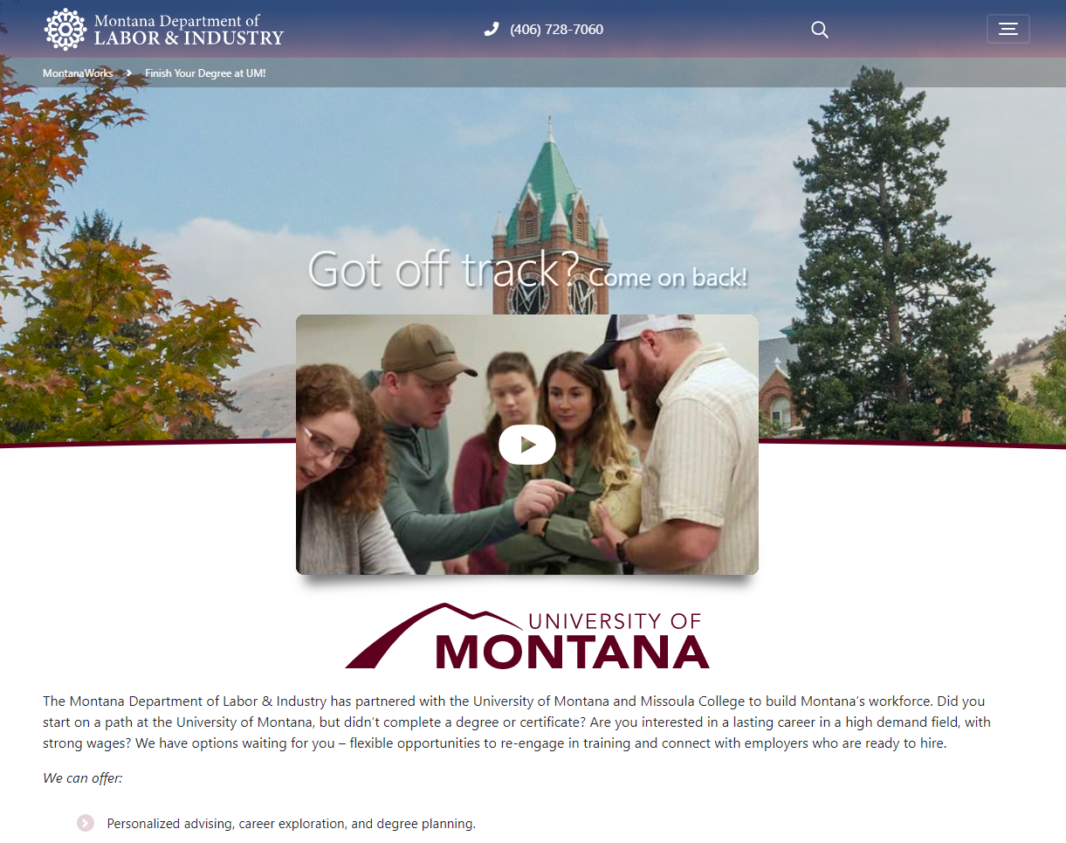
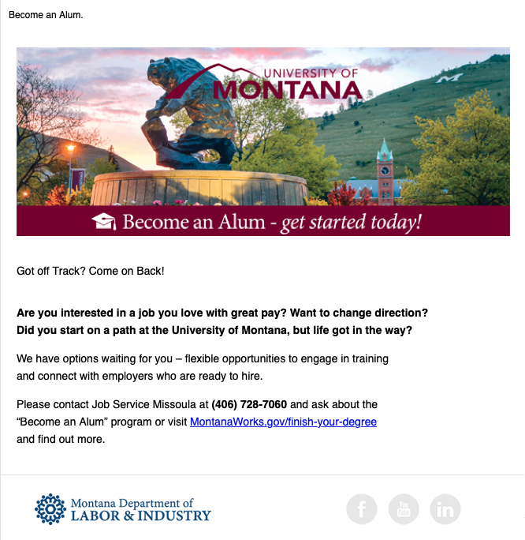
Outreach
Outreach

Slide 7

Investment
Approximately 1,238 staff hours dedicated to the project since July.
Entire Job Service Missoula office was involved initially in Feb/Mar of this year.
10 people in Job Service Missoula with ongoing BAA responsibilities.
2 staff dedicated full-time since July, both embedded on campuses.
Allocated $50,000 in funding for direct services from WSD.
Notes:
This time includes meeting with clients/potential clients, making contacts with U of M/Missoula College, doing outreach with community partners, developing/implementing a tracking system for Become An Alum.

Slide 8
Enrollment
Major/Area of Study | Enrolled students
Medical Assisting | 13
Phelotomy | 5
CDL | 4
Information Technologies | 4
Social Work | 4
Dental Assisting | 3
General AA | 3
Business Media Design | 2
Anthroplogy | 1
Biology | 1
Bookkeeping | 1
Business/MIS | 1
C.N.A. | 1
Computer Science | 1
EKG | 1
Elementary Education | 1
English | 1
Japanese | 1
Medical Information Technologies | 1
Parks and Rec | 1
Pre-Nursing | 1
Psychology | 1
Total Fall enrollment of 99
  Current DLI effort enrollment is 52.
  An additional 47 have enrolled based on the program, but haven’t sought DLI services.
38 have committed for Spring Semester.
70+ are engaged and in the pipeline.

Slide 9
Lessons Learned
Holistic Approach
  Re-enrollment
  Other Services
Unexpected Partnerships
  Broader Engagement
Staff Commitment
  Cross-training
  Proximity
Notes:
We needed to advise people beyond getting to the front door.
Counseling to overcome anxieties about returning after already leaving before completion.

Slide 10
Next Steps
Moving Beyond the Pilot
  Campus Expansion
  OCHE
Re-Enrollment Strategy
  Lifelong Learning
Final Report
  Economic Impact

