Slide 1
Two Year Education in Montana: Opportunities and Challenges Montana University System Board of Regents Meeting November 21, 2019 Montana State University - Bozeman
Office of the Commissioner of Higher Education

Slide 2
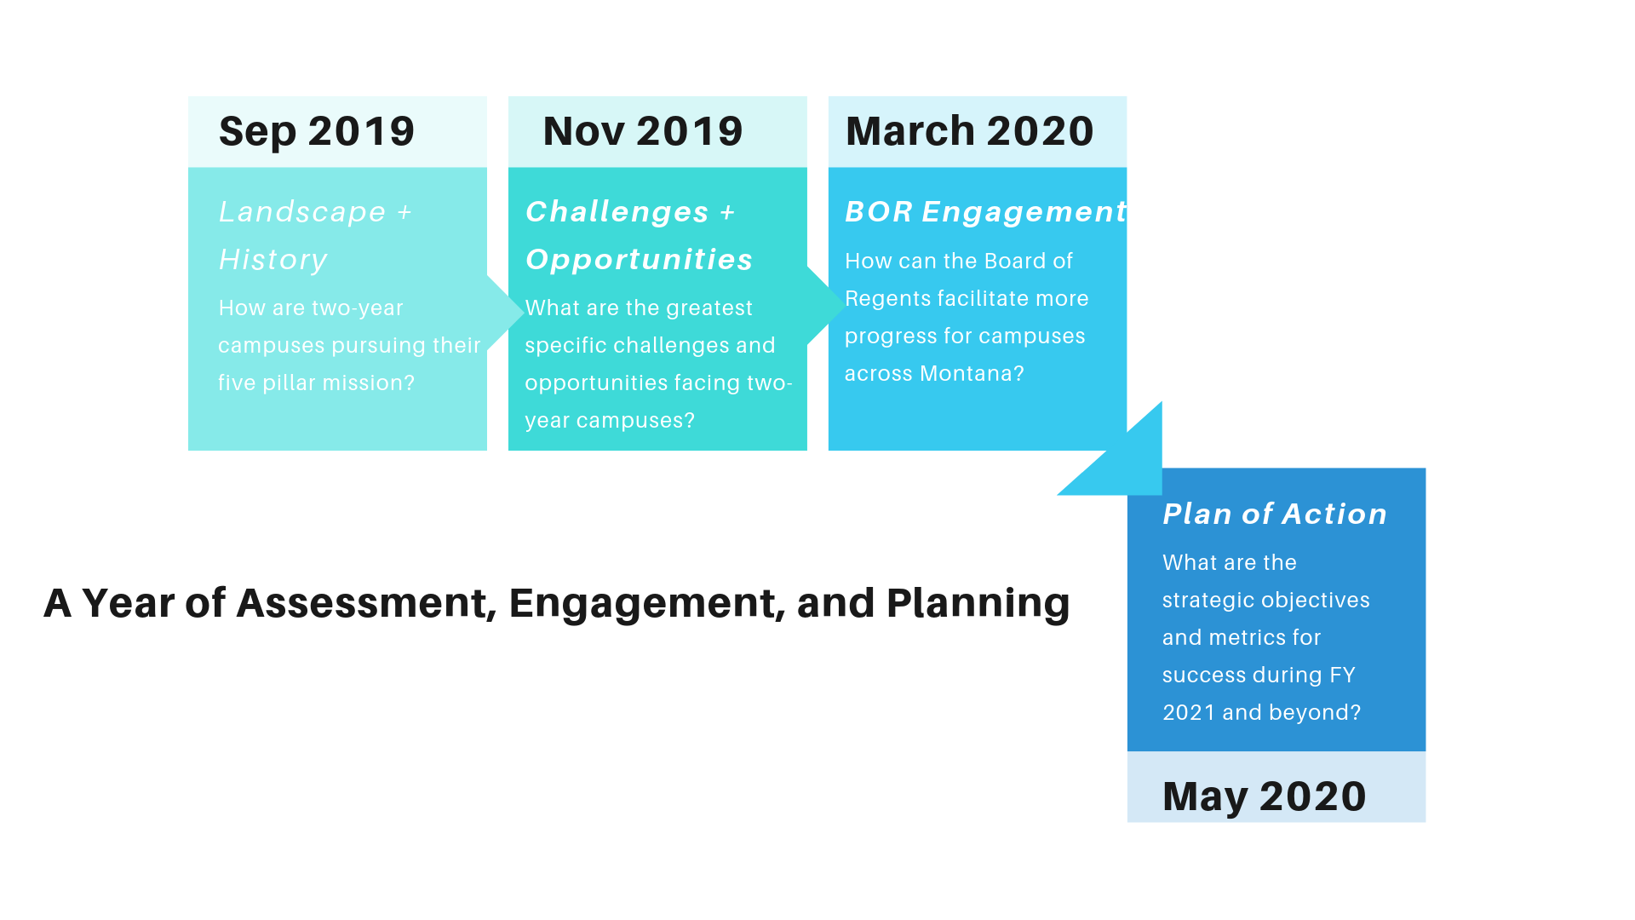
A Year of Assessment, Engagement, and Planning

Slide 3
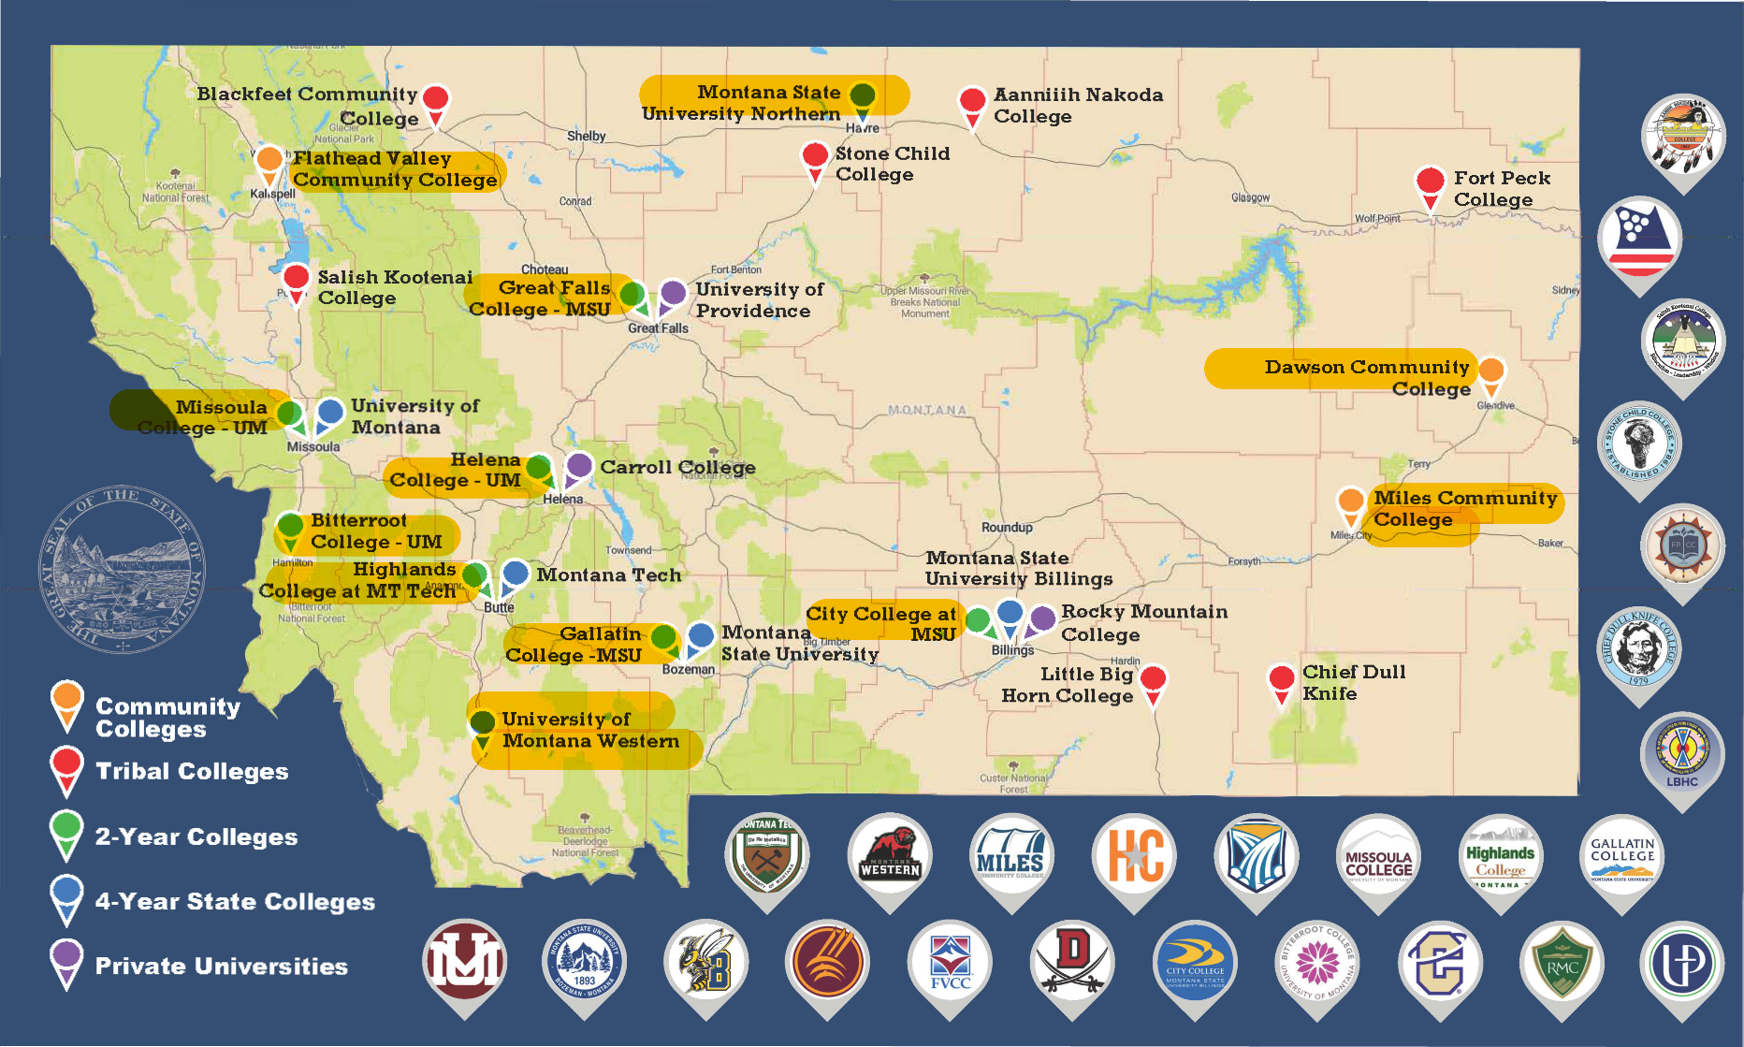
Map of all Higher Ed institutions in Montana
Two-Year Education in the Montana University System:
Understanding our landscape, our challenges, and our promise
September 11, 2019

Slide 4
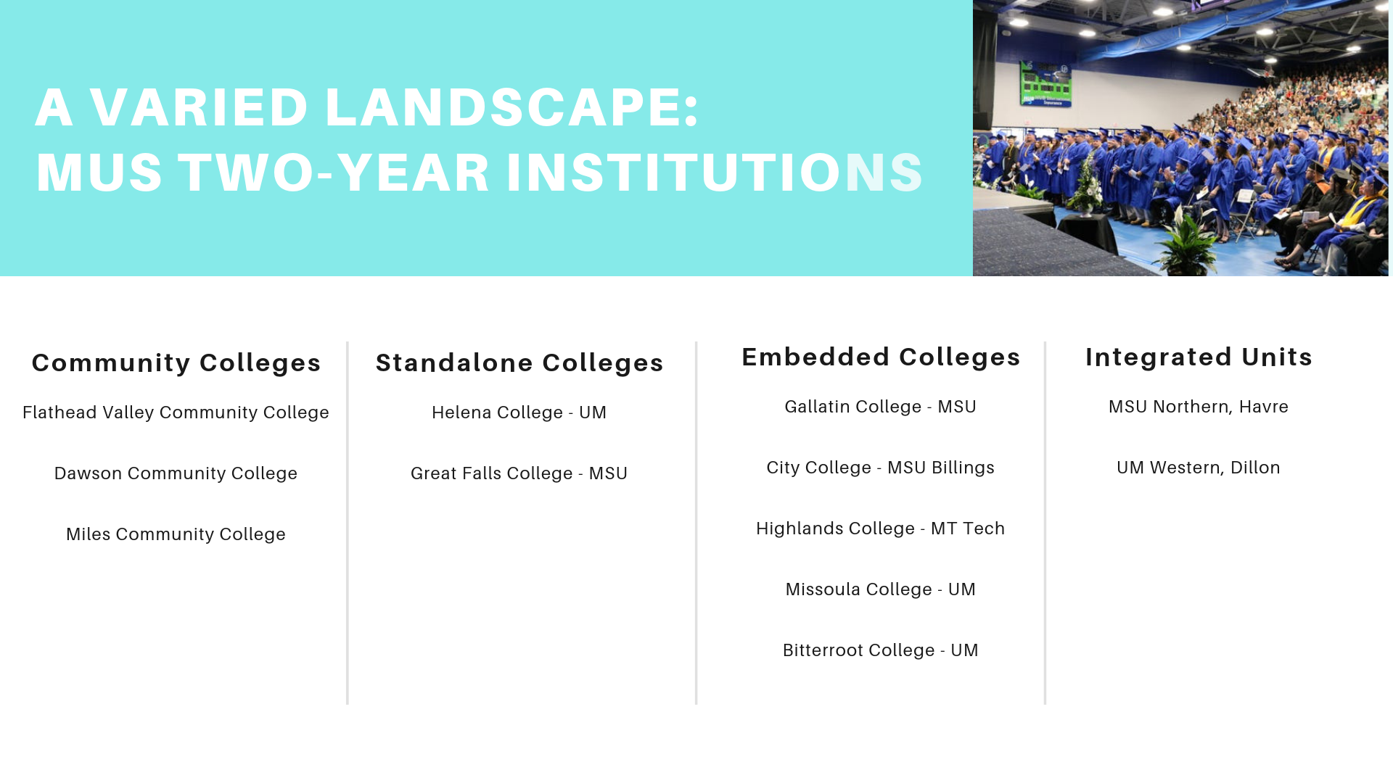
MUS Two-Year Institutions

Slide 5
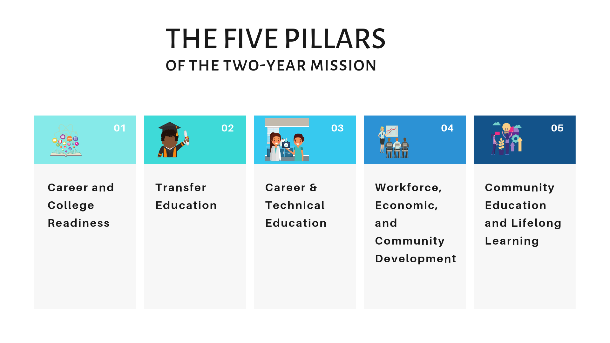
The Five Pillars of the Two-Year Mission

Slide 6
Examples of Mission Fulfillment
Examples of Mission Fulfillment
Career and College Readiness – Connections 101 (Great Falls College)
Transfer Education – Tribal College Transfer (MSU Northern)
Career & Technical Education – Apprenticeship Models (Missoula College)
Workforce, Economic, and Community Development – Lineman Program (Highlands College)
Community Education and Lifelong Learning - Welding Competition (Dawson Community College)

Slide 7
Panel Conversation: Opportunities and Challenges
A Panel Conversation: Opportunities and Challenges
President Jane Karas (Flathead Valley Community College), Dean Susan Wolff (Great Falls College), Dean Tom Gallagher (Missoula College), Dean Dave Gurchiek (Highlands College)
Communicating – to students, families, and communities - the promise of the two-year path
Working with employers to recognize the value of credentials and degrees during hiring and wage setting process
Emphasizing the development of transferrable essential/soft skills within all two-year programs, including CTE
Growing, tracking, and rewarding of non-credit / workforce training programs with industry partners.

