Slide 1
Montana College Application Week Site Coordinator Training Montana University System College Access Team

Slide 2
AGENDA
College Application Week Overview
Key Information
Preparing for College Application Week
During College Application Week
College Access Activities After College Application Week
Questions?

Slide 3
College Application Week Overview
Primary Purpose
Help students with the college application process
School Day Activity
Focused Student Populations
Low-income students
Students who may not otherwise apply
Collaborative Statewide Initiative

Slide 4
College Application Week Overview
2012 – 4 Pilot Schools, 144 Applications
2013 – 84 Schools, 1,777 Applications
2014 – 126 Schools, 2,736 Applications
2015 – 120 Schools, 3,231 Applications
2016 – 139 Schools, 3,811 Applications
2017 – 142 Schools, 3,561 Applications
2018 – 164 Schools, 4,607 Applications
2019 – 175 Schools, 5,701 Applications

Slide 5
Key Information
Montana Colleges have waived application fees during CAW
First year for the Apply Montana Application – more to come in an upcoming webinar.
Online applications available for many campuses
Mail paper application directly to appropriate college(s) immediately following CAW activities
Site Coordinators
Recruit Volunteers when possible
Plan Local Events
Help Students Complete Applications

Slide 6
Key Information
MUS Apply Montana Application
Waived Application Fees
Students may submit MULTIPLE applications to colleges and universities on the waived list.

Slide 7
Key Information
Online Materials
Site Coordinator Handbook
List of Colleges
Links to College Applications, Apply Montana Application
Student and Coordinator Survey Links
Templates for Materials to be Customized

Slide 8
Preparing for CAW
Utilize the Online Materials
https://mus.edu/college-access/collegeappweek.html
Market the Event
Assemble a Team
Reserve a Site/web platform (Computer Lab, Classroom, Zoom, etc.)
Promote Event & Build Enthusiasm
Customize Materials
Implement College and Career Activities
Prepare Students

Slide 9
Preparing for CAW
Preparing for Students
Find the right match
College options
Admission requirements
Program offerings
Identify college(s) to apply to during CAW
Complete the College Application Worksheet (from the toolkit) prior to your school’s event
Notes:
Remind students to be organized about the application process – sometimes creating a new email – that they will remember to check – will assist in keeping things organized. Remind them, that especially in a COVID landscape, online communication is important and that they should be checking email.
ALSO, do we remind them to submit transcripts? Does this happen automatically?

Slide 10
Preparing for CAW
Preparing for Volunteers
Identify and Recruit Volunteers
Let them know why CAW is important
Assign specific duties
Tour of HS campus or review online platform tools (zoom, teams, etc.)
Confirm with volunteers in writing
Online Materials
https://mus.edu/college-access/collegeappweek.html
Recruitment Letter
Duties List
Thank You Letter

Slide 11
During CAW
Remind Students
Review College Participation List
Distribute CAW materials
Track student data – see sign-in sheet.
Make College Participation List Available
Ask the Student to Complete the Survey
Have High School Info Available
CEEB Code
Capture & Celebrate
I Applied Wall

Slide 12
During CAW
Possible Activities
College Apparel Days
Door Decorating
College “Pep” Rally
Parent/Family Night
Homeroom Workshops
Guest Speakers
Raffles or College Gear Giveaways
College Trivia Contests
Have Fun and Create Excitement!

Slide 13
During CAW
For Students
APPLY TO COLLEGE!
Print our application confirmation page
Complete student survey
Let site coordinator know how many colleges and which ones applied to
Collect the “I Applied, Now What?” Handout

Slide 14
After CAW
For Site Coordinators
Complete Site Coordinator Survey by Friday, October 16 to be eligible as a school of excellence
Hold a Debriefing with Volunteers & Staff
Send Thank You Notes
Prepare a Press Release
Share Your School’s Story with the OCHE College Access Team (collegeaccess@montana.edu)
Assist students in sending transcripts/submitting test scores – Application is only one part of the process

Slide 15
After CAW
For Students
Register to Retake the ACT/SAT
Sign Up for an FSA ID & Plan to Participate in FASFA Events
Apply for Scholarships
Share College Acceptances
Plan to Participate in Decision Day

Slide 16
College Access Activities to Come
FASFA Completion Month to be determined
C.A.P Week April 1-5. 2023
Decision Day May 6-10, 2023

Slide 18
Preparing for a Hybrid/Online Event
Provide your colleagues with a communication calendar and students task timeline. Ask them to assist with reinforcing messages.
Share how you will communicate with students – formats and frequency
State your goals so that it will be easier to evaluate your success
colleagues with a communication calendar and students task timeline. Ask them to assist with reinforcing messages.
Share how you will communicate with students – formats and frequency
State your goals so that it will be easier to evaluate your success

Slide 19
Identify the Type of Event you are hosting

Slide 20
Explore how you plan to deliver information

Slide 21
Promotion, promotion, promotion
This is the most important step.
How are your students receiving information?
Surveys indicate that 85% of students prefer LIVE video or written content or videos.

Slide 22
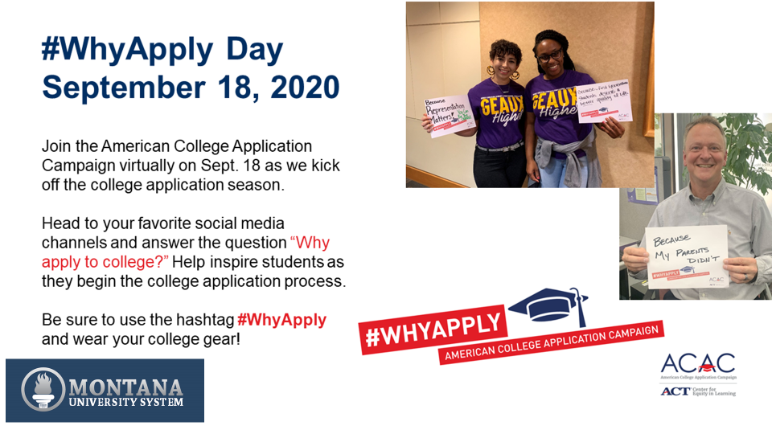

Slide 23
Big Thank You to our Partners

Slide 24
Questions
Contact the OCHE College Access Team at
collegeaccess@montana.edu
406-449-9138

