Slide 1
2023-2024 Dual Enrollment Report Office of the Commissioner of Higher Education
Chase Stahl, Data Specialist

Slide 2
Dual Enrollment Report
Dual Enrollment Counts
Participation Rates
Modality & Credit Type
Matriculation Rates
Comparative Statistics

Slide 3
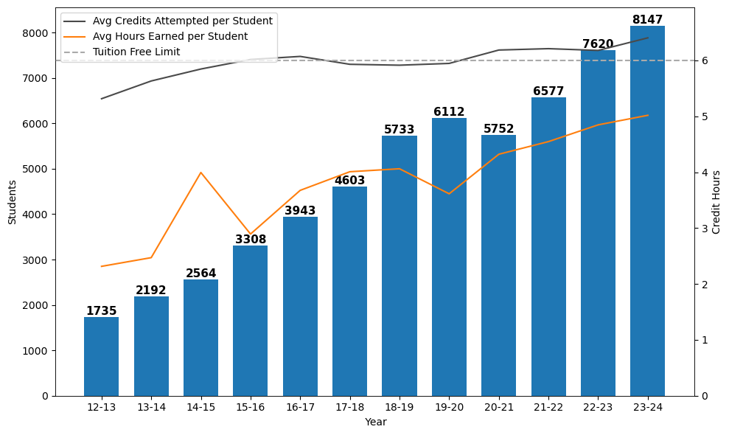
Dual Enrollment Count by Year
15.5% enrollment growth per year
6.9% enrollment growth from 2022-23
Unduplicated enrollment count

Slide 4
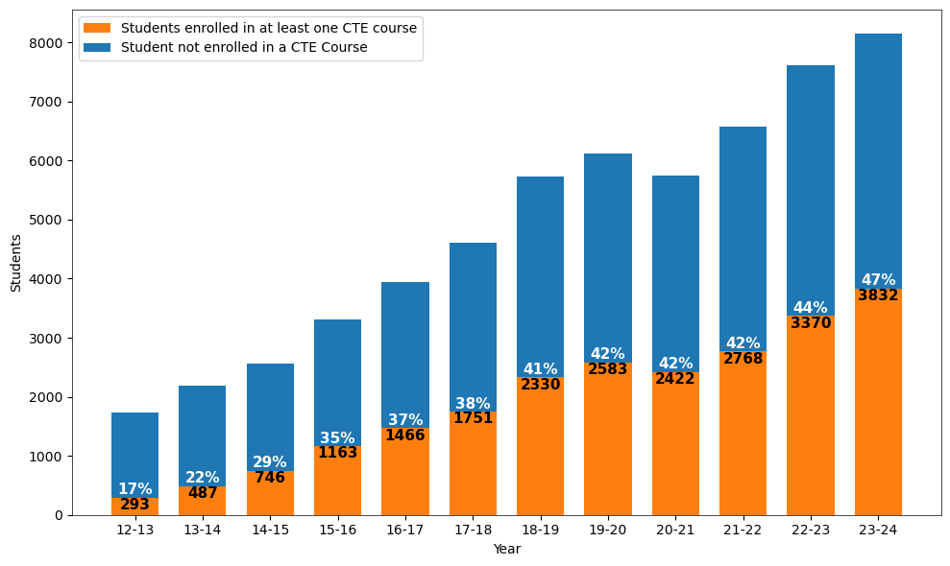
CTE Dual Enrollment Count by Year
15.3% CTE growth per year since 2016-17
13.7% increase from 2022-23
Unduplicated enrollment count

Slide 5
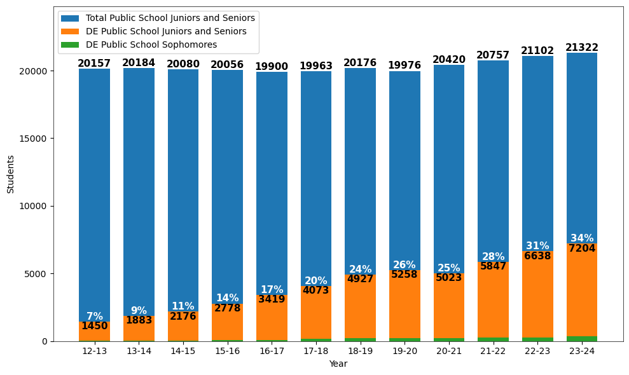
Public Student Participation in DE
88.4% of DE students attended a public high school in 2023-24
Age used to determine grade

Slide 6
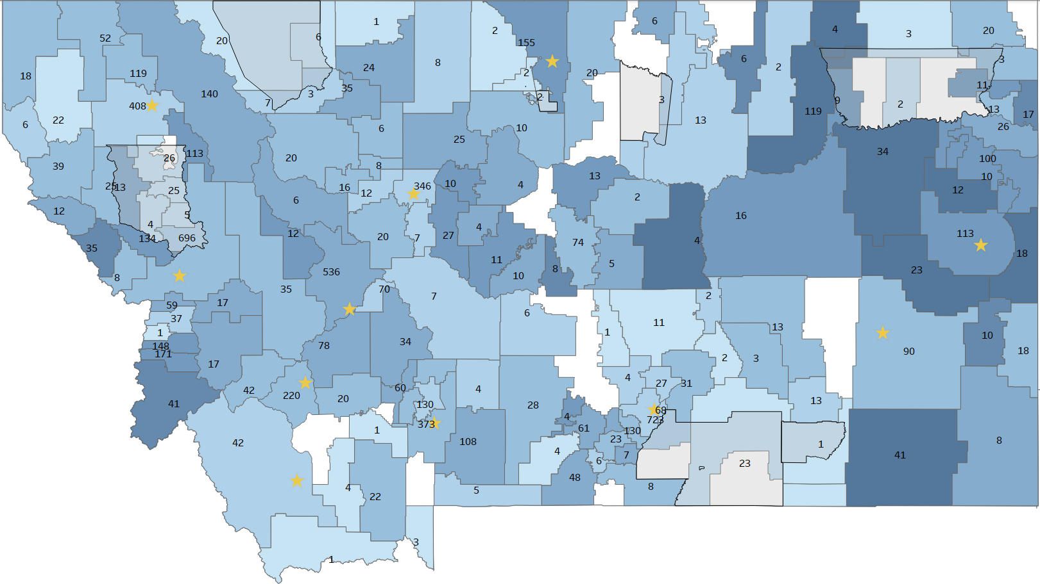
23-24 DE District Participation Rates & Counts
Participation Rates = DE Students in district / Total Juniors & Seniors in district
Number displayed = DE Students in District
.34
Only Public HS Students

Slide 7
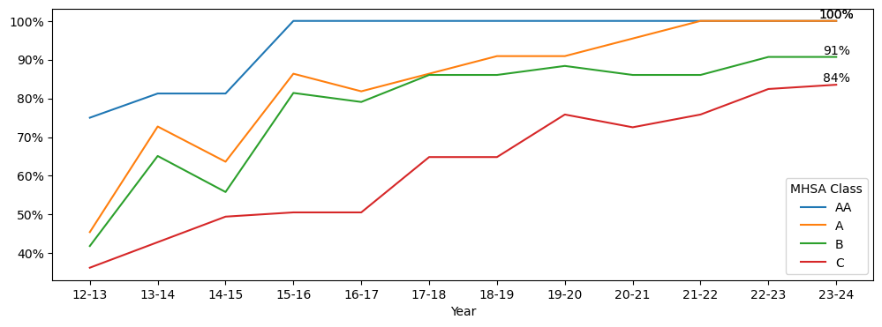
Public HS Participating in DE by MHSA Class
MHSA Class | HS with at least 1 DE Student in 2023-24 | Total MHSA High Schools in 2023-24
AA | 16 | 16
A | 22 | 22
B | 39 | 43
C | 76 | 91 | US Avg 89%
Total | 153 | 172 | 88.9%
23-24 MHSA classes applied to all years

Slide 8
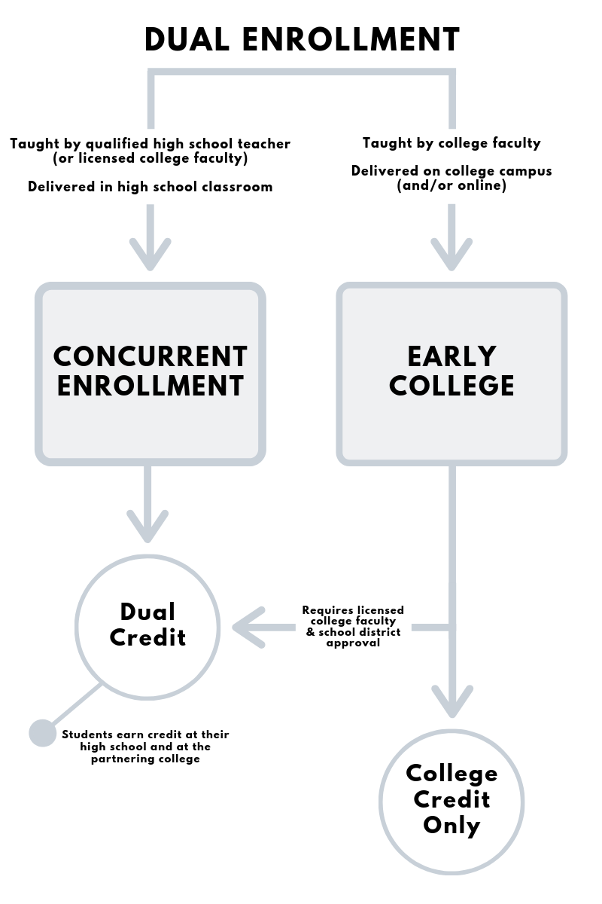
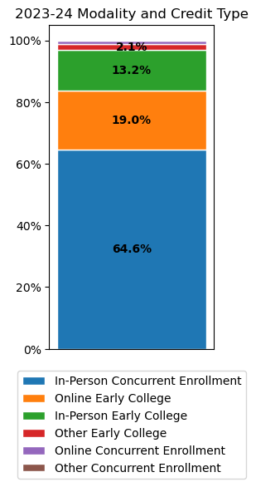
DE Modality & Credit Type
Online
In-Person In-Person

Slide 9
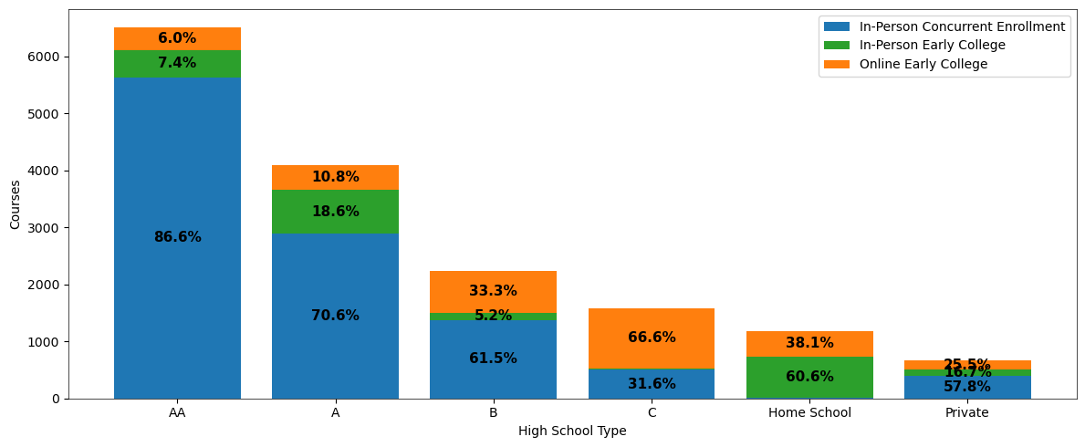
2023-24 DE Course Modality & Credit Type by HS Type
Pass Rates = Credit Hours Earned / Credit Hours Taken
Modality & Credit Type | AA | A | B | C | Home School | Private
In-Person Concurrent | 84.4% | 70.4% | 82.0% | 91.2% | 72.7% | 95.0%
In-Person Early College | 63.2% | 80.7% | 38.9% | 96.9% | 42.2% | 52.7%
Online Early College | 70.9% | 63.3% | 78.6% | 88.2% | 66.7% | 76.8%

Slide 10
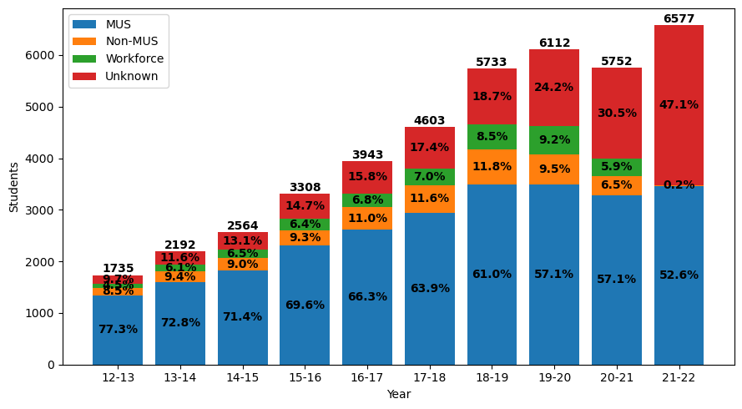
Matriculated DE Students by Year
* Only MUS data
Questions | Color
Did the student ever enroll in the MUS?
If not, did the student ever enroll outside of the MUS?
If not, was the student employed in Montana 2 years after participation in DE?
If none of the above, student categorized as other

Slide 11
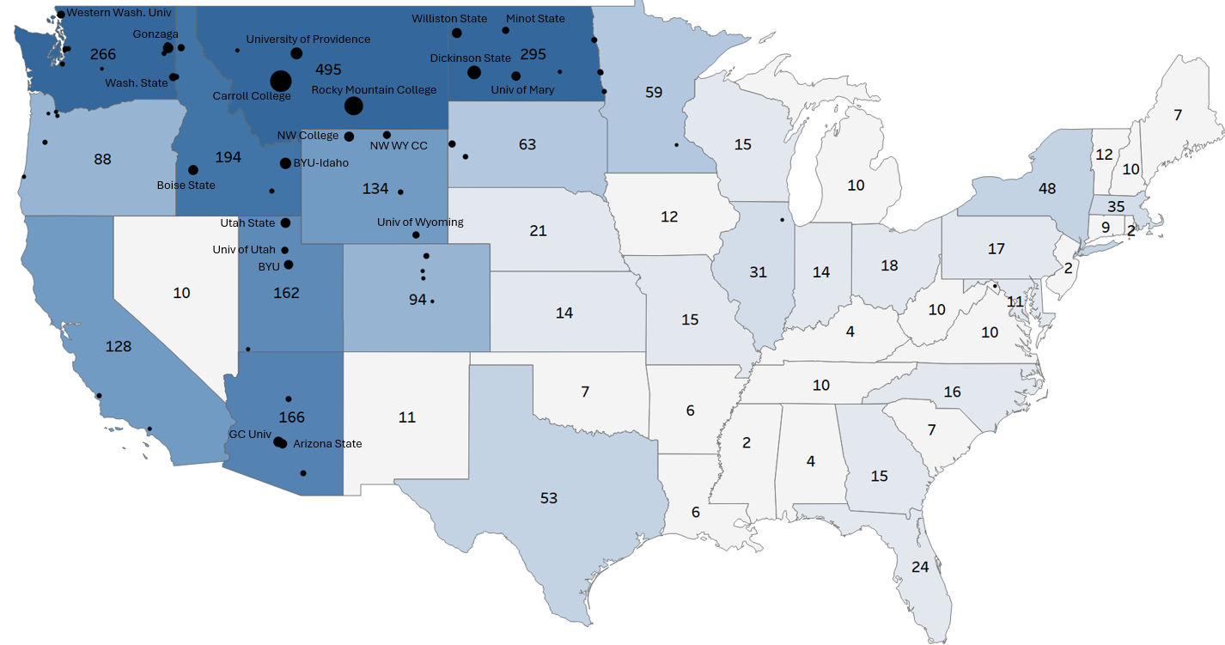
Matriculated DE Students by State
Top Majors
Undeclared
Biology
Nursing
Psychology
Business
Exercise Science
Elementary Education
Alaska- 6
Hawaii- 10
10 Students
40 Students
Top 20 Institutions Indicated by Name
Top 60 Institutions Indicated by
6.5% of all DE students matriculated outside of the MUS

Slide 12
Comparative Statistics
Metrics | DE Students in MUS | MUS (excludes DE)
Fall 2022 to Fall 2023 Retention (First-Time Freshman 2022 Cohort) | 80.4% | 63.9%
2 Year Associates Grad Rates (2022 Cohort) | 23.9% | 20.2%
4 Year Associates Grad Rates (2020 Cohort) | 37.8% | 28.9%
4 Year Bachelors Grad Rates (2020 Cohort) | 40.5% | 35.6%
8 Year Bachelors Grad Rates (2016 Cohort) | 61.3% | 50.8%
Upon graduation, DE students average $570 less in student loans per DE credit than non-DE graduates

Slide 13
Key Takeaways
DE & CTE DE counts and public school participation rates continue to increase
In-person concurrent enrollment is the primary credit type for DE
Online early college is more common in Class B & C schools
53-61% MUS matriculation rates for 2018-2022 DE cohorts
DE students have higher retention rates and graduation rates than non-DE students

