Slide 1

2022-2023 Annual Dual Enrollment Report
Office of the Commissioner of Higher Education
Chase Stahl, Data Specialist

Slide 2
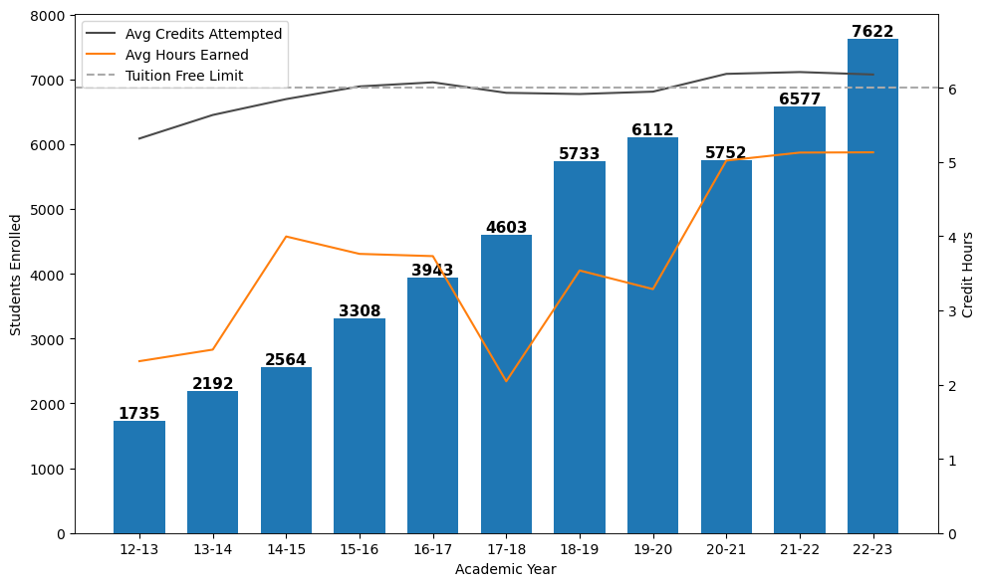
Dual Enrollment Count by Year
16.4% enrollment growth per year
15.9% increase from 2021-22

Slide 3
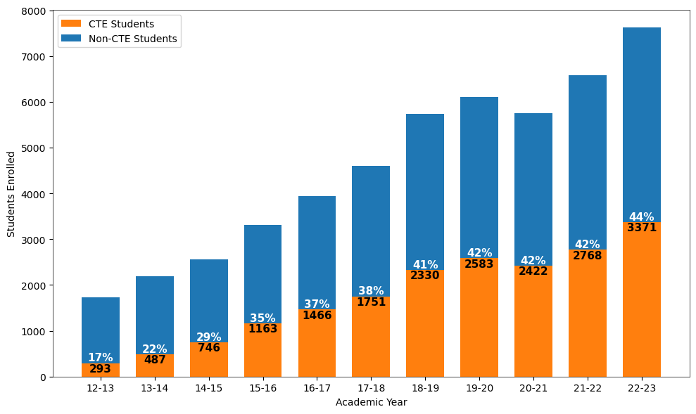
CTE Dual Enrollment Count by Year
15.5% CTE growth per year since 2016-17
21.8% increase from 2021-22

Slide 4
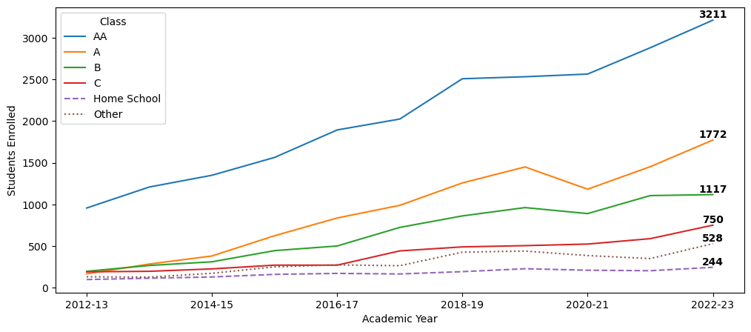
Dual Enrollment Count by MHSAA Class
MHSAA Class | Avg % Change per Year
AA | 13.2%
A | 28.9%
B | 20.2%
C | 15.9%

Slide 5
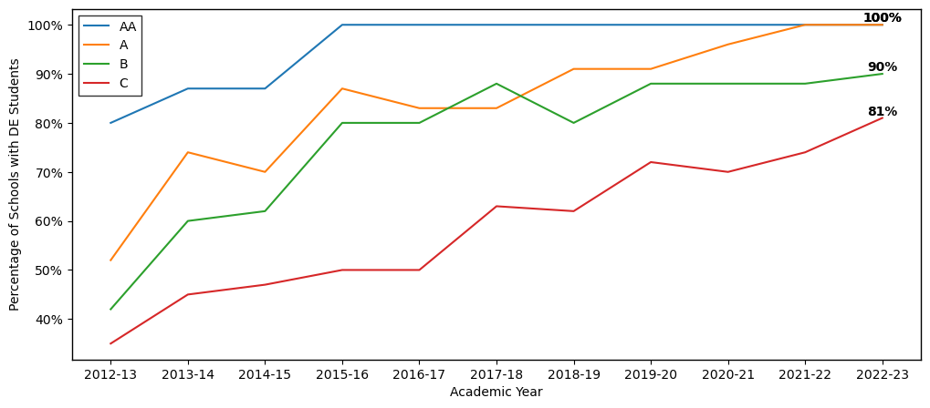
Increasing Share of MT High Schools Participating in Dual Enrollment
MHSAA Class | Number of HS with at least 1 Dual Enrollment Student in 2022-23 | Total MHSAA High Schools in 2023
AA | 16 | 16
A | 23 | 23
B | 36 | 40
C | 83 | 103

Slide 6
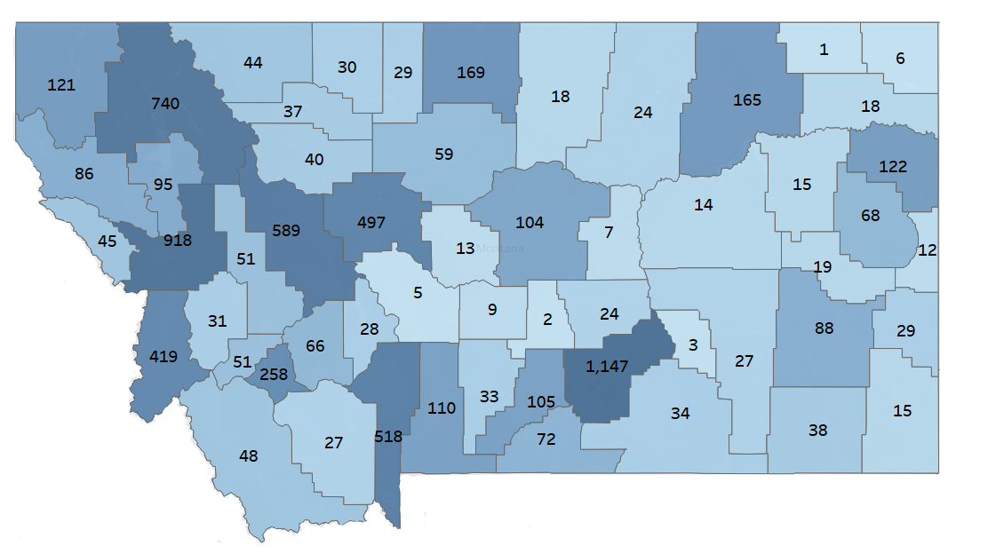
Dual Enrollment Count by County
Number displayed = total dual enrollment students
Every county had at least one student participate in DE in 2022-23

Slide 7
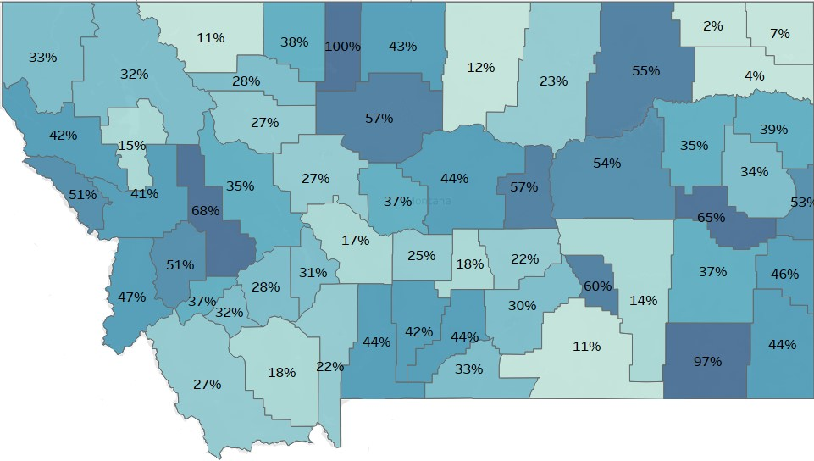
Participation Rates by County
Participation Rates = total public dual enrollment students / total public high school junior and seniors
31% of MT public high school junior and seniors participated in DE in 2022-23

Slide 8
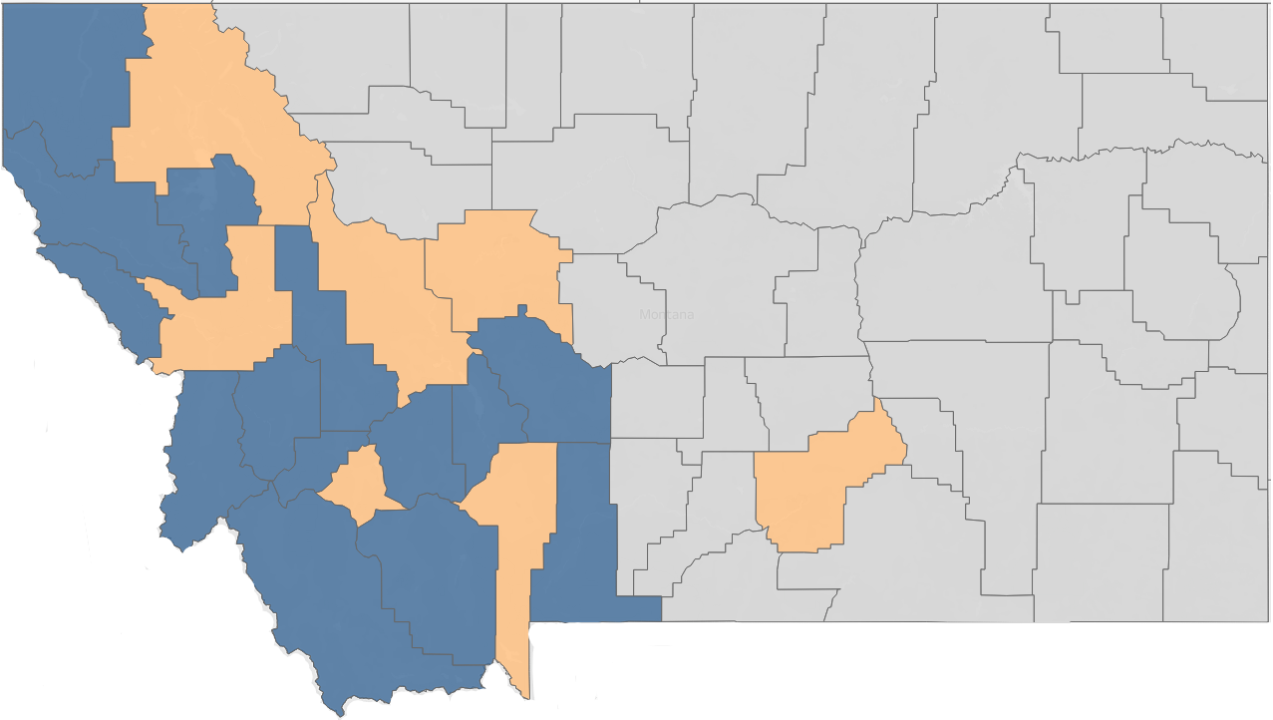
Dual Enrollment Participation by Region
Participation rates = total public dual enrollment students / total public high school junior and seniors
Color | Region | Participation Rates | % of DE Students Taking CTE Courses
 | Urban | 31.1% | 43.3%
 | Mountains | 35.7% | 39.0%
 | Prairie | 33.2% | 47.6%

Slide 9
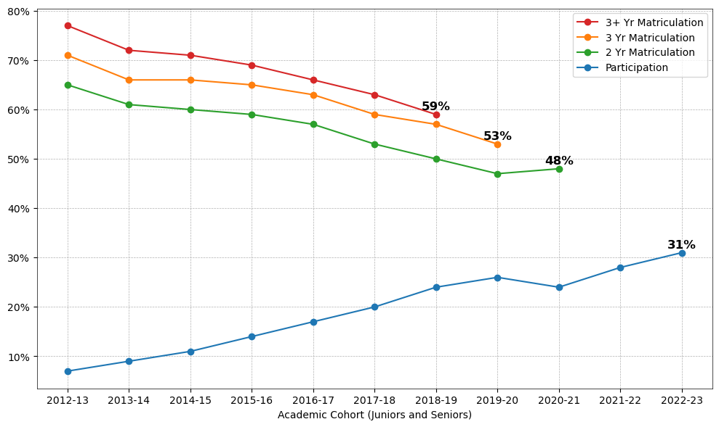
Participation and Matriculation Rates
89% of matriculated DE students enrolled within 2 years

Slide 10
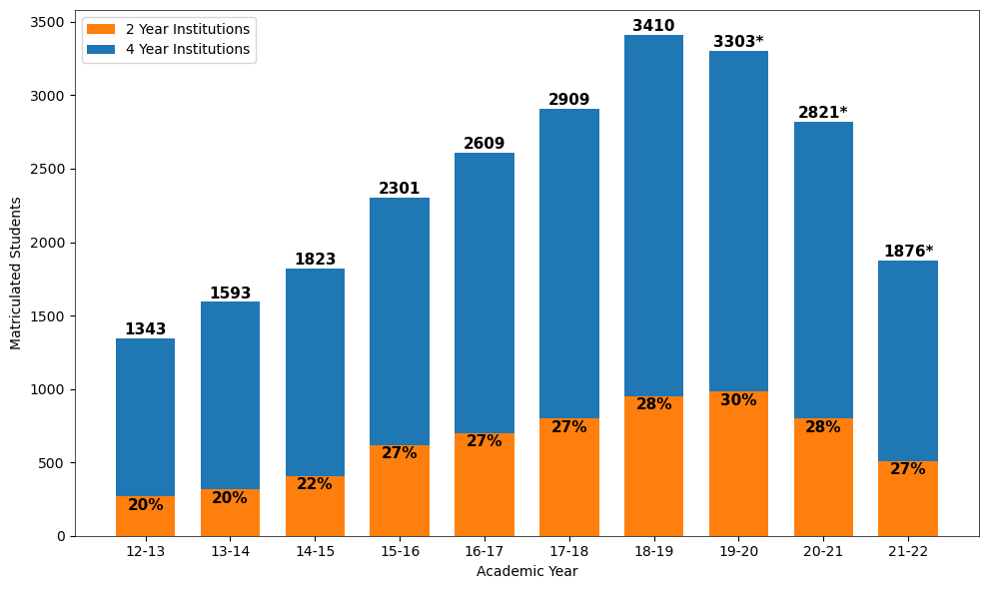
Dual Enrollment Students in the MUS by Year
16.9% matriculation growth per year from 2012-13 to 2018-19
* asterisk indicates expected increase

Slide 11
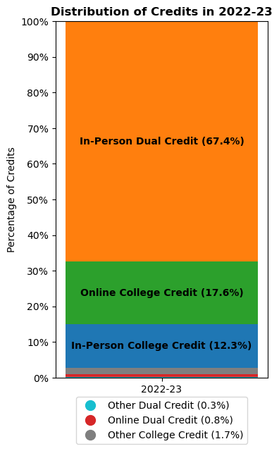
Dual Enrollment Coursework
Top 3 CTE Subjects
Welding
Computer Applications
Allied Health: Medical Support
Top 3 General Education Subjects
Communications
American History
Psychology
Top 3 Math or Writing Subjects
College Writing
College Algebra
Precalculus

Slide 12
Key Takeaways
16% dual enrollment growth rate per year – record enrollment
44% of students have taken CTE classified courses – record enrollment
Consistent growth in Class B & C high schools
87% of MHSAA HS offer dual enrollment
  88% is the national average (Dept. of Ed.)
31% statewide DE participation in public schools – record participation
  34% is the national average (Dept. of Ed.)
Roughly 59% of all DE students matriculate into the MUS
67% of DE credits are taken as dual credit and in-person at the high school

