Slide 1

2024-2025 Dual Enrollment Report Office of the Commissioner of Higher Education
Chase Stahl, Data Specialist

Slide 2
Overview
DE Counts
Participation Rates
Course Modality & Credit Type
Pass Rates
Top Courses & Subjects
Matriculation Rates
New National Student Clearinghouse Data
Graduation Rates: DE Students in the MUS
Key Takeaways

Slide 3
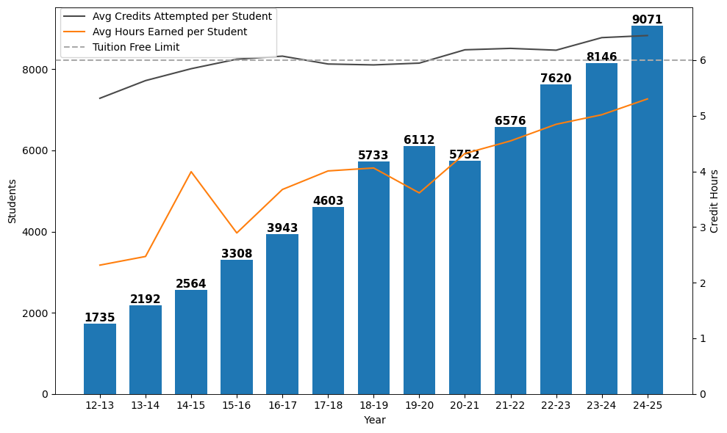
Dual Enrollment Count by Year
15.2% enrollment growth per year
11.4% enrollment growth from 2023-24 (7% US Avg - NSC)

Slide 4
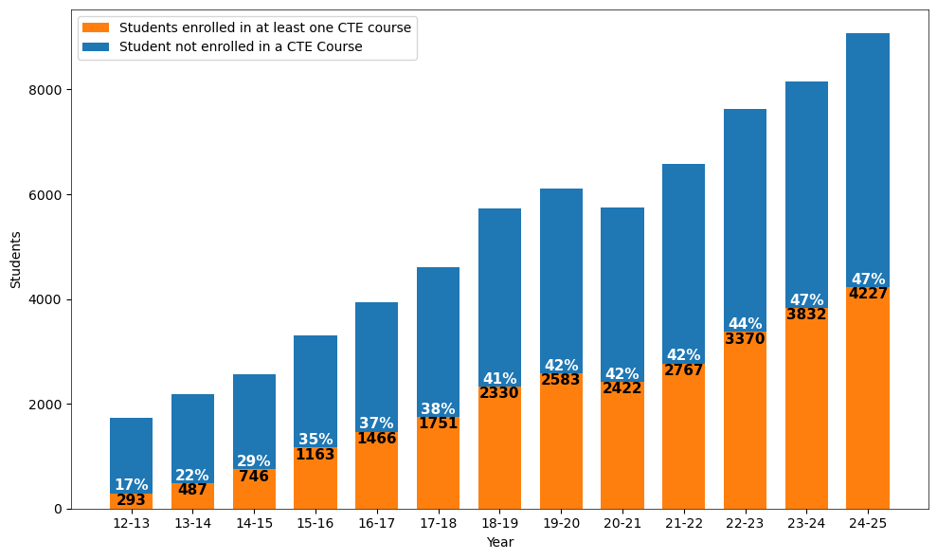
CTE Dual Enrollment Count by Year
14.6% CTE growth per year since 2016-17
10.3% increase from 2023-24
NCES 2-digit CTE CIP Codes

Slide 5
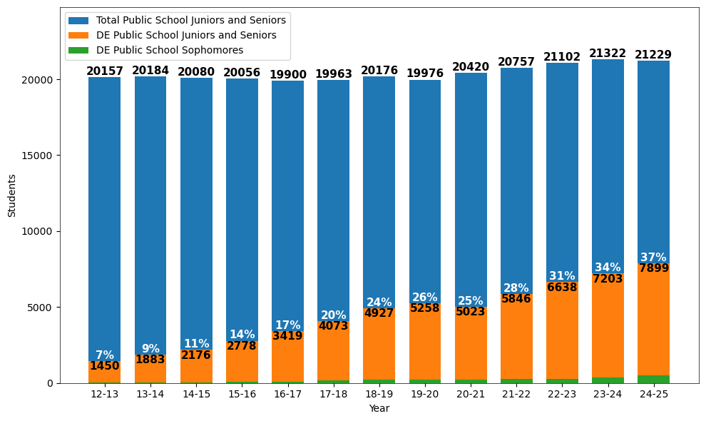
Public Student Participation in DE
87.1% of DE students attended a public high school in 2024-25
Age used to determine grade

Slide 6
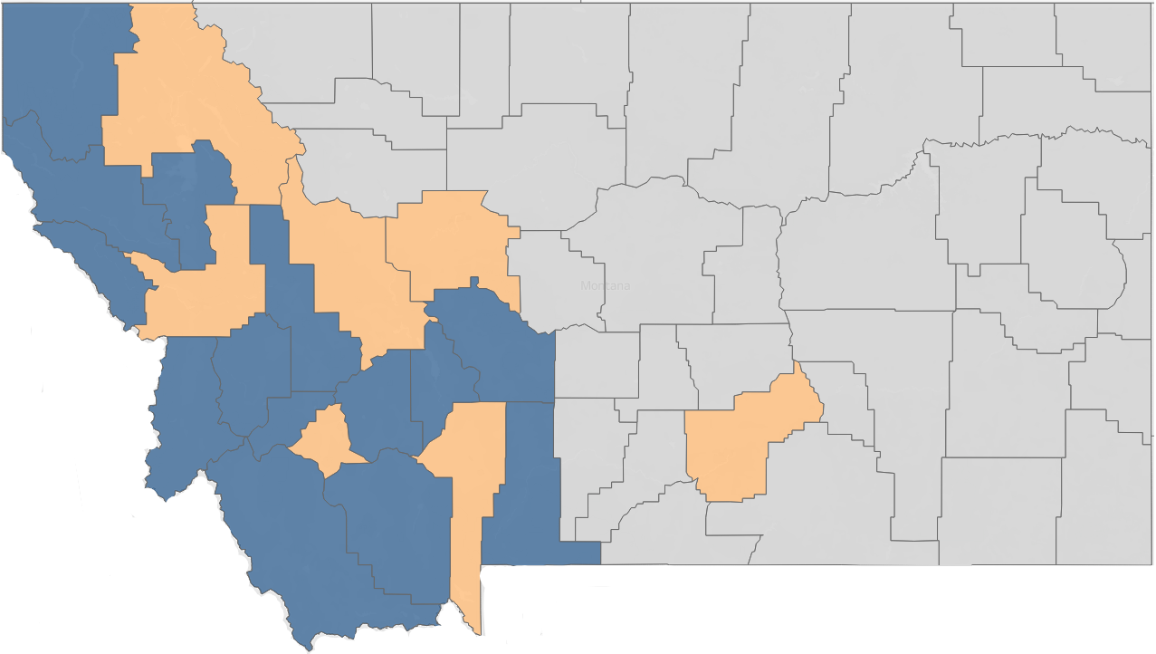
2024-25 DE Participation Rates by Region
Participation rates = total public dual enrollment students / total public high school junior and seniors
Color | Region | Participation Rates | % Change from Last Year
 | Urban | 37.3% | +4.7%
 | Mountains | 37.6% | +2.0%
 | Plains | 38.3% | +2.1%

Slide 7
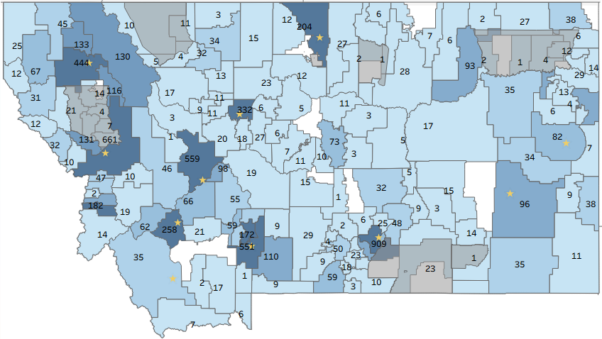

2024-25 Dual Enrollment Count by District
Number displayed = total public dual enrollment students
87.1% of DE students attended a public high school in 2024-25

Slide 8
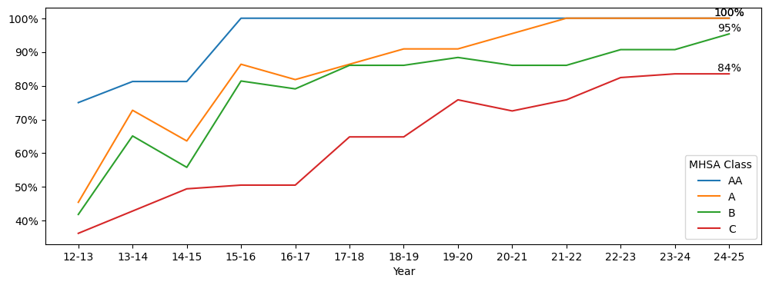
Public HS Participating in DE by MHSA Class
MHSA Class | HS with at least 1 DE Student in 2024-25 | Total MHSA High Schools
AA | 16 | 16
A | 22 | 22
B | 41 (+2) | 43
C | 76 | 91 | US Avg 90%
Total | 155 | 172 | 90.1%
23-24 MHSA classes applied to all years

Slide 9
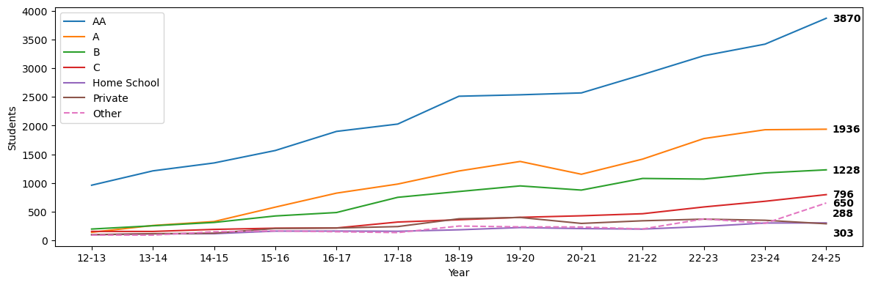
Dual Enrollment Count by HS Types
HS Type | Avg % Change per Year | % Change from 2023-24 | Pass Rates
AA | 12.6% | 13.2% | 81.9%
A | 27.4% | 0.5% | 82.9%
B | 17.6% | 4.5% | 80.4%
C | 15.2% | 17.1% | 88.2%
Home School | 10.9% | 0.7% | 73.1%
Private | 12.1% | -17.5% | 88.4%
Other | 25.6% | 119.6% | 81.3%
23-24 MHSA classes applied to all years

Slide 10
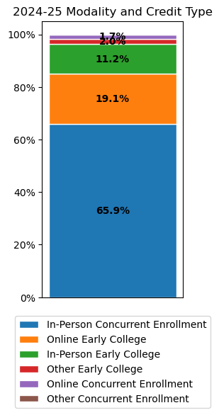
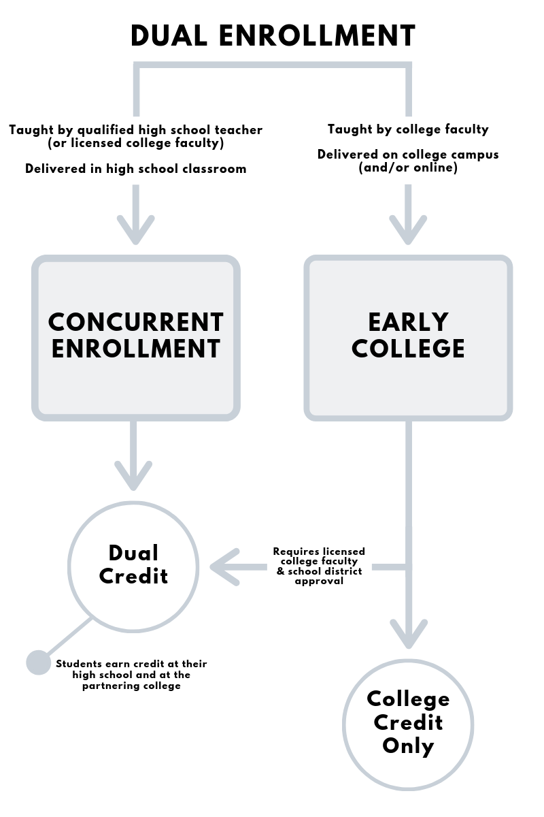
DE Modality & Credit Type
Online
In-Person In-Person

Slide 11
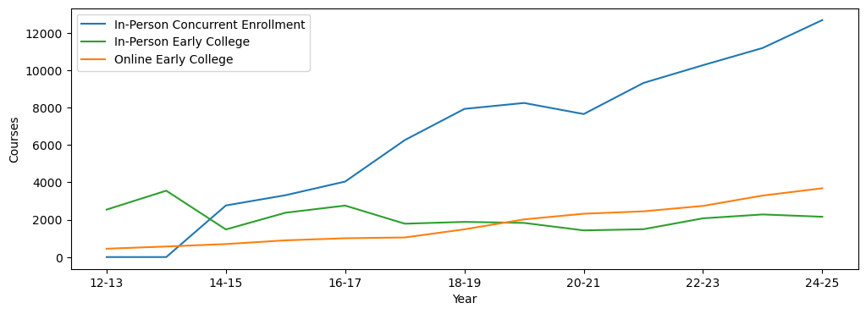
DE Course Modality & Credit Type by Year
Pass Rates = Credit Hours Earned / Credit Hours Taken
Modality & Credit Type | Pass Rates (all years) | 2024-25 Pass Rates
In-Person Concurrent | 73.2% | 82.8%
In-Person Early College | 49.4% | 74.3%
Online Early College | 80.1% | 83.8%
Total (all modes) | 69.9% | 82.3%

Slide 12
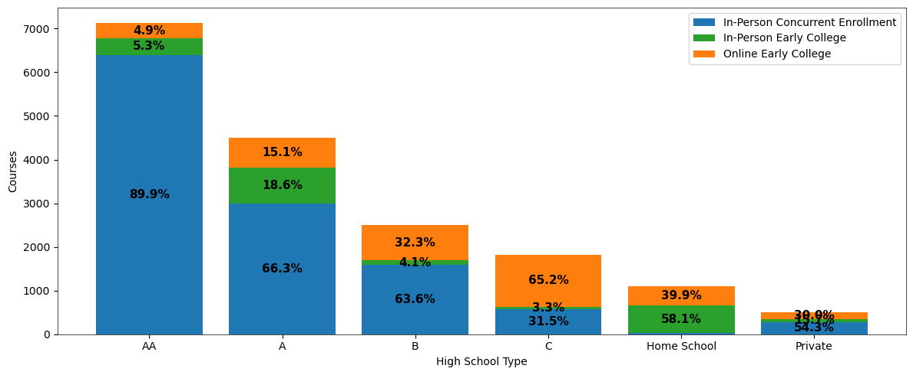
2024-25 DE Course Modality & Credit Type by HS Type
Pass Rates = Credit Hours Earned / Credit Hours Taken
Modality & Credit Type | AA | A | B | C | Home School | Private
In-Person Concurrent | 82.7% | 82.6% | 78.6% | 85.3% | 85.5% | 88.5%
In-Person Early College | 67.1% | 86.3% | 73.9% | 76.1% | 63.4% | 56.4%
Online Early College | 78.1% | 78.8% | 83.5% | 90.2% | 82.1% | 79.5%

Slide 13
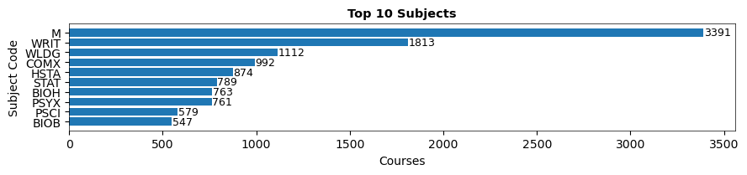
2024-25 Top 10 Enrolled General & CTE Courses
Top 10 General Courses
College Writing I
College Algebra
Intro to Statistics
Precalculus
Intro to American Government
American History I
American History II
Intro to Literature
Intro to Psychology
Probability and Linear Math
Top 10 CTE Courses
Intro to Public Speaking
Medical Terminology
Welding Theory I Practical
Intro to Business
Welding Theory I
Welding Qualification Test Prep
Career Development & Interpersonal Skills
Intro to Interpersonal Communication
Basic Microsoft Office
Child and Adolescent Development
NCES 2-digit CTE CIP Codes

Slide 14
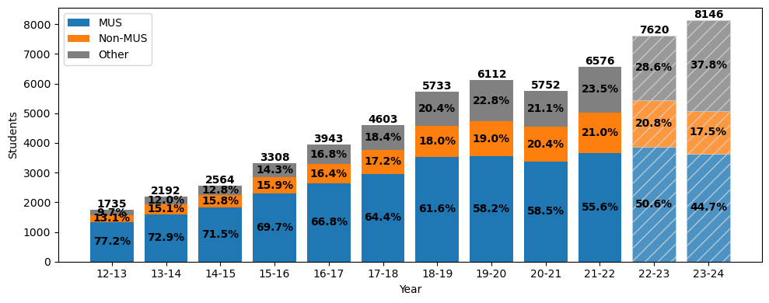
Matriculated DE Students by Year
*Shading indicates expected growth*
Questions | Color
Did the student ever enroll in the MUS? | OCHE Data (includes Fall 2025 CENSUS)
If not, did the student ever enroll outside of the MUS? | Spring 2025 NSC
If neither, then categorized as other
68.3% of all DE students continue their education and enroll after DE
52.3% of all DE students matriculate into the MUS

Slide 15
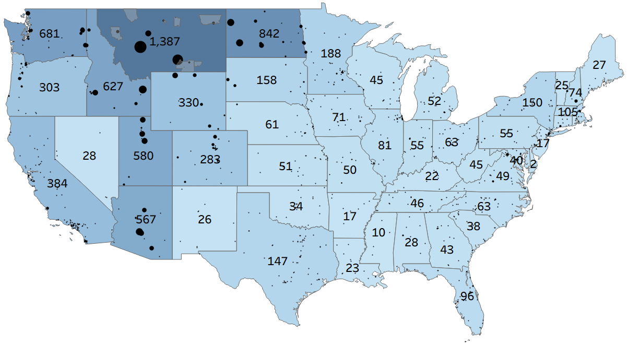
Non-MUS Matriculation
Top 30 Matriculated Institutions Indicated by Name
Western Washington University
Williston State
Gonzaga University
Salish Kootenai College
University of Providence
North Idaho College
Bismark State College
Dickinson SU
Washington State University
Carroll College
Rocky Mountain College
University of Mary
Oregon State University
Northern Wy CC
Northwest College
Black Hills
Boise State University
BYU-Idaho
Utah State University
University of Wyoming
University of Utah
Brigham Young University
Top Majors
Undeclared
Biology
Nursing
Psychology
Business
Exercise Science
Elementary Education
Northern Arizona University
Grand Canyon University
Arizona State University
Alaska- 19
Hawaii- 53
50 Students
250 Students
University of Arizona
16.0% of total DE students matriculated outside the MUS
NSC Spring 2025 data

Slide 16
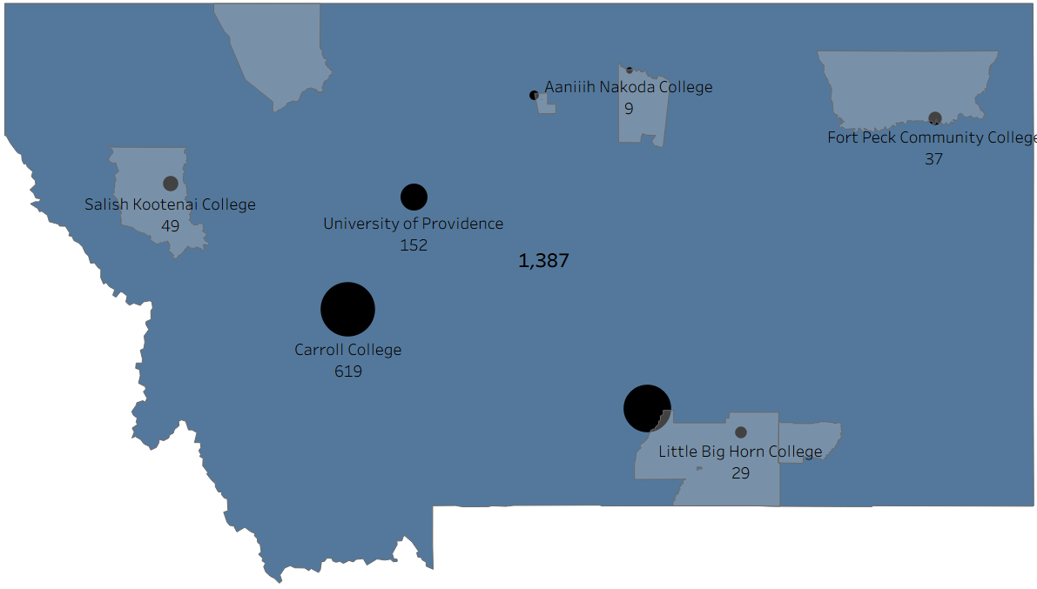
Montana Non-MUS Matriculation
Blackfeet Community College
Stone Child College
19
Rocky Mountain College
473
Chief Dull Knife College
*Only National Student Clearinghouse participating institutions matriculated student count displayed
16.8% of non-MUS matriculated students enroll in Montana institutions
NSC Spring 2025 data

Slide 17
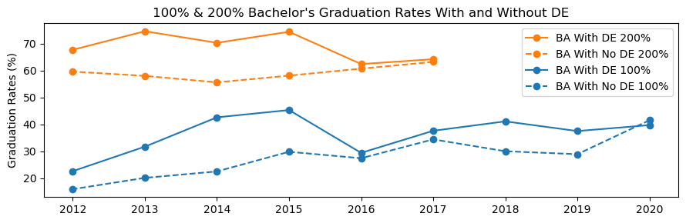
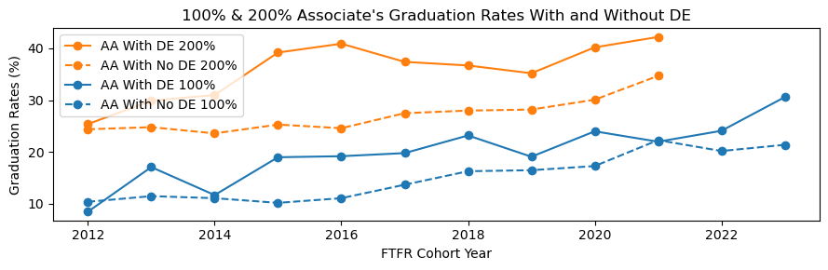
DE Students in the MUS: Graduation Rates

Slide 18
Key Takeaways
Continued and sustained growth in Dual Enrollment
Public participation rates continue to rise (~3% per year)
In-person concurrent enrollment is the primary credit type for Class AA & A
Online early college is the primary credit type for Class B & C schools
Pass rates continue to increase
7/10 students enroll after DE
MUS students that participated in DE have higher graduation and retention rates
Upon graduation, DE students average $570 less in student loans per DE credit than non-DE graduates

