Slide 1
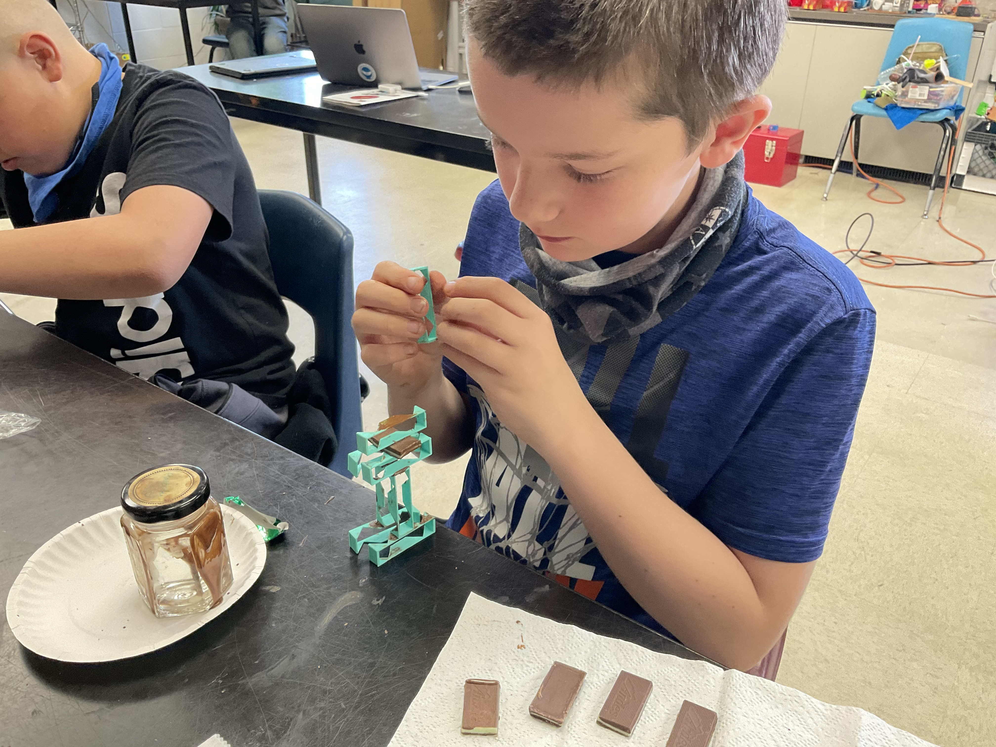
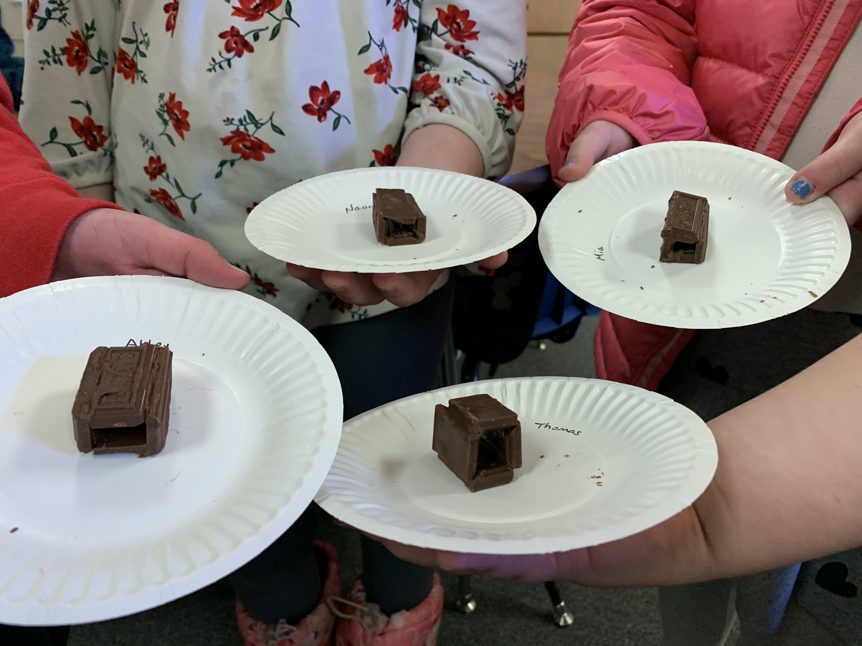

iGraduate Project:
The Bitterroot After-School Career Academy
Nathalie Wolfram
Director

Slide 2



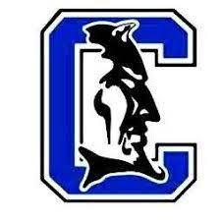

Partners
Office of the Commissioner of Higher Education, Office of Public Instruction, Dennis and Phyllis Washington Foundation, and Montana Department of Labor and Industry
AY21-22 Project Partners:
Hamilton Middle School
Corvallis Middle School
Ravalli County 4H

Slide 3
Project Goals
Increase eighth-grade students’ awareness of and interest in:
Locally in-demand careers in technical fields
Relevant post-secondary educational pathways
CTE and other educational opportunities available locally for high school students

Slide 4

AY20-21

Slide 5
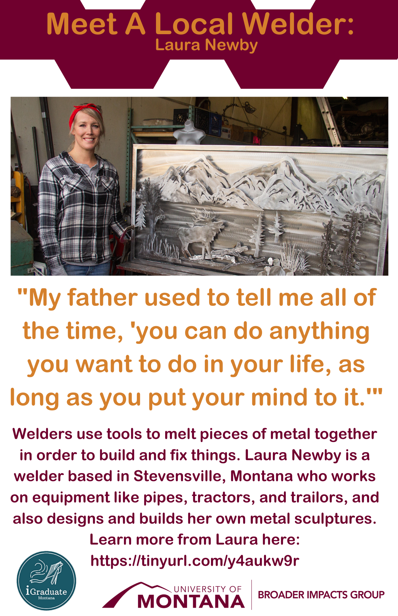
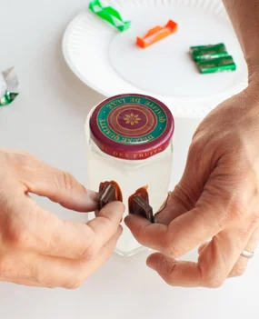
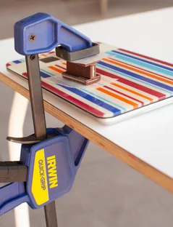
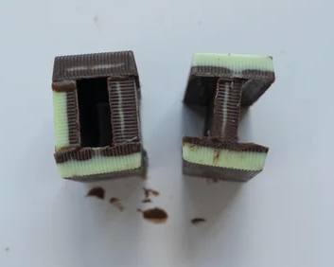
Welding with Chocolate

Slide 6
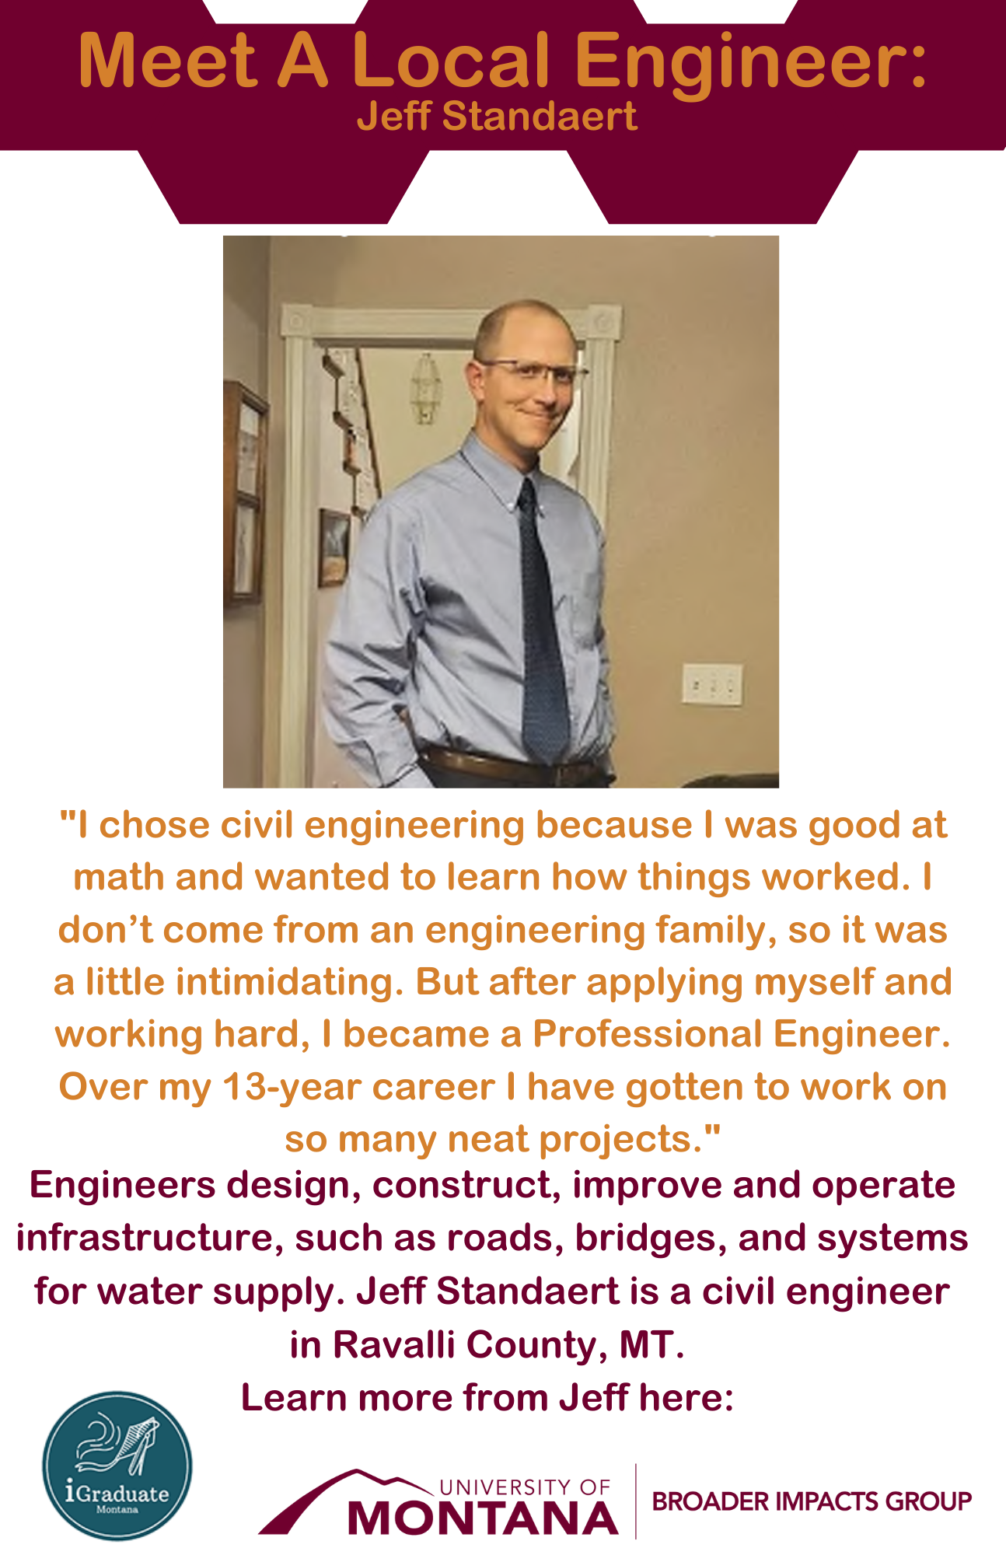
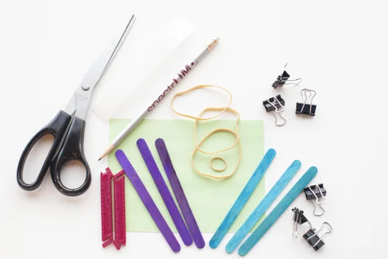
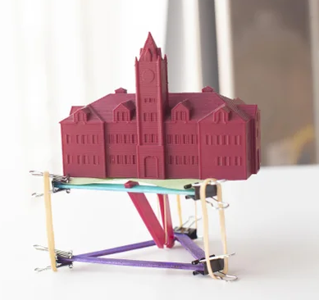
Engineering a Tensegrity Table

Slide 7
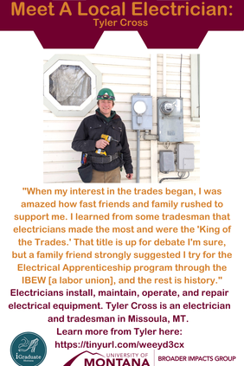
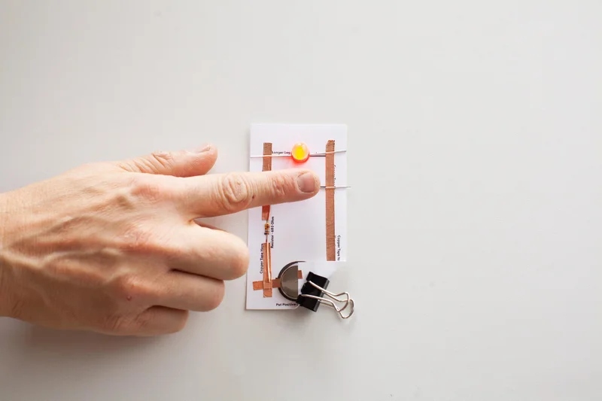
Build a Sensor-Activated Night Light

Slide 8
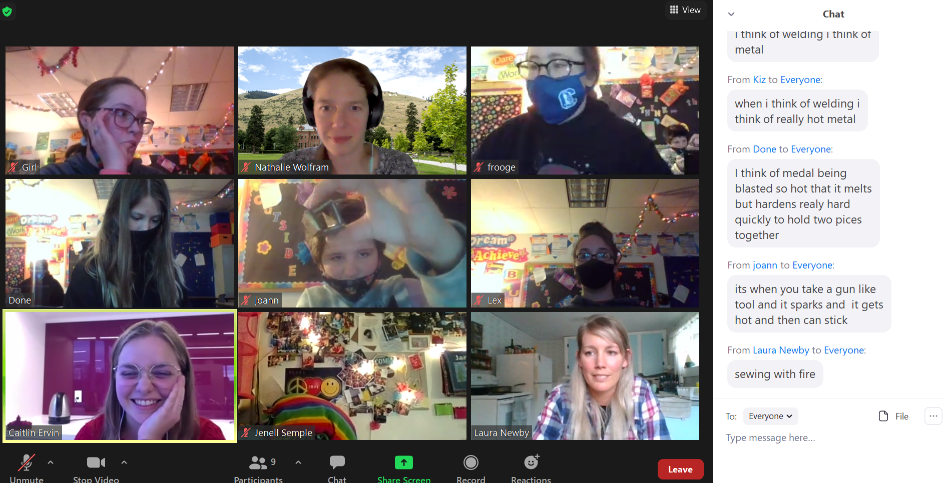

Slide 9
AY21-22: What’s Next
Fall 2021: Health Careers Club (6 weeks, in person)
Spring 2022: Trades Club (6 weeks, in person)
Hands-on activities connected to careers
Field trip to Missoula College
Visits with career role models

Slide 10
Lessons Learned
Doing a hands-on activity together builds connections between students and role models.
Despite its limitations, Zoom expands the possibilities.
Consider ways to extend impact with inexpensive, take-home activities.

