Slide 1

Ronan High School
iGraduate
Jessica Johnson RHS Vice Principal
Heather Gray Business Ed Teacher
Julian Strait RHS Senior/Intern

Slide 2
RHS iGraduate Info/Background Jessica
The RHS iGraduate grant has been instrumental in the collaboration between Ronan High School, CSKT, and local businesses in order to prepare students for college and/or careers. This project is designed around communication, collaboration, and building relationships with the hope that we learn from one another and come together to support our students as they explore their interests.
iGraduate has allowed for a variety of opportunities for our students through college visits, internships, and family engagement. The RHS iGraduate program is focused on increasing the American Indian high school graduation rate, increasing student enrollment in college and work readiness opportunities through the Flathead Reservation.

Slide 3
RHS CTE
Family Consumer Sciences
Construction & Drafting
Ag. Mechanics
Ag. Operations
Ag. Science
Ag. Natural Resources
Medical Terminology
CNA Certification
CTE Math
Vocational Internships
Business Applications
Yearbook Publication
College & Career Readiness
Work Release
STEM Lab
Engineering
Computer Science

Slide 4

R-Cantina Food Trailer
Come out and support our
Career and Technical Student Organizations
Buy a taco meal or two!
The Flying R Trailer will be located next to the Ronan Cooperative Brewery.
R-Cantina News Release

Slide 5
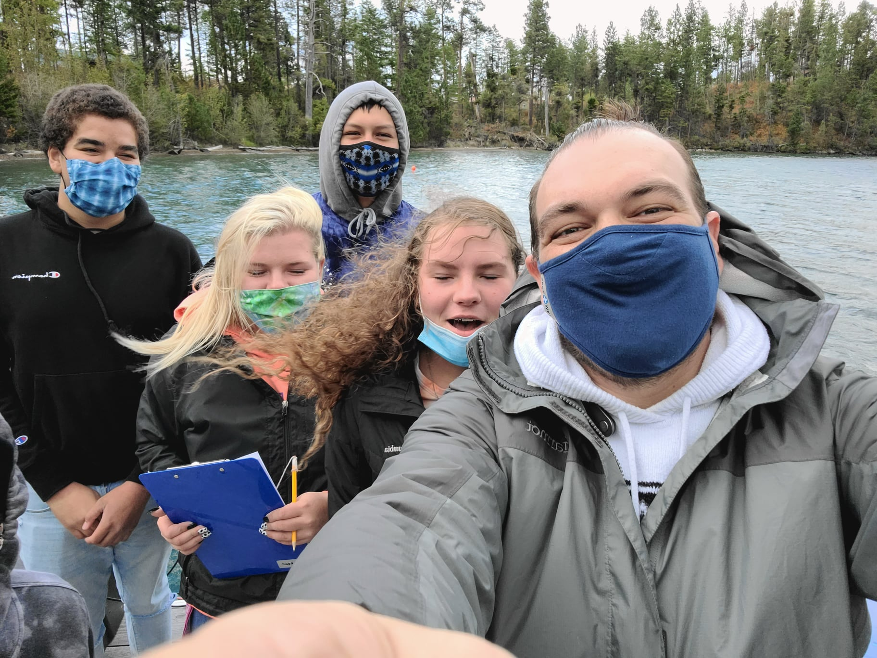
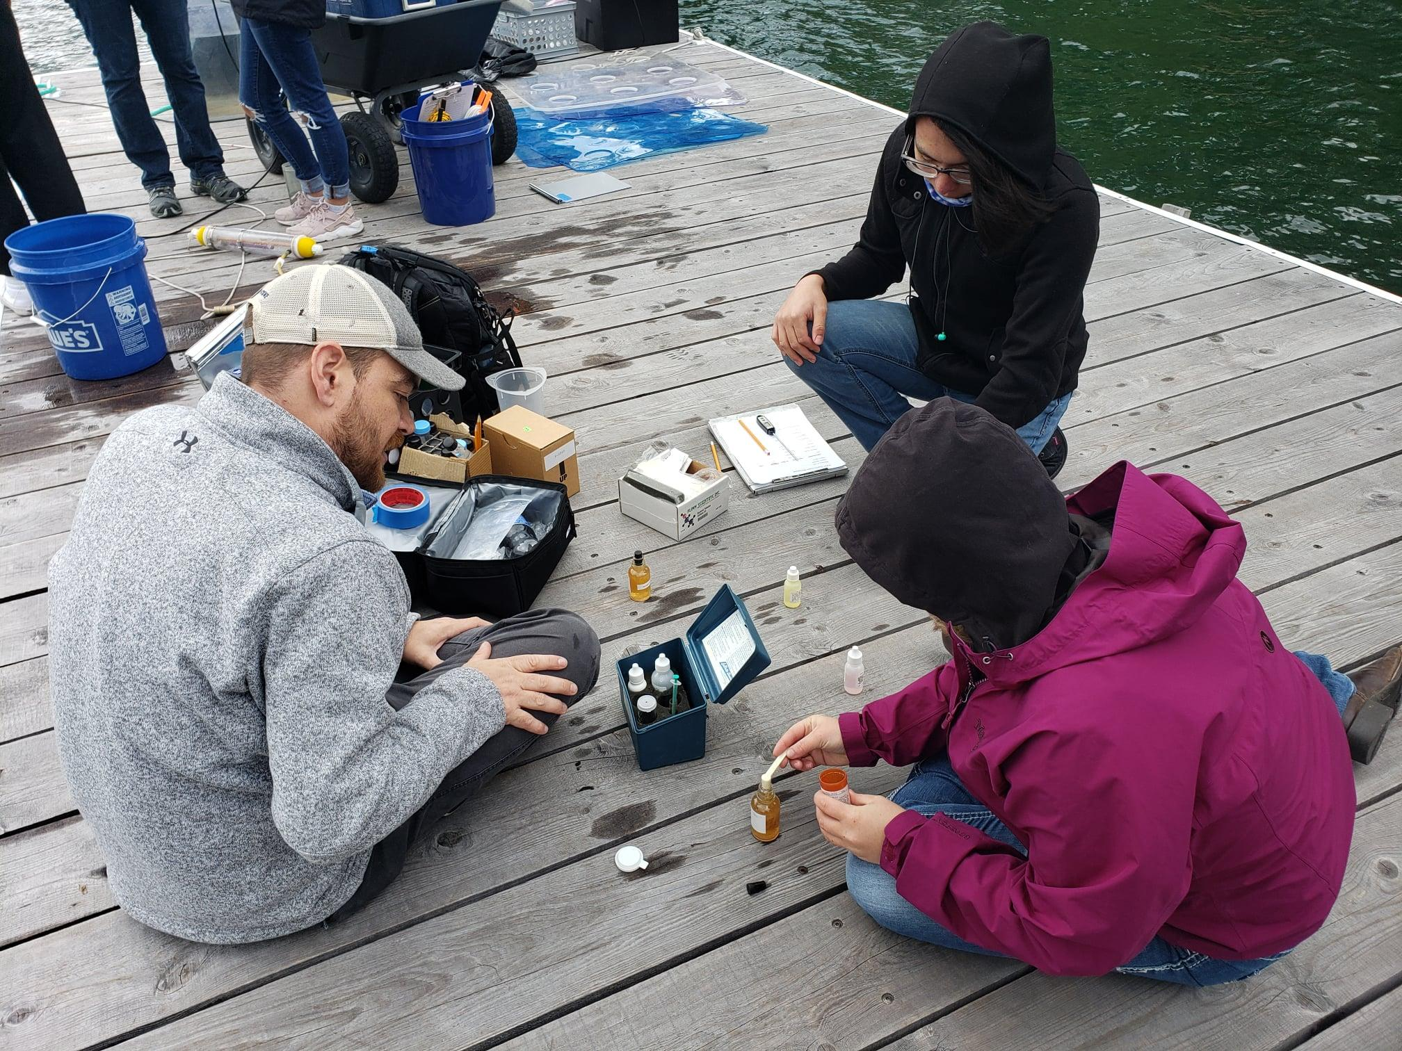
SKC STEM Academy
SKC Garden Network/Food Sovereignty
Flathead Lake Biological Station

Slide 6
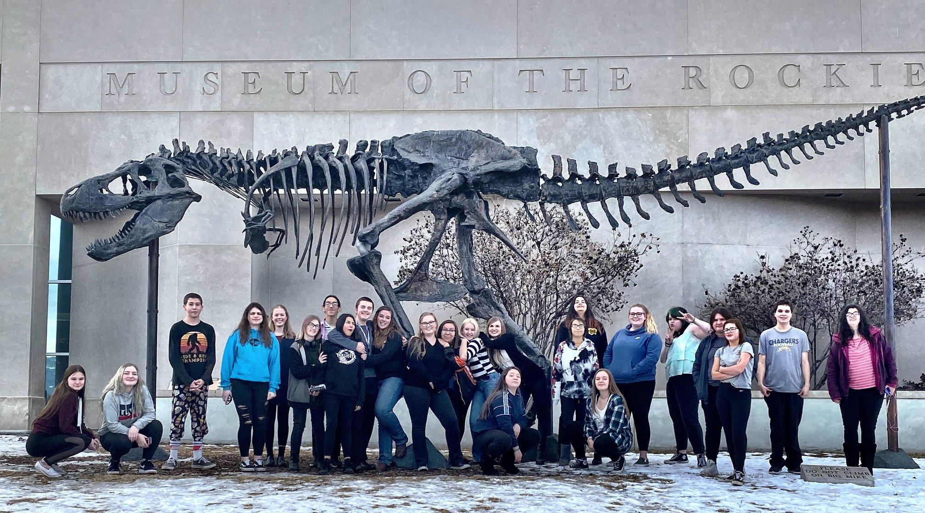
UM Tour
MSU Tour
Payne Family Native American Center
Museum of the Rockies

Slide 7
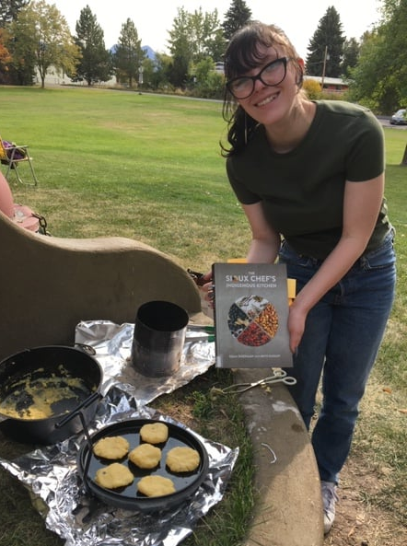

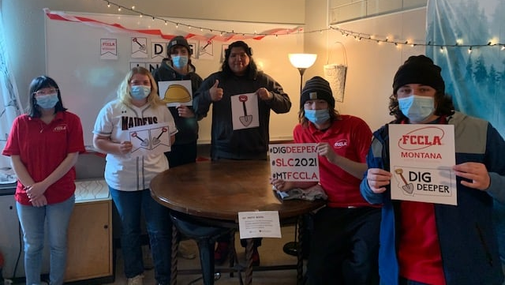

FCCLA

Slide 8
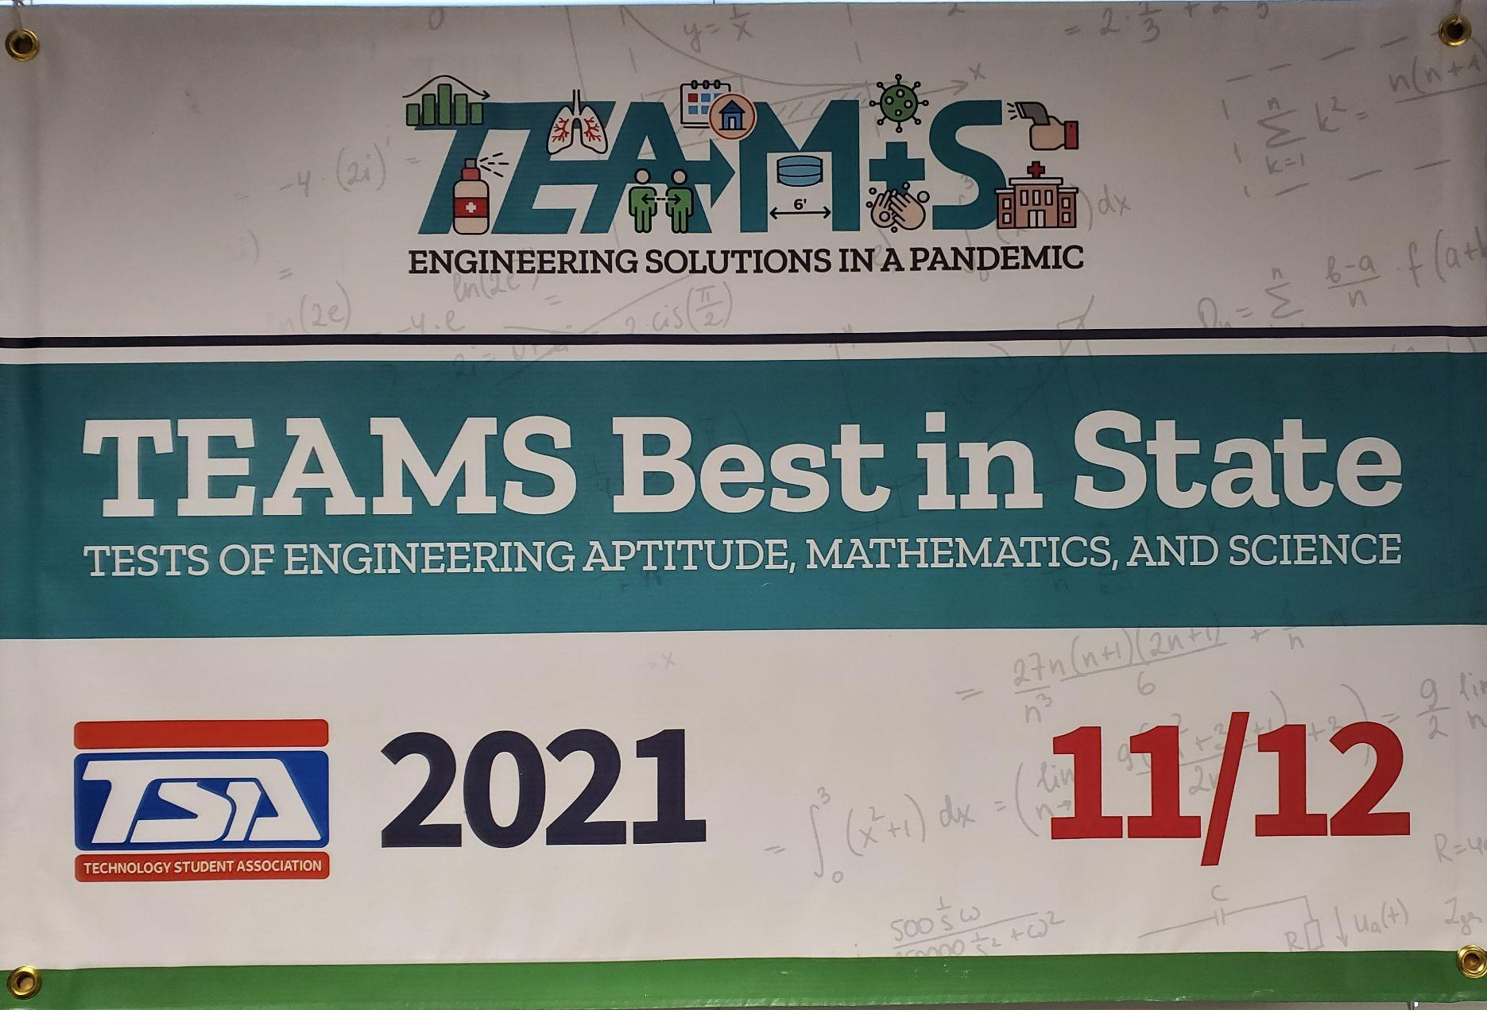
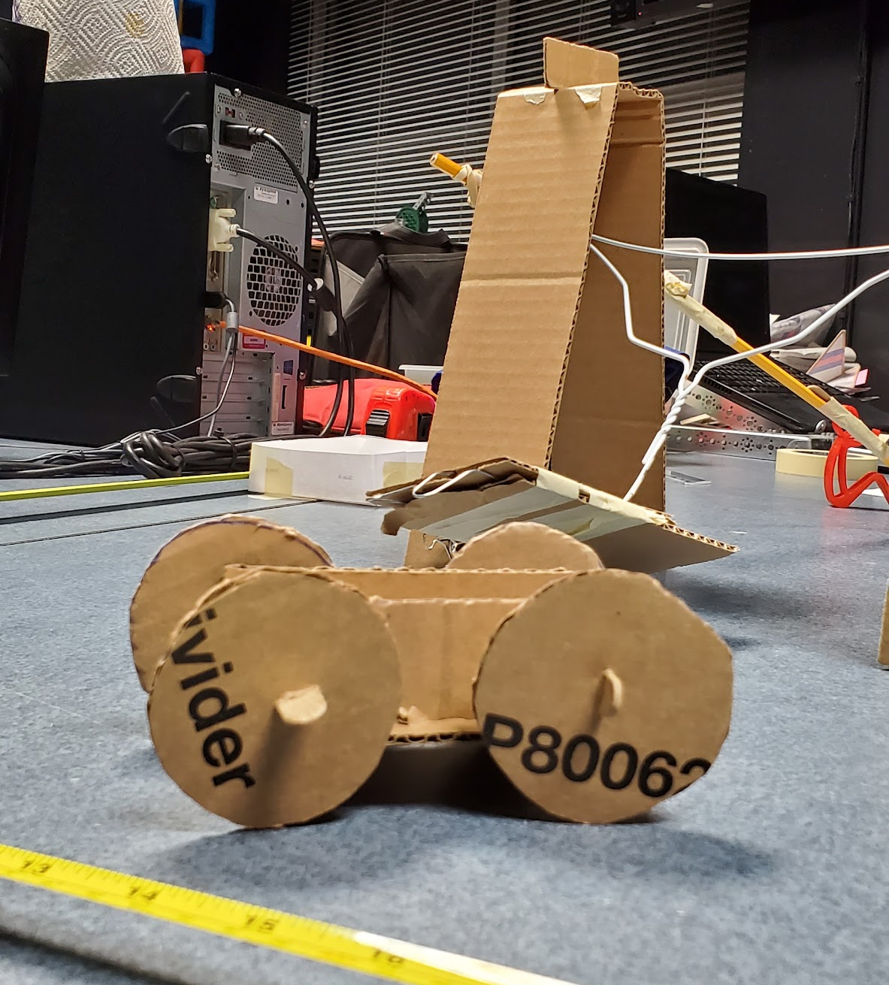
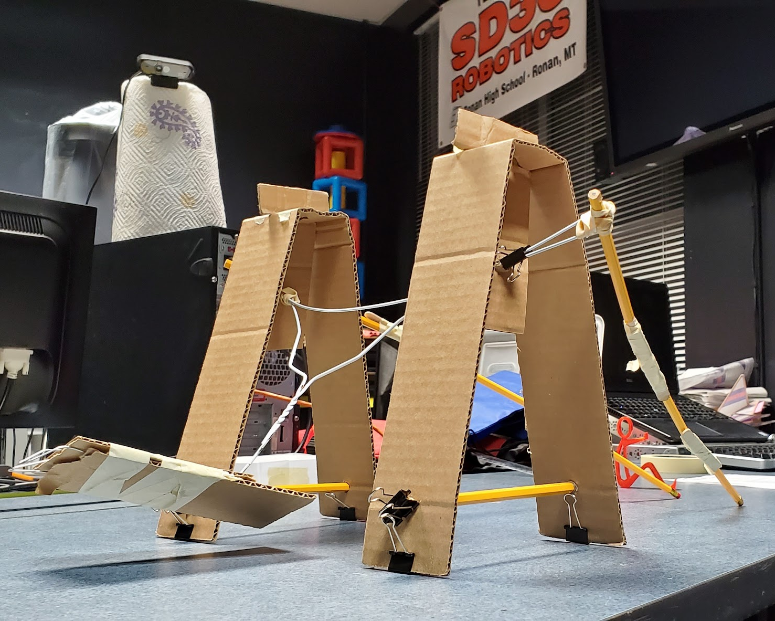
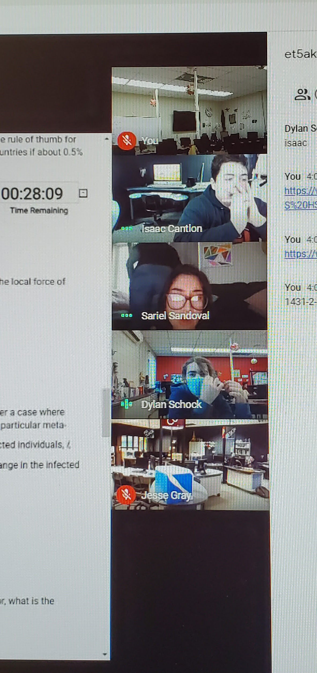
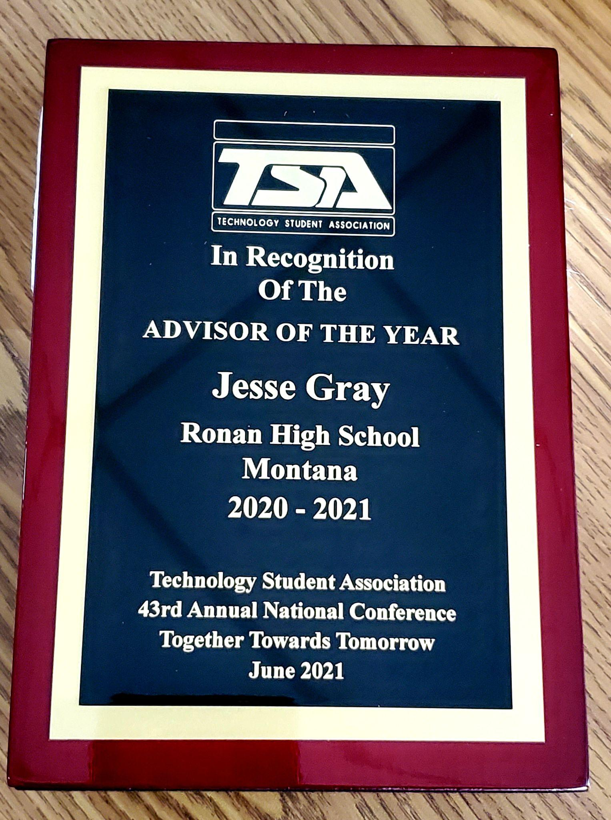
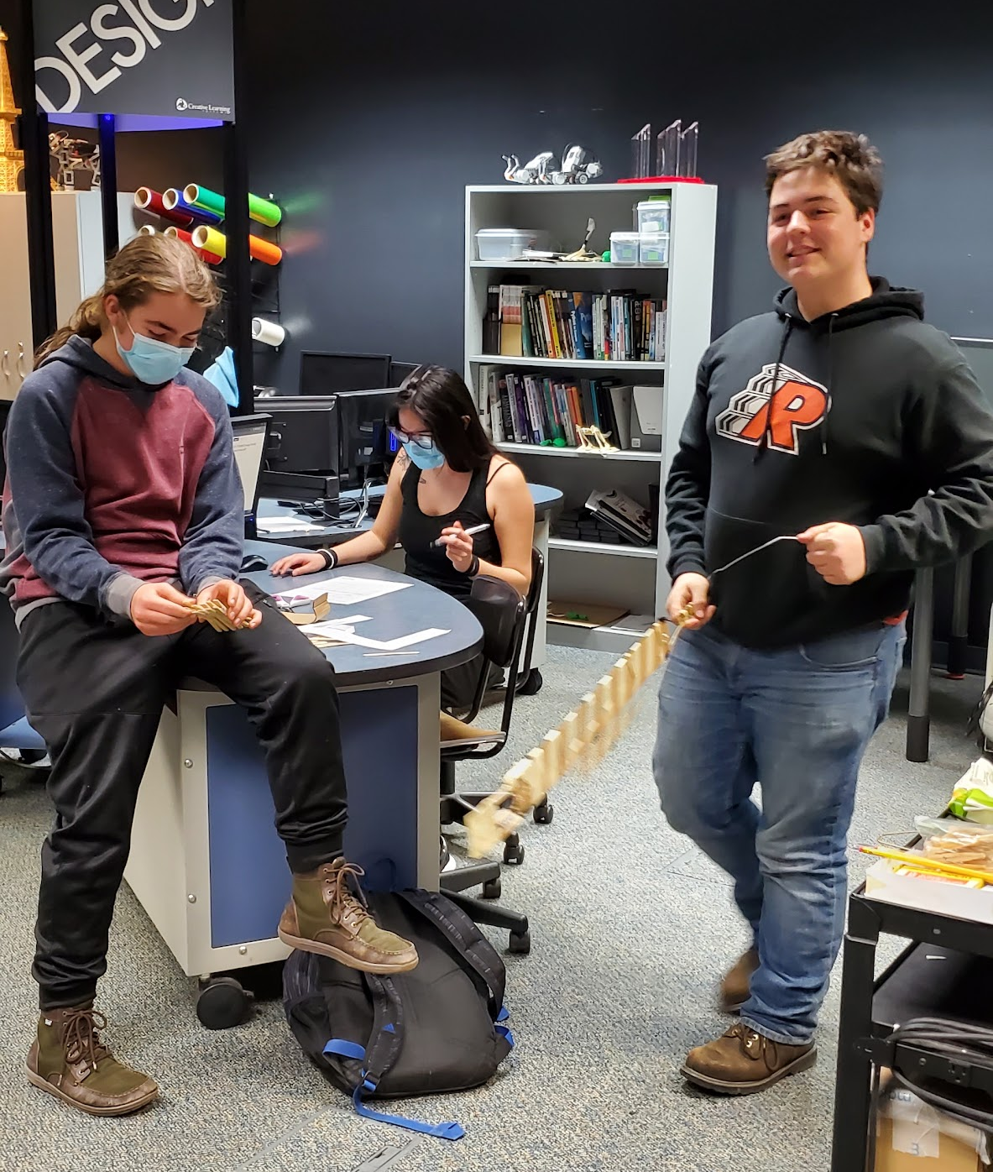
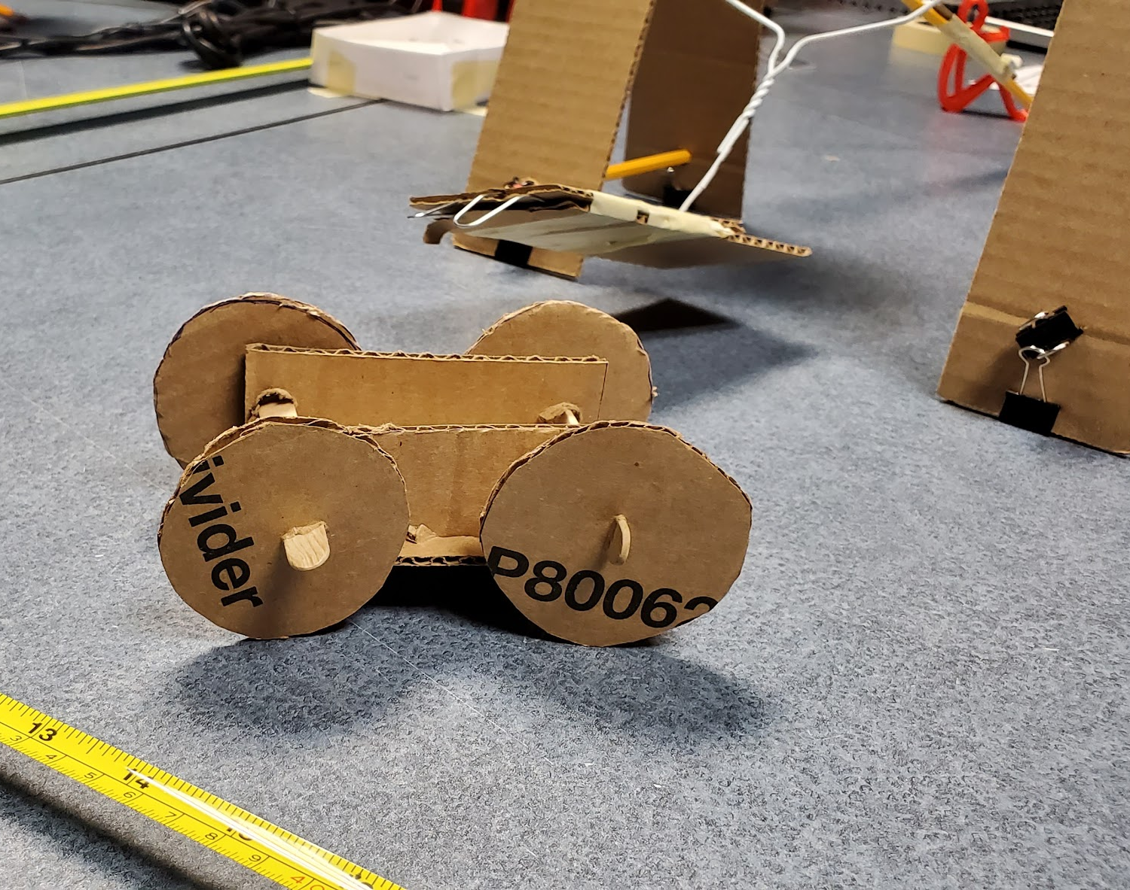
TSA

Slide 9
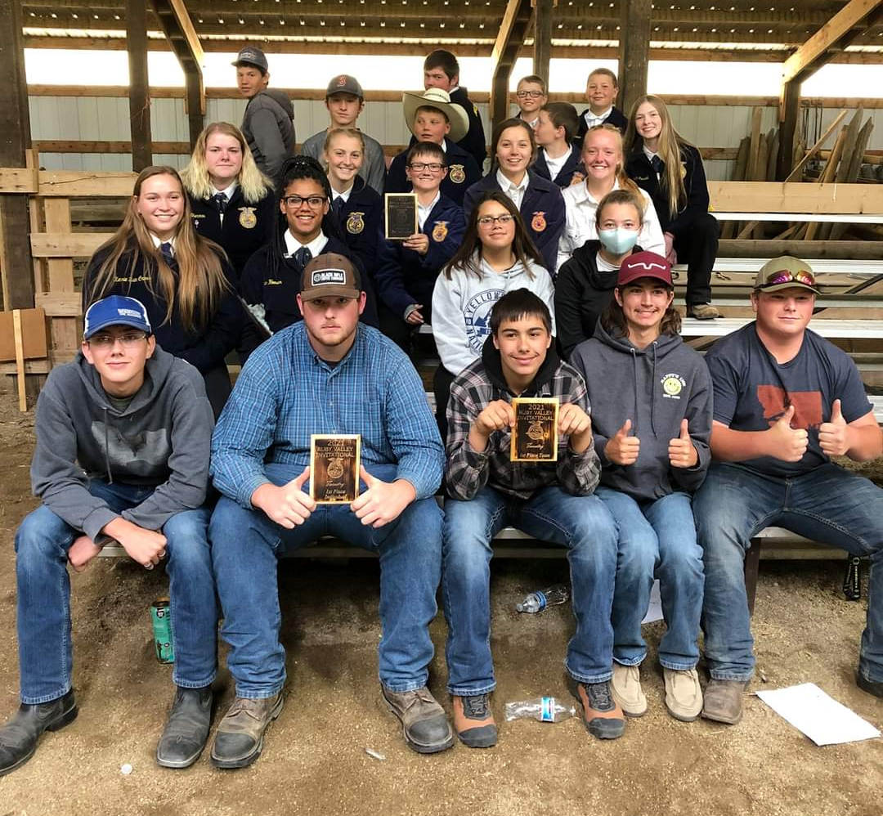
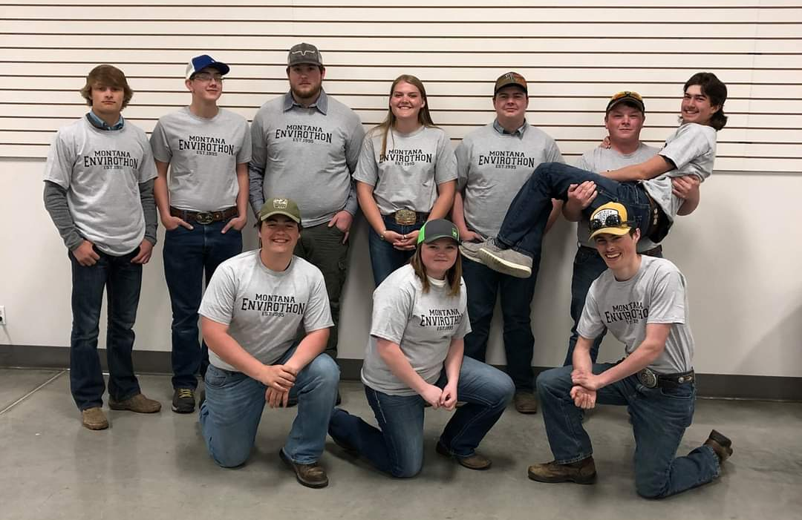

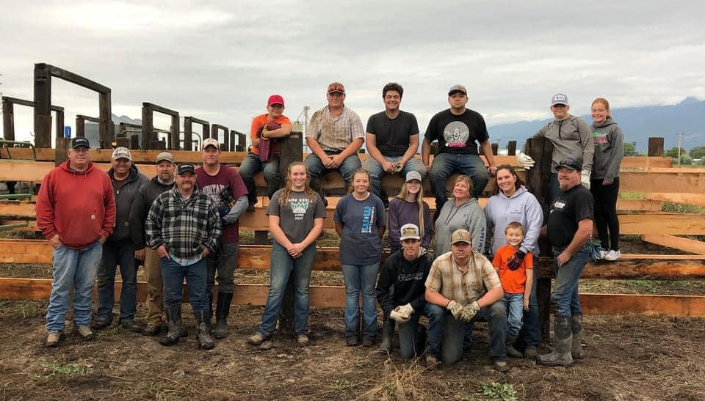
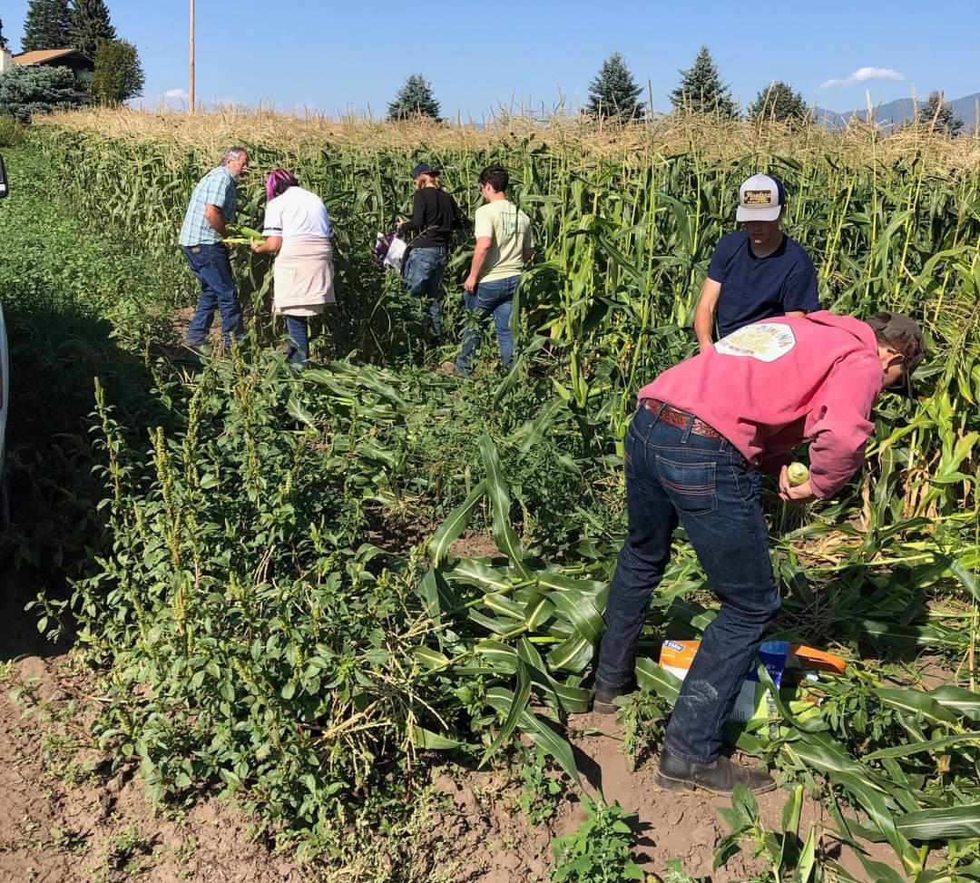
FFA

Slide 10
College Signing Day

Slide 11
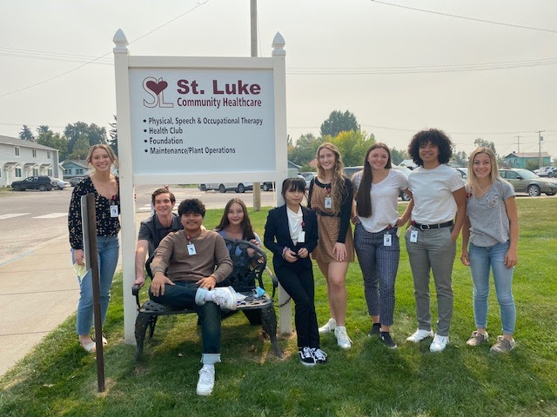
Career Exploration Internships
Internships provide students with hands-on experiences that enhance their learning and assist them in developing professional skills.
By connecting the classroom to occupations, internships also help students explore their skills and abilities in the context of career options.

Slide 12

Internship Paperwork and Expectations
Vocational Internship Overview
Student Paperwork
Worksite Paperwork
Evaluations
  Midterm
  Quarter
  Semester/Final
  K. William Harvey Elementary
  St. Luke Rotation
Vocational Internship Hours
Teacher Recommendations
Entrance and Exit Interviews
Schedules
  St. Luke Schedule
Journal and Log sheets
Hours Expectations
Weekly Schedules
In Class Sessions
Guest Speakers
MCIS
Scholarships

Slide 13
Local Businesses working w/RHS Vocational Interns
St. Luke Hospital
  Variety of all departments
  Administration
  Pharmacy
  Extended Care
Local Banks
  Valley Banks
  Eagle Bank
Local Veterinarians
  Dr. Detwiler
  Dr. Blevins
Ronan School District
  K. William Harvey Elementary
  RSD Food Service
CSKT Tribal Forestry and Fire
Family Health Pharmacy
Western Building Center & Polson Outdoor Center
K-O Auto
Ronan Body Shop Towing & Repair
Jensen Excavating
SKC Science Research Department
Montana Power Products
Total Automotive

Slide 14
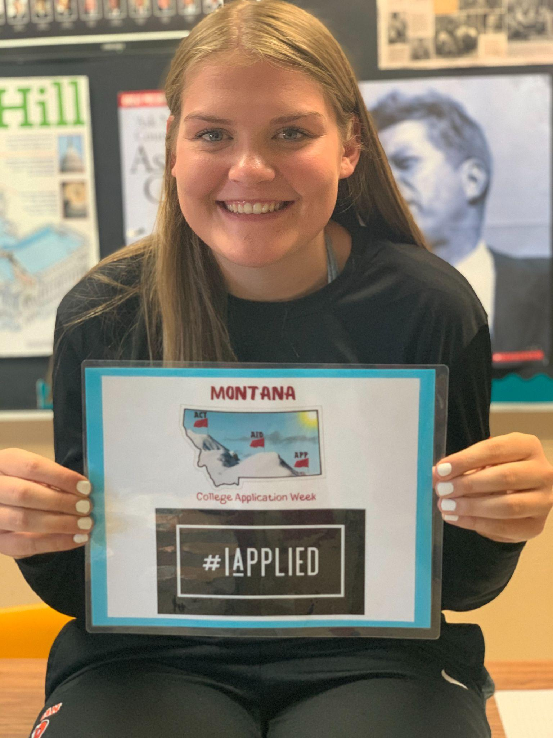
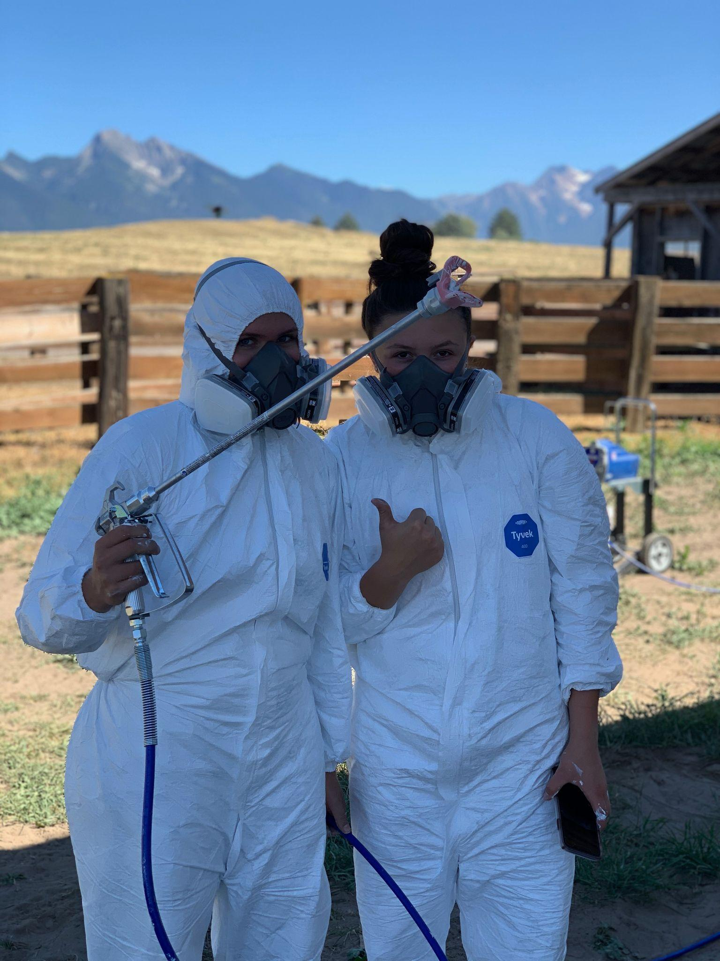
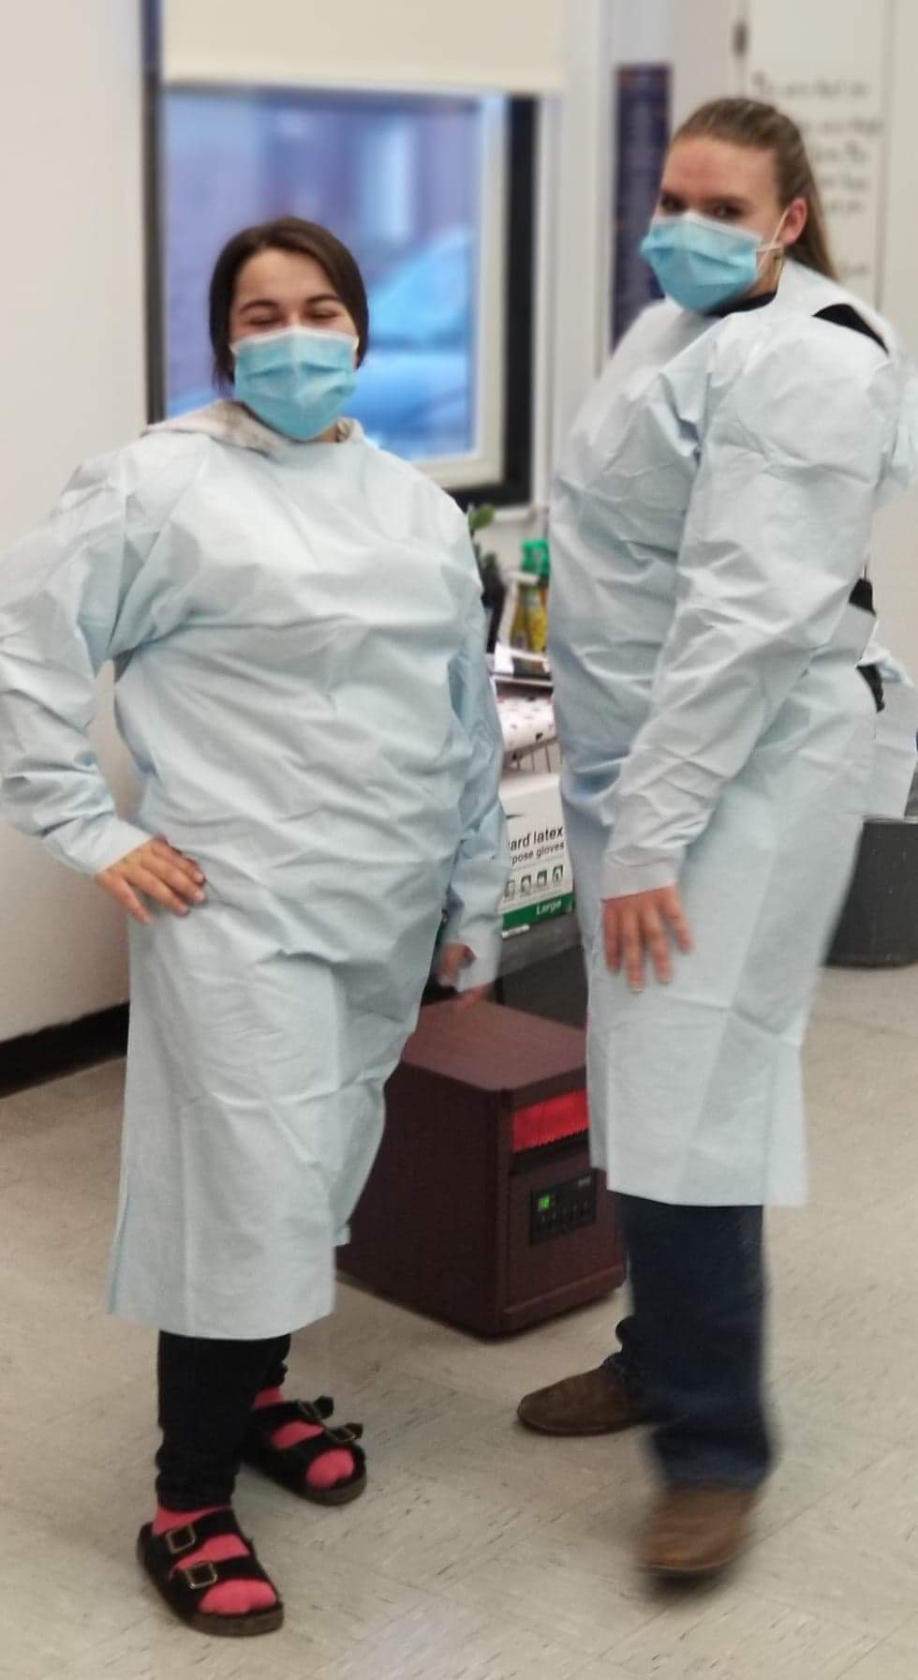
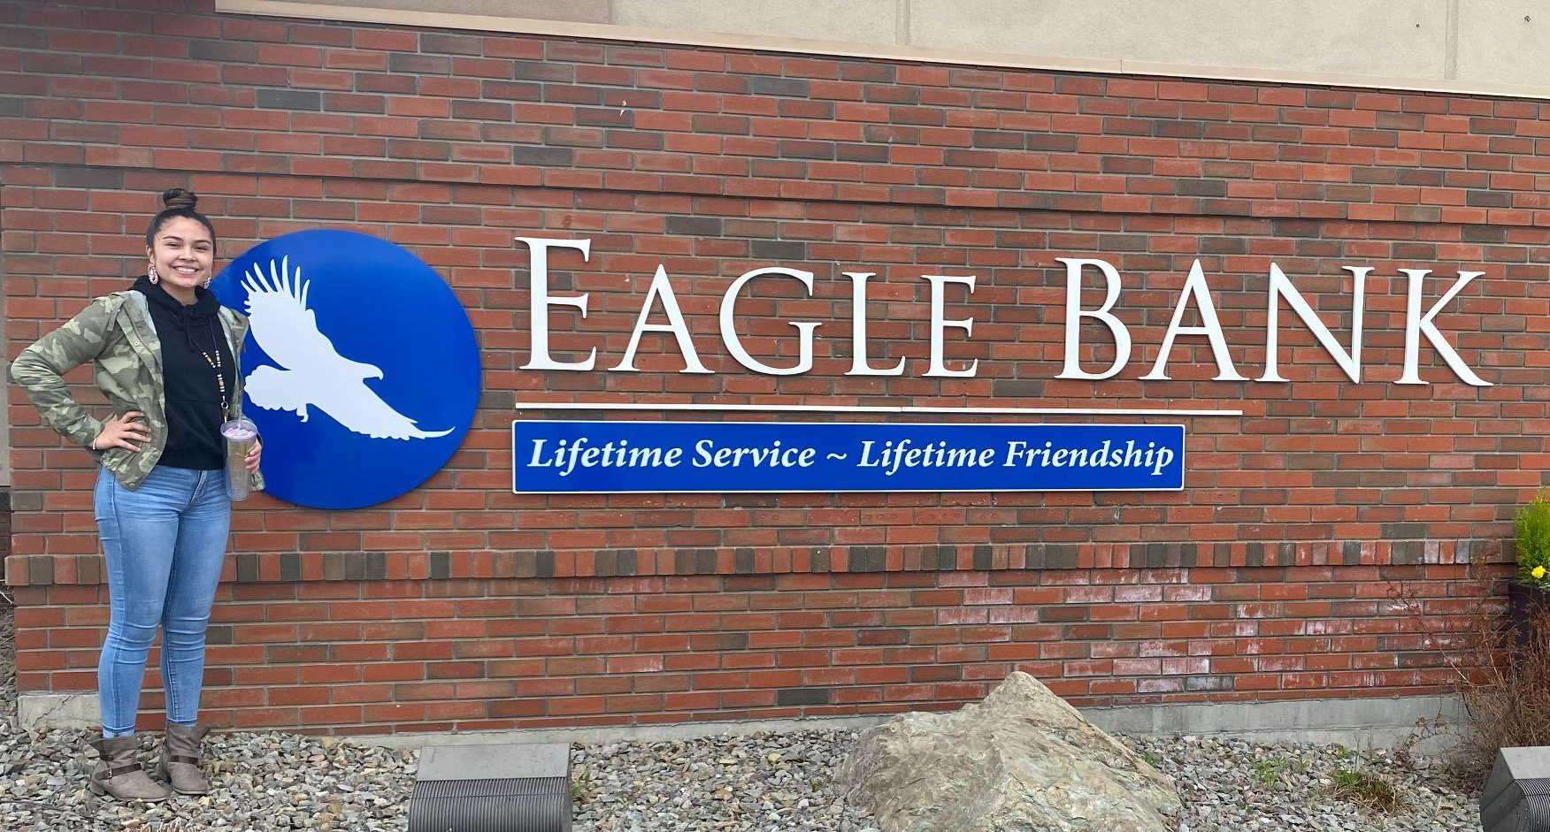
Vocational Internships

Slide 15
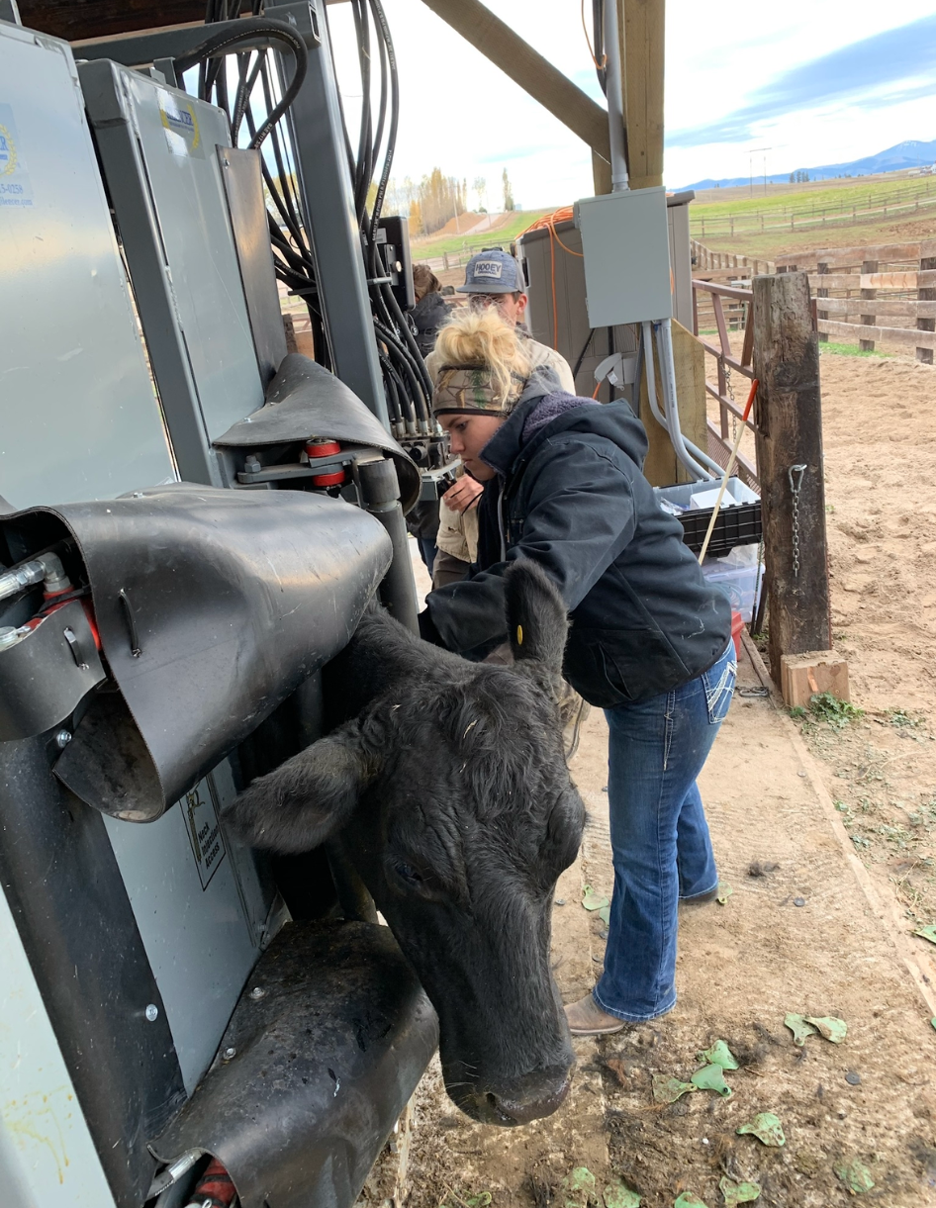
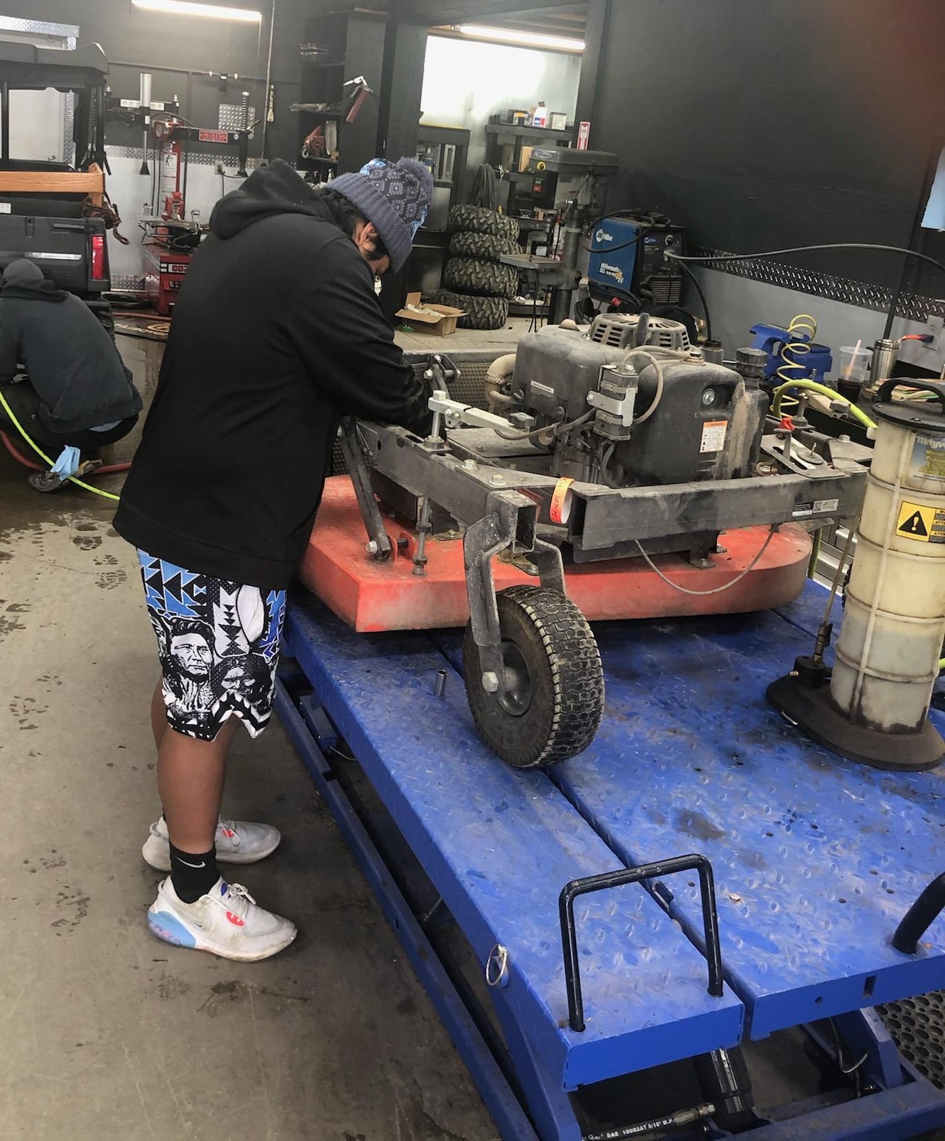
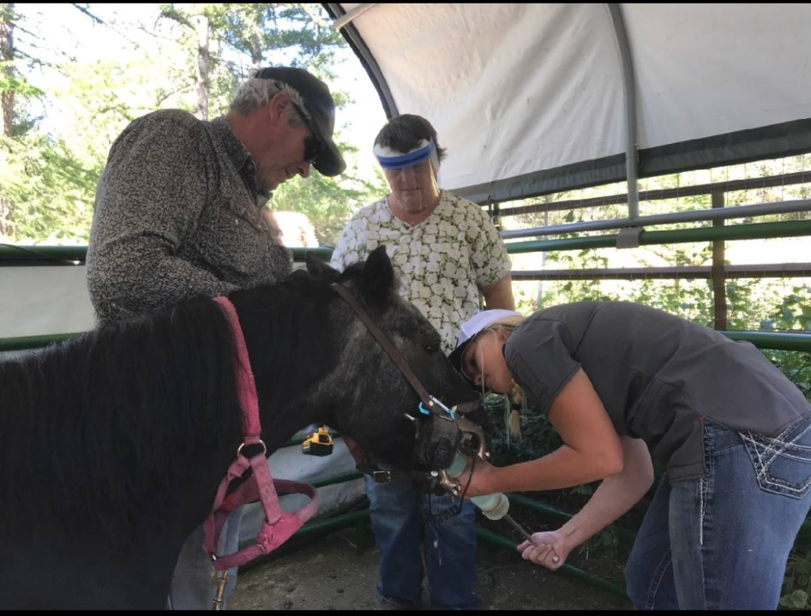
Vocational Internships

Slide 16
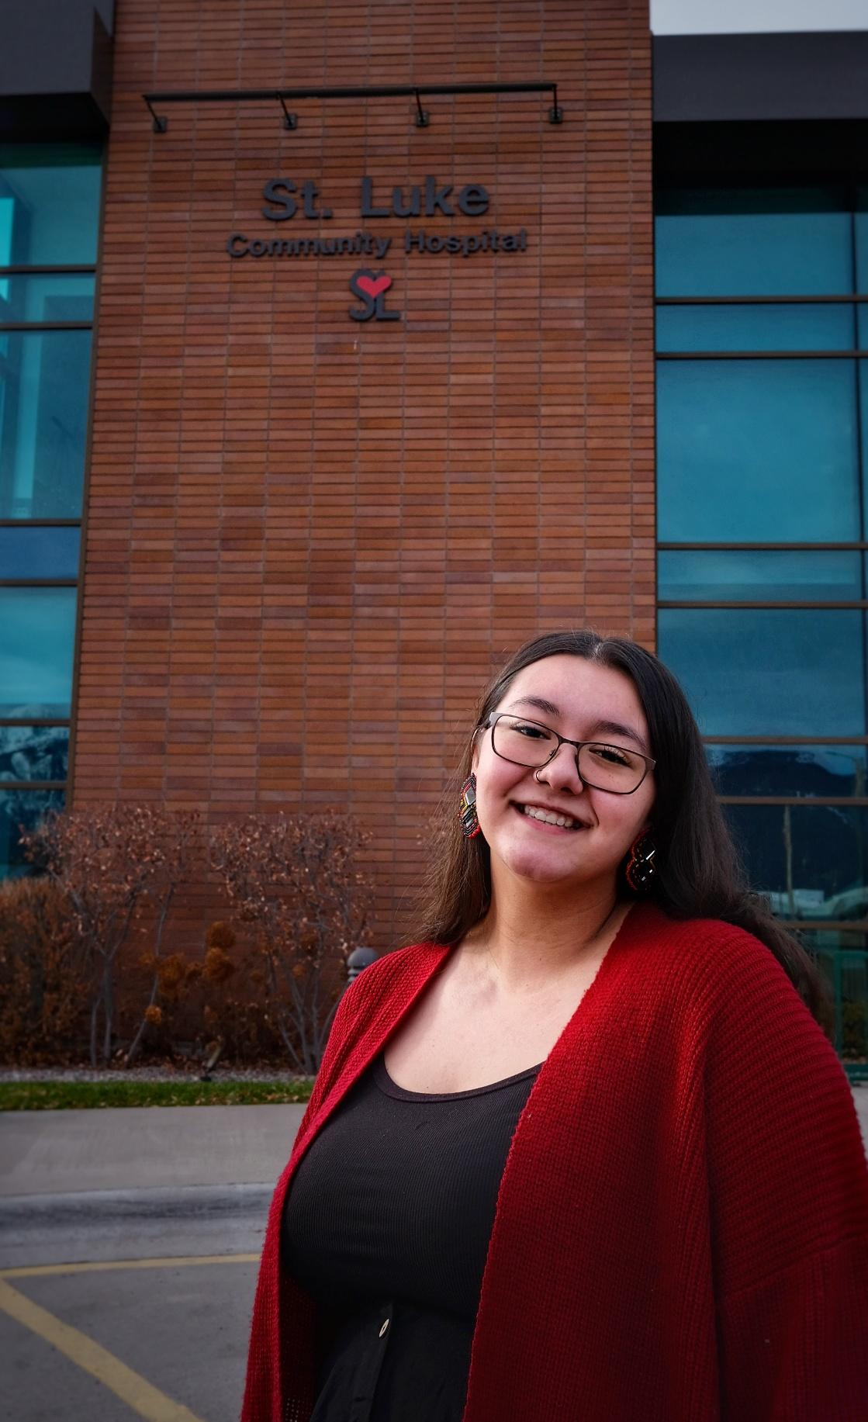
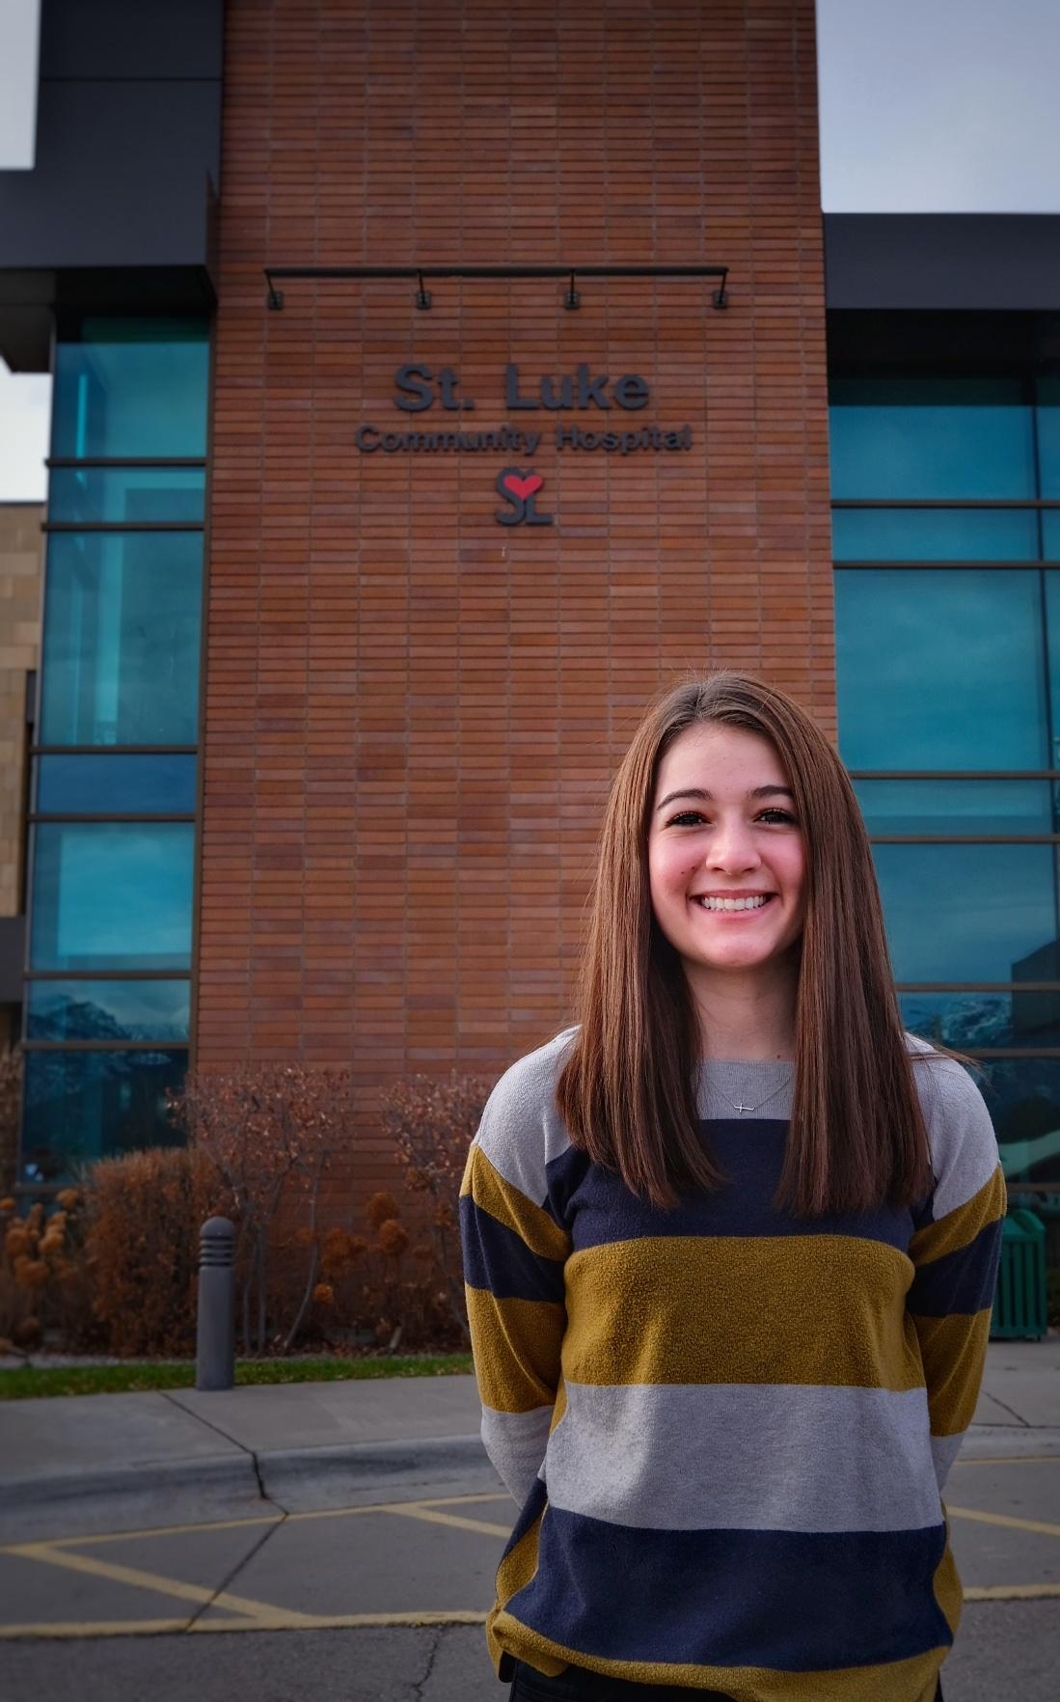
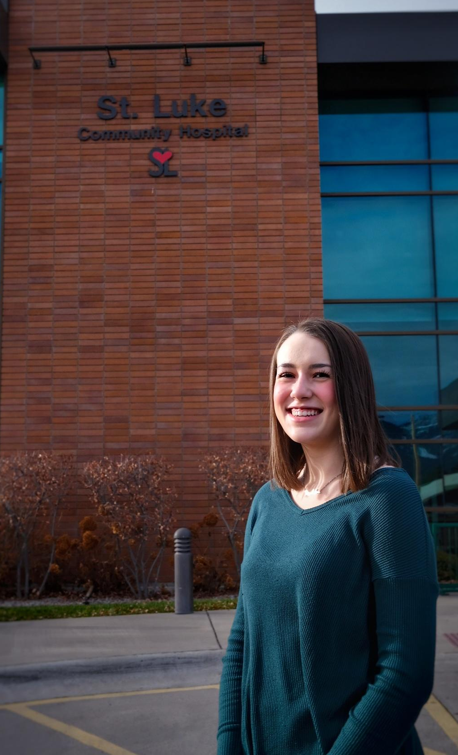
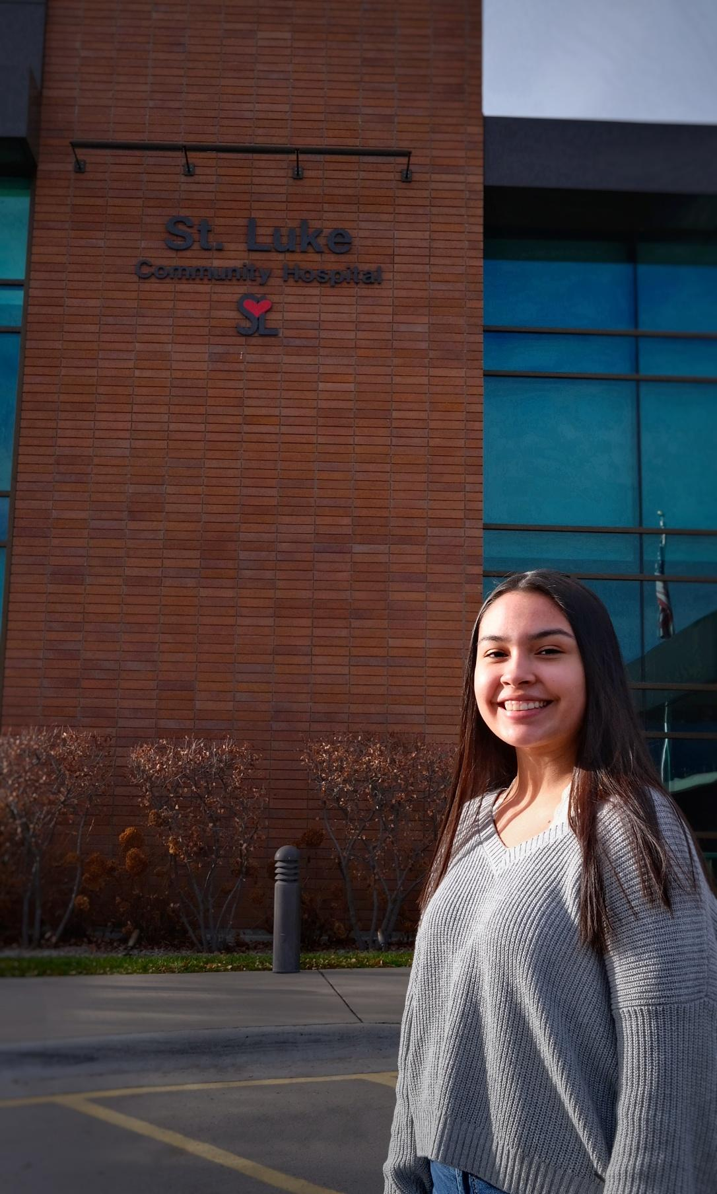
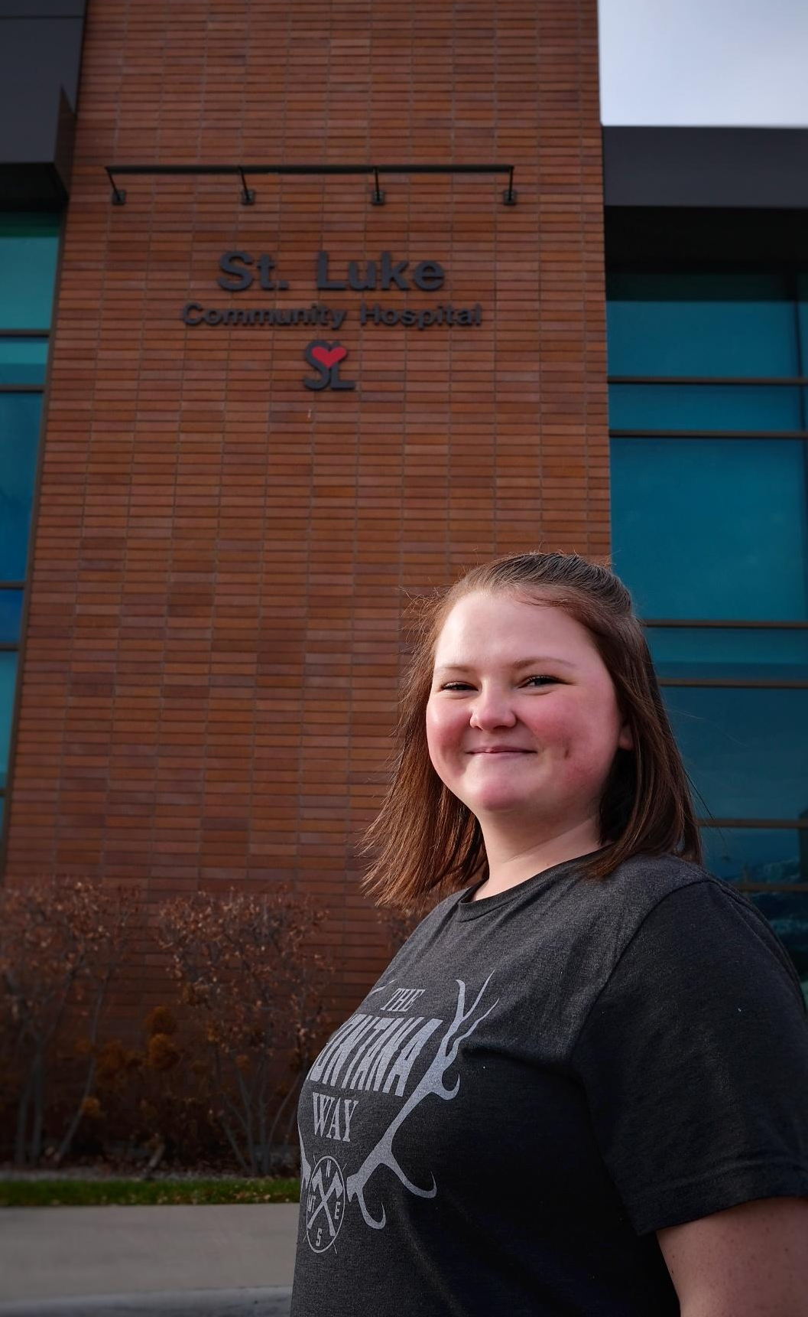
St. Luke Hospital

Slide 17
Thank you!
Jessica Johnson (406) 676-3390 ext 7503 jessica.johnson@ronank12.edu
Heather Gray (406) 676-3390 ext 7535 heather.gray@ronan12.edu

