Slide 1
iGraduate Online Opportunities
Troy Junior High / High School

Slide 2
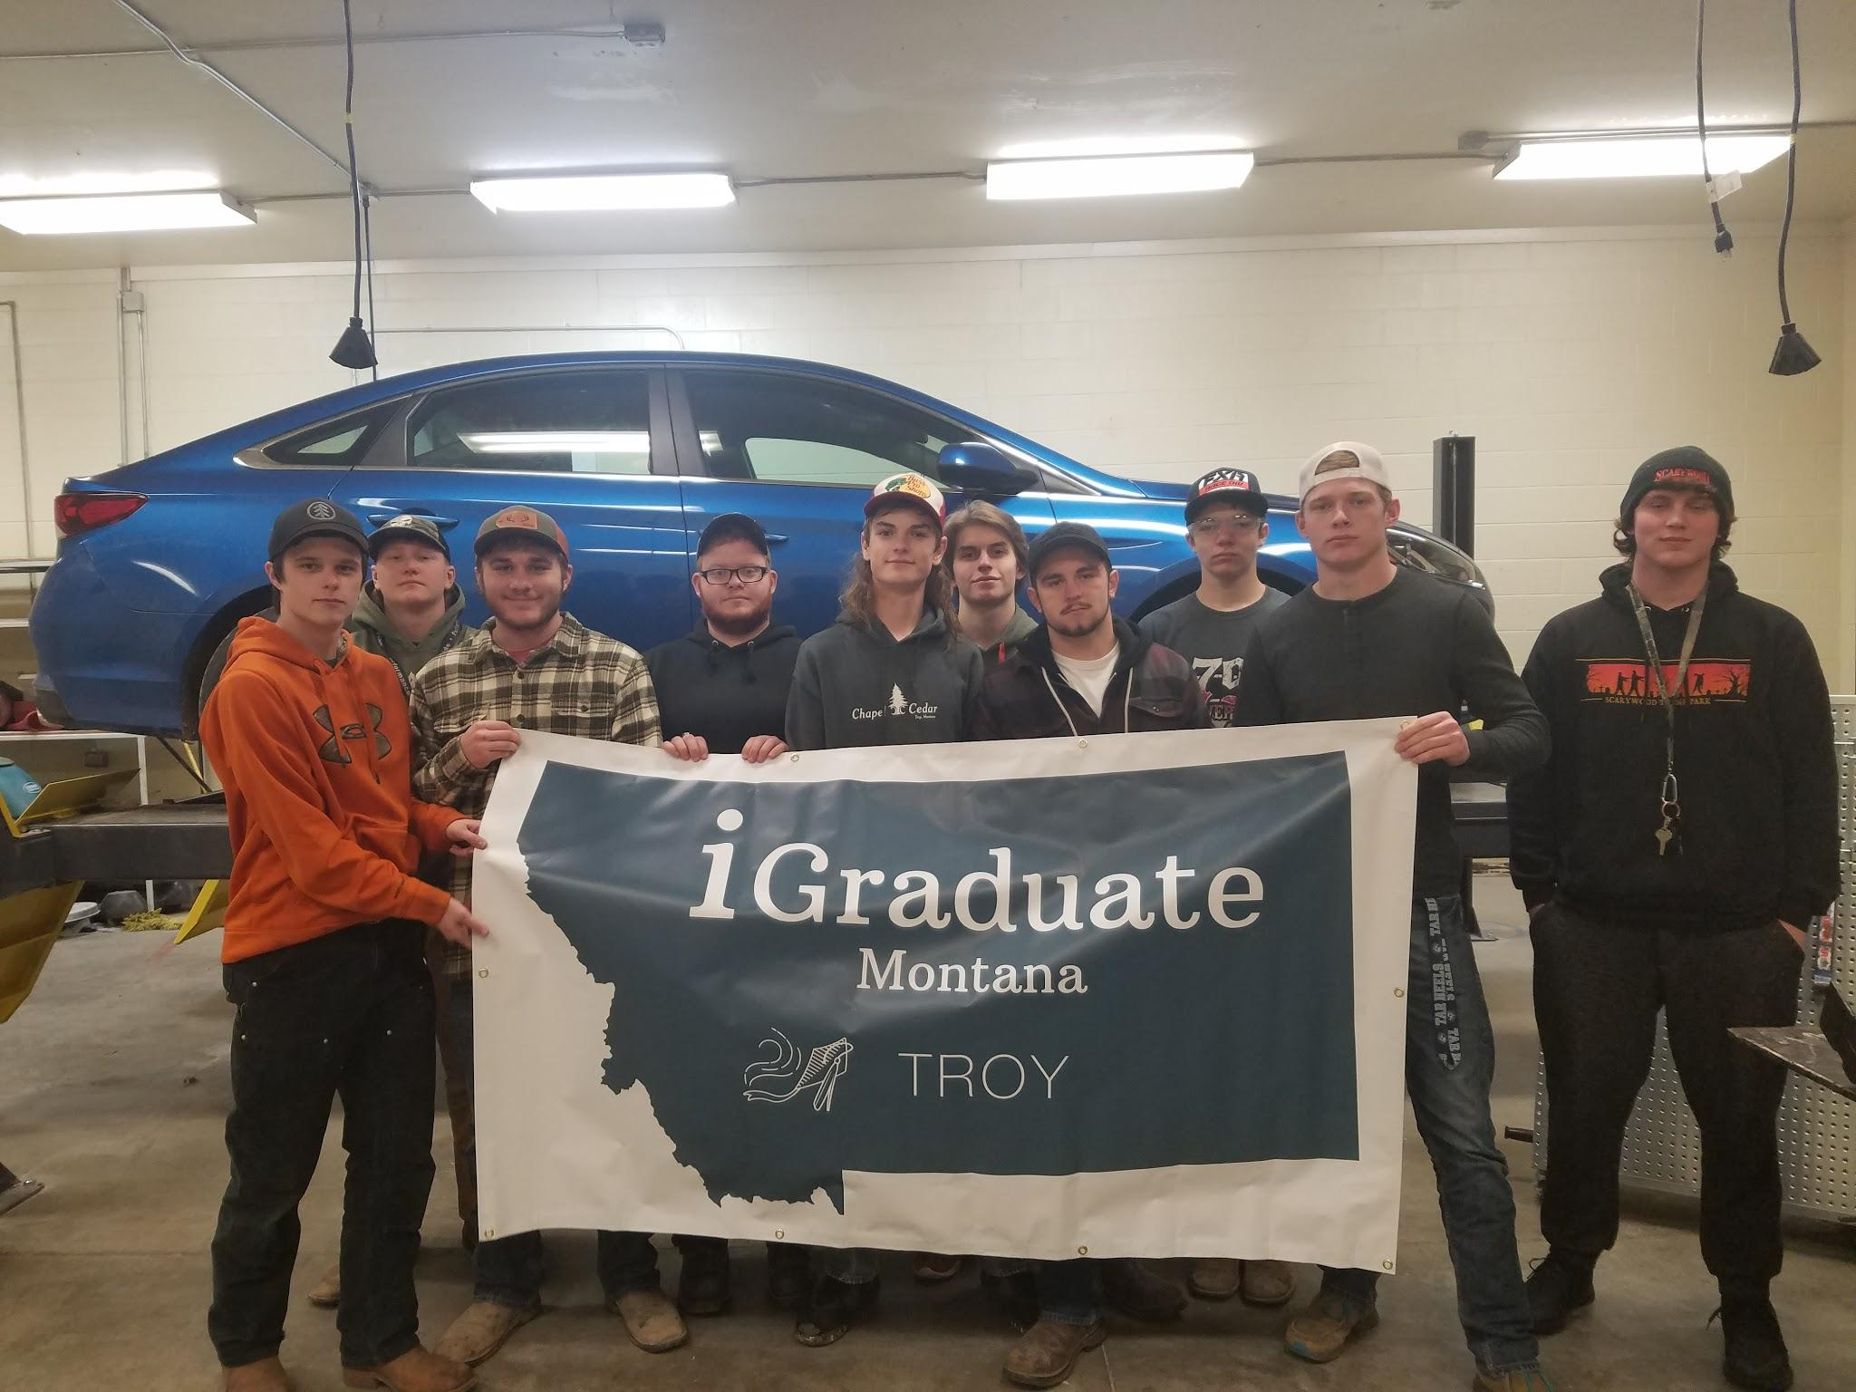
iGraduate Montana Students

Slide 3
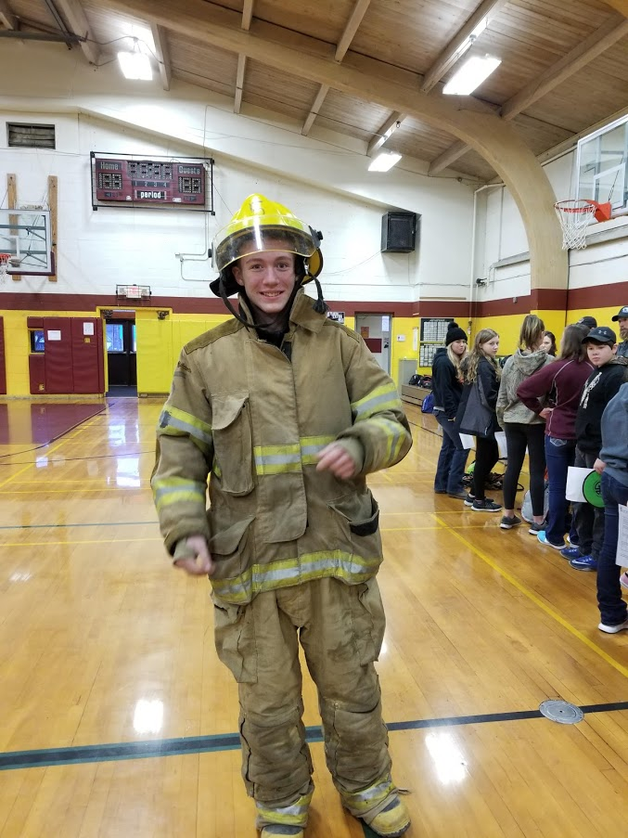
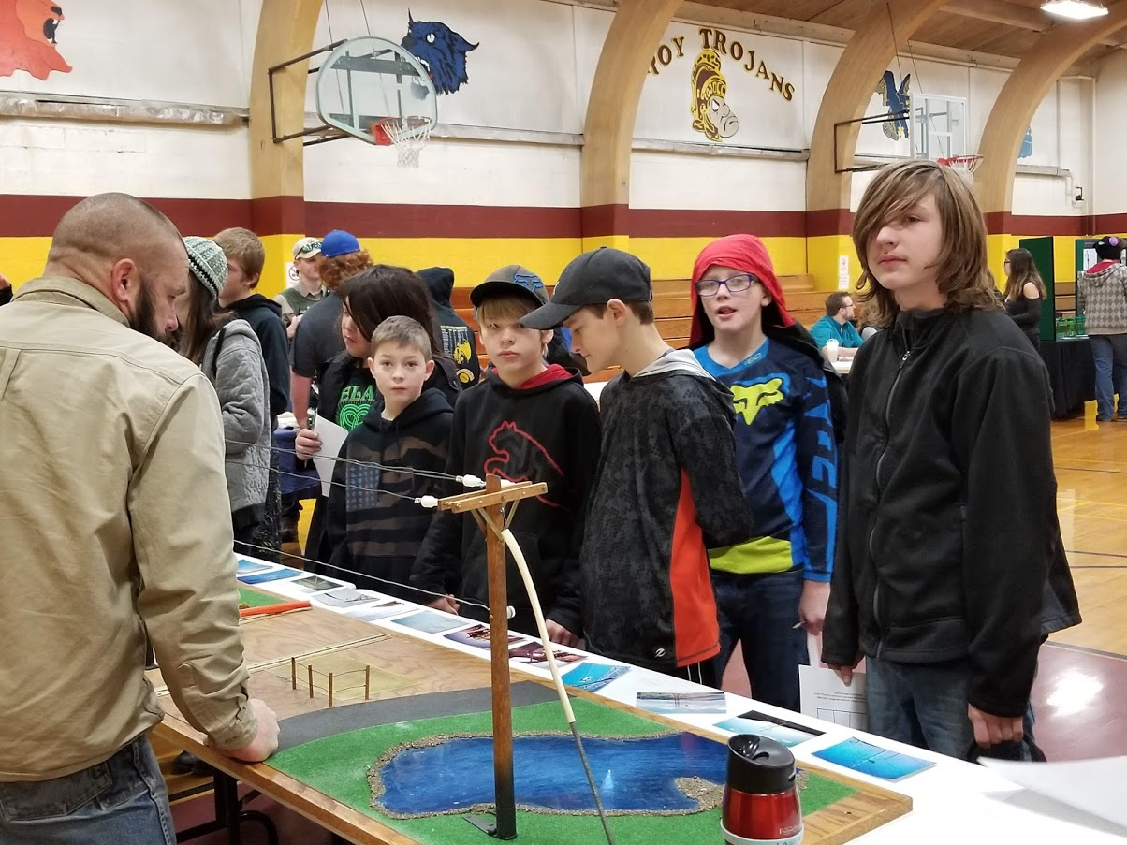
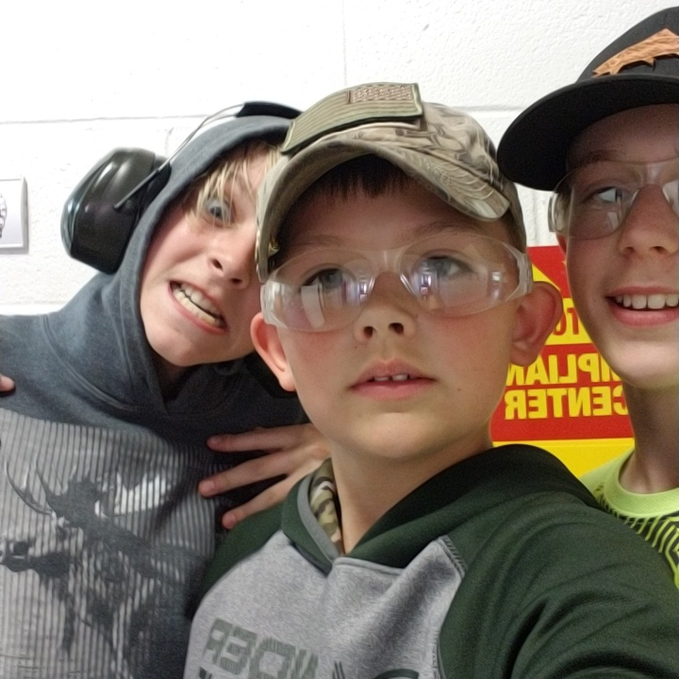
Reality Fair Online Game
Powerpoint Presentation
Reality Fair Video

Slide 4
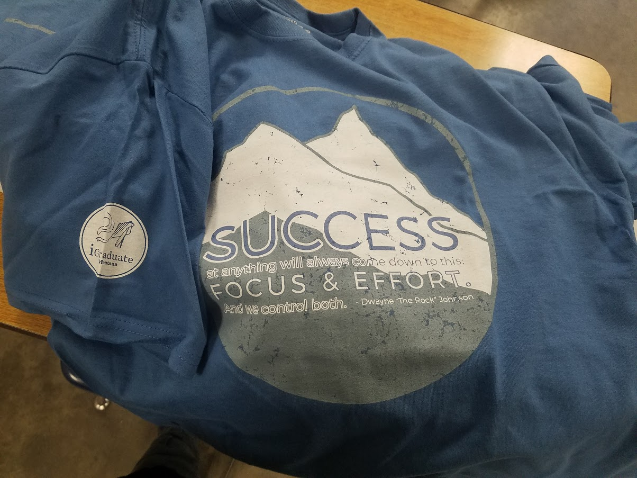
iGraduate Montana T-Shirt

Slide 5
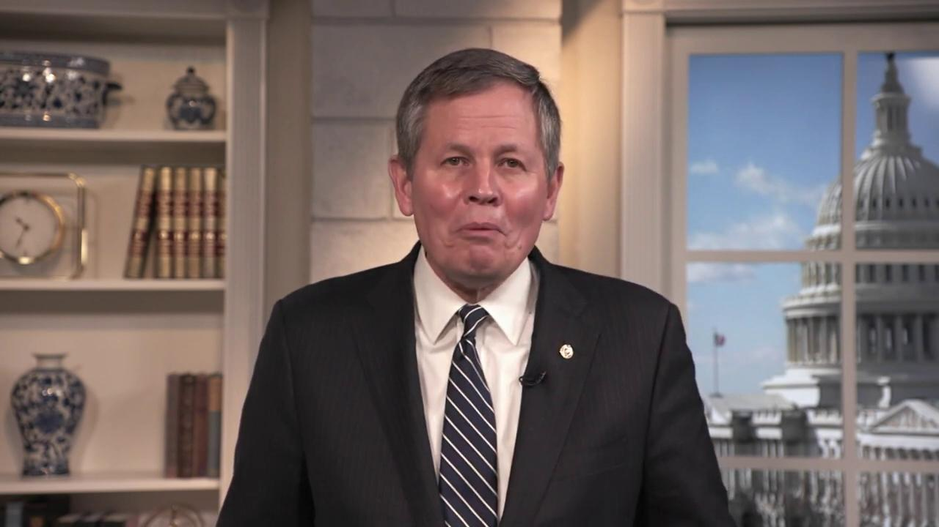
Online Community Career Fair
Online Career Fair

Slide 6
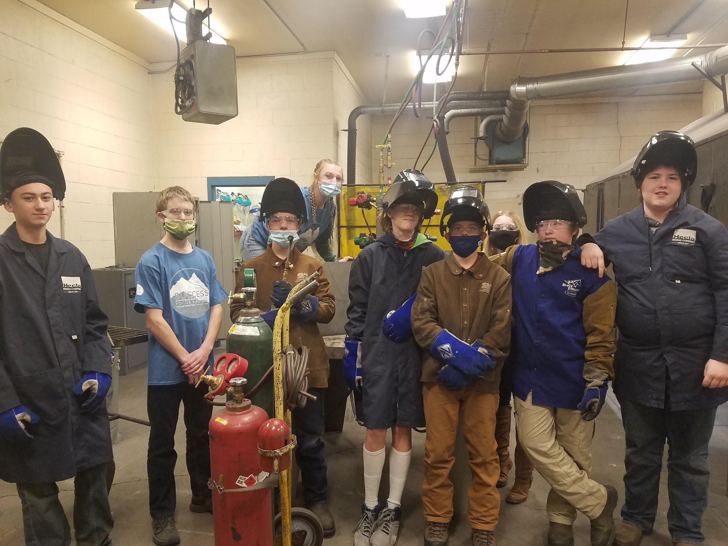
Online Student Portfolios
Online Strut Your Stuff
Allyson’s Portfolio
Abigail’s Portfolio
Trevor’s Portfolio

Slide 7
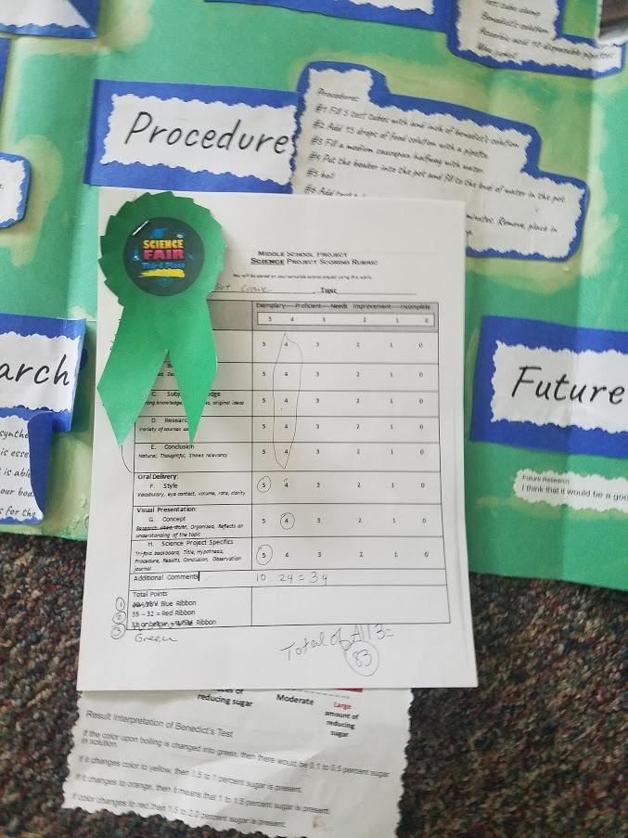
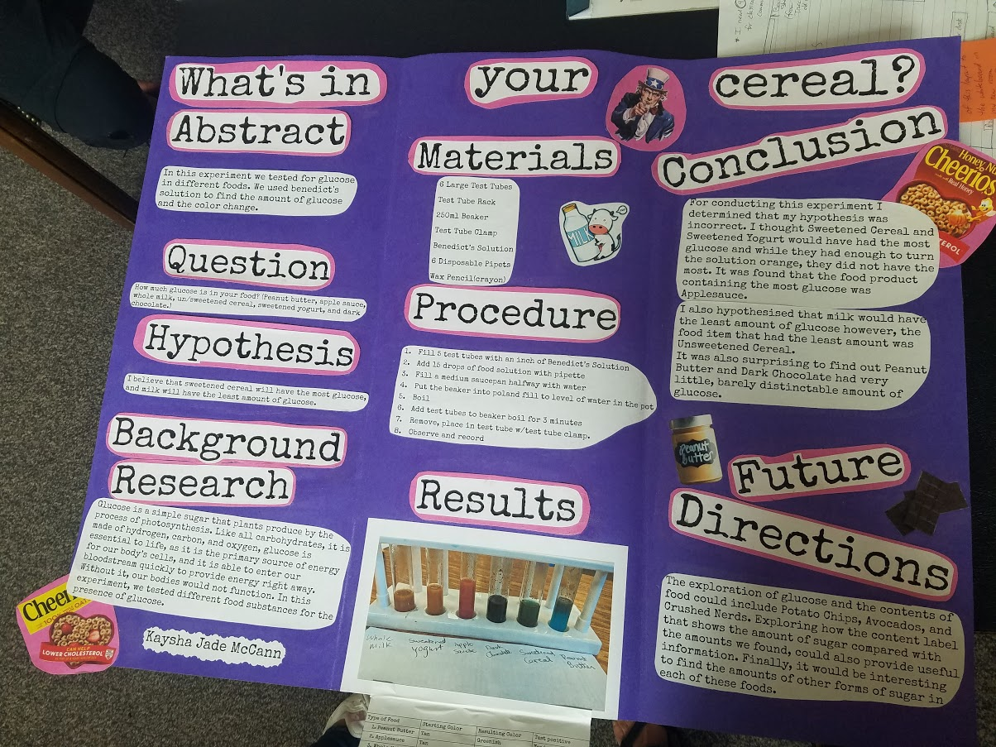
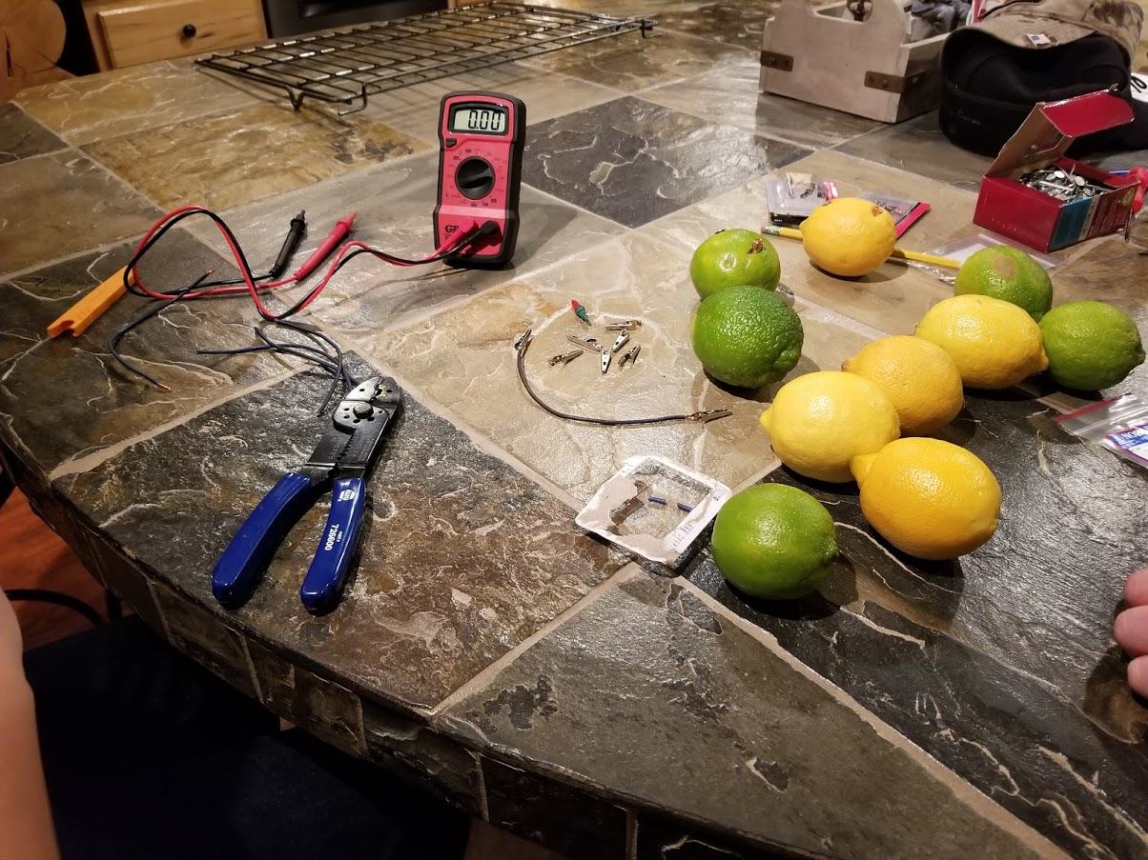
Virtual Science Fair

Slide 8
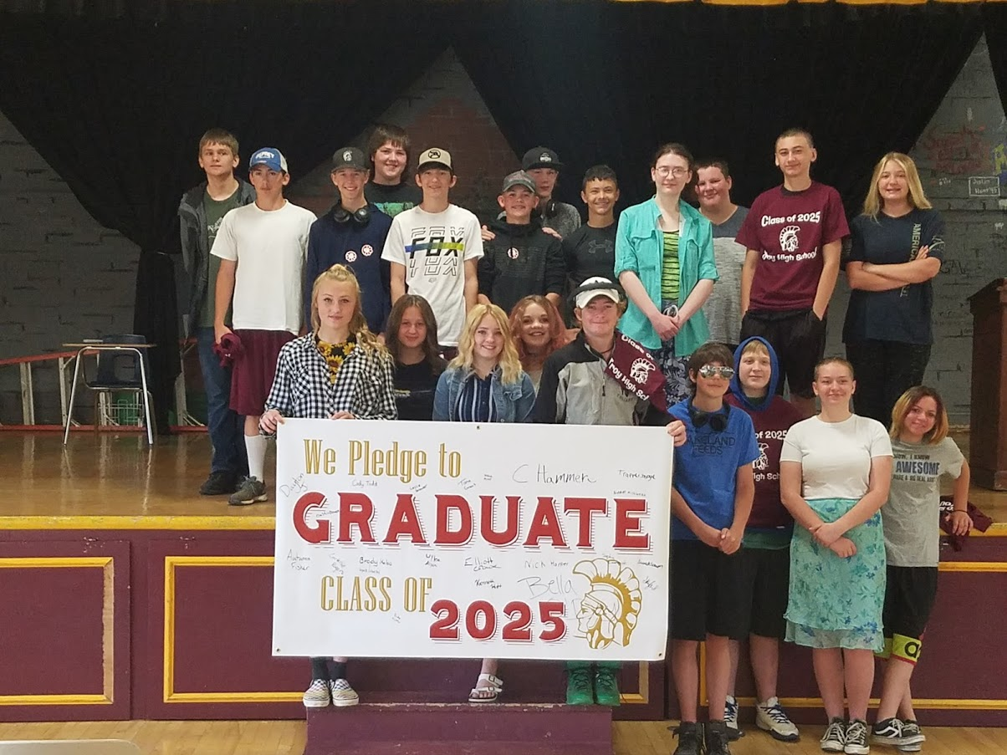
Pledge to Graduate Class of 2025

Slide 9
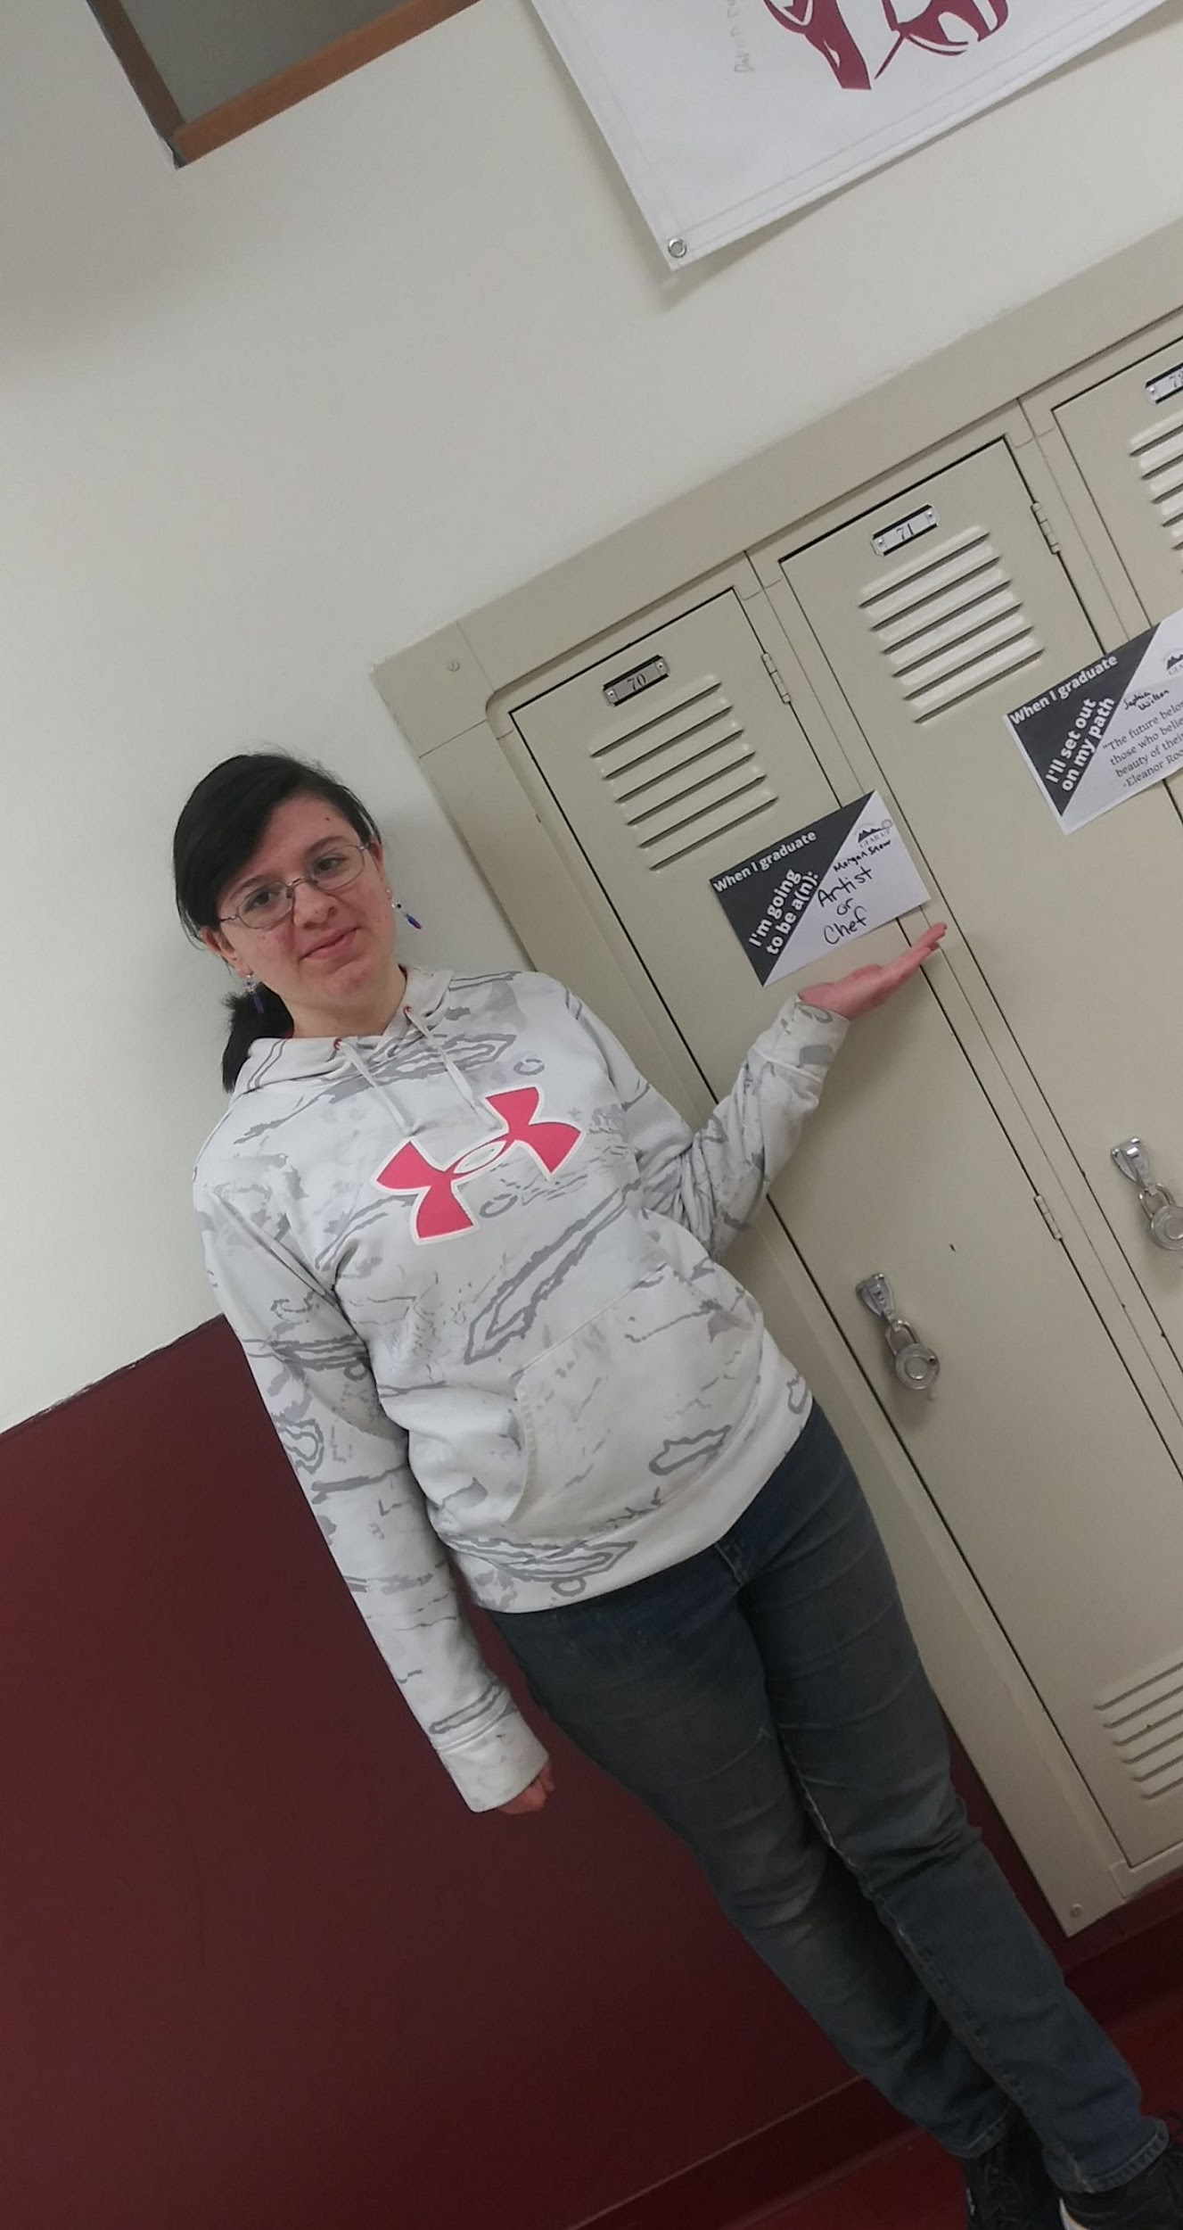
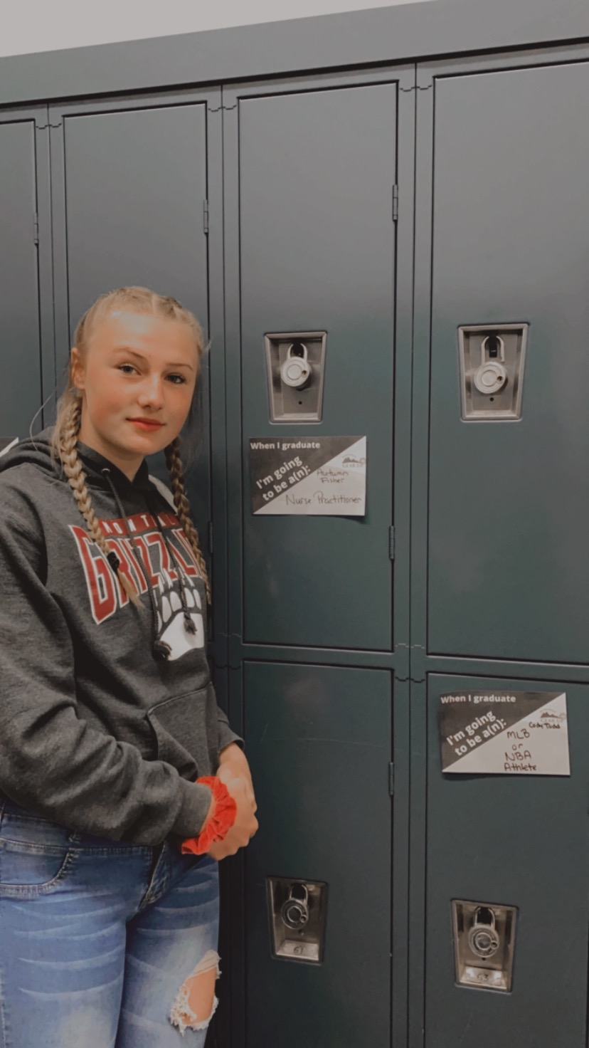
Future Goals &
Career Mentorship
College Week Scavenger Hunt
College Week Locker Celebration
College Week Video
Career Interest Survey
End of Year Check Out

Slide 10
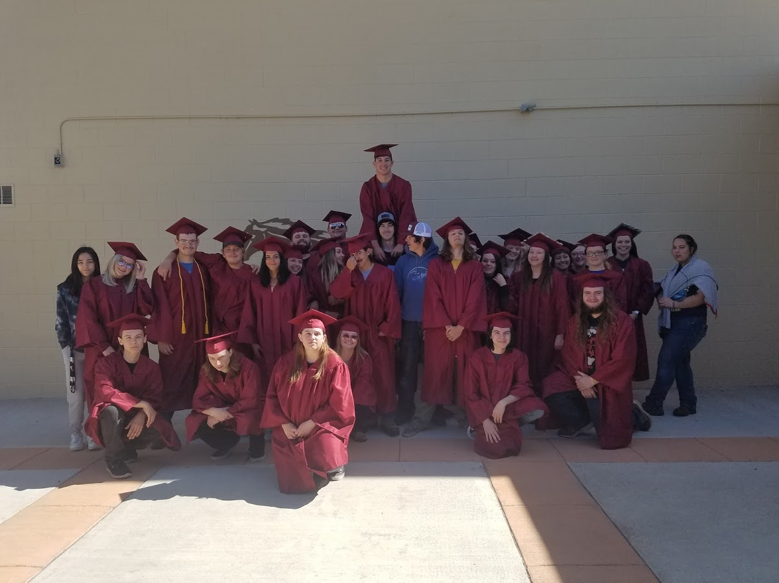
Photo of Graduates

Slide 11
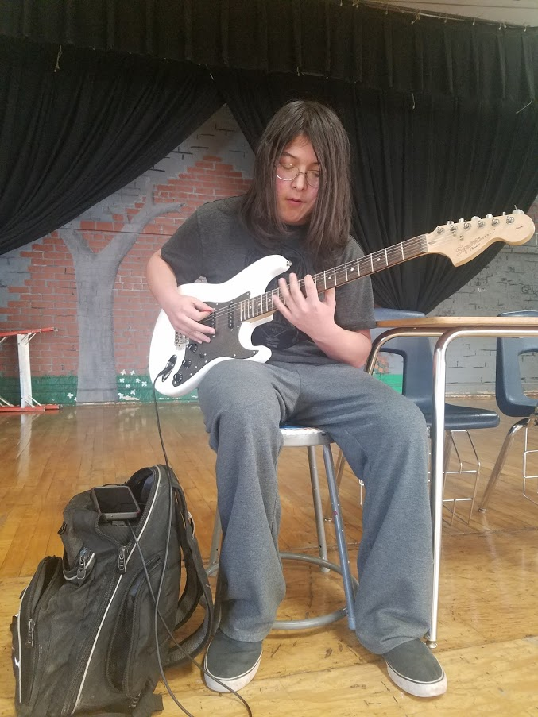
Virtual Talent Fair
Started out as a game of “The Masked Singer”....
Aiden
Elliot

