Slide 1




iGraduate Montana
2019-2020
Transcripts for every slide
can be found in Notes.
Notes:
Hi, my name is Angela McLean. I'm the Director of American Indian and Minority Achievement and K-12 Partnerships at the Office of the Commissioner of Higher Education.
We wanted to offer this webinar, to you, to support your efforts as you make application for an iGraduate Montana Challenge Fund Grant. We hope that you'll find the contents of this webinar helpful, as you navigate the grant application.
If you have questions along the way, please don't hesitate for a second to send me an email: amclean@montana.edu

Slide 2
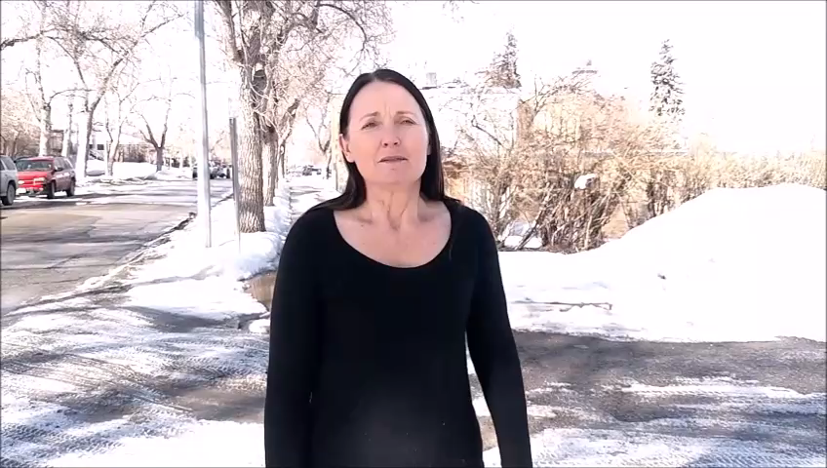
To watch the video.
Hover the mouse over
And click on the picture
Many of you may be familiar with Graduation matters Montana. I know I was familiar with it as a classroom teacher. iGraduate seeks to build on those efforts. For more information on how this can happen, please watch this video.
Notes:
Many of you may be familiar with Graduation matters Montana. I know I was familiar with it as a classroom teacher. iGraduate seeks to build on those efforts. For more information on how this can happen, please watch the video.
Video Transcript:
My name is Angela McLean and right now I am the Director of American Indian Minority Achievement and K-12 Partnerships for the Office of the Commissioner of Higher Education for the Montana University System. Before that, I was a classroom teacher in Anaconda where we used Graduation Matters to graduate more of our high school students and at the same time make sure that they were college and career ready. That’s why I am so excited that I get to be a part of the next phase, iGraduate Montana. We hope that you will join us in making sure that we not only continue to graduate more of our students but we make sure at the same time that they are college and workforce ready.

Slide 3
iGraduate Montana Challenge Fund 2019-2020
Through the generosity of the Dennis & Phyllis Washington Foundation,
The Office of the Commissioner of Higher Education,
in partnership with the Office of Public Instruction.
announces the availability of funds through
the iGraduate Montana (iGM) Challenge Fund.
Notes:
The Office of the Commissioner of Higher Education is proud to partner with the Office of Public Instruction through the generosity of the Dennis and Phyllis Washington Foundation to deliver iGraduate Montana Challenge Fund grants for the school year 2019-2020.

Slide 4
iGraduate Montana Challenge Fund 2019-2020
Grants of up to $10,000
are available to communities through a
competitive application process
Successful applicants will receive
technical assistance support.
Notes:
For the 2019-2020 school year, iGraduate Montana will be awarding grants of up to $10,000. These grants are available to communities, to school districts, and to other partners.

Slide 5
iGraduate Montana Challenge Fund 2019-2020
Encourages secondary schools, post-secondary institutions and non-profits and tribal governments to apply.
The grant can be used for activities that promote more high school completion, apprenticeship participation, and college enrollment.
Notes:
We encourage secondary schools, post-secondary institutions, and non-profits as well as tribal governments to apply for iGraduate Montana Challenge Fund grants. The grant can be used for activities that promote more high school completion, apprenticeship participation, and college enrollment.

Slide 6
iGraduate Montana Challenge Fund 2019-2020
These applications can be submitted to amclean@montana.edu
Before 5:00 pm Wednesday, February 6th.
Award determinations will be announced in March.
A grants scoring committee will then select 10-15 applicants to be funded in iGraduate Montana’s 2019-2020 funded year.
Notes:
Please submit your applications to me, Angela McLean, at amclean@montana.edu, on or before Wednesday, Feb 6^{th,} at the close of business. Award determinations will be announced in March.
Once we receive your application, a scoring committee will then select 10-15 applicants to be funded in iGraduate Montana’s 2019-2020 school year.

Slide 7
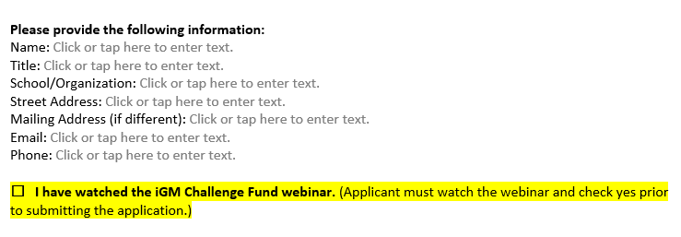
iGraduate Montana Challenge Fund 2019-2020
The Application is a straight forward MS Word fillable document.
The 1st Section contains very basic contact information.
If multiple entities are submitting a joint application, please only put the contact info for the person and organization who will be the primary contact for the grant.
Notes:
This first part of the application asks very basic contact information. If there will be more than one (1) entity submitting a joint application, please only put the contact information for the person and organization who will be the “primary” contact for the grant.
As you know, it is important that you watch the iGraduate Montana Challenge Fund webinars. So, this is something you can easily check off your list of things to do.

Slide 8
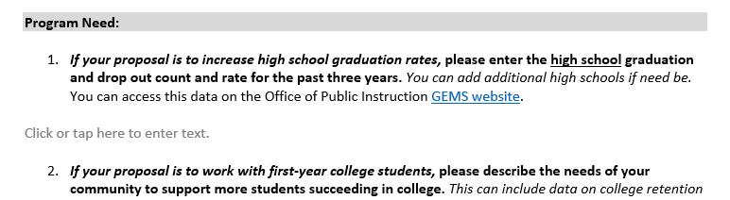
iGraduate Montana Challenge Fund 2019-2020
The next section aims to gauge
the need of grant applicants.
Not all of these questions may be pertinent to your organization, but please fill out all the fields that you determine are relevant.
This is your opportunity to make your case as to
why your community should be funded.
Notes:
The next section of the grant application aims to help us assess the need that you may have in your school or in your community.
If you proposal is to increase high school graduation rates, please enter the high school graduation and dropout count and rate of the past three (3) years. You can go to the GEMS website to do so.
If you proposal is to work with first year college students, please describe the needs of your community to support more students succeeding in college.
We realize that there will be an array of topics covered by each of the applicants for this year’s grant. Not all of these questions may be pertinent to your organization, but please fill out all of the fields that you determine are relevant.

Slide 9
iGraduate Montana Challenge Fund 2019-2020
PLEASE NOTE:
Your proposal can focus on more than one area.
Example:
A project could focus on identifying, graduating, and supporting a cohort of students into their post-high school next steps, which could include college and/or apprenticeship opportunities.
Notes:
Your proposal can focus on more than one area. For example, a project could focus on identifying, graduating, and supporting a cohort of students into their post-high school next steps, which could include college and/or apprenticeship opportunities.

Slide 10
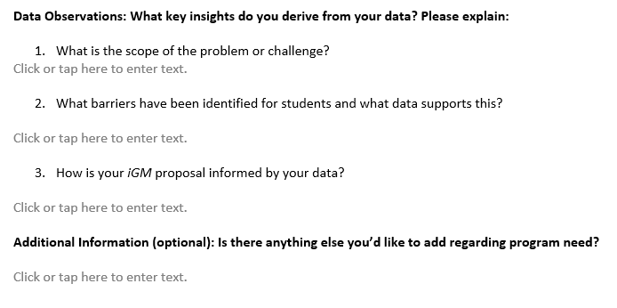
iGraduate Montana Challenge Fund 2019-2020
We would then like you to conduct a brief analysis of the data available to:
Demonstrate that your proposed plan has identified specific problems or challenges
Use relevant information to address those problems and challenges.
Notes:
The next part of the application asks you to use data to guide our understanding of the problem or challenge that you plan to address.
Basically, we’d like you to demonstrate that your proposed plan has identified specific problems or challenges and then use this relevant information to address those problems and challenges and make your case for being funded.

Slide 11
iGraduate Montana Challenge Fund 2019-2020
There is also a field if you would like to
provide additional context.
Notes:
This is an opportunity for you to provide additional context around your problem or your challenge as well as the solutions that you present.

Slide 12
iGraduate Montana Challenge Fund 2019-2020
iGM is looking to impact:
high school graduation rates
college and career readiness
college enrollment.
Specifically, with the goal of
closing achievement gaps in those areas
for young American Indian students.
Notes:
iGraduate Montana is looking to impact high school graduation rates, college and career readiness and college enrollment.
We want our grantees to pay particular attention to opportunities that will work to close achievement gaps in these areas for our American Indian students.

Slide 13
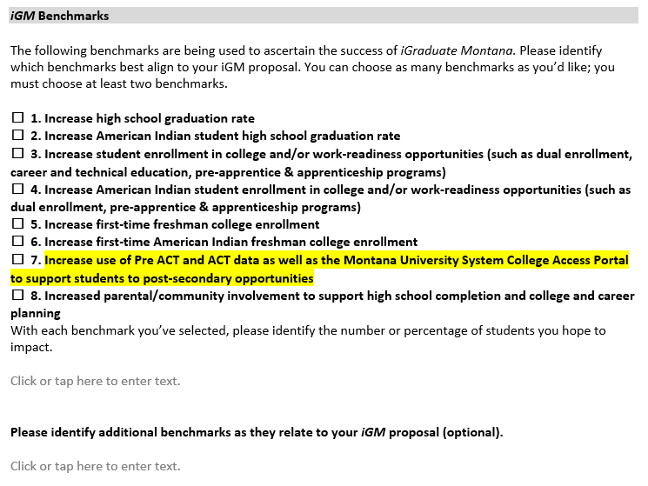
iGraduate Montana Challenge Fund 2019-2020
Check the box next to the
benchmarks your project will focus on.
We are looking for applications that
set goals for choosing benchmarks.
Notes:
On this part of the application, you have the opportunity to choose as many benchmarks as you would like that would best align to you iGraduate Montana proposal. These are important benchmarks to the iGraduate Montana partners as well as our sponsor, the Dennis and Phyllis Washington Foundation.
Number seven (7) speaks to increasing use of Pre ACT and ACT data, as well as the Montana University System College Access Portal, to support students to post-secondary opportunities. This is an important one because the Montana University System, through GEAR UP, is pleased to pay for the Pre ACT for all of Montana’s high school sophomores and the ACT for all of Montana’s high school juniors.
We think this is an important investment and we’d like to support schools in making sure that they’re using that data, as well as our newly created portal, to support students to post-secondary success.

Slide 14
iGraduate Montana Challenge Fund 2019-2020
In the text box below:
type either the number or percentage of students
that will be impacted:
Notes:
Recording your data is very important! Please tell us either the number or the percentage of students that will be impacted. This number will be monitored at the beginning of your grant as well as at the end.

Slide 15
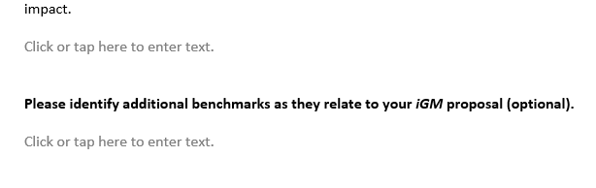
iGraduate Montana Challenge Fund 2019-2020
In the text box below:
If you have any other benchmarks that are not listed already, you may identify them here:
Notes:
You’ve had an opportunity to check off any benchmarks that you hope to meet through your iGraduate Montana Challenge Fund grant. This opportunity in the application will allow you to identify any additional benchmarks that were not a part of the list.

Slide 16
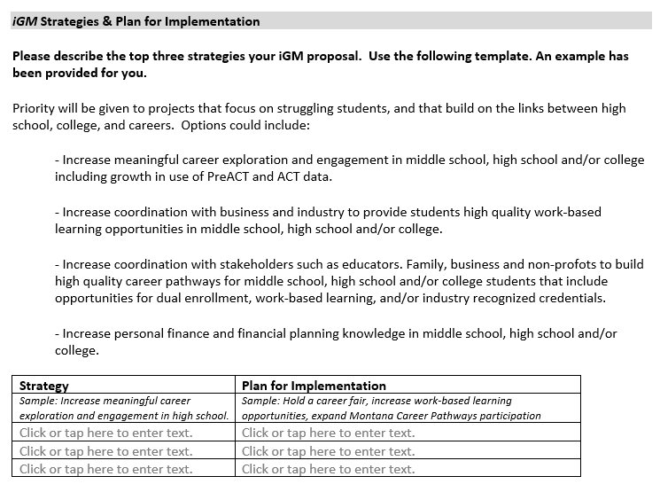
iGraduate Montana Challenge Fund 2019-2020
The Strategies and Plan for Implementation
section is the
most important component
of the application.
Notes:
You’ve had an opportunity to explain your challenges and problems that you hope to address. Additionally, you had the chance to check off boxes of the benchmarks that you hope to address through your grant. And now, you have the task ahead of you of explaining the strategies and plan for implementing your grant to fully address the challenges and problems that you mentioned in your proposal earlier.

Slide 17
iGraduate Montana Challenge Fund 2019-2020
The Strategies and Plan for Implementation (cont.)
Your community is engaging in multiple strategies that prepare students for high school graduation, college and careers:
Identify the three practices that you think
will be the most effective and impactful.
Succinctly describe the three strategies
Provide a brief, but concrete, plan to implement them.
Notes:
Telling us your strategies and your plan for implementation is your chance to tell us how you plan to meet your school or your community needs in the benchmarks that you hope to address. Make sure that you’re clear on the strategies and you’re clear on the plan and the dates for how to implement them.

Slide 18
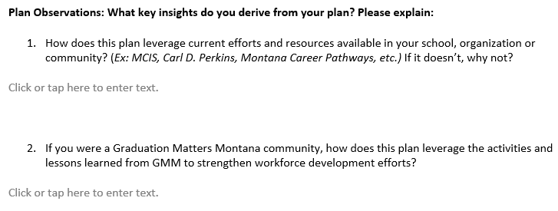
iGraduate Montana Challenge Fund 2019-2020
The next two text fields allow you to provide evidence and insight regarding the strategies that will be utilized to accomplish goals of the project.
This is an opportunity to highlight current and past partnerships and practices that could strengthen your proposal.
Notes:
We know that many of our school districts and our communities across the state are already doing a number of things to graduate more students from high school and to make sure that more students go to college.
This is your chance to tell us how you will leverage those opportunities that are already taking place on behalf of students in your school or community.
It’s also an opportunity for you to tell us how you plan to take what you might have learned or done during Graduation Matters Montana and leverage it with an iGraduate Montana Challenge Fund grant to strengthen workforce development efforts.

Slide 19
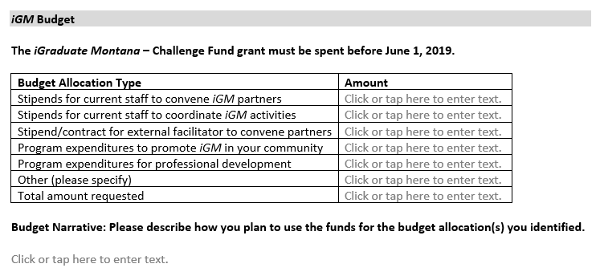
iGraduate Montana Challenge Fund 2019-2020
Please draft a project budget using the simple budget template.
Strong applications will have budget narratives that tie the projected expenditures directly to the Strategies and Plan for Implementation.
The maximum funding is $10,000.
Notes:
At this point in the grant, you have an opportunity to develop a project budget. You’re going to take your strategies and your plan for implementation and determine how much each of those components is going to cost.
As you can see here, there are items such as stipends, program expenditures, you might have travel, there might be program development efforts that need to take place in your school or your community.
And what we want is a clear picture of where the expenditures are going to be made and what is the cost to your best guess at this point.

Slide 20
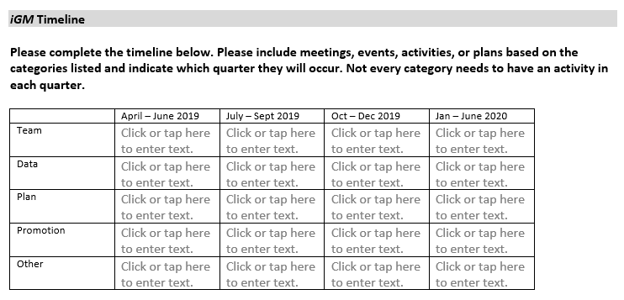
iGraduate Montana Challenge Fund 2019-2020
This timeline matrix is for you to indicate which quarter:
Meetings, events, activities, or plans will take place
In what area the project will be involved.
The timeline will be utilized during grant monitoring to make sure applicants are following through with their proposed efforts.
Successful applicants will be able to update their timelines throughout the year.
Notes:
This point of the application asks you to develop a timeline and as you can see it will begin in April of 2019 and it will wrap up your activities by June of 2020.
So what we’re looking for here is a well thought out vision and a plan for how to implement every step of your grant and who might be responsible for that implementation and the “when” they would be responsible for making those things happen.

Slide 21
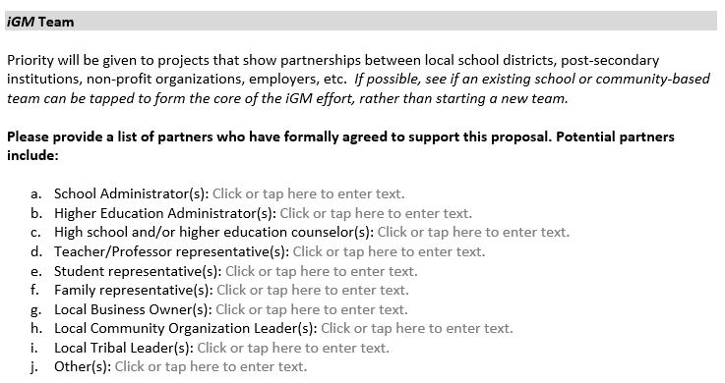
iGraduate Montana Challenge Fund 2019-2020
List all partners who have agreed to be part of this initiative.
Please feel free to list multiple entries.
We are not requesting letters of support, but people and organizations on this list must have given written or verbal commitment to be part of the iGraduate effort.
Notes:
We believe that graduating more students from high school and making sure that more of our students go on to get a post-secondary credential and that they’re ultimately college and career ready, is a conversation that belongs to every one of us.
And what we want to do, with this part of the application, is help you determine who are your partners in helping your school or your community get to a better place with high school graduation, college attainment and college completion. And we think that this lends itself to you being thoughtful about bringing together a group of stakeholders from across the board and from across your community.

Slide 22
iGraduate Montana Challenge Fund 2019-2020
Thank you
for taking the time to learn more about this application.
Completed applications may be emailed to
amclean@montana.edu
Notes:
So that takes us through the application for iGraduate Montana Challenge Fund grants for the school year 2019-2020.
We want to thank you for taking the time to learn more about the application process and most importantly, for all you do in your schools and in your communities to support students’ success.
If you have any questions please email me at amclean@montana.edu and make sure you send your completed application to this email address by the close of business on February 6th.
Good Luck!

