Slide 1

2023-24 Prior Learning Assessment (PLA) Report
Office of the Commissioner of Higher Education

Slide 2
MUS Accepted PLA Credits
Standardized Tests- AP, CLEP, DSST/DANTES, IB, Straighterline and UExcel
Challenge Exams- comprehensive exams of the course subject matter
Portfolio Assessments- students submit a portfolio showcasing their knowledge for faculty evaluation
American Council on Education (ACE) and National College Credit Recommendation Service (NCCRS)- proposes college credit equivalencies for learning outside of the college classroom
Military Credit- credits earned by branches of the US military
Experiential Learning- credits earned through work experience or learning outside of the college classroom

Slide 3
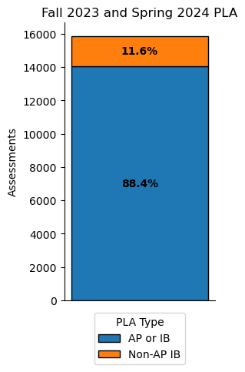
PLA by Semester
PLA Credits | Fall 2022 | Spring 2023 | Fall 2023 | Spring 2024
Advanced Placement (AP) | 6529 | 6198 | 6576 | 6185
Military | 287 | 276 | 265 | 260
Challenge | 105 | 94 | 83 | 80
College-Level Examination Program (CLEP) | 159 | 140 | 138 | 122
International Baccalaureate (IB) | 621 | 590 | 652 | 620
Other: Experiential Learning, ACE, Portfolio, Straighterline, Dantes, UExcel and Other | 463 | 447 | 450 | 436
Total | 8164 | 7745 | 8164 | 7703
7,973 students were awarded credit in 2023-24

Slide 4
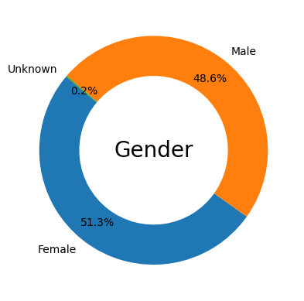
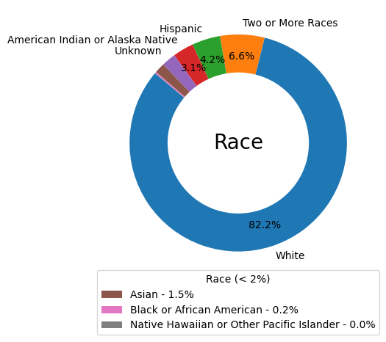
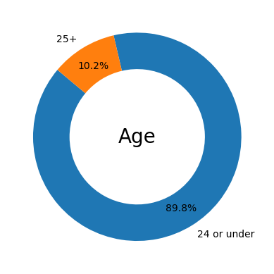
2023-24 PLA Student Demographics

Slide 5
2023-24 PLA Demographics Compared
Demographics | All PLA | AP & IB | Non-AP/IB
Female | 51% | 53% | 42%
Male | 49% | 47% | 58%
24 or under | 90% | 93% | 61%
25+ | 10% | 7% | 39%
White | 82% | 83% | 77%
Two or More Races | 7% | 7% | 5%
Hispanic | 4% | 4% | 7%
American Indian or Alaska Native | 3% | 3% | 5%
Unknown | 2% | 2% | 4%
Asian | 2% | 2% | 1%
Black or African American | 0% | 0% | 1%
Native Hawaiian or Other Pacific Islander | 0% | 0% | 0%
Non-Veteran | 95% | 98% | 72%
Veteran | 5% | 2% | 28%

Slide 6
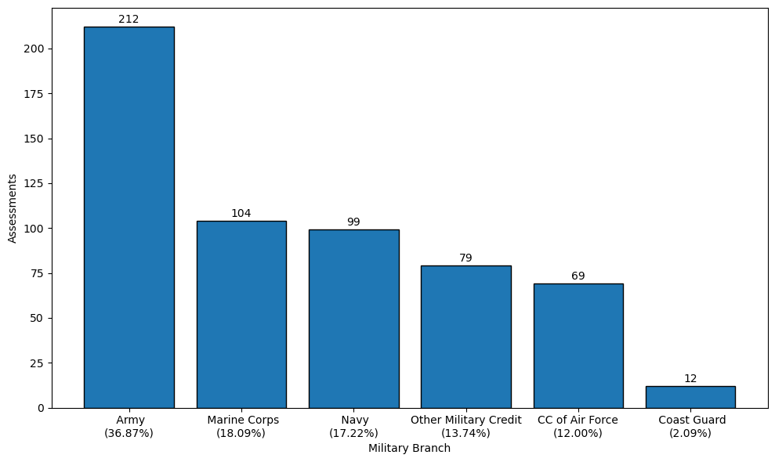
2023-24 Military Credits by Branch
341 out of 504 (67.7%) of veteran students that were awarded PLA credits used military transcripts in 2023-24

Slide 7
2023-24 PLA by Campus
PLA | City College | Dawson CC | Flathead Valley CC | Gallatin College | Great Falls College | Helena College | Highlands College | MSU- Northern | MSU-Billings | MSU-Bozeman | MT Tech | Miles CC | Missoula College | UM-Missoula | UM-Western | Total
Advanced Placement (AP) | 49 | 11 | 442 | 177 | 40 | 38 | 40 | 25 | 245 | 8295 | 461 | 0 | 126 | 2693 | 119 | 12761
Challenge | 18 | 0 | 9 | 0 | 7 | 5 | 4 | 0 | 57 | 27 | 28 | 0 | 2 | 6 | 0 | 163
College-Level Examination Program (CLEP) | 1 | 0 | 9 | 3 | 18 | 0 | 0 | 2 | 13 | 185 | 4 | 0 | 4 | 18 | 3 | 260
International Baccalaureate (IB) | 0 | 0 | 233 | 6 | 3 | 0 | 0 | 3 | 13 | 625 | 27 | 0 | 15 | 329 | 18 | 1272
Military | 15 | 0 | 42 | 4 | 13 | 28 | 3 | 0 | 51 | 231 | 8 | 2 | 16 | 105 | 7 | 525
Other: Experiential Learning, ACE, Portfolio, Straighterline, Dantes, UExcel and Other | 30 | 27 | 8 | 0 | 85 | 18 | 2 | 0 | 72 | 563 | 40 | 0 | 2 | 32 | 7 | 886
Total | 113 | 38 | 743 | 190 | 166 | 89 | 49 | 30 | 451 | 9926 | 568 | 2 | 165 | 3183 | 154 | 15867

Slide 8




2023-24 PLA Statistics
24.0% of undergraduate students in MUS have PLA credits
17.9% of undergraduate students in the MUS age 25+ have PLA credits
37.2% of undergraduate veteran students have PLA credits

Slide 9
PLA Information
Website:
https://www.mus.edu/pla/
Contact:
Jacque Treaster
jtreaster@montana.edu
(406) 449-9135

