Slide 1
2022 Prior Learning Assessment Annual Report
Office of the Commissioner of Higher Education

Slide 2
MUS Accepted PLA Credits
Standardized Tests- AP, CLEP, DSST/DANTES, IB, Straighterline and UExcel
Challenge Exams- comprehensive exams of the course subject matter
Portfolio Assessments- students submit a portfolio showcasing their knowledge for faculty evaluation
American Council on Education (ACE) and National College Credit Recommendation Service (NCCRS)- proposes college credit equivalencies for learning outside of the college classroom
Military Credit- credits earned by branches of the US military
Experiential Learning- credits earned through work experience or learning outside of the college classroom

Slide 3
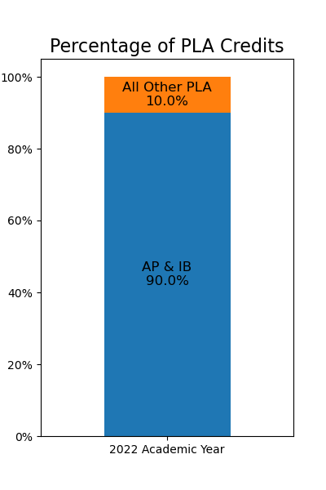
MUS Students with PLA Credits
PLA Credits | Fall 2021 | Spring 2022 | Fall 2022 | Spring 2023
Advanced Placement (AP) | 6522 | 6135 | 6354 | 5888
International Baccalaureate (IB) | 615 | 586 | 586 | 547
American Council on Education (ACE) | 16 | 16 | 16 | 15
Challenge | 112 | 103 | 82 | 70
College-Level Examination Program (CLEP) | 199 | 170 | 140 | 121
Military | 292 | 263 | 259 | 248
Other | 314 | 312 | 259 | 241
StraighterLine | 30 | 26 | 19 | 12
Total | 8100 | 7611 | 7715 | 7142

Slide 4
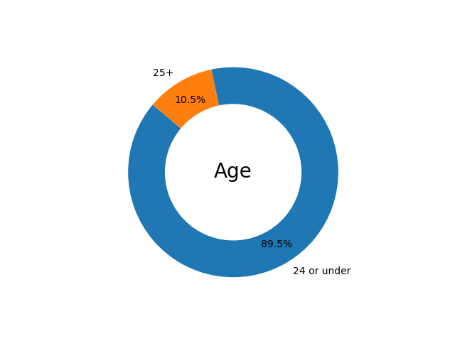
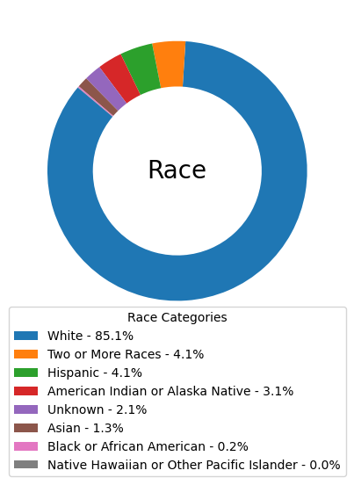
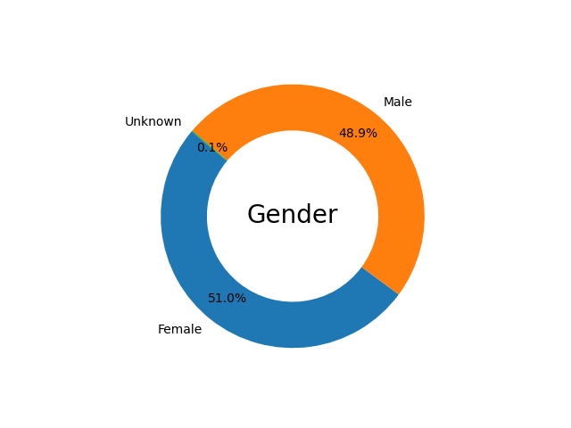
PLA Student Demographics
Status | Percentage
Non-Veteran | 95%
Veteran | 5%

Slide 5
Student Demographics Compared
Demographics | All PLA | AP & IB | Non-AP/IB PLA
Female | 52% | 53% | 39%
Male | 48% | 47% | 61%
24 or under | 90% | 93% | 58%
25+ | 10% | 7% | 42%
White | 85% | 86% | 79%
Two or More Races | 4% | 4% | 3%
Hispanic | 4% | 4% | 6%
American Indian or Alaska Native | 3% | 3% | 5%
Unknown | 2% | 2% | 5%
Asian | 1% | 1% | 1%
Black or African American | 0% | 0% | 1%
Native Hawaiian or Other Pacific Islander | 0% | 0% | 0%
Non-Veteran | 95% | 98% | 66%
Veteran | 5% | 2% | 34%

Slide 6
PLA Statistics
45% of students enrolled in the MUS have PLA credits
28% of students enrolled in the MUS 25 or older have PLA credits
62% of veteran students enrolled in the MUS have PLA Credits

Slide 7
PLA Information
Website:
https://www.mus.edu/pla/
Contact:
Jacque Treaster
jtreaster@montana.edu
(406) 449-9135

